Slide 1
F1 Base
Data Management project
Michele Nicoletti - 1886646
Lorenzo Pecorari - 1885161

Slide 2


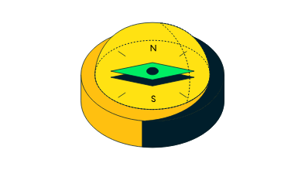
DM tool: MongoDB
NoSQL DBMS
collections and BSON documents
flexible and fast
advanced query operations
Compass, mongosh, Atlas and pymongo

Slide 3


Dataset and Data Modellation
Kaggle: Formula 1 World Championship (1950 - 2024)
circuits, drivers, constructors, races, standings, qualifyings, results and others
csv files imported as collections with referenced model
queries generating embedded-modelled data

Slide 4



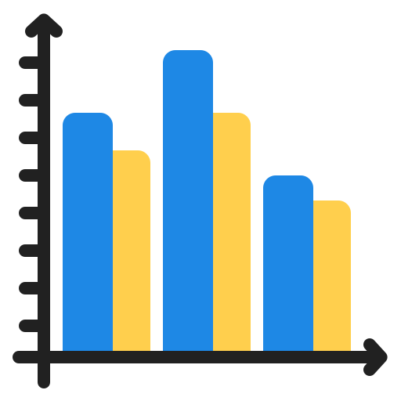
Objectives of the project
dataset exploration to investigate:
constructors’ performances
driver career performances
WDC and WCC wins among the seasons
failures and retirements
Acquire knowledge about a new DM tool
:

Slide 5
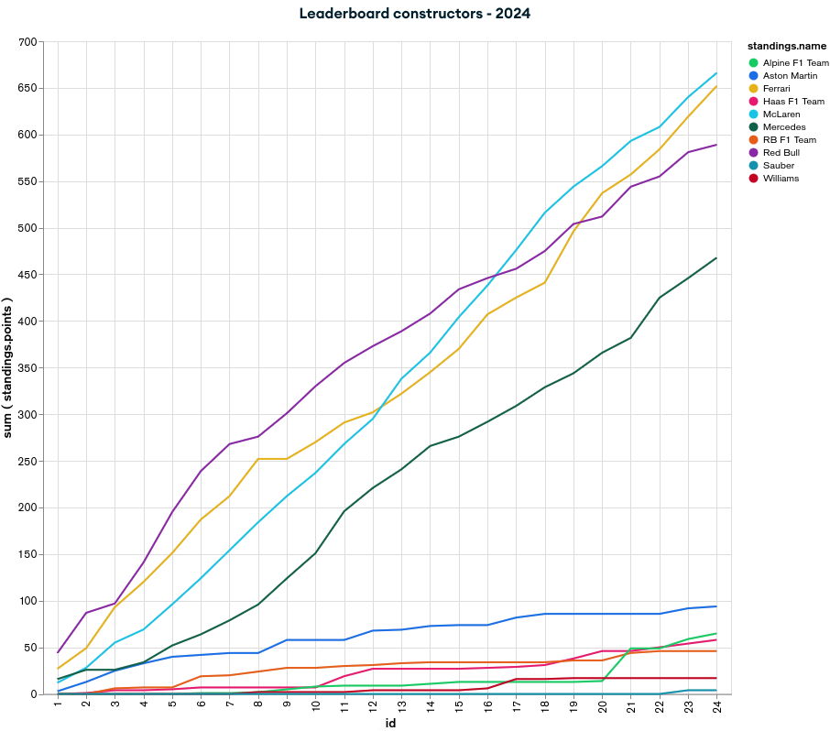
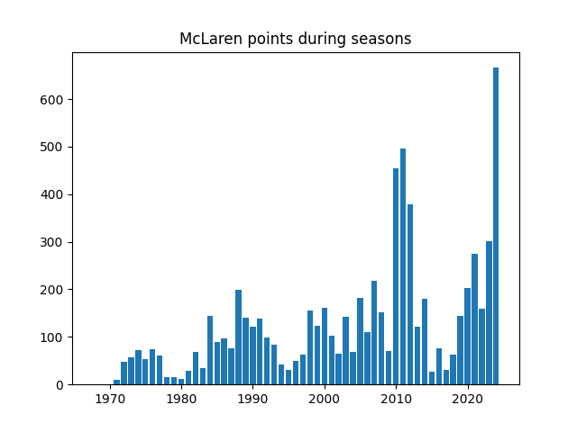
Constructors’ performances
leaderboard evolution during a season
points-pit stops comparison of constructors during weekends
team points trend of a team along seasons
points
year

Slide 6
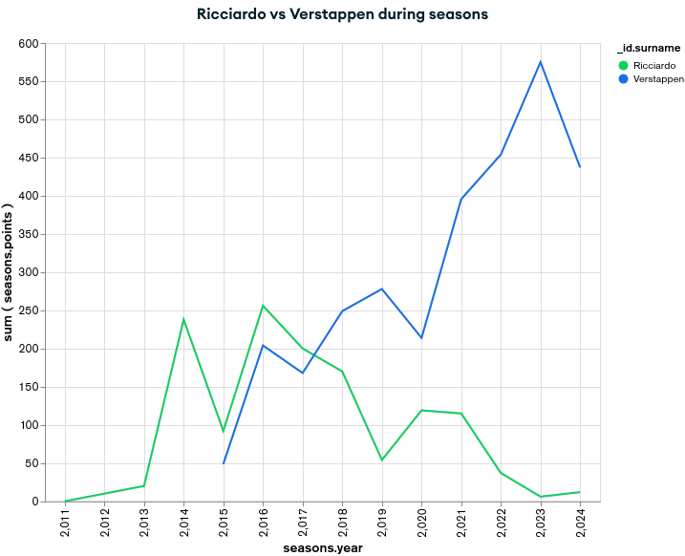
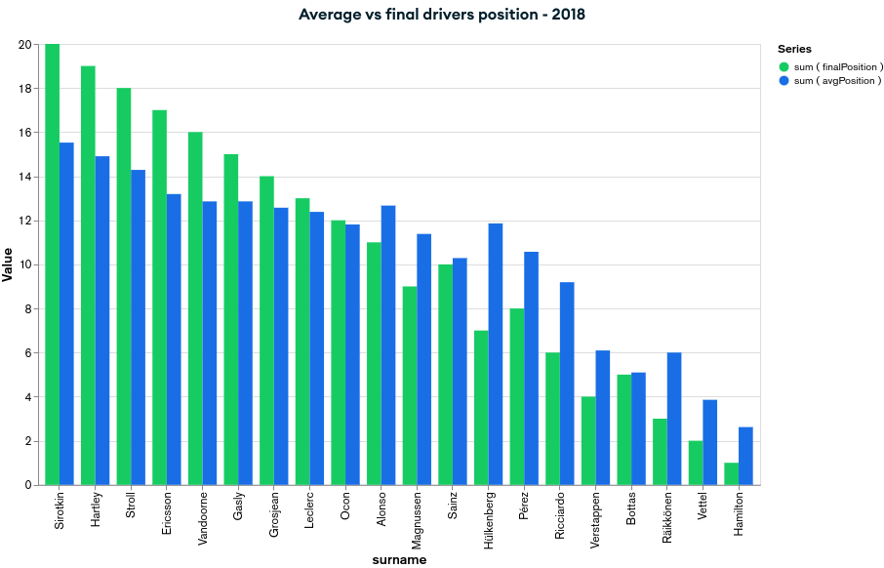
Driver career performances
average points scored in a weekend
average points scored in a weekend per constructors
teammates comparison in a season
final position vs average position in a season

Slide 7
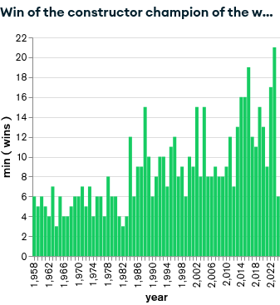
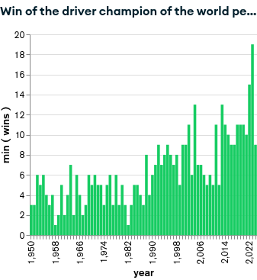
WDC and WCC wins along the seasons
number of wins of constructors champion along seasons
number of wins of drivers champion during years

Slide 8
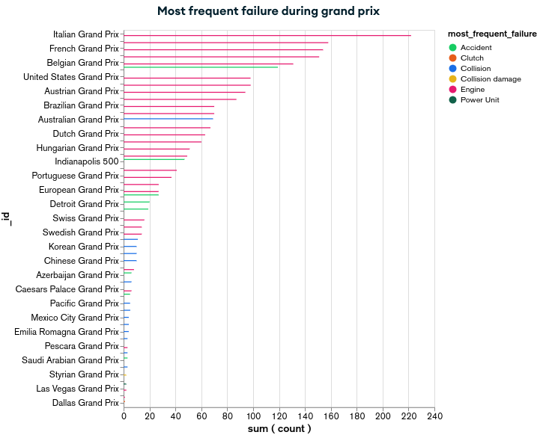
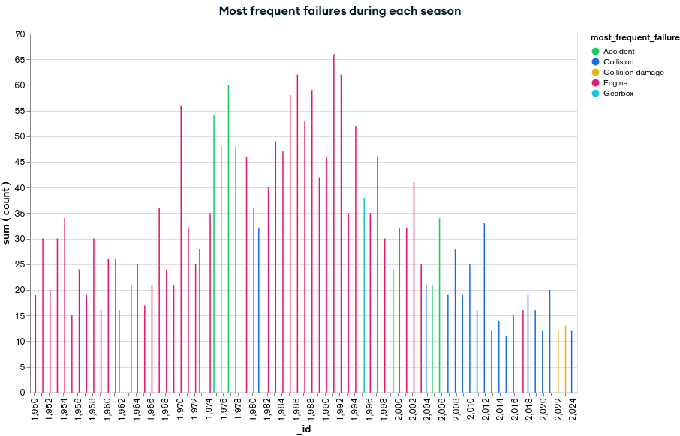
Failures and retirements
most frequent failures during all the seasons
most frequent failure for each grand prix

Slide 9
Query analysis: “Driver champion wins”
{$lookup:
{from:"races",
let:{year:"$_id",round:"$lastRound"},
pipeline:[
{$match:
{$expr:{$and:
[{$eq:["$year", "$$year"]},
{$eq:["$round","$$round"]}]}}},
{$project: {raceId: 1,year: 1}}
],
as: "lastRace"}
}
{
$group: {
_id: "$year",
lastRound: {$max:"$round"}
}
}
{$unwind: "$lastRace"}
GROUP
LOOKUP
UNWIND

Slide 10
Query analysis: “Driver champion wins”
{
$project: {
_id: 0,
year: "$_id",
driverId: "$standing.driverId",
wins: "$standing.wins",
name: "$driver.forename",
surname: "$driver.surname"
}
}
{
$sort:{
year:1
}
}
PROJECT
SORT

Slide 11

Indexes
adopted for improving performances
single and combined
defined for most used collections in queries
ex: indexes for collection “races”
db.races.createIndex({year: 1})
db.races.createIndex({raceId: 1})
db.races.createIndex({year: 1, round: 1})

Slide 12
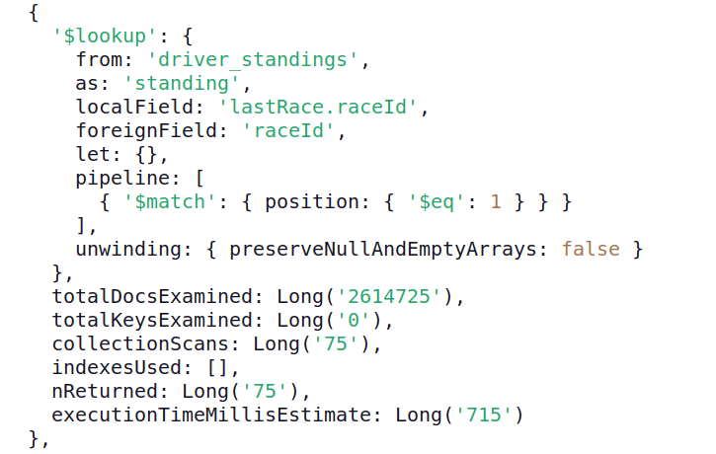
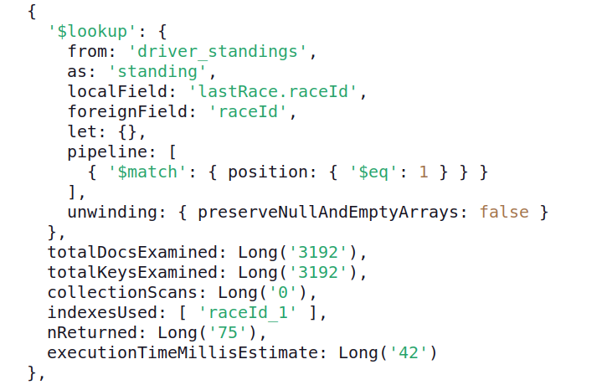
Indexes: feedback on “Driver champion wins”
db.<COLLECTION>.aggregate(...).explain(“executionStats”)

Slide 13



Data analysis through a script
interaction between MongoDB and an application
connection to the cluster
querying a database of the cluster
data analysis on JSON-like output
- command: python3 main.py

