Slide 1

Formula 1 lap time prediction
A prediction tool for race engineers
By Yaacoub Harkat

Slide 2
Problem & Story
F1 Teams want to improve their performance every season
Data-driven strategy decisions are needed
Tool to consult the race engineer in deciding whether a pit stop should be made

Slide 3
What should be predicted
Stint: time period between pit stops (tire change)
Each lap the tire wears and the car becomes slower
Goal predict the the delta lap time compared to the first lap of a stint
www.openf1.org
www.github.com/br-g/openf1
Notes:
The data source is the OpenF1 REST API
Contains various endpoints with historical and live data
Endpoints are telemetry data of the f1 car during Races/FP/Qualifyings
Data about the championship
Positiondata of the cars
Team Radio and many more
OpenF1 data is used to populate the database with historical data
From there on the database will be maintained by FIA officials

Slide 4
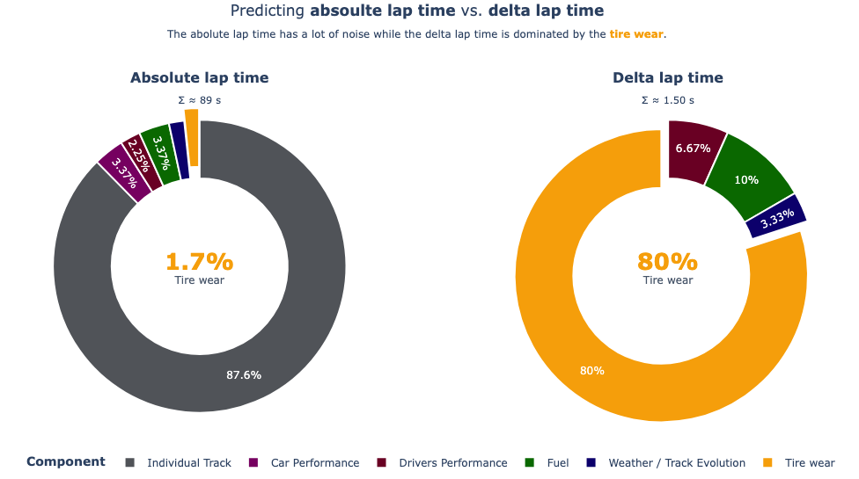
Notes:
Database structure with all the data
One table for meetings -> one meeting is one race weekend
One table for drivers -> each driver in one season can be entered there
Bridge Table entries -> each driver needs to be registered for one raceweekend (entry)
CHAR(n): is a convention in PostgreSQL for exactely n characters, if less chars are provided, the rest is filled with spaces (always n chars) (only self documentation no real error if less than n)
VARCHAR(n): up to n characters (upper bound) can be less but not more
Text: unlimited characters
Why not all Text: input validation

Slide 5
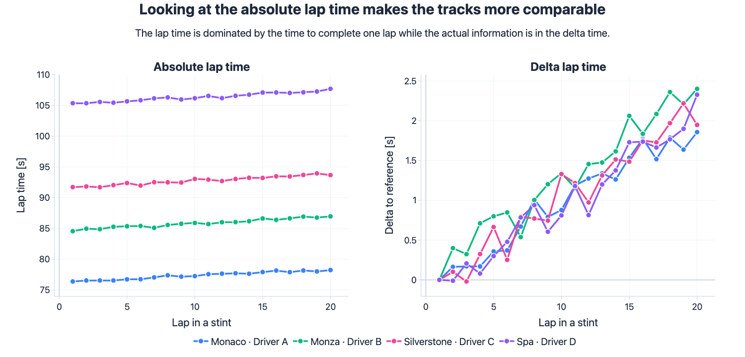

Slide 6
Features
Features
track_id | Unique Identifier of a track
team_id | Unique Identifier of a team
year | Year of a season, is needed for change in rules
stint_age | Lap number in a stint
compound | Tire compound (Soft, Medium, Hard)
tyre_age | Number of laps the tire has been used
air_temperature | Temperature of the air in °C
track_temperature | Temperature of the track in °C
humidity | Air humidity in %
rainfall | Rainfall (True/False)
race_progess | For fuel consumption

