Slide 1
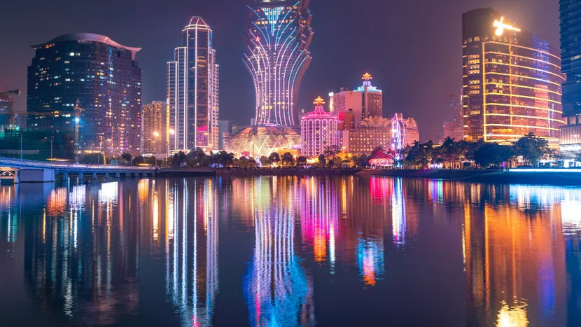
Macao
Keyu Feng

Slide 2
Macao: A Small Island Developing State
Location:
Officially the Macao Special Administrative Region (SAR) of China, located on the southern coast of China.
Size and Population:
Covers 32.9 square kilometers.
Population: Approximately 684,000.
One of the most densely populated regions in the world.

Slide 3
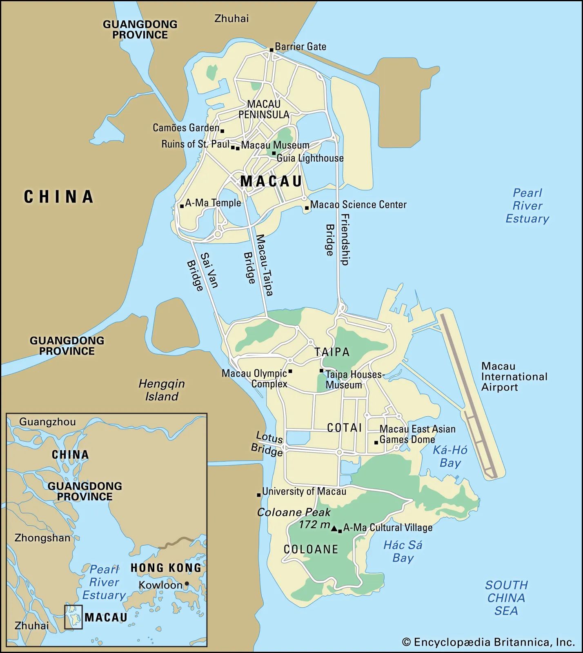
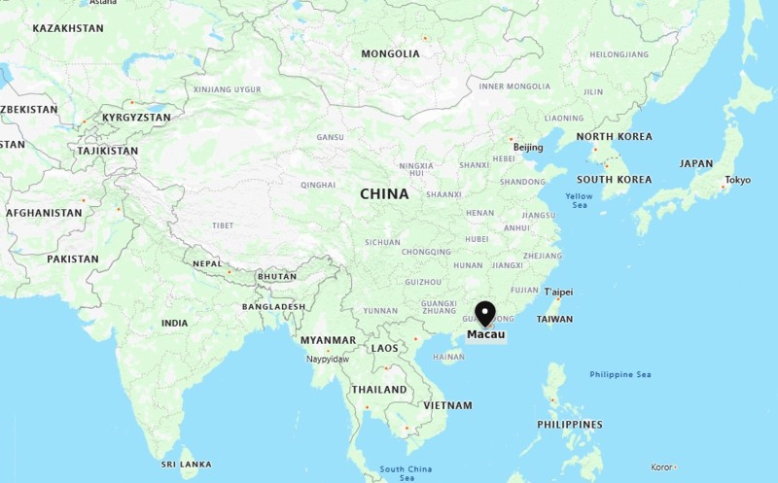
The Location of Macao

Slide 4
History
Historical Background:
Macao was established as a Portuguese settlement in 1557.
It was the first and last European colony in China.
Served as a bridge between the East and West for centuries.
Cultural Influence:
Macao blends Chinese and Portuguese cultures, creating a unique multicultural identity.

Slide 5
History
UNESCO Heritage:
Features notable sites like the Ruins of St. Paul’s and A-Ma Temple.
Modern Status:
Thrives as a global tourist and cultural destination.

Slide 6


Government
Special Administrative Region (SAR) Status:
“One Country, Two Systems” framework.
Legal and Judicial System:
Based on Portuguese civil law.
Independent control over economy, taxation, immigration, and public security.
Legislative Assembly:
Law-making body with members selected through:
Direct elections.
Indirect elections.

Slide 7
Economy
Global Wealth Ranking:
Consistently ranked among the wealthiest regions globally.
GDP per capita exceeded $40,000 in 2021, top 10 globally.
Gaming Industry:
“Las Vegas of Asia.”
No.1 globally in gaming revenue, billions annually.
Tourism:
Ranked in the top 20 globally for visitor numbers.
Among the top 10 cities globally for tourism revenue.

Slide 8
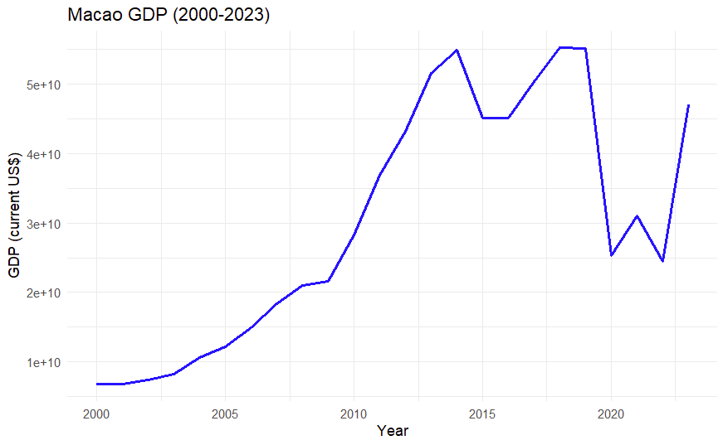
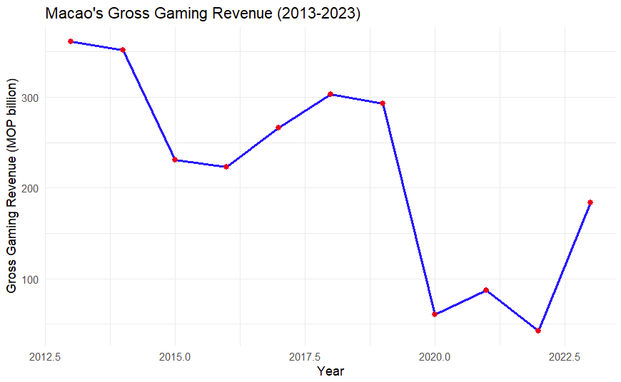
Graphs

Slide 9
People
Population:
Approximately 684,000 populations.
92% of residents are Chinese, others are Portuguese, Macanese and other ethics.
Languages:
Cantonese and Portuguese as official languages.
English is commonly used in business and tourism.
Education:
Chinese and Portuguese curricula with highly regarded education system.

Slide 10
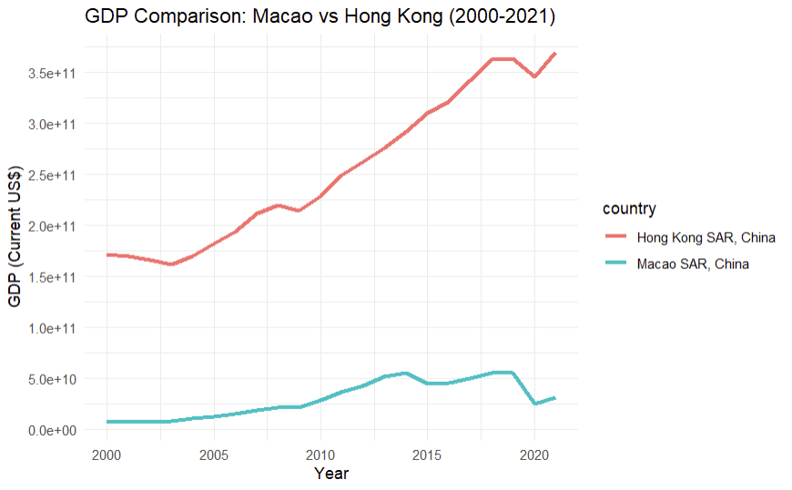
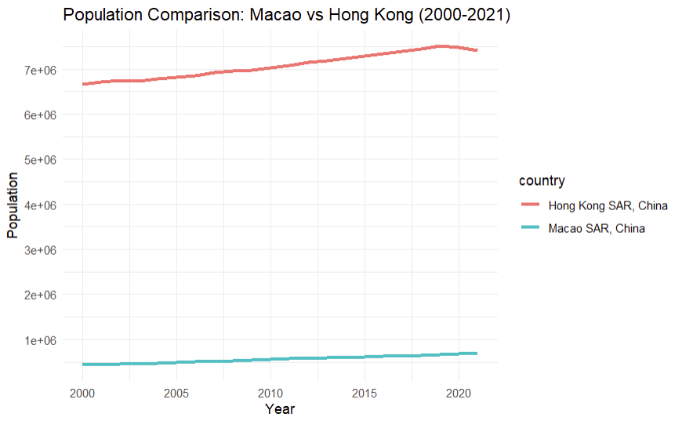
Comparison
Overall lower GDP than Hong Kong.
Overall lower population than Hong Kong.

Slide 11
SWOT Analysis Part 1
Strengths
Global leader in gaming revenue.
High GDP.
Unique cultural blend of Portuguese and Chinese influences.
Weaknesses
Rely on gaming and tourism.
Limited land area.
Population and workplace limit.

Slide 12
SWOT Analysis Part 2
Opportunities
Diversification into financial services, technology, and cultural tourism.
Enhanced regional cooperation with Mainland China.
Growth in education and healthcare sectors to attract global talent.
Threats
Global recessions.
Rising competition from other gaming and entertainment hubs.
Environmental concerns like land reclamation and climate change impacts.

Slide 13
Thank You

