Slide 1
Medical Device Inventory Management
the IMPLEMENTATION OF ECOSYSTEM

Slide 2
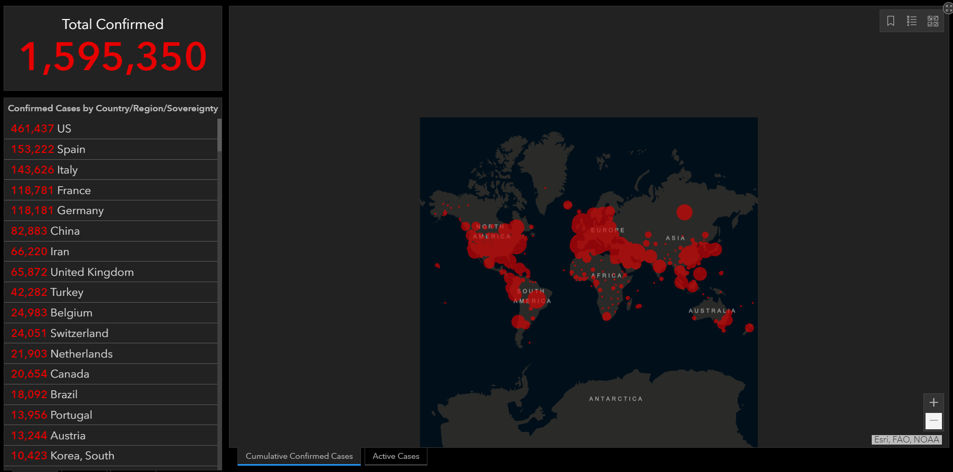
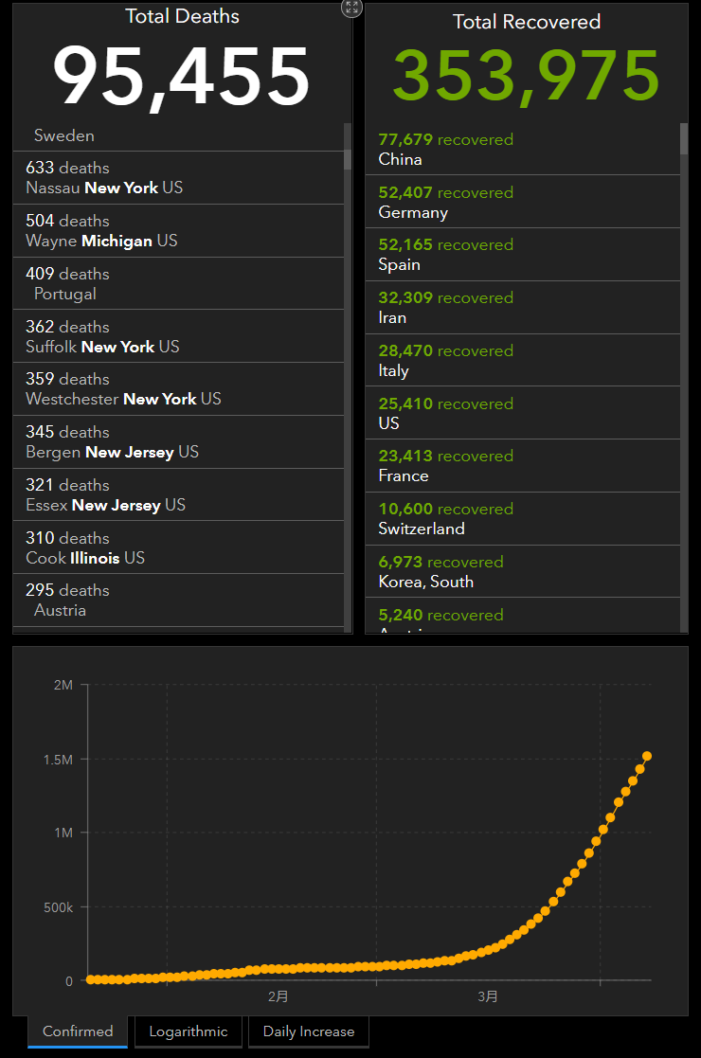
Project/problem Overview

Slide 3
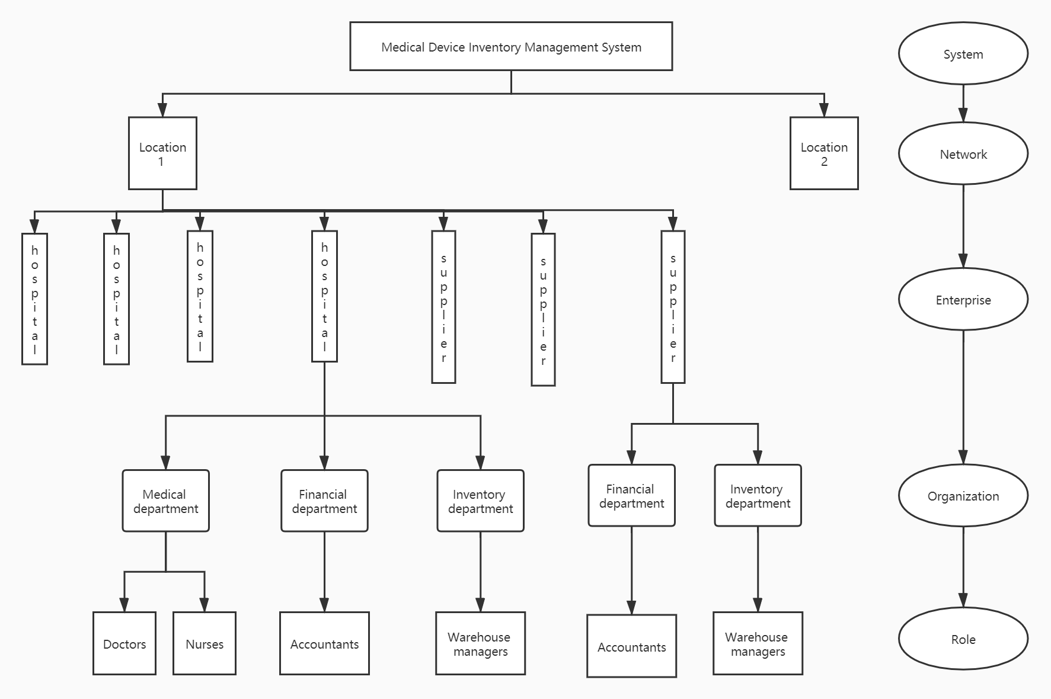
My job – design of the network

Slide 4
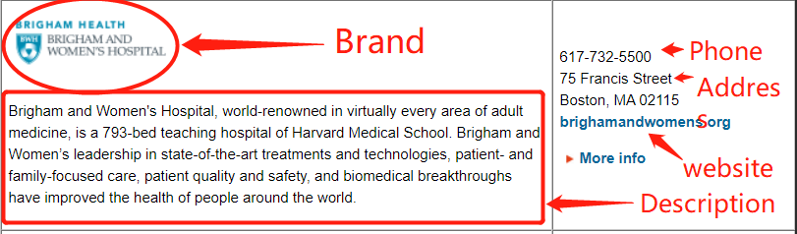
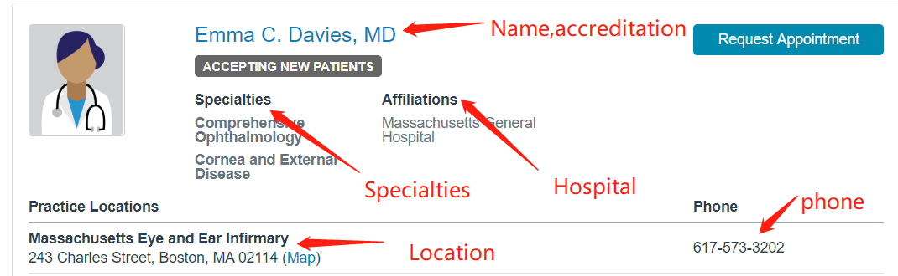
The definition of hospital entities and doctor entities

Slide 5
Application Key Functionalities
Hospital admin
Doctor:
Warehouse manager
1. Create new entities
2. Allocate account and password
1. Create schedule of clinical procedures
2. View all surgery scheduling
3. View time table of medical device and other detailed information of device
4. View time table of room
5. Search available room and medical device
6. Sort medical device by name and other features
1. Create schedule of required medical device according to the clinical procedures created by doctor.
2. View time table of medical device and other detailed information of device
3. Sort medical device by name and other features

Slide 6
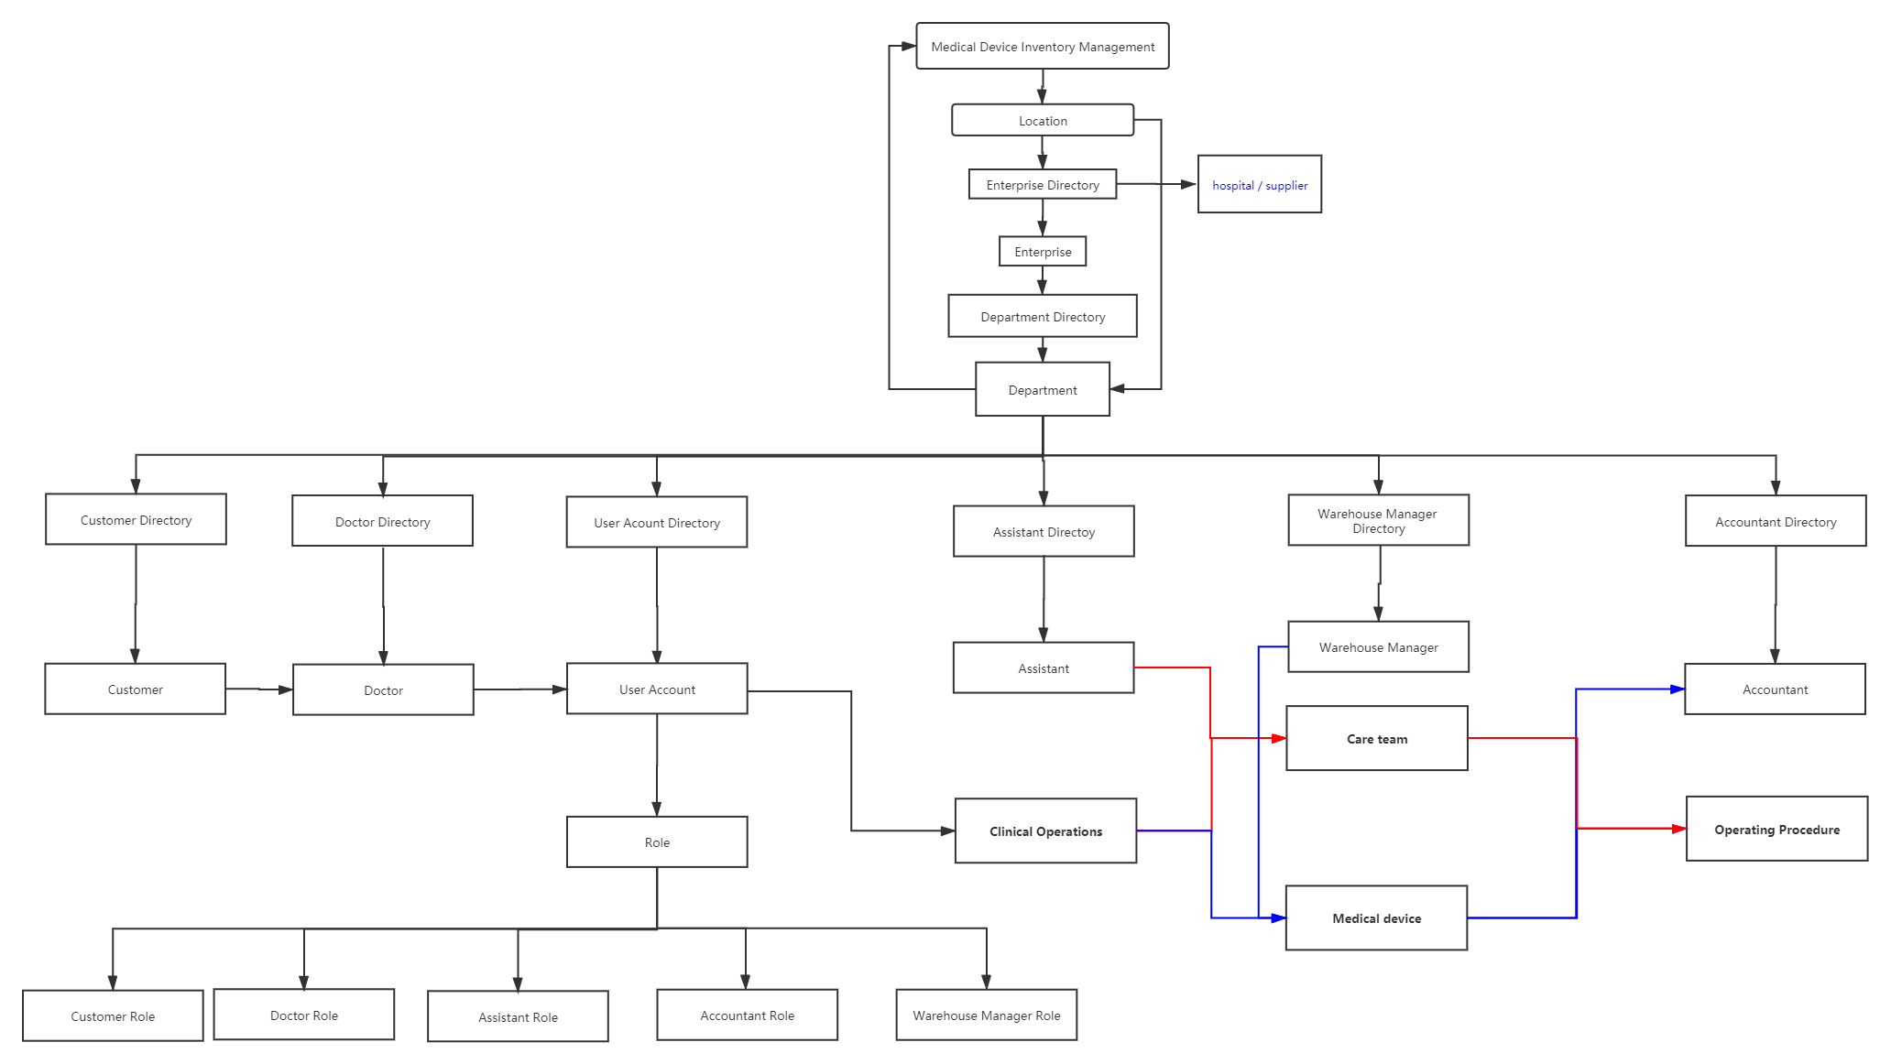
Architecture of outer system

Slide 7
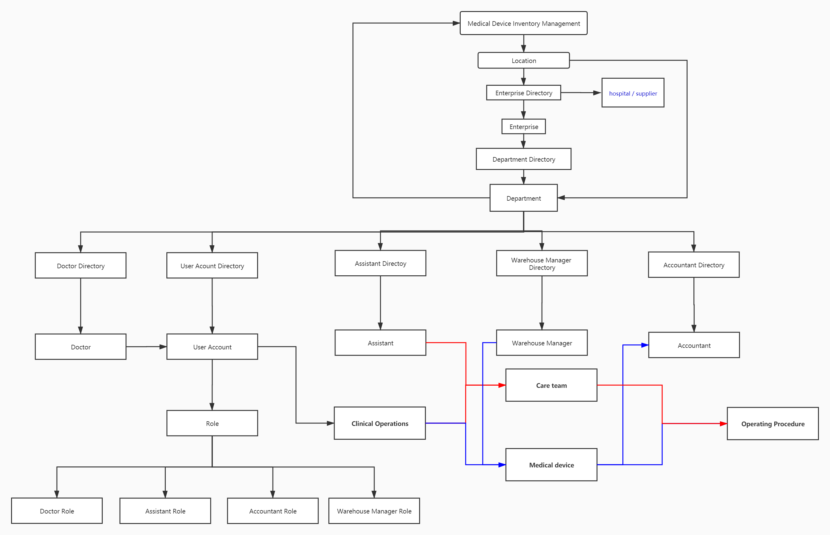
Architecture of inner system

Slide 8


Challenges
MD (Medical Doctor)
NP (nurse practitioner)

Slide 9
What I learned
金无足赤，人无完人“ - No man is perfect.

