Slide 1
Chinese Hospital outpatient and Medical Device Inventory Management
Group name : cheeseburger
Group members : keyu liu(001302066), siyuan zhang(001306669)

Slide 2
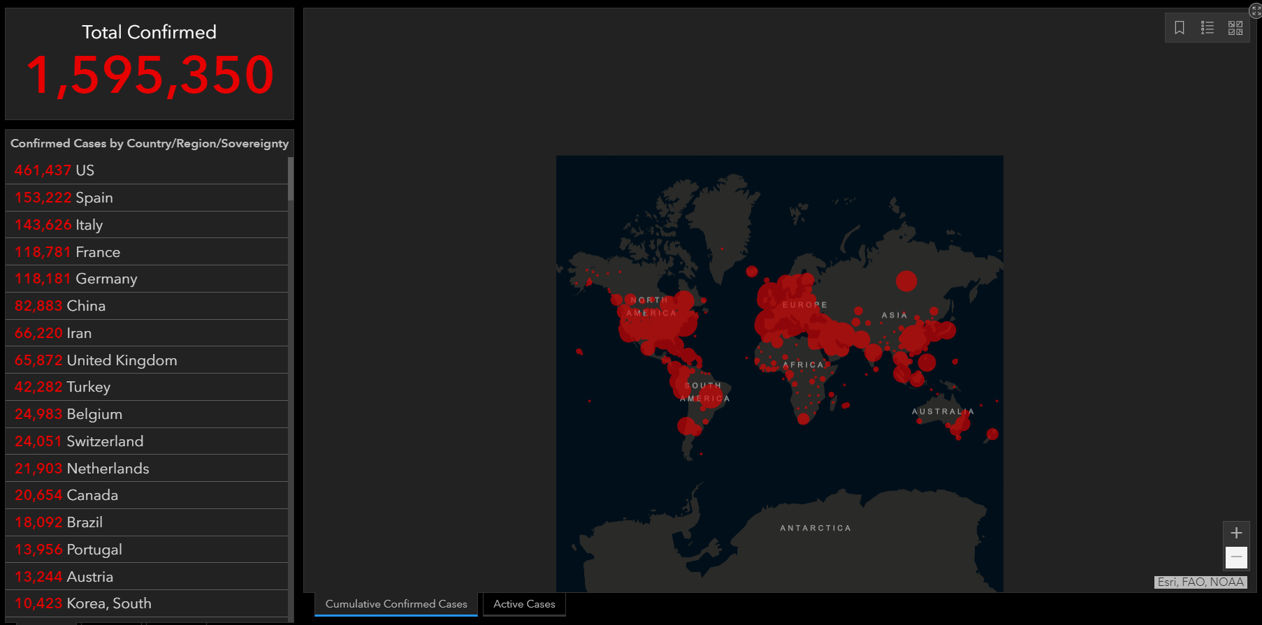
Problem Statement
With the widespread spread of COVID-19, medical devices, equipment and tools have become increasingly scarce.

Slide 3
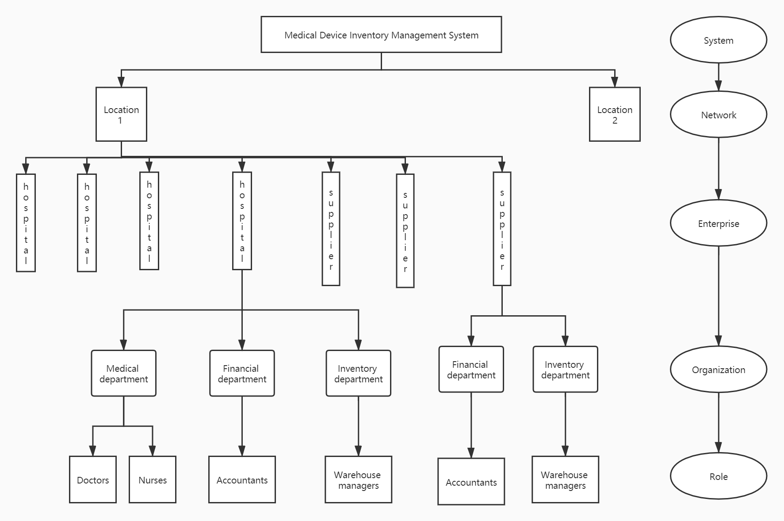
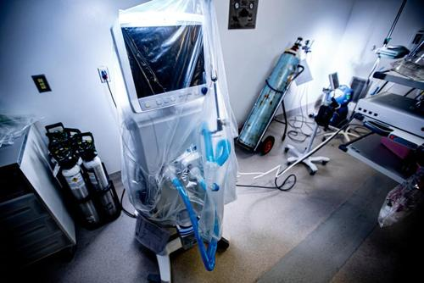

How to solve this issue?
More effective ways of utilizing expensive medical equipment?
Share expensive equipment in their service provider network.

Slide 4

Issues can be solved by…
There is no need to purchase expensive equipment that is not often used.
In other words, good management of equipment inventory means efficient use of medical device and staff time.

Slide 5
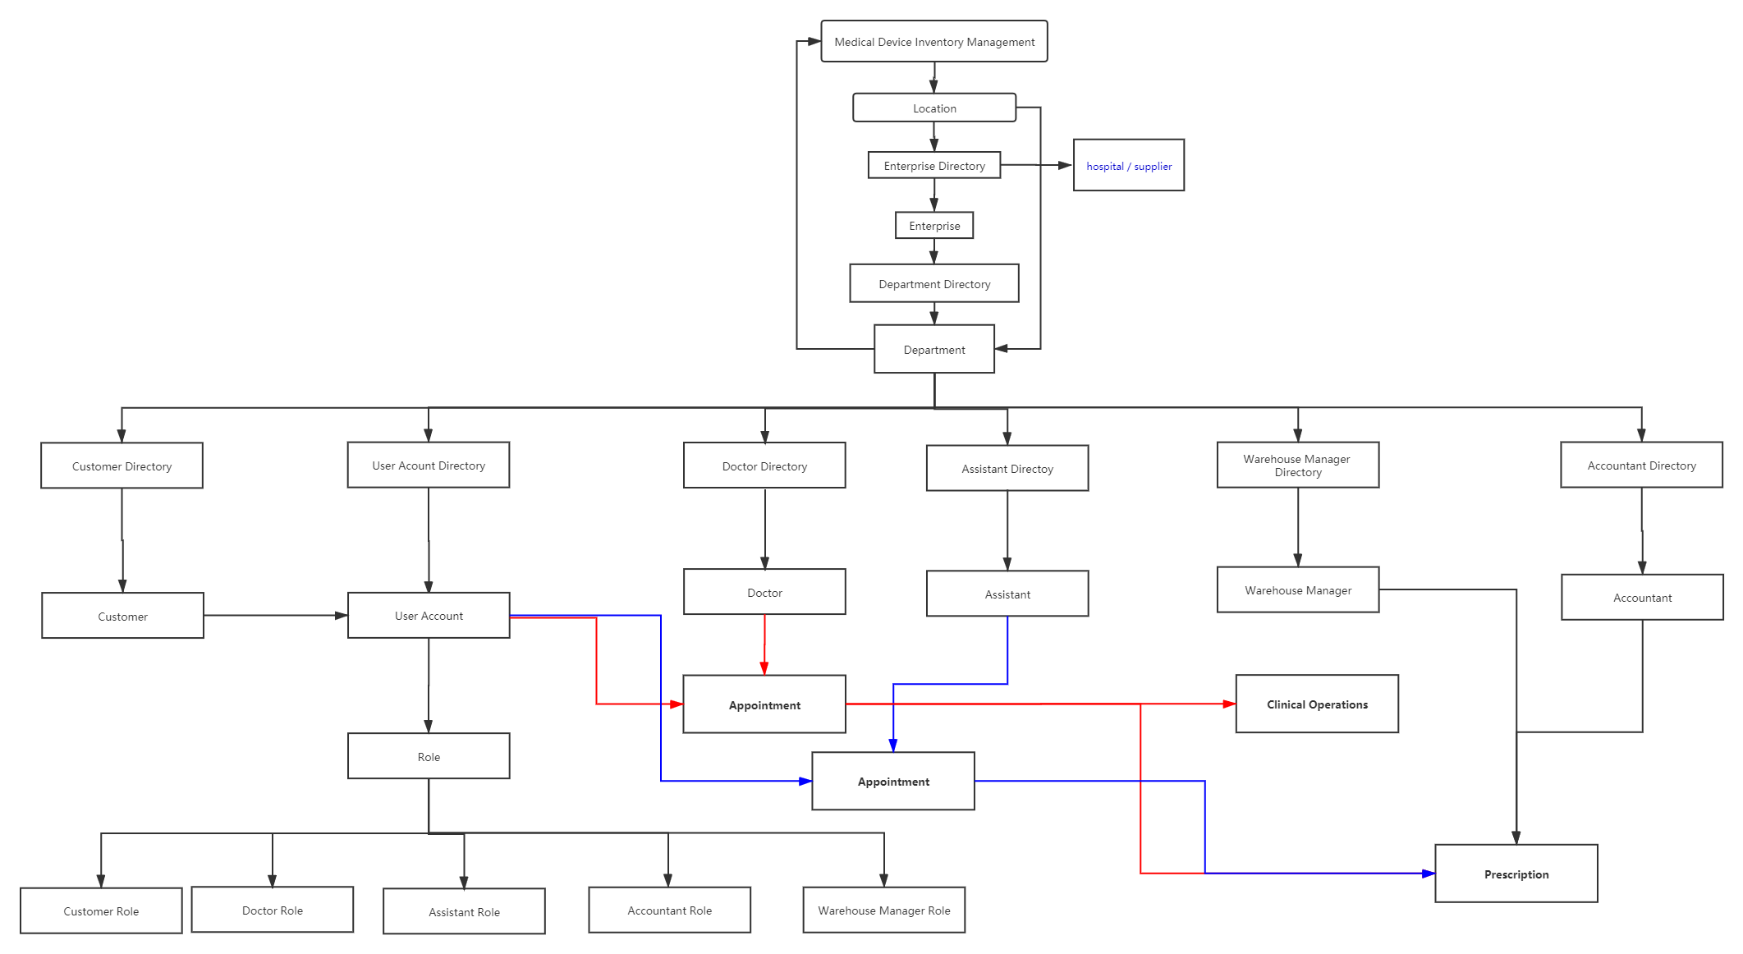
Eco-System Architecture Diagram – Customer

Slide 6
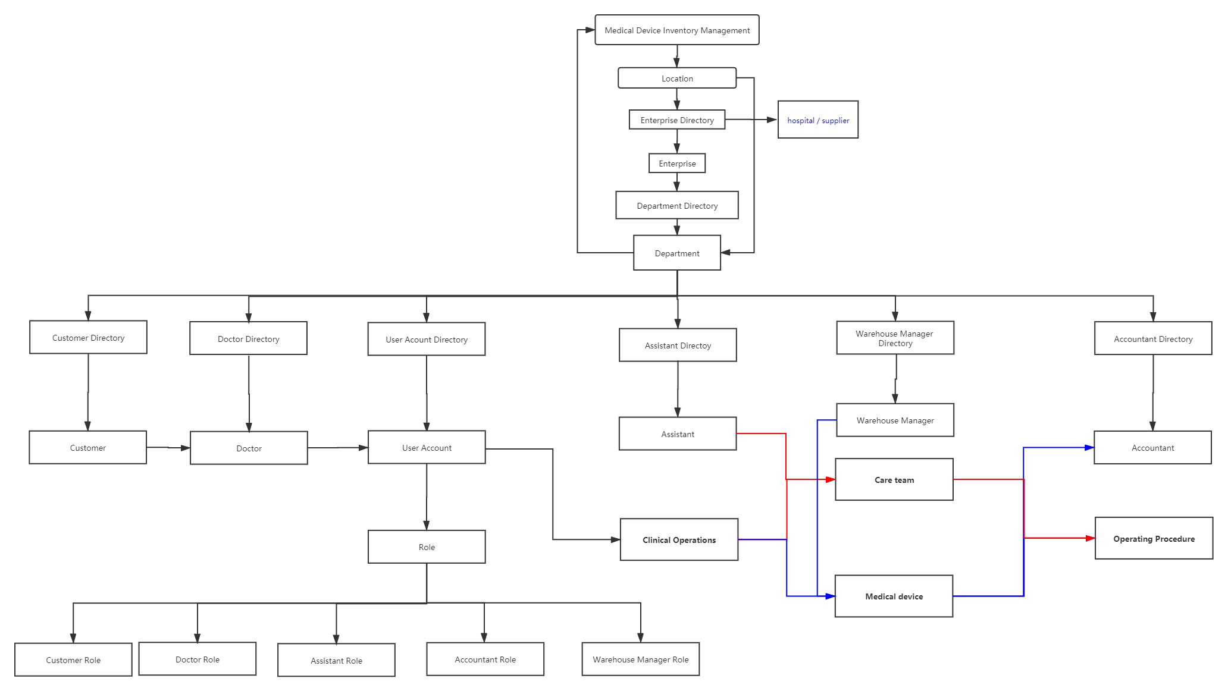
Eco-System Architecture Diagram - Clinical Procedures

Slide 7
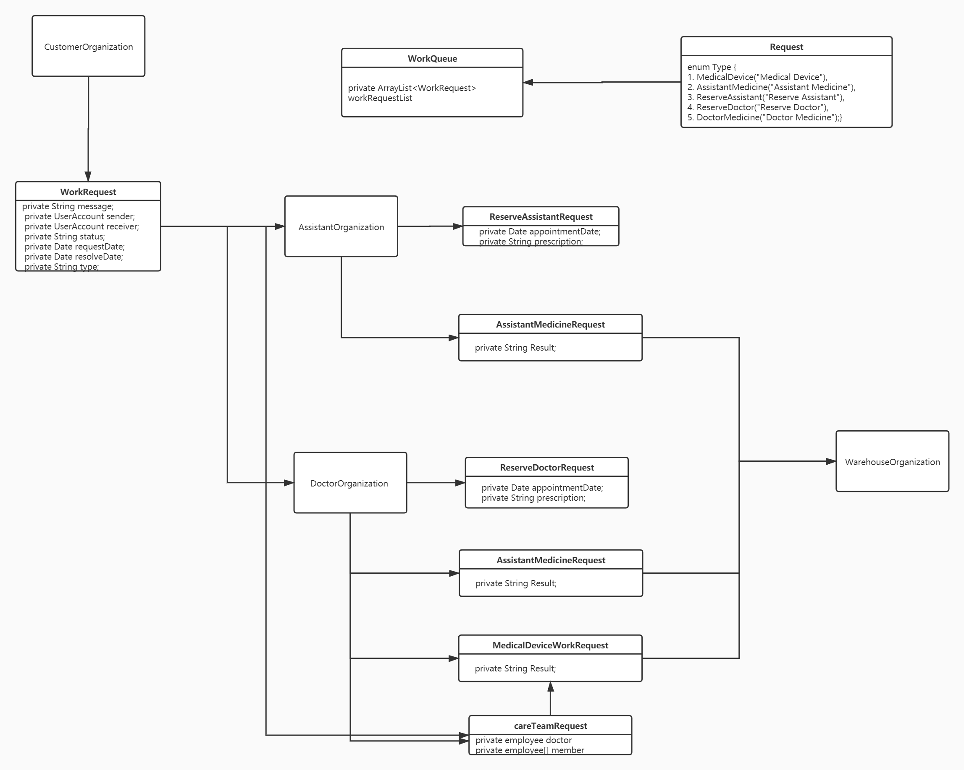
UML diagram of main work flow

Slide 8
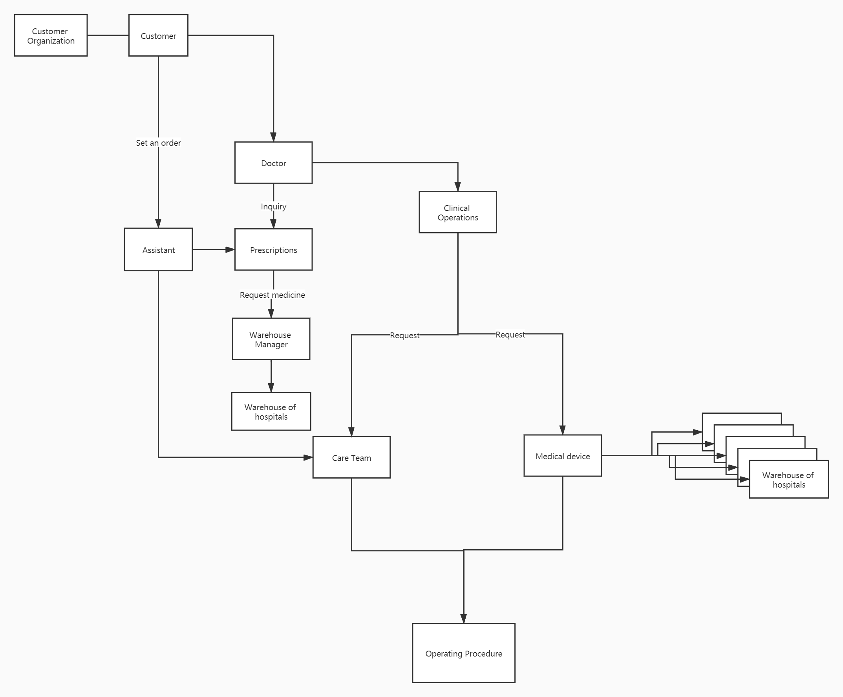
Work Flow
Left is prescriptions work flow.
Right is clinical operations work flow.

Slide 9

User case – Customers
Customers
Choosing doctor/assistant to make appointment.
Entering a description of health condition to help the doctor diagnose.
Finding their own diagnostic progress.

Slide 10

User case – Doctors
Doctors
Diagnosing the illness by information from customers.
Making a prescription / clinical procedures.
Request for medicine.
Organize a care team for one clinical procedure.
Request medical device from other hospital.

Slide 11

User case – Assistant
Assistant
Diagnosing the illness by information from customers.
Making a prescription.
Request for medicine.
Join care team to finish one clinical procedure

Slide 12

User case – Admin
Network Staff/Hospital Admin/Organization Admin:
1. Create new entities
2. Allocate account and password

Slide 13
Thank you

