Slide 1

Sustainability and Groundwater Level Prediction Using Machine Learning
A Machine Learning Approach to Water Sustainability
Presented by: Keyur Padia, Abhinav Gupta, Anshul Sunkari
Supervised by: Biji C.L.
Date: 13/9/24

Slide 2
Introduction
Groundwater is a critical resource for both agriculture and human consumption. Responsible management of groundwater is crucial to preserving it for future generations.
Sustainability Concern: Increasing contamination of groundwater, particularly nitrate (NO3), threatens both environmental and human health.
Project Objective: Build and implement machine learning models to predict nitrate levels using groundwater data, providing actionable insights for environmental sustainability.

Slide 3
What is Sustainability?
Description: Meeting the needs of the present without compromising future generations.
Environmental Sustainability: Focus on preserving ecosystems and natural resources.
Link to Water Resources: Groundwater sustainability ensures the protection of a critical freshwater resource from depletion and contamination.

Slide 4
Groundwater’s Role in Sustainability
Importance of Groundwater:
- Vital for agriculture, drinking water, and ecosystems.
- Over 30% of the world’s freshwater is groundwater.
Challenges: Over-extraction and contamination with pollutants (e.g., nitrates) degrade water quality and availability.
Goal: Achieving a balance between use and natural replenishment.

Slide 5
Impact of Nitrate Pollution
Sources: Nitrate pollution stems from fertilizers, industrial waste, and improper waste disposal.
Consequences of High Nitrate Levels:
- Health risks: methemoglobinemia ('blue baby syndrome').
- Ecosystem damage: water becomes unsafe for drinking and agriculture.
Need for Prediction and Monitoring: Predicting nitrate levels helps in taking timely corrective measures.

Slide 6
Machine Learning in Water Sustainability
ML's Role in Sustainability:
Machine learning models predict nitrate levels based on historical and real-time data.
This informs targeted actions to reduce contamination and manage groundwater resources.
Long-Term Impact: Accurate predictions help develop sustainable water management strategies and policies.

Slide 7
Data and Features
Dataset Used: Telangana state’s ground water data.
Features: Bicarbonate (HCO3), Electrical Conductivity (E.C), Fluoride (F), Chloride (Cl), Sulfate (SO4), Sodium (Na), Potassium (K), Calcium (Ca), Magnesium (Mg).
Target Variable: Nitrate (NO3) levels.

Slide 8
Machine Learning Models
Models Used for Prediction:
- Linear Regression
- Decision Tree
- Random Forest
- SVR
- MLP
- XGBoost
- LightGBM
- K-Neighbors
Why multiple models? Different models capture varying patterns in data for better predictive accuracy.

Slide 9
Model Evaluation Metrics
Evaluation of Model Performance:
- Mean Absolute Error (MAE): Measures the average prediction error.
- Root Mean Squared Error (RMSE): Emphasizes larger errors.

Slide 10
Streamlit Application Overview
Interactive Interface:
- Allows users to upload groundwater data.
- Select different ML models for real-time nitrate level prediction.
- Real-time prediction output displayed with actual vs predicted nitrate levels.

Slide 11

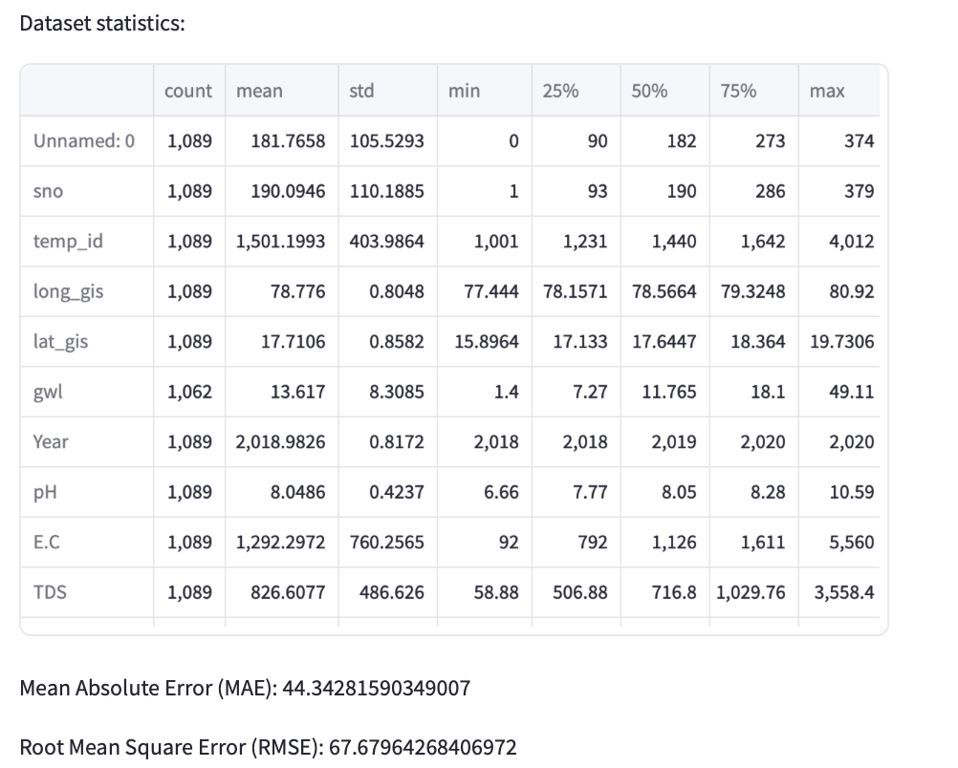
Streamlit Application Overview

Slide 12
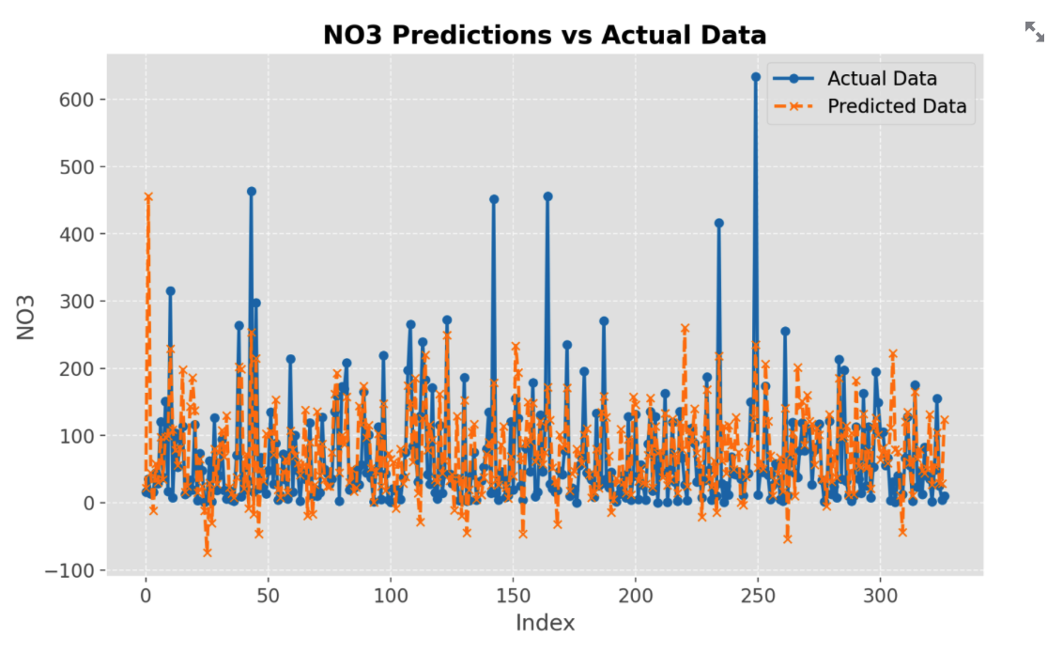
Visualization of Results
Predicted vs. Actual NO3 Levels:
Comparing actual NO3 levels with predicted values to showcase model performance.

Slide 13
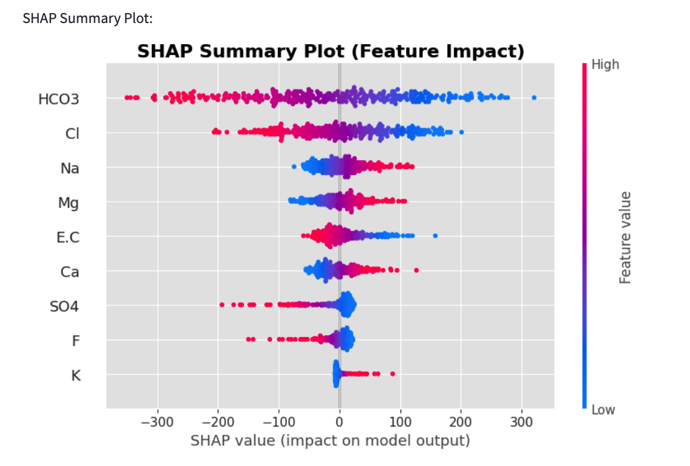
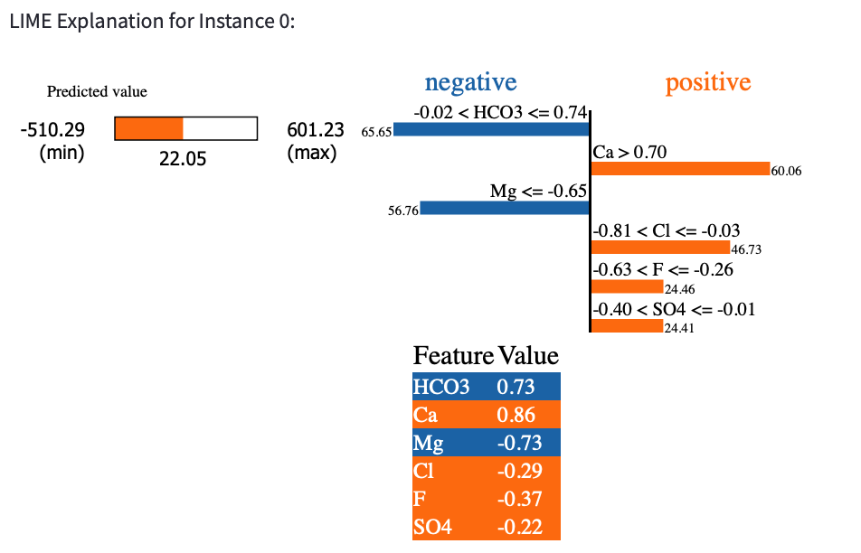
SHAP and LIME Explanations
- SHAP: Visualizes feature importance for global interpretability.
- LIME: Explains predictions for individual instances.

Slide 14
Sustainability and Water Management
Linking Data to Policy:
Machine learning predictions guide decision-makers in addressing nitrate pollution.
Helps implement sustainable agricultural practices and water management strategies.

Slide 15
Conclusion
Machine learning models predict groundwater nitrate levels, contributing to better resource management and environmental sustainability.
Ensuring clean water through accurate predictions supports both current and future generations.

