Slide 1

Title of Paper: Explainable AI for Ground water nitrate content prediction using machine learning frameworks in Telangana Paper ID: 763 Presenting Author: Abhinav Gupta
Author and Co-Authors: Anshul Sunkari
Keyur Padia Biji C.L.
Affiliation:
Vellore Institute of Technology
Date: 21-08-2025

Slide 2
Table of Contents
Introduction
Literature Survey
Proposed Approach
Results and Discussions
Conclusion

Slide 3
Introduction
Groundwater supplies around 2 billion people worldwide with drinking water.
In India, around 80% of the rural population relies upon groundwater, while 50% of the urban households depend on it.
Approximately 12% of water samples in Telangana were found to be chemically contaminated, with areas like Khammam and Medchal experiencing the highest levels of nitrate contamination
There are major health risks associated to this, such as, ‘blue baby syndrome’, cancer and various reproductive issues.
The World Health Organization recommends a maximum nitrate level of 50 mg/L, while the Bureau of Indian Standards recommends 45 mg/L in drinking water to prevent such health risks.
Monitoring nitrate levels requires frequent water sampling and lab testing, which is expensive, time-consuming, and logistically challenging, especially in large and rural areas.
This leads to data gaps in many villages and districts are left unmonitored, making it difficult for policymakers to act early.

Slide 4
To address this issue we used predictive modeling using machine learning models offers a scalable and cost-effective solution.
Instead of sampling every well, AI can interpolate and estimate nitrate levels where no direct measurements are available.
Most machine learning models are ‘black boxes’. Therefore, they predict results but fail to give solid reasoning to support their findings.
Hence, we use Explainable AI (xAI), specifically SHAP and LIME, which identifies the most influential hydrogeological factors that drive nitrate contamination.
Various factors have been linked as influential in predicting nitrate concentration, including ammonium, phosphate, pH, temperature, dissolved oxygen, natural oxygen demand, suspended solids and streamflow.
By employing accurate and interpretable AI techniques in nitrate prediction models, researchers and policy-makers can gain accurate predictions and valuable insights in sustainable water management, by curbing this ever increasing nitrate contamination.

Slide 5
Literature Survey
Several studies have applied machine learning models such as Random Forest, XGBoost, SVR, and ANN for groundwater quality prediction.
These models are effective in capturing non-linear relationships and handling large multi-parameter datasets.
However, most prior works treat the models as black-boxes, offering little explanation of how predictions are made.
Many studies face issues of overfitting and are not easily adaptable to different regional contexts like Telangana.
At present, India lacks robust predictive systems to forecast emerging groundwater contamination hotspots from existing government data.
Existing research has focused largely on prediction accuracy, with limited emphasis on interpretability and transparency.
Our work addresses this gap by analyzing groundwater samples across districts (2018–2020) from Telangana.

Slide 6
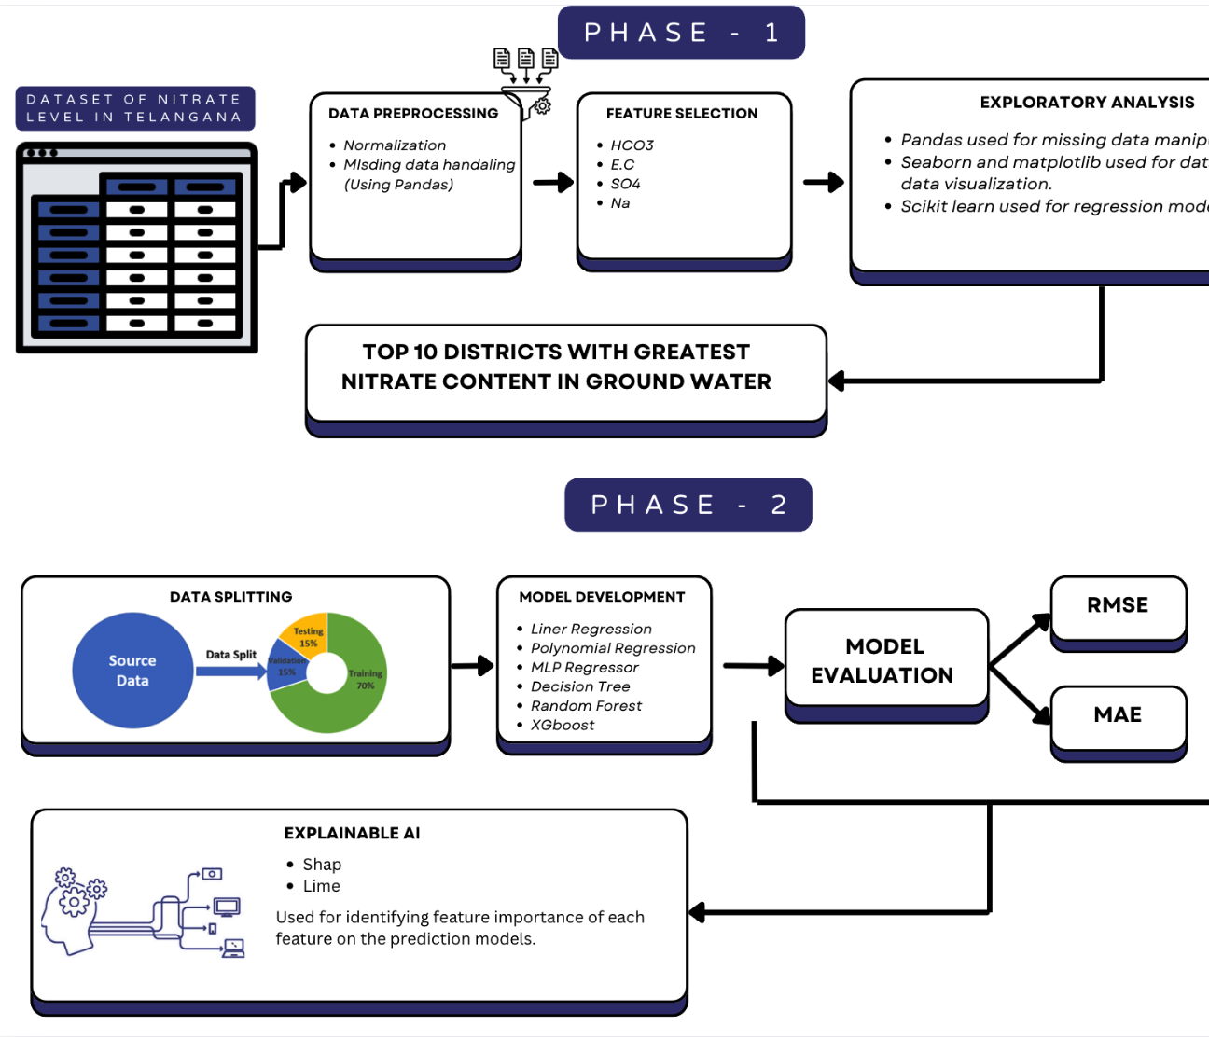
Proposed Approach
We used 1,089 groundwater samples from 33 districts of Telangana.
Preprocessing included imputation for missing values, z-score based outlier removal, and feature scaling with StandardScaler.
Exploratory analysis revealed that there were 71 unsafe and 51 marginal cases indicating local hotspots.
Hydro-chemical features such as HCO₃, EC, Cl, SO₄ etc. were selected as predictors, by performing correlation analysis.
These imbalances motivated the use of robust models that can generalize across varying contamination levels.

Slide 7
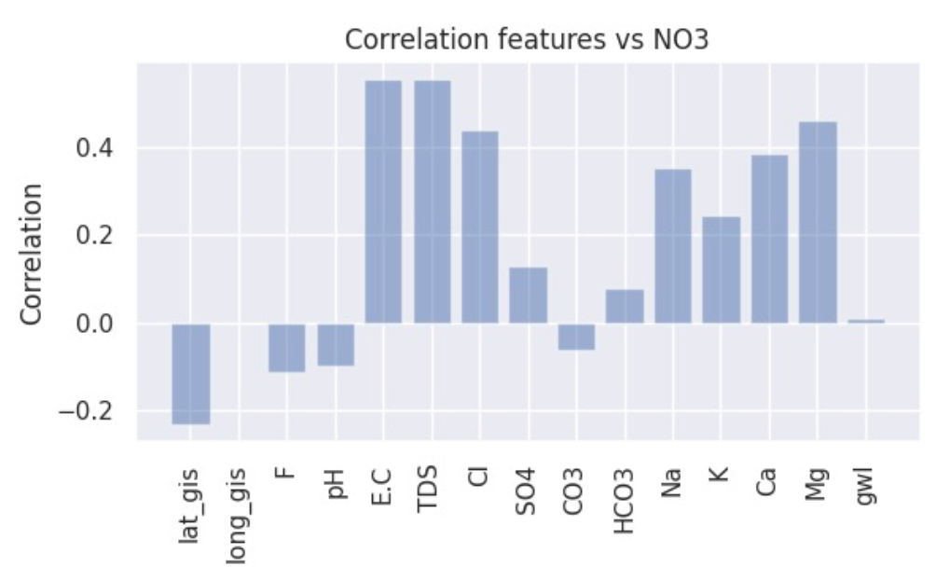
Phase-1 [Correlation Analysis]
To understand which parameters influence nitrate (NO₃) levels the most, we began with a correlation analysis.
We identified various factors that show positive and negative correlation with NO3.
Elements like Mg, Cl, Ca, and Na, though moderately correlated, still significantly affect nitrate levels, reflecting the impact of soil chemistry and salinity.
Even with lower correlations, features like K and SO₄ may impact nitrate levels when certain environmental factors are at play.
Considering our findings, these parameters were selected for our machine learning models.

Slide 8
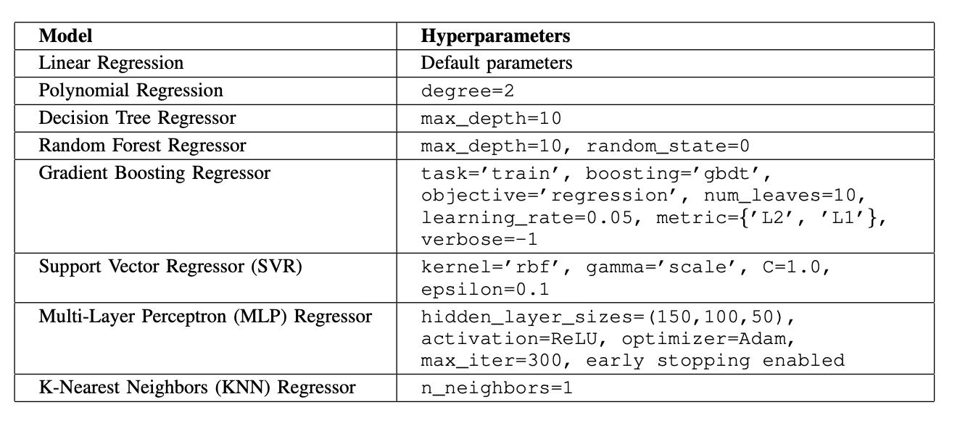
Phase-2 (Model Development)
We sought to evaluate nine regression models including Linear & Polynomial regression, Decision Trees, Random Forest, SVR, KNN, XGBoost, LightGBM, and MLP.
We tested both simple (Linear/Polynomial) and advanced models to capture different levels of nitrate–feature relationships.
Tree-based models (RF, XGBoost, LightGBM) were strong at handling feature interactions and noise in water chemistry data.
MLP was used for effectively capturing complex non-linear dependencies between TDS, EC, Ca, Cl, and nitrate levels.
To ensure interpretability, we used SHAP explainability and LIME predictability to identify key drivers of nitrate.

Slide 9
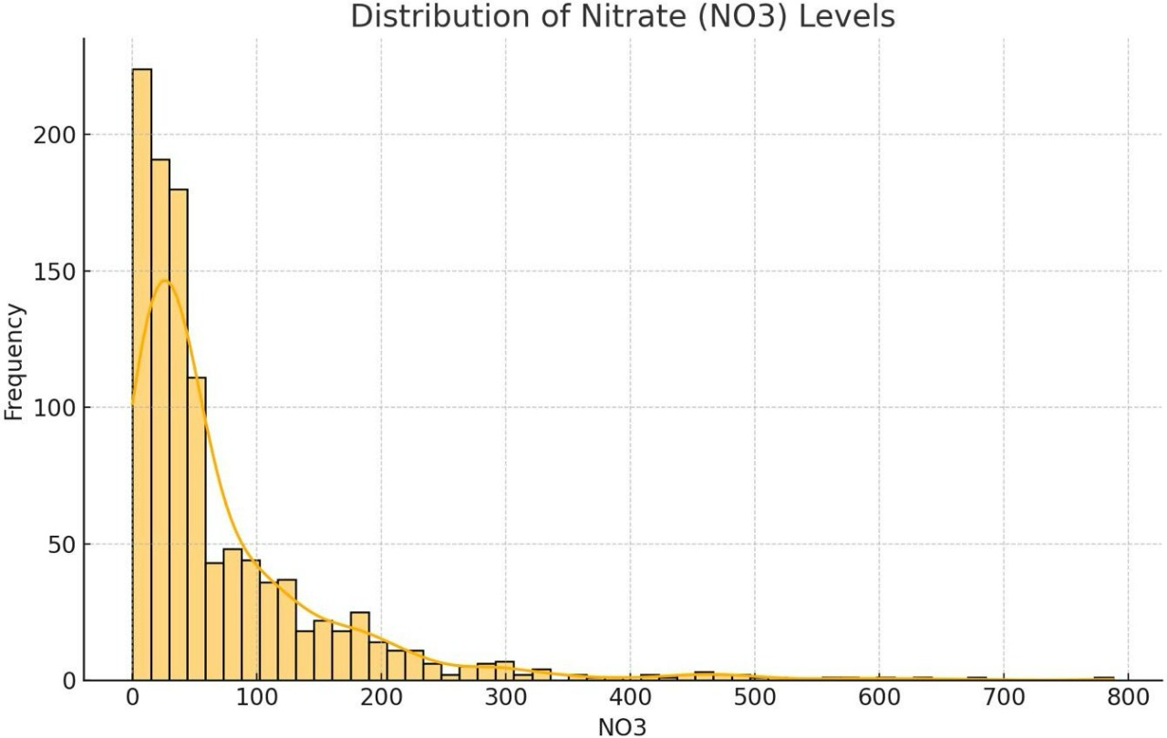
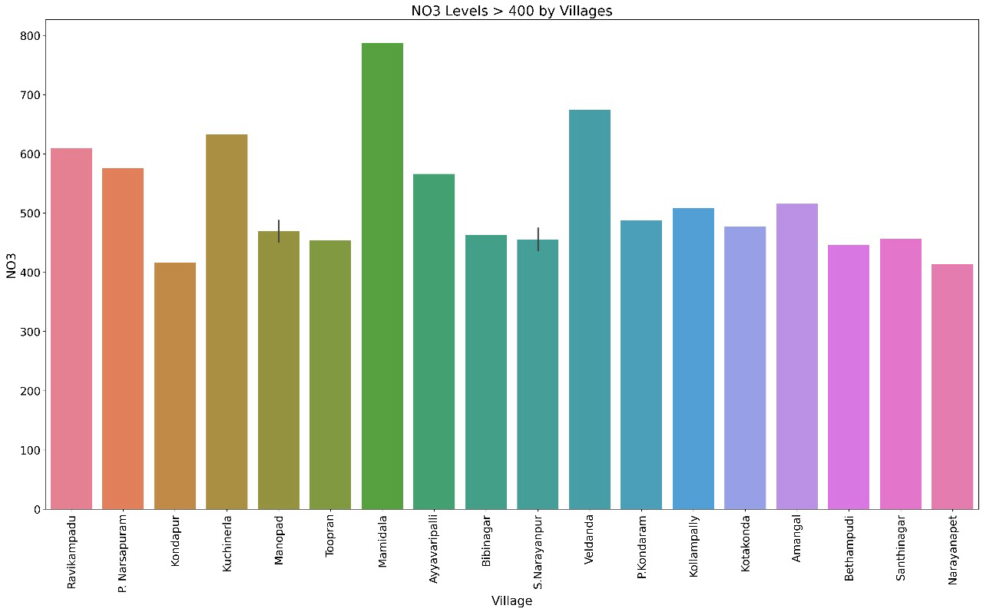
Results and Discussions
To detect unsafe wells (>400 mg/L), we used a box plot, which clearly shows a cluster of safe wells but also a few extreme outliers with nitrate levels going above 700 mg/L.
By classifying wells into permissible, marginal, and unsafe categories, we found that while the majority are safe, a small fraction is highly unsafe, and these are not spread randomly, but they are localized hotspots.
From the histogram, we can see that most samples fall well within the WHO safe limit of 50 mg/L, but the long tail highlights contamination in specific villages.

Slide 10
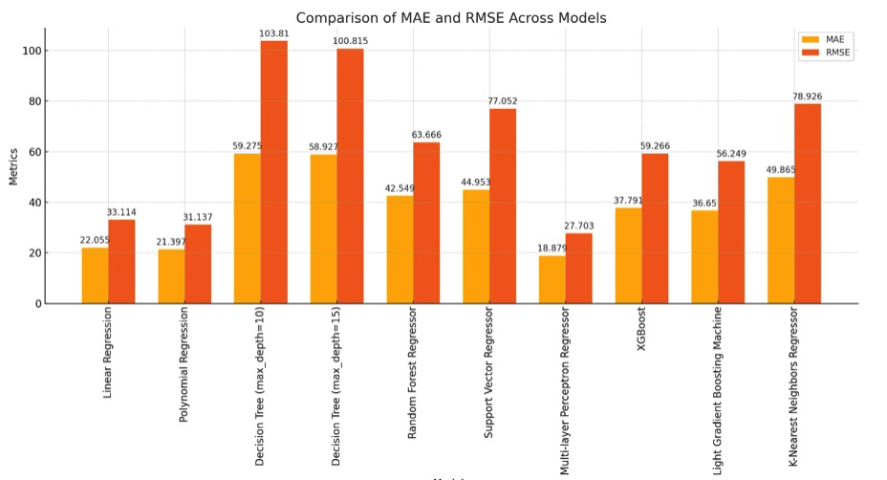
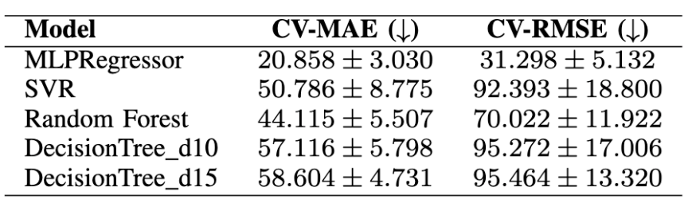
Why MLP?
We tested nine regression models, and the MLP Regressor clearly stood out with the lowest error values, showing it could best capture the complex nitrate interactions.
To confirm reliability, we used cross-validation, which showed consistent performance across folds, reducing the risk of overfitting and proving that the model is stable.
When we compared other models, ensemble methods like XGBoost and LightGBM did reasonably well, but simpler models such as Linear Regression, Polynomial Regression, and KNN either underfit the data or produced high errors

Slide 11
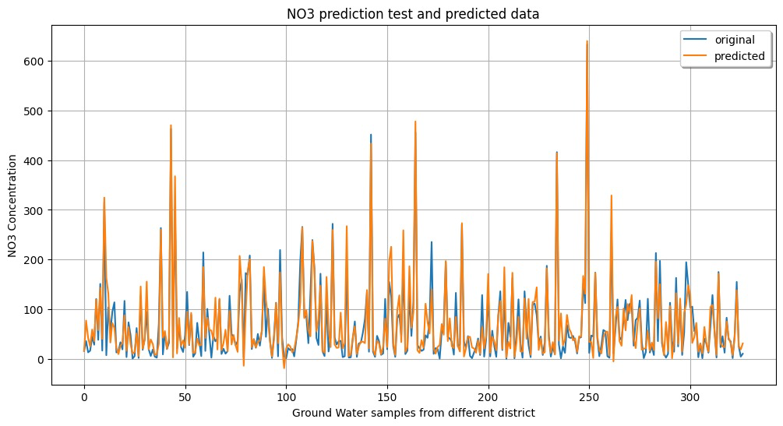
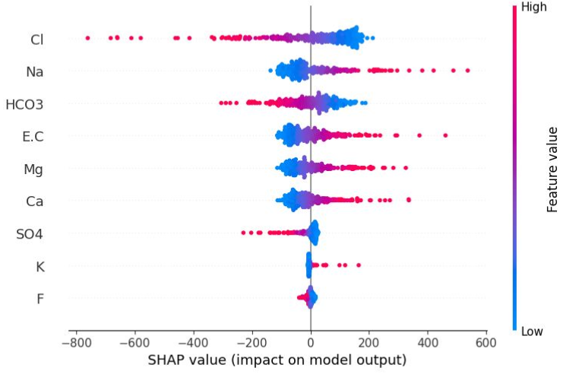
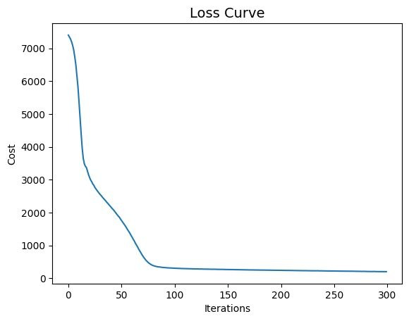
MLP Results: Accuracy, Drivers & Efficiency
The Predicted vs Actual plot showed that the MLP was highly accurate for nitrate levels below 200 mg/L, but it struggled with extreme outliers above 400 mg/L because unsafe wells are much fewer in the dataset.
The SHAP summary plot shows that Cl, Na, and HCO₃ are the strongest drivers of nitrate predictions in the MLP model, confirming the model’s ability to capture real-world chemical influences.
The loss curve analysis showed that performance stabilized after around 100 iterations, allowing us to stop training early, saving computation time while preserving accuracy.

Slide 12
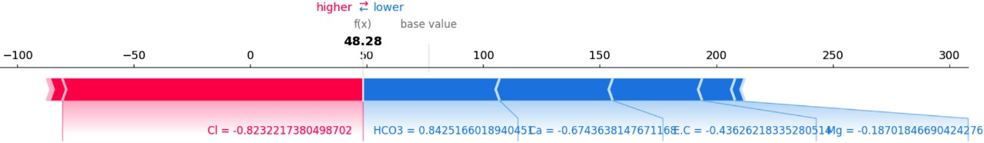
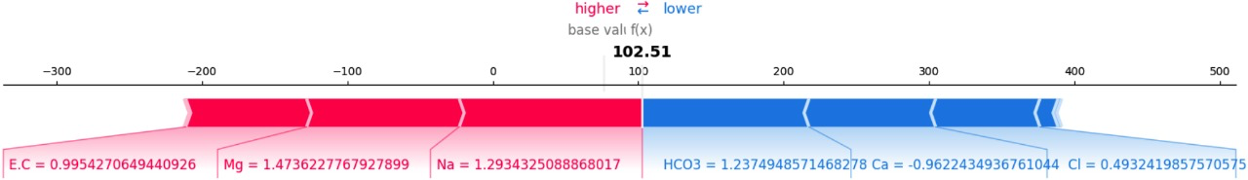
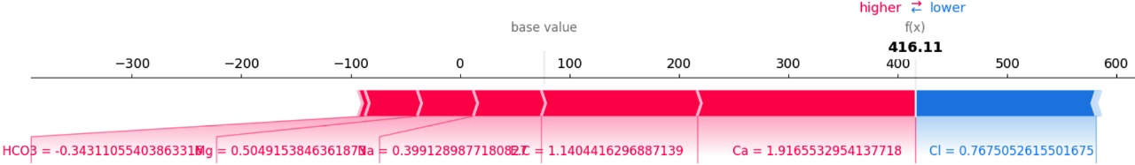
SHAP Force Plots: Safe, Marginal & Unsafe Wells
In safe wells (~50 mg/L), we observed that HCO₃ tends to push nitrate up, while Cl helps balance it → even small changes could tip these wells into unsafe ranges.
In marginal wells (~100 mg/L), Na and Mg emerged as the main contributors, linking contamination directly to fertilizer overuse and wastewater seepage.
In unsafe wells (>400 mg/L), Ca and Cl were dominant factors, pointing to industrial effluents and local geological influence.

Slide 13
Conclusion
By coupling predictive accuracy with interpretability, the framework makes groundwater risk forecasting policy-ready for state agencies.
Our framework helps identify contamination hotspots, to formulate regulation of agricultural and industrial practices, and support the development of early warning systems for rural communities.
We found that using a larger dataset, adding space and time factors, and scaling the framework can make it a powerful decision-support tool for groundwater management across the state.

Slide 14
References
Siebert, S., Burke, J., Faures, J. M., Frenken, K., Hoogeveen, J., Doll,¨P., & Portmann, F. T. (2010). Groundwater use for irrigation–a global inventory. Hydrology and earth system sciences, 14(10), 1863-1880.
Sahoo, S., Russo, T. A., Elliott, J., Foster, I. (2017). Machine learning algorithms for modeling groundwater level changes in agricultural regions of the US. Water Resources Research, 53(5), 3878-3895.
Rajmohan, N., et al. (2020). Nitrate contamination in groundwater and associated health risks in India’s agricultural heartlands. Environmental Science and Pollution Research, 27(16), 19534–19547.
Lundberg, S. M., & Lee, S. I. (2017). A unified approach to interpreting model predictions. Advances in neural information processing systems, 30.

