Slide 1

Easy Homes Group 24 (Development Team)
Damandeep Kaur: B00904831 Keyur Vaghani: B00901000​
Shaik Asaduddin: B00894318 Dhruvrajsinh Vansia: B00891415​
Radhey Rupapara: B00910695 Qinyue Wang: B00892024
TA: Harit Patwa

Slide 2
Basic Information
Development team number: 24
Damandeep Kaur
Keyur Vaghani
Shaik Asaduddin
Dhruvrajsinh Vansia
Radhey Rupapara
Qinyue Wang
Client team number: 17
Dhairya analbhai doctor
Aayushi Rashesh Gandhi
Sanjana Bhogavali
Saurabh jayeshbhai das
Shivangi bhatt
Project name
Easy Homes
TA: Harit Patwa

Slide 3
Achievements
Allow users to sign in and sign up with emails
Allow users to post, edit and remove properties and services
Allow users to search properties and services with filters
Allow users to collect their favorite properties and services
Allow users to send messages to property owners and service providers
Allow users to schedule a meeting with property owners and book an appoint with service providers
Allow users to chat with property owners and service provides
Allow users to pay for properties and services
Allow users to add reviews to properties and services

Slide 4
User Stories
Total Number: 15
Damandeep Kaur
Add a property
Payment integration for services
Keyur Vaghani
Add a service
Edit properties or services
Home page view
Shaik Asaduddin
Add filters to get properties and services
Home page navigation
Basic chatting between users
Dhruvrajsinh Vansia
Notification
Registration and Login
Set up CICD
Radhey Rupapara
Front end for adding a review for services
Backend API for adding feedback to services
Qinyue Wang
Add properties or services to favorites
Favorite list view

Slide 5
Tasks
Total Number: 40
Damandeep Kaur
Backend API for adding property service
Unit test cases for adding property API
Set up database integration
Font-end changes for adding property
Integrate code quality (DesigniteJava and Qscored) with CI pipeline
Font-end changes for PayPal integration on the service page
Backend API changes to store payment details in DB
Unit and integration test cases for payment API
Keyur Vaghani
Creation of service landing page
Creation of UI-form for adding services
The database extension for service feature
Backend API creation for service feature
Deployment on Heroku
Resolved CORS errors
Shaik Asaduddin
UI changes for home page navigation
Implement logout functionality
Implement UI to integrate WebSockets and chat between users
Integrate WebSockets in UI
Integrate WebSockets in Spring boot
Set up Redux for state management in the UI application
Integrate react library with maven
Set up swagger UI for testing APIs

Slide 6
Tasks
Total Number: 40
Dhruvrajsinh Vansia
Resolved: Email service on Heroku
Payment confirmation receipt
Schedule a meeting with a property owner
Book an appointment with a service provider
Forgot password
Resolved: Spring security issue
Set up JWT token and spring security
User activation via an email link
Radhey Rupapara
Create Unit test cases for adding service review API
Create Integration test cases for adding service review API
Implement UI to add ratings, description and subject to a service
Implement API to add ratings, description and subject to a service
Create documentation files for Easy Homes
Qinyue Wang
APIs for favorite properties and services
Favorite button for properties and services on the dashboard page
Unit and integration test cases for favorites APIs
List a user’s favorite properties and services
Add and remove favorite properties and services in both front end and back end

Slide 7
Meeting Held (as a developer)
Meeting Type | Number of meetings
With TA | 12
Total | 27

Slide 8
Tech Stack
Back End:
Java
Spring boot
Spring Security
JWT
JPA
Hibernate
Front End:
React
Redux

Slide 9
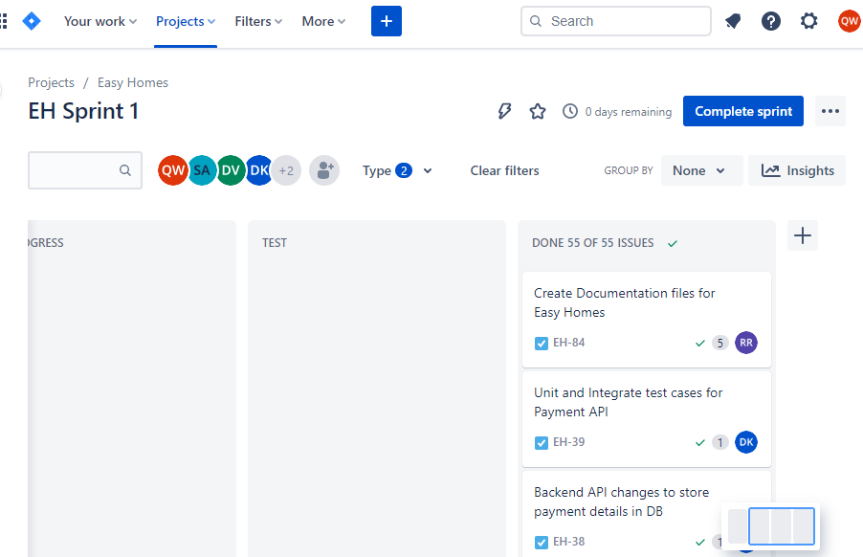
Demo
JIRA Dashboard

Slide 10
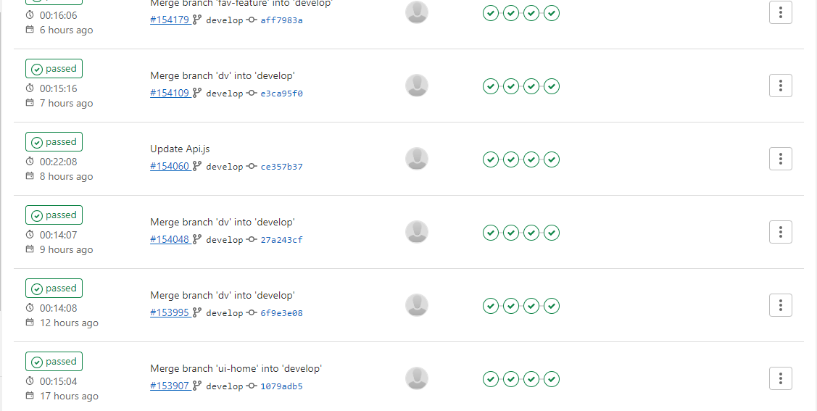
Demo
Successful Implementation of CI /CD pipeline

Slide 11
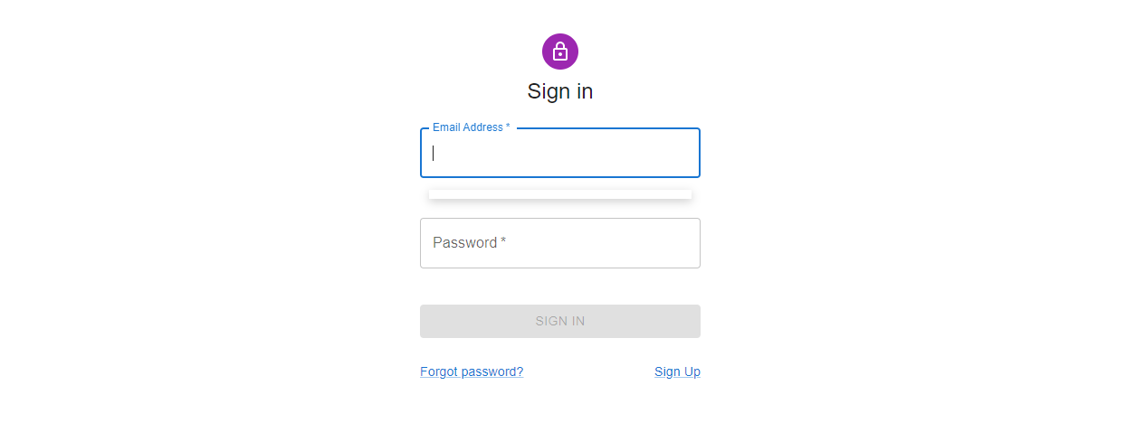
Demo
Login Page

Slide 12
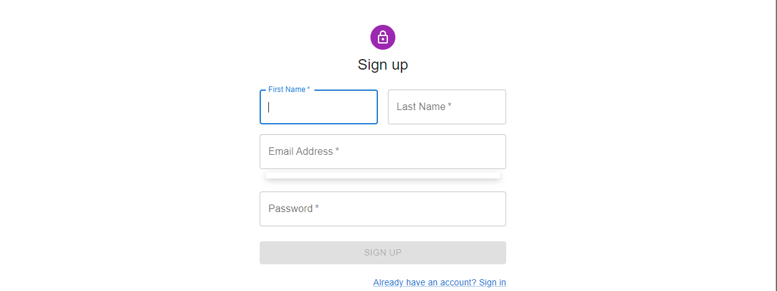
Demo
Sign Up Page

Slide 13
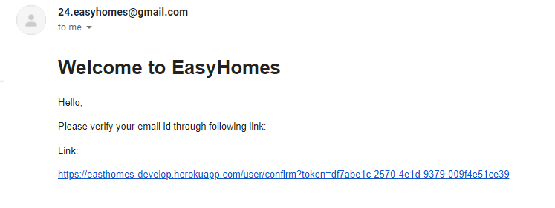
Demo
Email Verification

Slide 14
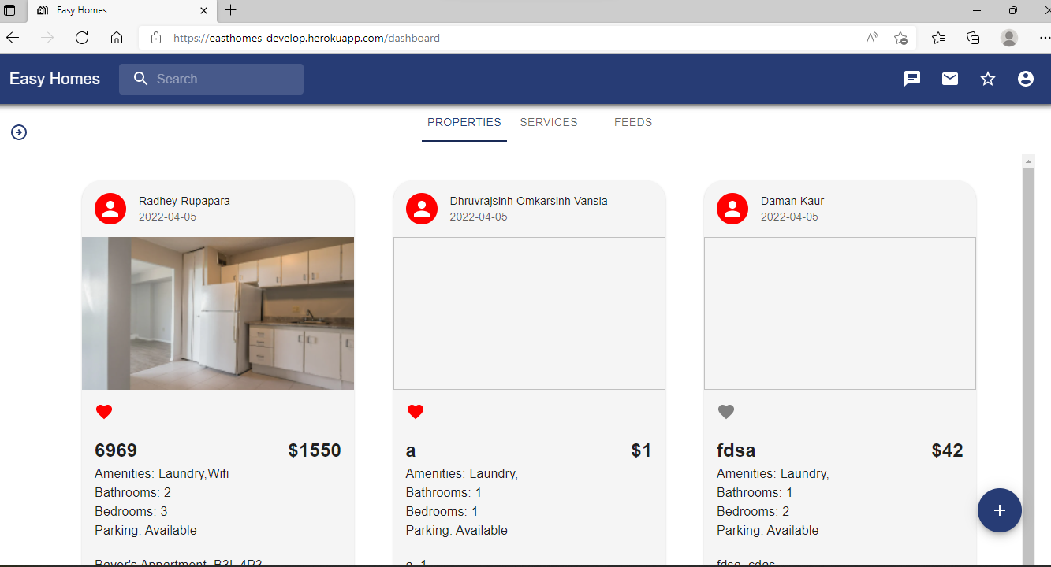
Demo
Dashboard Page

Slide 15
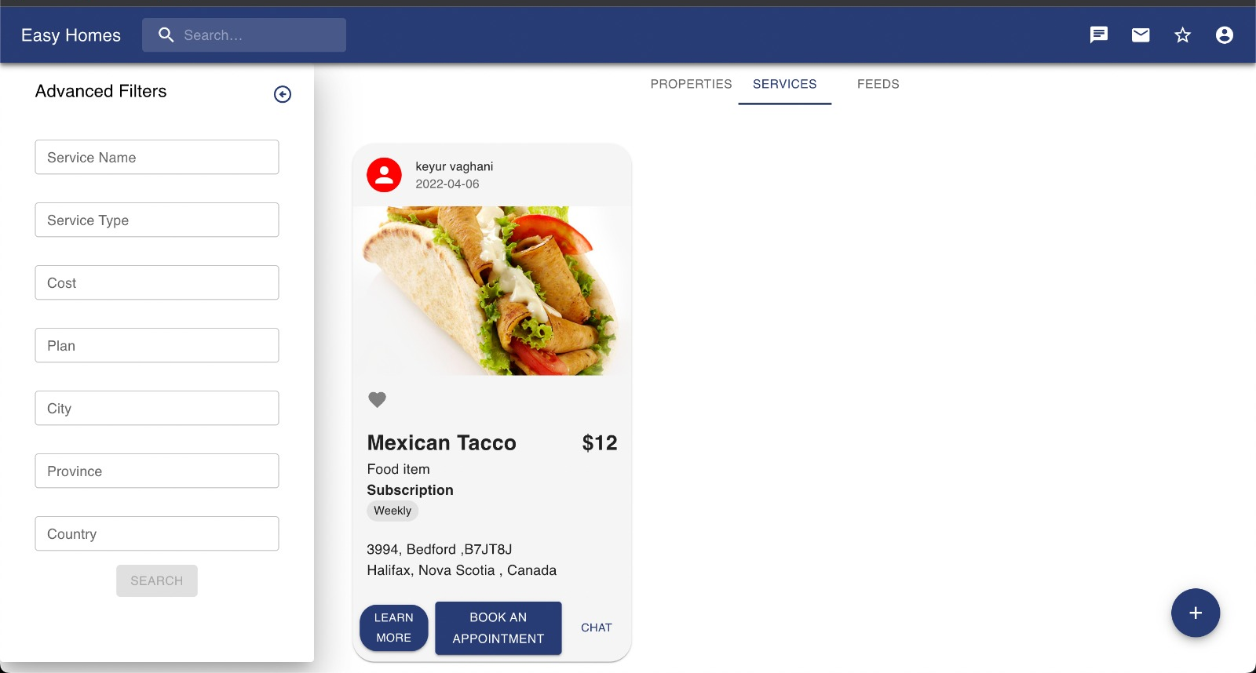
Demo
Filters in Dashboard Page

Slide 16
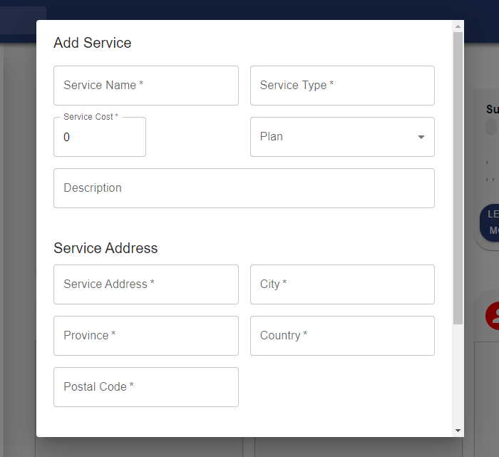
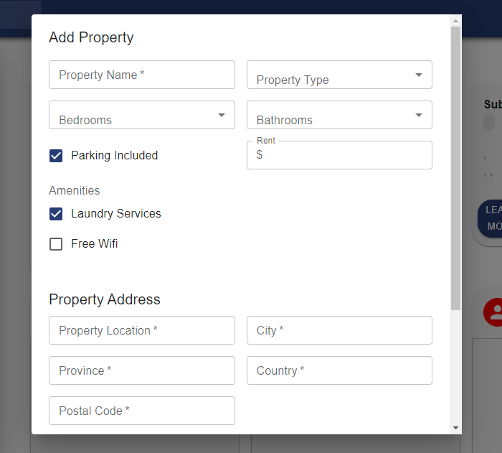
Demo
Adding a Property or Service

Slide 17
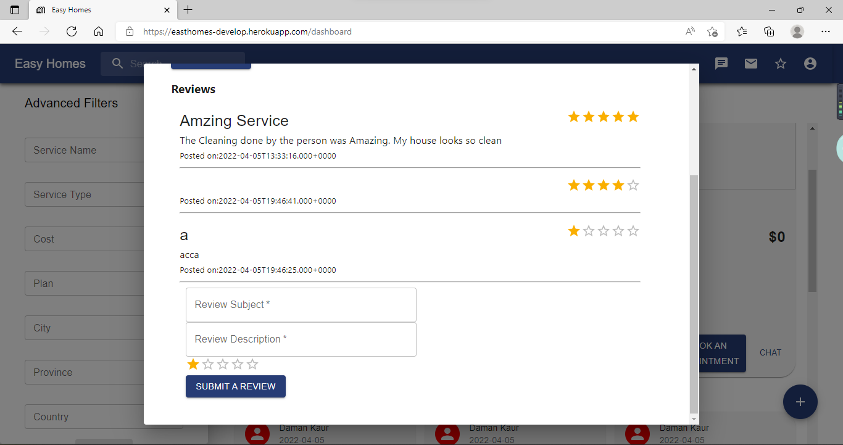
Demo
Reviews for Properties and Services

Slide 18
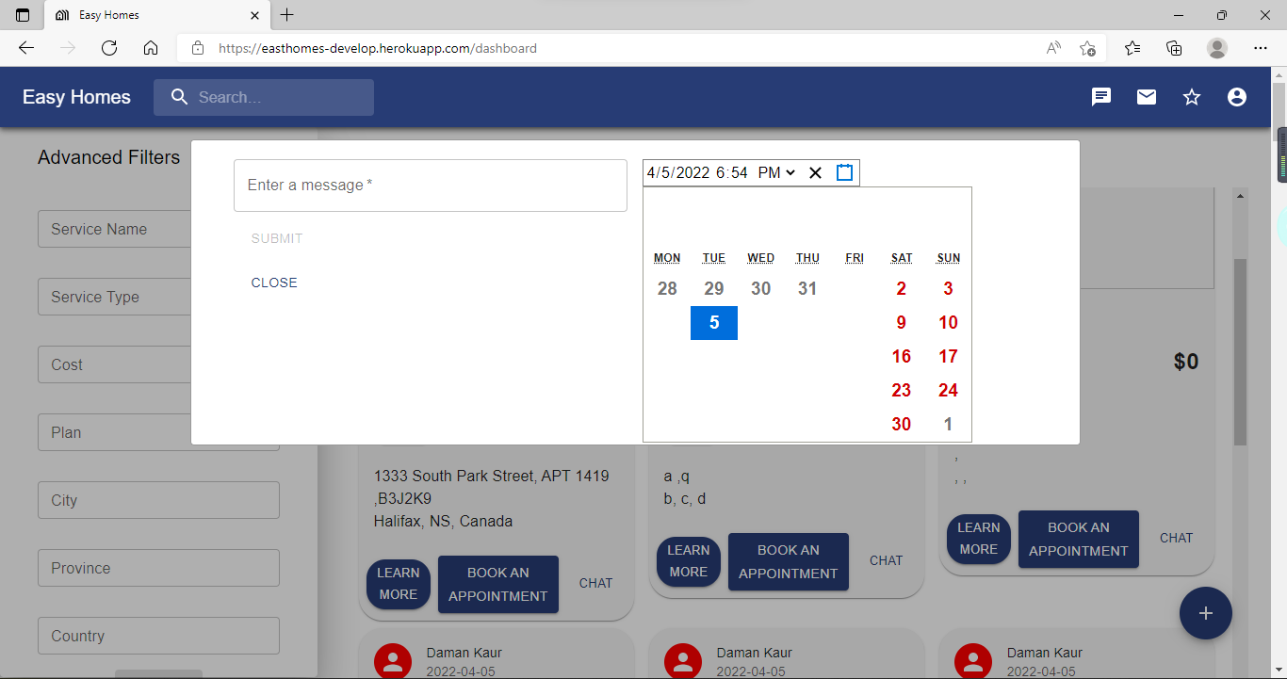
Demo
Scheduling meeting

Slide 19
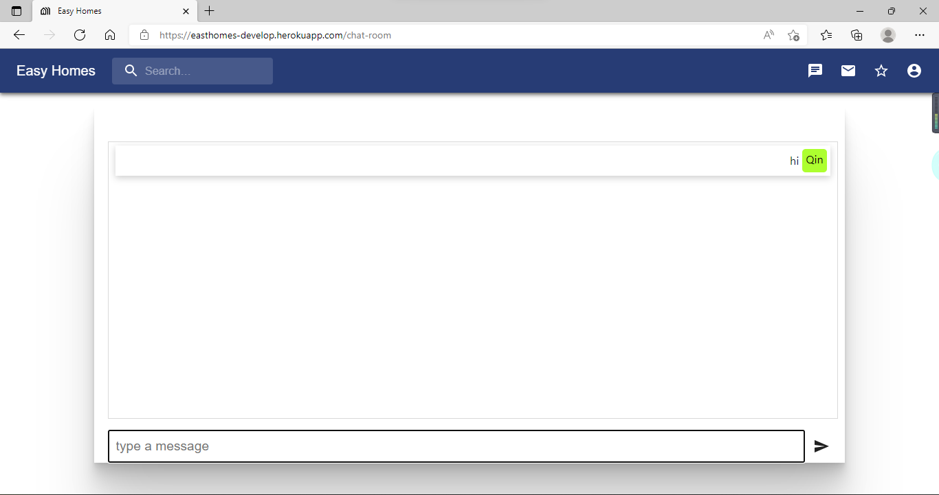
Demo
Chatting between users

Slide 20
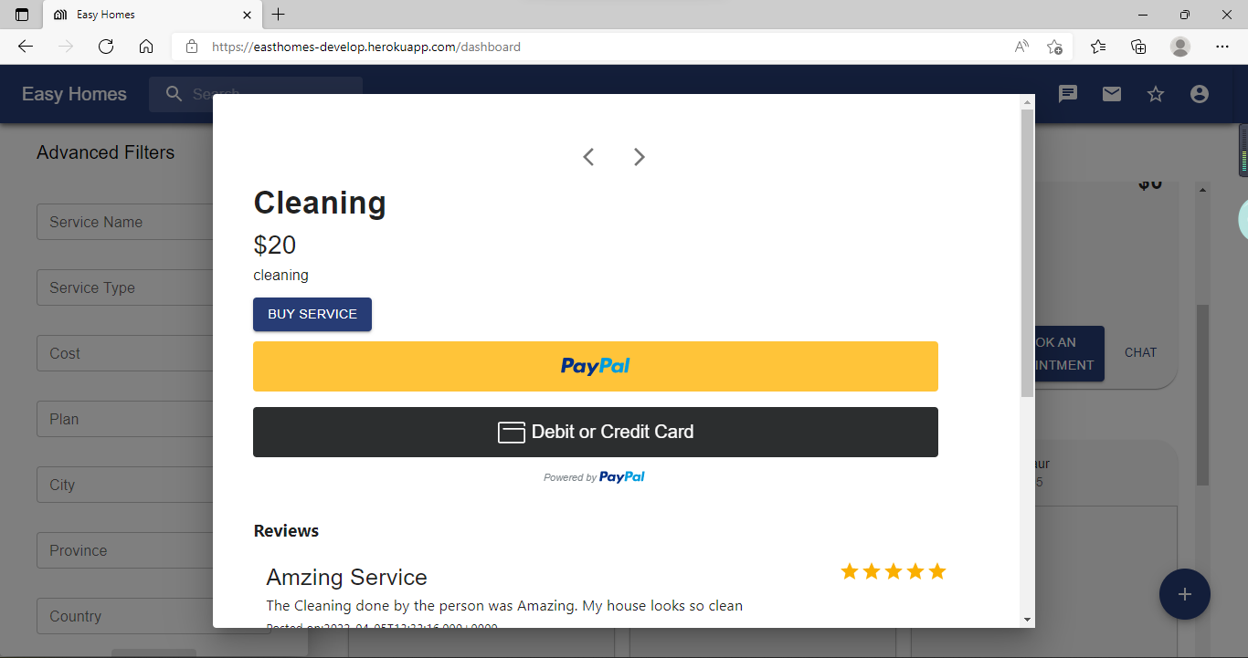
Demo
Buying services

Slide 21
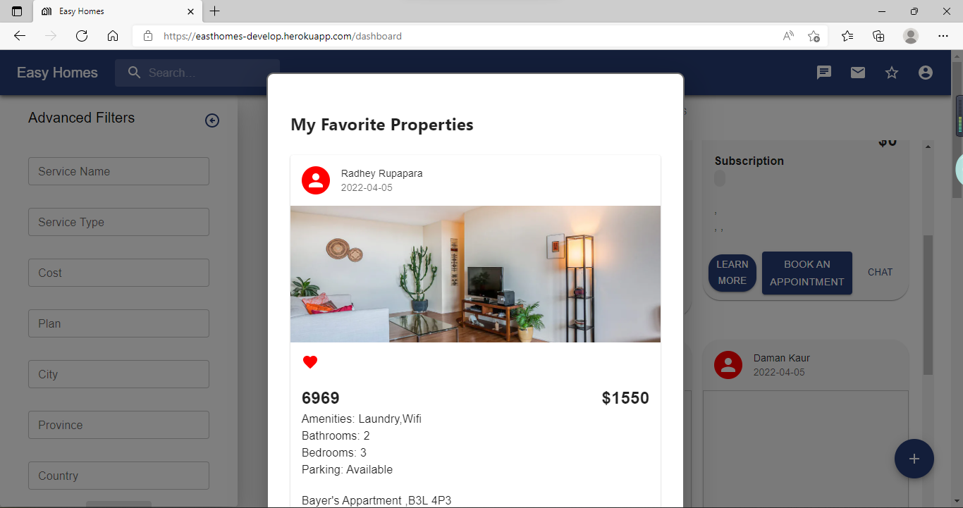
Demo
Favorites List of Properties and Services

Slide 22
Project Status
Goals | Status
Login and Sign Up | Achieved
Post a property and a service | Achieved
Search properties and services | Achieved
View properties and services | Achieved
Add reviews to services and properties | Achieved
Chat with the owner and service provider | Achieved
Schedule a meeting with the owner and book an appointment with the service provider | Achieved
Get notifications related to properties and services | Achieved
Payment integration | Achieved
Bookmarking a property or service | Achieved

Slide 23
Learning From the Project
Configuring the CI/CD pipeline
Designing an efficient database so that the complexity of queries reduces
Learning ReactJS and Spring boot to implement features
Adapting to GIT workflow
Utilizing TDD to design codes
Improving code quality through DesigniteJava and Qscored
If we get a chance to repeat this project, we would follow agile development strictly and implement each feature under the situation of ensuring good code quality and design patterns

