Slide 1
SmartDine
Intelligent Restaurant Management System
ICT203 Assessment 3 | Full-stack web application
React
Express API
MySQL
>
>
Customer ordering
Admin order management
Rule-based assistant
Notes:
Good morning everyone. Our project is SmartDine, an intelligent restaurant management system developed for ICT203 Assessment 3. It is a full-stack web application built with React, Express.js, and MySQL. The system supports customer food ordering, admin order management, and a rule-based assistant that helps users with menu questions and recommendations.

Slide 2
Problem and Users
SmartDine supports the everyday workflow of a small restaurant.
Customer
Admin
- Browse menu clearly
- Maintain menu details
- Search and filter food
- Track order progress
- Place orders with less confusion
- Use protected dashboard tools
SmartDine | 2
Notes:
The problem we focused on is the daily workflow of a small restaurant. Customers need a clear way to view the menu and place orders. At the same time, restaurant staff need a simple way to manage menu information and track order progress. SmartDine separates customer and admin actions so each user only sees the tools that match their role.

Slide 3
Technology and Team Roles
The stack was chosen to support a working full-stack demo.
- React gives the frontend reusable components and quick interface updates.
- Express.js provides API routes for login, menu, orders, and chatbot messages.
- MySQL stores users, menu categories, menu items, orders, and order items.
- Team work was divided across coordination, frontend, backend, database, QA, and documents.
SmartDine | 3
Notes:
For the technology stack, we used React for the frontend because it is suitable for building reusable interface components and updating the page quickly. Express.js was used for backend API routes such as login, menu, orders, and chatbot messages. MySQL stores the real project data. The team work was divided across coordination, frontend, backend, database, testing, and documentation.

Slide 4
System Architecture
The final demo connects the interface, API, and database.
React Frontend
Menu, login, orders, chatbot
Express API
Auth, menu, orders, assistant
Aiven MySQL
Users, menu items, orders
>
>
Example routes:
/api/auth/login
/api/menu/items
/api/orders
/api/chatbot/message
SmartDine | 4
Notes:
The system architecture has three main parts. The React frontend is what the user interacts with. The Express backend receives API requests and applies the system logic. The MySQL database stores the real data used by the application. For example, when the menu loads, the frontend requests menu items from the backend, and the backend reads those items from MySQL.

Slide 5
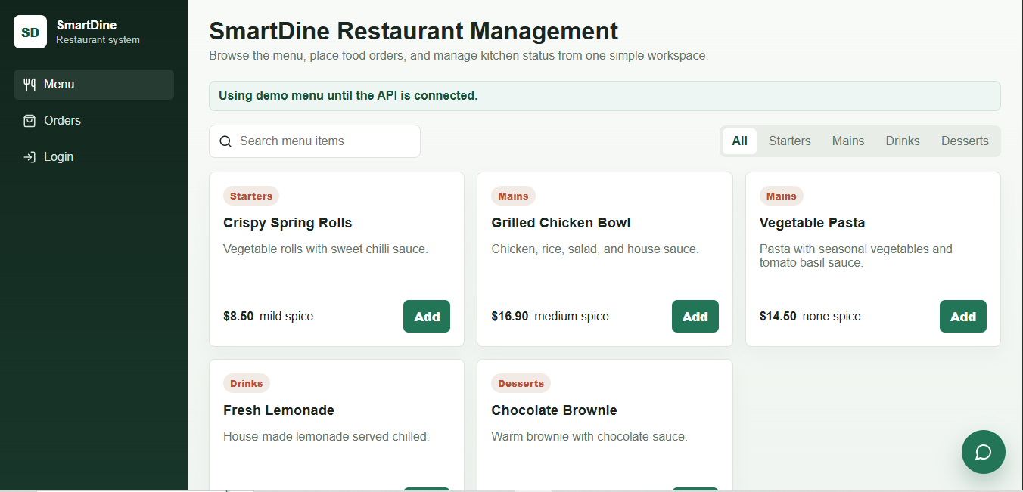
Live Menu Data
Menu cards are loaded through the API from the SmartDine database.
- Menu items load from MySQL through the API.
- Search and category filtering work.
- Seeded and admin-created items appear in the customer view.
SmartDine | 5
Notes:
This slide shows that the menu is not just static content on the frontend. The menu cards are loaded through the backend API using data from MySQL. Customers can search for food and filter by category. The seeded database items appear in the menu, and new items created by an admin can also appear after the page refreshes.

Slide 6
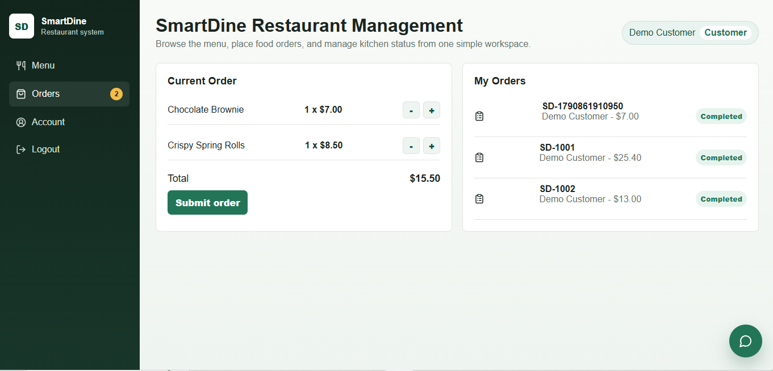
Customer Workflow
Customers can log in, build an order, and submit it.
Login
Browse menu
Add to cart
Place order
Saved in DB
>
>
>
>
- Cart count updates after adding items.
- Order stores quantity and total amount.
- Backend creates the customer order record.
SmartDine | 6
Notes:
The customer workflow starts with a customer login. After logging in, the customer can browse the menu, add items to the cart, and submit the order. The cart count updates when items are added. When the order is placed, the backend stores the order details, including item quantity and total amount.

Slide 7
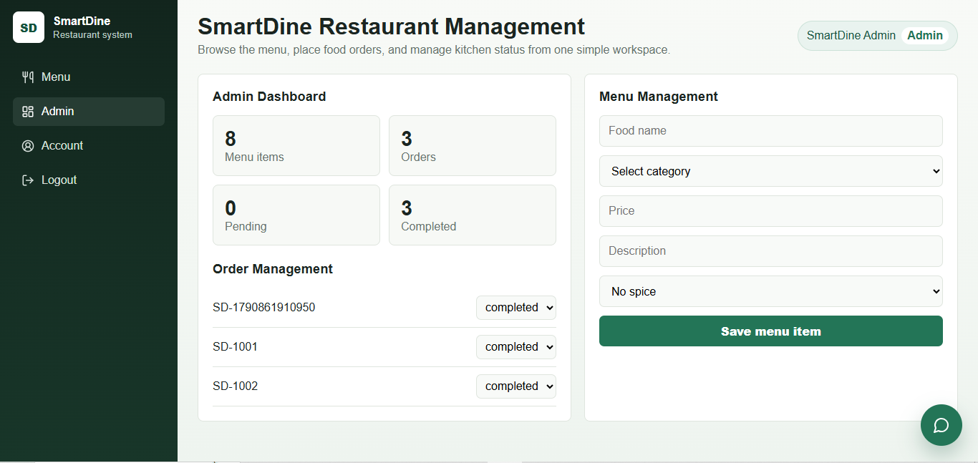
Admin Workflow
Admin users manage restaurant operations from a protected area.
Admin login
Protected dashboard
Update order status
Customer sees progress
>
>
>
- Admin-only tools appear only for admin users.
- Role-based access blocks customers from admin actions.
- Admin accounts cannot place customer orders.
SmartDine | 7
Notes:
The admin workflow is separate from the customer workflow. Admin users can access protected tools, such as order management and menu management. Customers cannot open admin tools because the system checks the user's role. Admins can update order status, but they cannot place customer orders, which keeps the roles clear.

Slide 8
Backend API and Access Control
The backend keeps application rules outside the frontend.
Request
Session check
Role middleware
API response
>
>
>
- Authentication, menu, order, and chatbot routes are separated.
- Admin routes are protected by role checks.
- Validation messages explain missing or incorrect data.
SmartDine | 8
Notes:
The backend is organised into separate API areas for authentication, menu, orders, and chatbot logic. After a user logs in, the session keeps track of the current user. Role middleware protects admin routes and blocks restricted actions. The backend also returns validation messages so users can understand what went wrong when data is missing or incorrect.

Slide 9
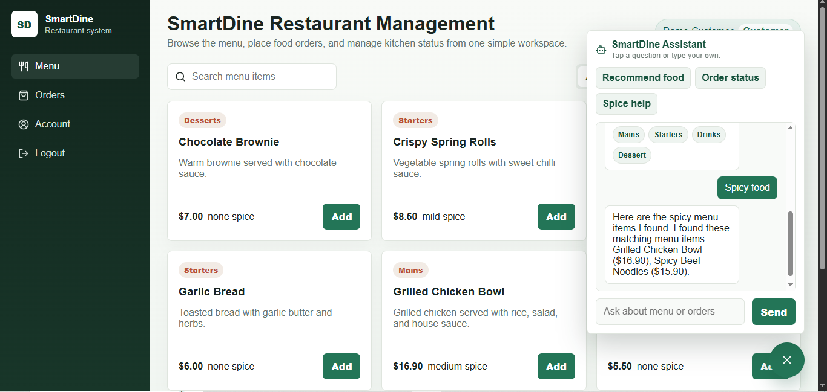
SmartDine Assistant
A focused rule-based assistant supports restaurant questions.
- Not a general chatbot.
- Answers within the SmartDine workflow.
- Asks taste preferences before recommending food.
- Helps with spice levels, ordering steps, and order status.
SmartDine | 9
Notes:
SmartDine Assistant is a rule-based assistant. It is not a general chatbot and does not use an external AI service. It answers questions inside the restaurant workflow, such as menu recommendations, spice levels, ordering steps, and order status. For recommendations, it can ask about the user's taste preference before suggesting food.

Slide 10
Database Design
The database supports users, menu data, orders, and assistant rules.
Users
Orders
Order items
Menu items
>
>
>
Chatbot rules
Activity logs
Categories
The ERD connects customers, orders, menu records, assistant rules, and audit history.
SmartDine | 10
Notes:
The database design supports the main application features. Users are connected to orders, and each order is connected to order items. Order items link the order to selected menu items. Categories help organise menu items for browsing and filtering. Activity logs record important actions such as login, menu updates, and order changes.

Slide 11
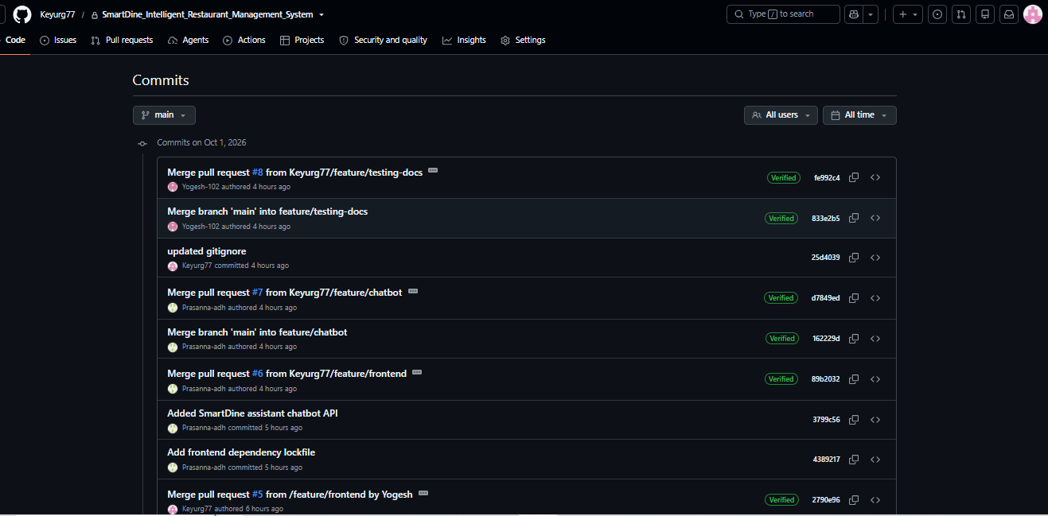
Testing and Evidence
The final system was checked through the main demo workflows.
- Customer login and order placement were tested.
- Invalid login feedback was checked.
- Admin restrictions and status updates were tested.
- GitHub branches, commits, and pull requests show collaboration.
SmartDine | 11
Notes:
For testing, we checked the main workflows that will be shown in the demo. This includes customer login, customer order placement, invalid login feedback, admin restrictions, and admin order status updates. We also kept GitHub evidence such as branches, commits, and pull requests to show team collaboration.

Slide 12
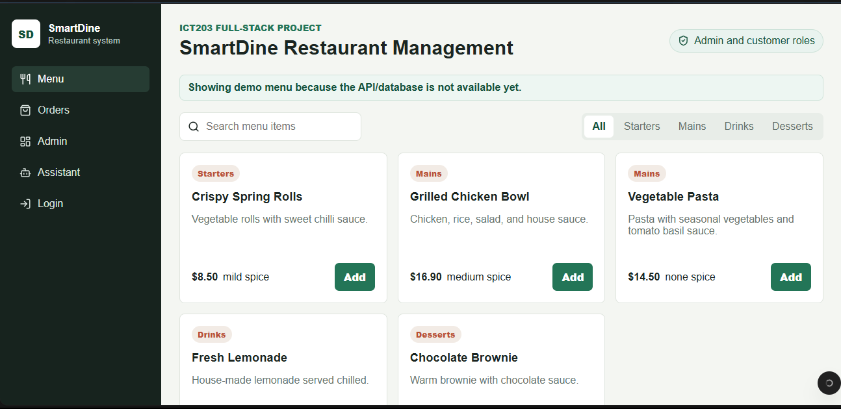
Deployment and Demo Plan
The finished system is available through public deployment links.
Netlify
Frontend
Render
Backend API
Aiven MySQL
Hosted database
>
>
Live demo flow: menu loading > customer order > admin update > chatbot support
SmartDine | 12
Notes:
For deployment, the frontend is hosted on Netlify, the backend API is hosted on Render, and the database is hosted on Aiven MySQL. In the live demo, we can show the menu loading from the database, a customer placing an order, an admin updating the order status, and the chatbot helping with menu questions.

