Slide 1
DESIGN AND ANALYSIS OF ALGORITHMS
Dijkstra’s
Algorithm
Find the shortest path — one smart choice at a time.
DAA · shortest paths · greedy strategy
Notes:
Today we will find a shortest route through a small city network. The main idea is simple: at every stage, choose the smallest known distance and use it to improve the remaining routes.

Slide 2
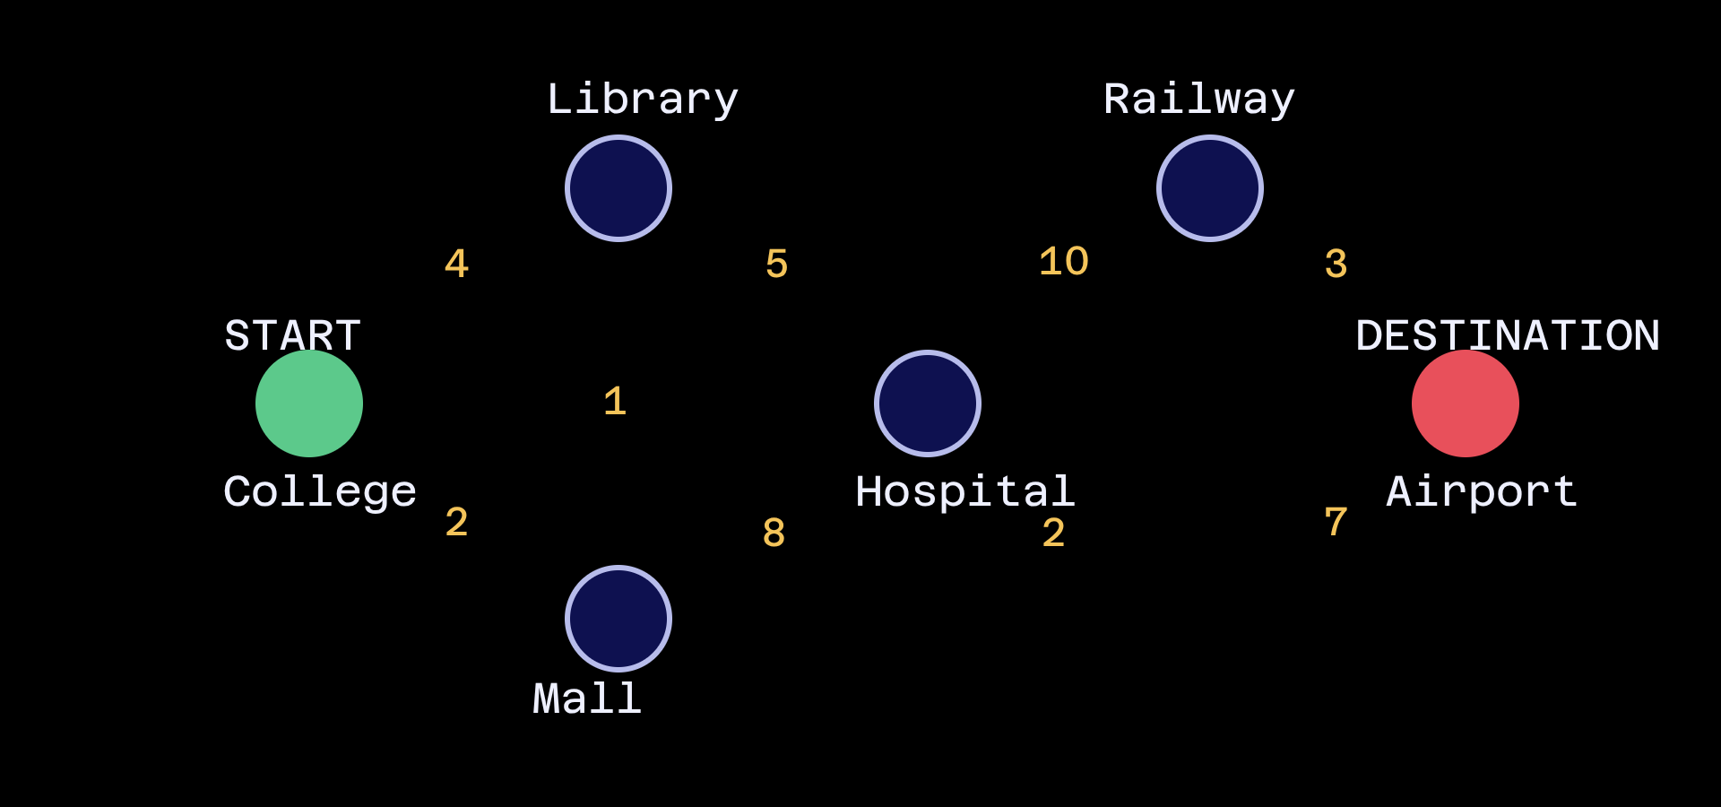
Which route is the shortest?
Start at College. Reach the Airport. Multiple roads, different distances, one shortest route.
ROAD DISTANCES · KM
10
College → Library · 4 km
College → Mall · 2 km
Mall → Library · 1 km
4
3
Start
5
2
1
7
Library → Hospital · 5 km
Mall → Hospital · 8 km
Library → Railway Station · 10 km
2
8
Destination
Hospital → Railway Station · 2 km
Railway Station → Airport · 3 km
Hospital → Airport · 7 km
Notes:
We begin with the same six locations throughout the example. The green node is our source, College, and the red node is our destination, Airport. The numbers are distances in kilometres, so each complete route has a total cost.

Slide 3
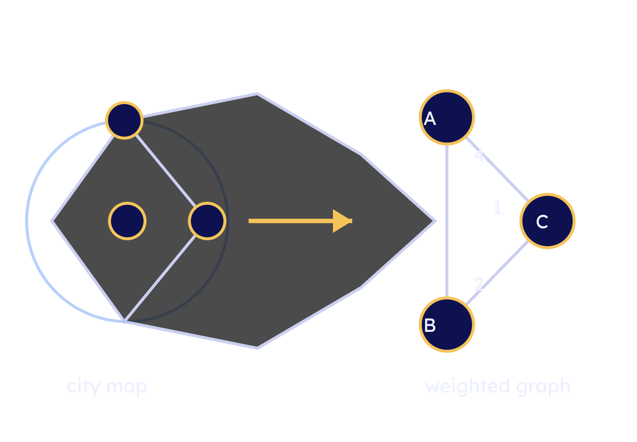

Turn the city into a weighted graph
THE MODEL
Nodes
B
Vertices: the places we can visit.
4
Roads
1
A
Edges: the connections between places.
2
C
Numbers
Weights: the distance on each edge.
Dijkstra is greedy and works when edge weights are non-negative.
01
02
03
04
05
Start
Explore
Select minimum
Update
Repeat
Notes:
Before applying the algorithm, we convert the city into a graph. Locations become vertices, roads become edges, and distances become weights. Dijkstra repeatedly explores this weighted graph by selecting the smallest temporary distance.

Slide 4
DISTANCE TABLE · INITIAL STATE
VERTEX | DISTANCE
College | 0 km
Library | ∞
Mall | ∞
Hospital | ∞
Railway Station | ∞
Airport | ∞
Step 1: Initialize distances
Start at College. Set the source to 0 and every other vertex to infinity.
Only the source has a known cost.
Notes:
We start with a distance table. College is the source, so its distance is zero. Every other location is unknown, represented by infinity. These values are temporary until the algorithm discovers better routes.

Slide 5
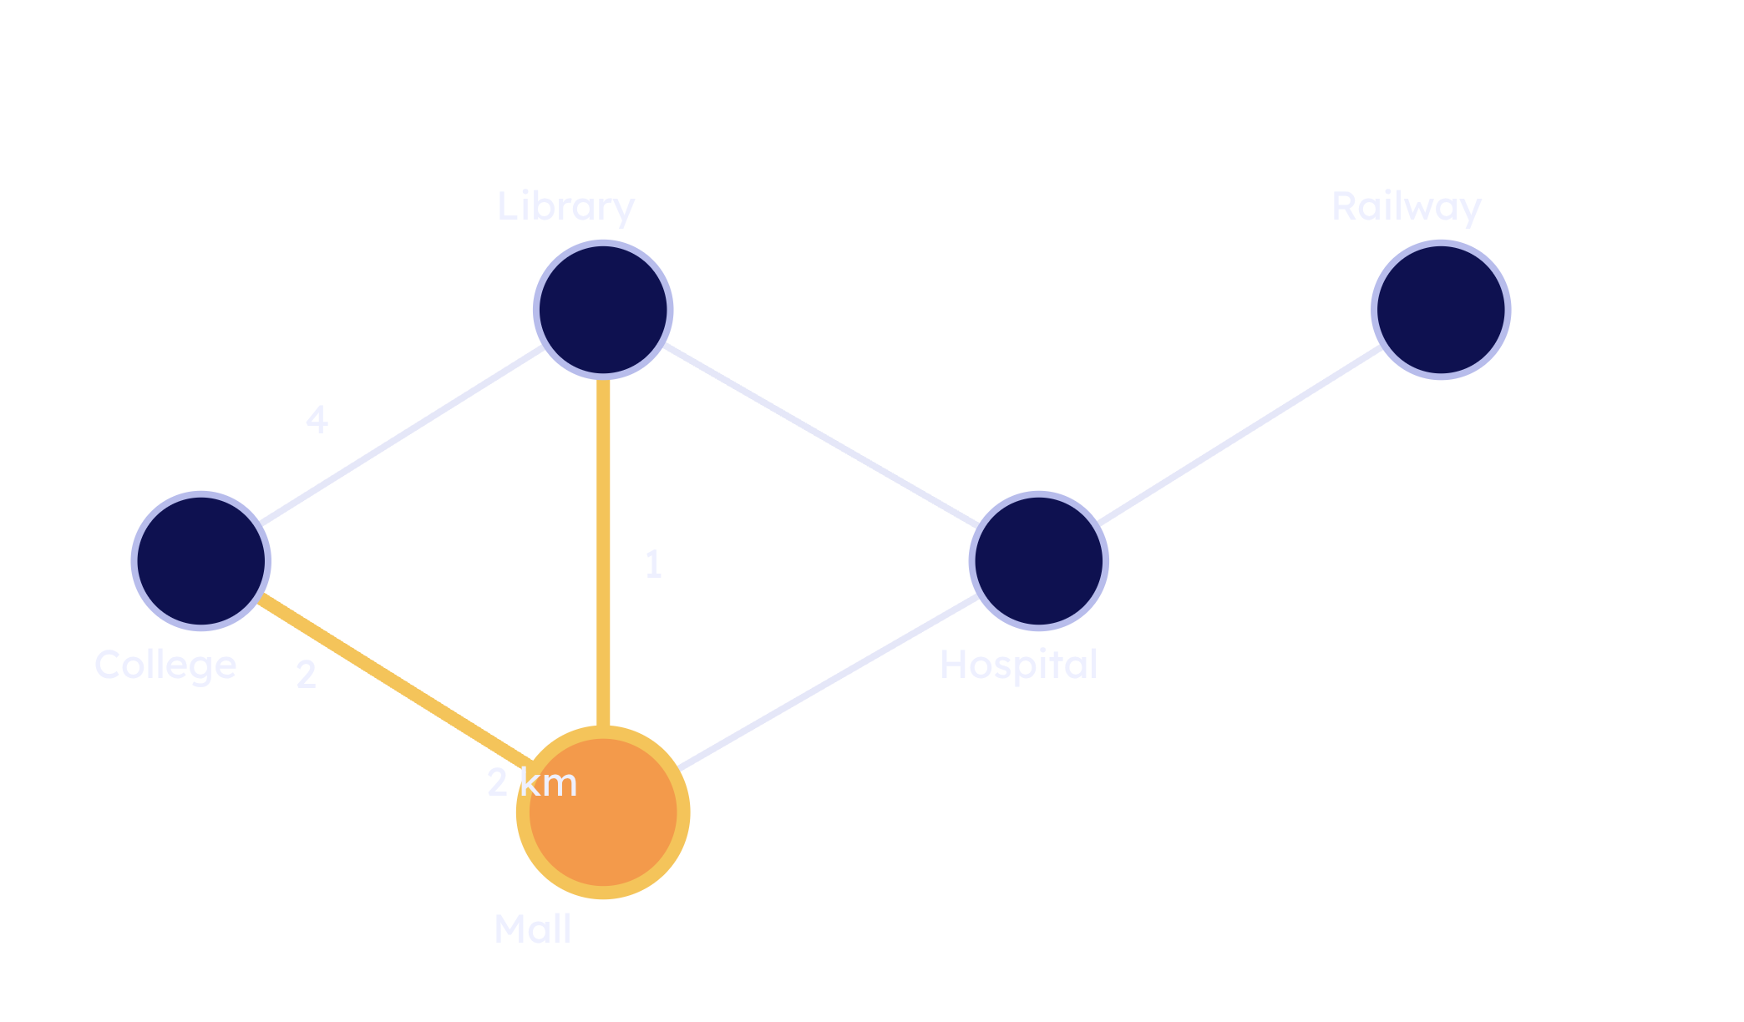
STEP 2 · SELECT THE MINIMUM
Step 2: Choose the smallest distance
From College:
Library
4
Mall
2
Choose Mall.
Then test Mall → Library:
2 km
Mall
2 + 1 = 3
Mall is the smallest known distance: 2 km.
Library: 4 ✕ → 3 ✓
Notes:
From College we can reach Library in four kilometres or Mall in two. Dijkstra chooses Mall because two is smaller. From Mall, the route to Library becomes two plus one, which is three. That improves Library’s temporary value from four to three.

Slide 6
CURRENT DISTANCES
Step 3: Update the neighbours
College
0
Library is now the closest unvisited vertex at 3 km.
Mall
2
TO HOSPITAL
Library
3
3 + 5 = 8
Hospital
8
TO RAILWAY STATION
3 + 10 = 13
Railway Station
13
Hospital = 8 is the next smallest choice.
Airport
∞
Notes:
Library is now the closest unvisited vertex, at three kilometres. We inspect its neighbours. Hospital gets a possible distance of eight, and Railway Station gets thirteen. The smallest unvisited value is Hospital at eight, so that becomes our next choice.

Slide 7
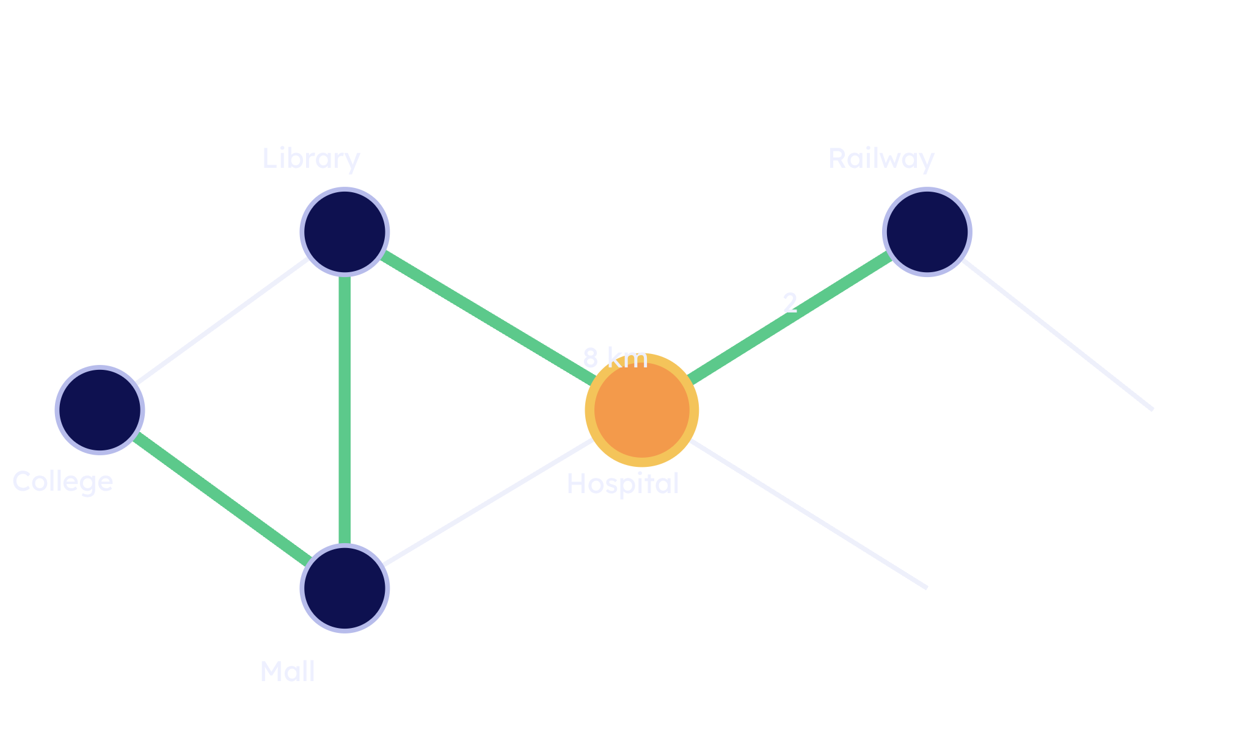
STEP 4 · IMPROVE THE ROUTE
Step 4: Find an even shorter route
Hospital = 8 km.
Hospital → Railway Station = 2 km.
8 + 2 = 10
Railway Station: 13 ✕ → 10 ✓
The new route reaches Railway Station in 10 km.
College → Mall → Library → Hospital → Railway Station
Notes:
At Hospital, we test the route to Railway Station. The old temporary value was thirteen. Going through Hospital costs eight plus two, or ten, so we replace thirteen with ten. The green route shows the path discovered so far.

Slide 8
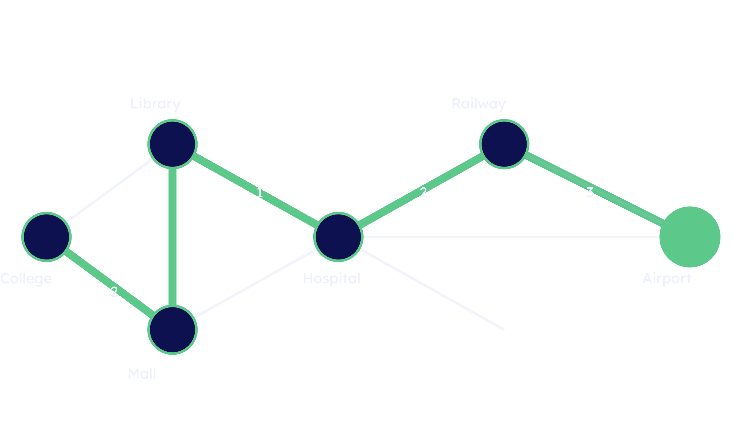
STEP 5 · DESTINATION REACHED
Step 5: Reach the Airport
Railway Station → Airport = 3 km.
10 + 3 = 13 km
13 km
SHORTEST DISTANCE
College → Mall → Library → Hospital → Railway Station → Airport
Other roads fade because they are not part of the final path.
2 + 1 + 5 + 2 + 3 = 13 km
Notes:
Finally, Railway Station connects to Airport with three more kilometres. Ten plus three gives thirteen. The complete shortest path is now visible, while the unused roads fade into the background.

Slide 9
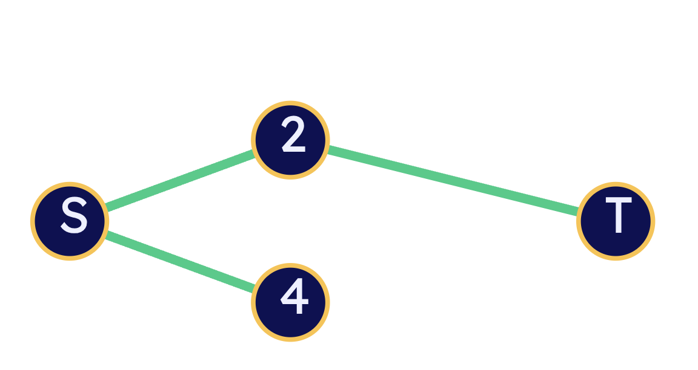
THE GREEDY IDEA
Dijkstra in 7 simple steps
Always choose the smallest known distance.
01
Start from source
02
Set source = 0
LIMITATION
Negative edge weights need Bellman–Ford.
03
Set others = ∞
04
Select minimum unvisited vertex
05
Update neighbour distances
06
Mark vertex as visited
07
Repeat
Notes:
This is the full algorithm in seven actions. Set the source to zero, set all other distances to infinity, then repeatedly select the smallest unvisited vertex and update its neighbours. The greedy choice is safe here because the edge weights are non-negative. For negative weights, we need Bellman–Ford.

Slide 10
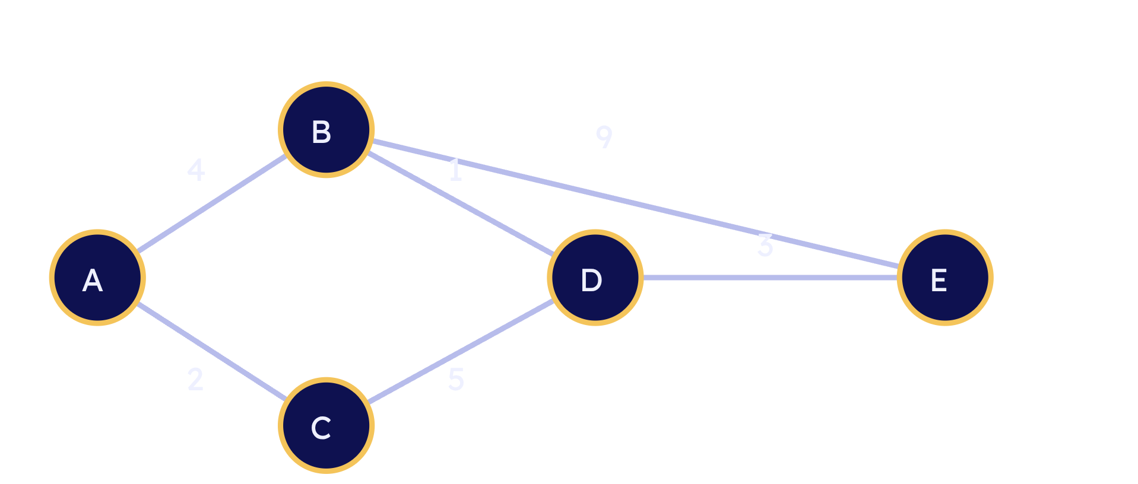
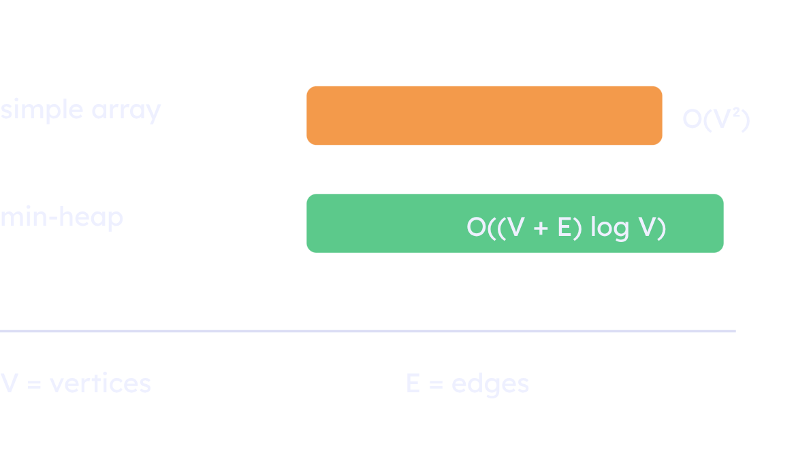


Complexity + interactive challenge
CHALLENGE · NEW GRAPH
1
COMPLEXITY
3
$${O(V)}^{2}$$
$$\text{O}\text{((}\text{V}\text{ + }\text{E} \text{)}log{V}$$
What is the shortest path from A to E?
A → B → D → E = 8
Priority queue / min-heap is useful for larger sparse graphs.
“That’s exactly what Dijkstra’s Algorithm does — one smart choice at a time.”
Notes:
The simple array implementation takes O(V²). With a priority queue or min-heap, the complexity becomes O((V + E) log V). Now try a separate five-node graph from A to E. Count down, choose the smallest temporary distance at each stage, and reveal the shortest path: A to B to D to E, with total cost eight.

