Slide 2
Binary-to-text Encoding
Encoding is designed to carry data stored in binary formats across channels that only reliably support text content
The purpose of encoding is to transform data so that it can be properly (and safely) consumed by a different type of system, e.g.
binary data being sent over the response of an API calling,
viewing special characters on a debug console or unit test function.
is not to keep information secret, but rather to ensure that it’s able to be properly consumed.
Encoding transforms data into another format using a scheme that is publicly available so that it can easily be reversed. It does not require a key as the only thing required to decode it is the algorithm that was used to encode it.

Slide 3
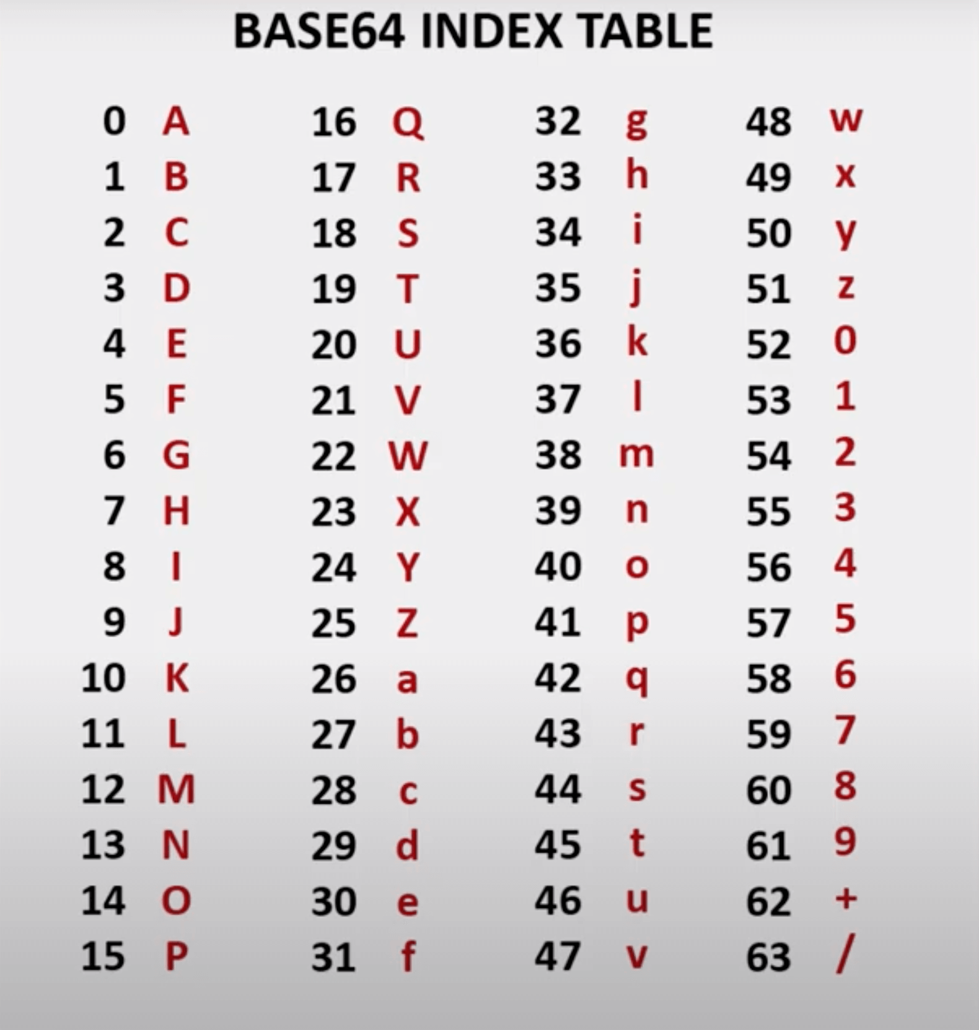
Base64 Encoding - Algorithm
Input byte array : 0xFF 0xE2
To binary form : 1111 1111 1110 0010
Split to 6 bits groups : 111111 111110 0010
Pad the last group (if needs) : 111111 111110 001000
Convert each 6 bits group : / + I
Pad the result (if needs) : / + I =

