Slide 1

P220-Patient's Condition Classification Using Drug Reviews
Group No-04
CHANDRA SEKHAR MANGA.
PRIYA AVADUTHA.
PRUDHVI GOLLAPALLI.
KALYANI FULPAGARE.
SHRIHA REDDIGARI.
AZAD AHMAD.
HARITHA PANDUGAYALA
Mentor By:
NATARAJAN SIR

Slide 2
Business Objective:
This is a sample dataset which consists of 161297 drug name, condition
reviews and ratings from different patients and our goal is to examine how
patients are feeling using the drugs their positive and negative experiences so
that we can recommend him a suitable drug. By analyzing the reviews, we can
understand the drug effectiveness and its side effects.
The dataset provides patient reviews on specific drugs along with related
conditions and a 10 star patient rating reflecting overall patient satisfaction.
So in this dataset, we can see many patients conditions but we will focus only on
the below, classify the below conditions from the patients reviews
a. Depression
c. High Blood Pressure
d. Diabetes, Type 2

Slide 3


Agenda
Patients conditions
Depression
High blood pressure
Diabetes, type 2

Slide 4
Attribute Information:
1. Drug Name (categorical): name of drug
2. condition (categorical): name of condition
3. review (text): patient review
4. rating (numerical): 10 star patient rating
5. date (date): date of review entry
6. useful Count (numerical): number of users who found review useful

Slide 5
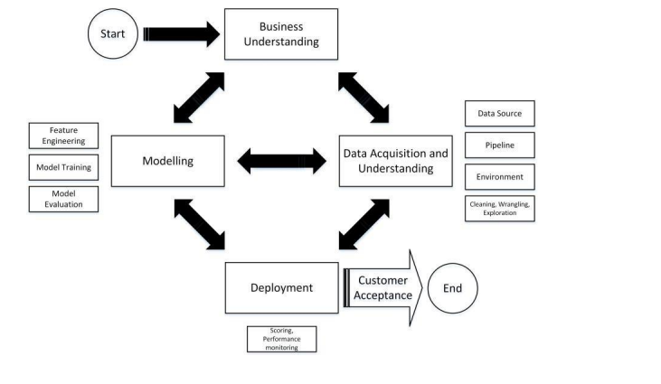
Project Architecture / Project Flow

Slide 6
Exploratory Data Analysis (EDA) and Feature Engineering

Slide 7
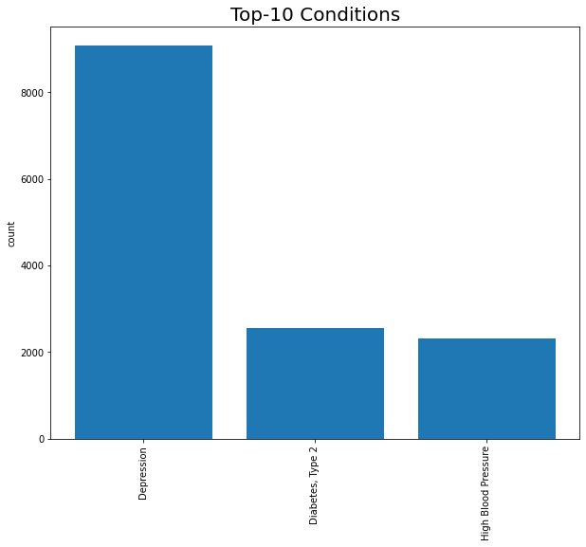
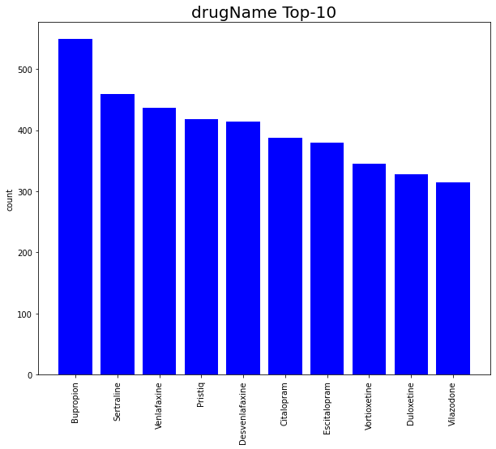
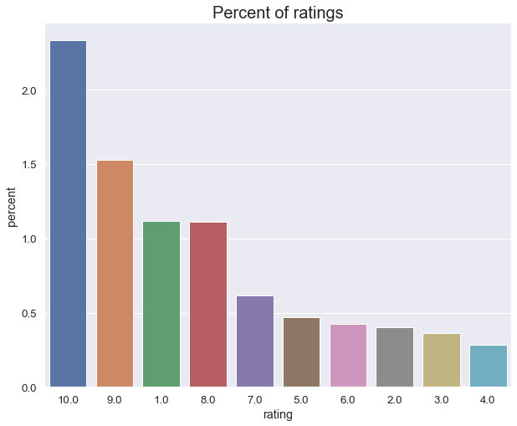
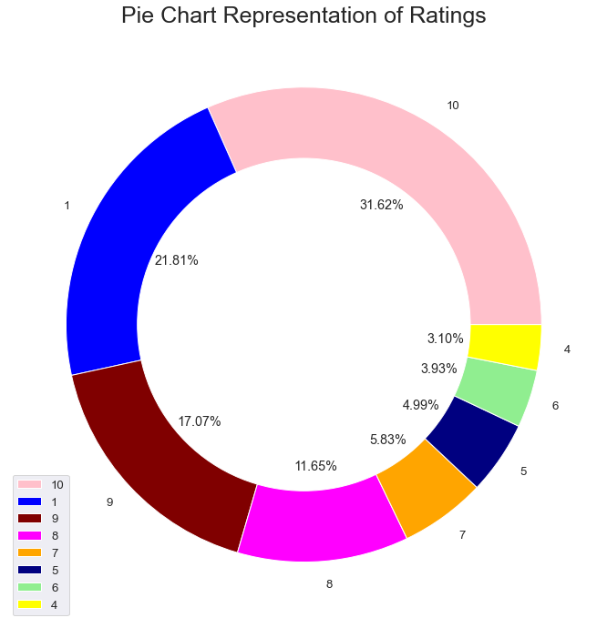
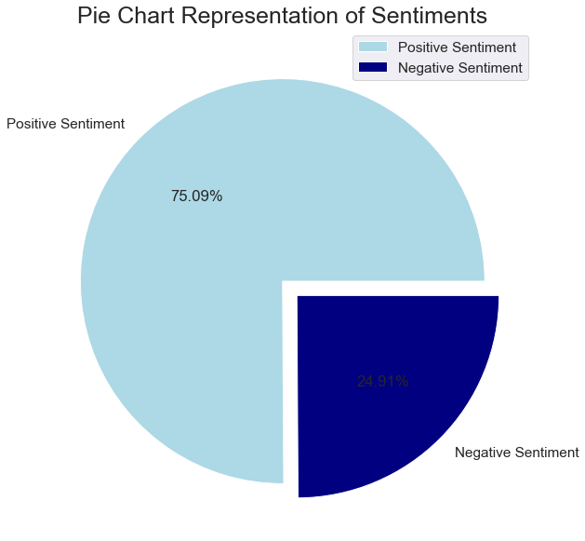

Slide 8
The train-test split procedure is used to estimate the performance of machine learning algorithms when they are used to make predictions on data not used to train the model. The train-test split procedure is appropriate when you have a very large dataset, a costly model to train, or require a good estimate of model performance quickly. So we divided the data for training data into 88% and test data into 12%
SPLITTING THE DATA

Slide 9
Naïve Bayes Classifier:
Naïve Bayes Classifier is one of the simple and most effective Classification algorithms which helps in building the fast machine learning models that can make quick predictions. it is a supervised learning algorithm, which is based on Bayes theorem and used for solving classification problems.is a supervised learning algorithm, which is based on Bayes theorem and used for solving classification problems.
we got the values of
Accuracy = 0.7225143403441683
Precision = 0.8253457703441621
Recall = 0.8059045226130653
F1_Score = 0.8155092960432226

Slide 10
Decision Tree
Decision Tree is a Supervised learning technique that can be used for both classification and Regression problems, but mostly it is preferred for solving Classification problems. It is a tree-structured classifier, where internal nodes represent the features of a dataset, branches represent the decision rules and each leaf node represents the outcome.
we got the values of
Accuracy = 0.8016252390057361
Precision = 0.8645866838211643
Recall = 0.8679367129480142
F1_Score = 0.8662584595552691

Slide 11
Random Forest
The random forest technique can also handle big data with numerous variables running into thousands. It can automatically balance data sets when a class is more infrequent than other classes in the data.
we got the values of
Accuracy = 0.8506214149139579
Precision = 0.9543261498874236
Recall = 0.86
F1_Score = 0.9047110840067083

Slide 12
Passive Aggressive Classifier:
The passive aggressive classifier is a machine learning algorithm that is used for classification tasks. This algorithm is a modification of the standard Perceptron algorithm.
we got the values of
Accuracy = 0.3482313575525813

Slide 13
Support Vector Machine:
Support Vector Machine or SVM is one of the most popular Supervised Learning algorithms, which is used for Classification as well as Regression problems. However, primarily, it is used for Classification problems in Machine Learning.
we got the values of
Accuracy = 0.3482313575525813

Slide 14
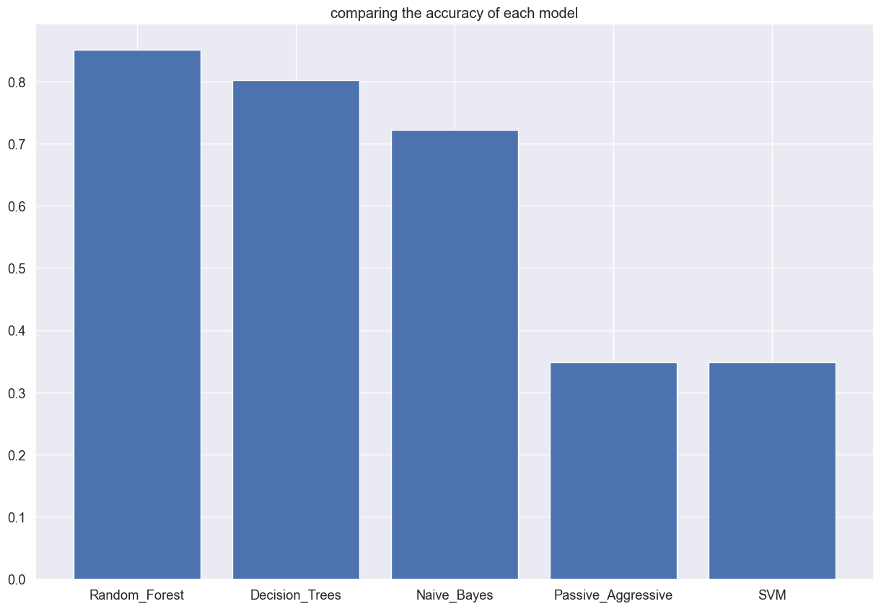
CONCLUSION CHART :

Slide 15
By comparing Accuracy values of all algorithms, we can say that Random Forest model performs well in prediction as its Accuracy value is very less than that of other models. Also from the above graphs, we can clearly see that Random Forest identifies the future trend correctly.

Slide 16


Thank you…

