Slide 1
Alethea: A Reinforcement Learning Model
11 June 2019 Update

Slide 2
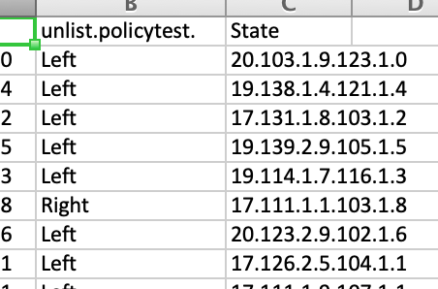

Slide 3
