Slide 1
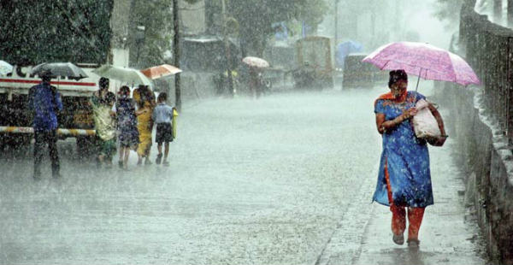
Will it Rain/ Snow Tomorrow?
A Logisitic Regression
Kathleen Gatliffe-Lee Panter-Leo Zhang
University of Colorado at Denver
MATH 6388 Professor Audrey Hendricks
Notes:
Lee

Slide 2

How far in advance can we successfully predict precipitation (yes/no) for the following day?
Notes:
Lee

Slide 3
The Data Set
Hourly readings from Denver International Airport taken between 1 September 2013 and 31 August 2018
Variables recorded include: temperature, pressure, humidity, wind speed and direction, precipitation accumulation, cloud cover and course and fine categorical descriptions.
Notes:
Lee

Slide 4
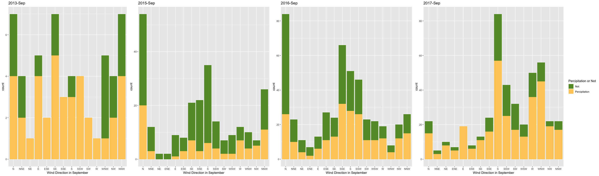

Slide 5
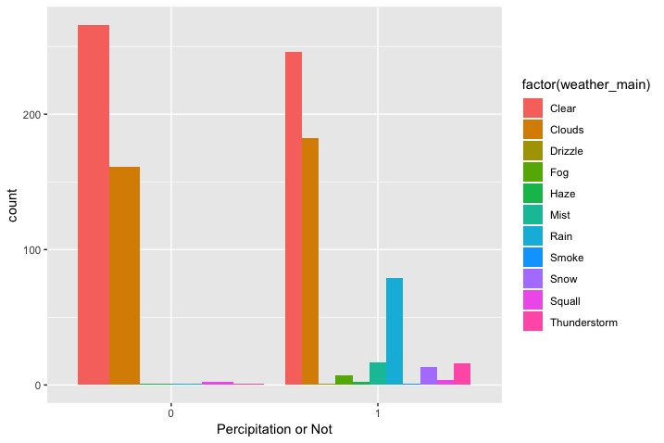

Slide 6
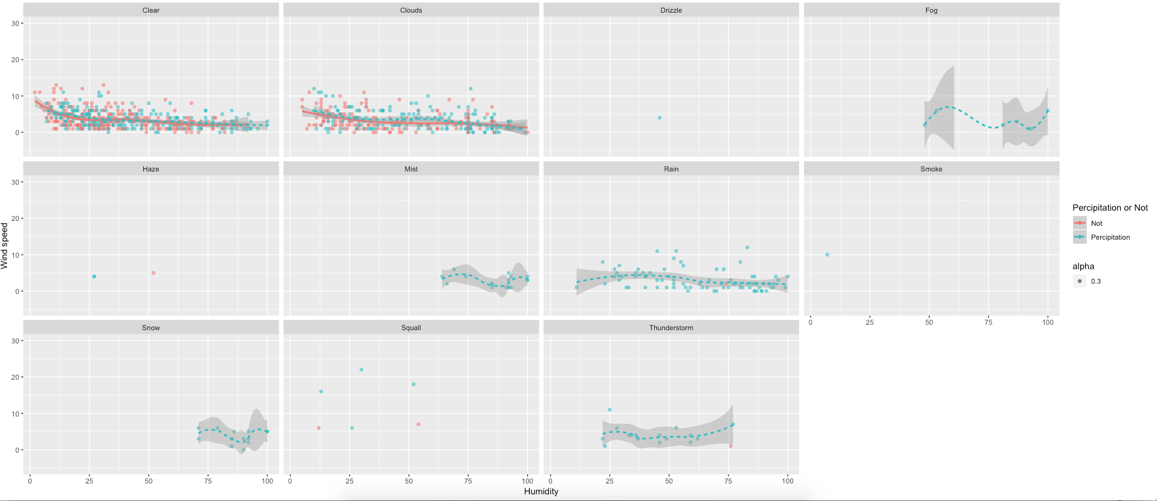

Slide 7
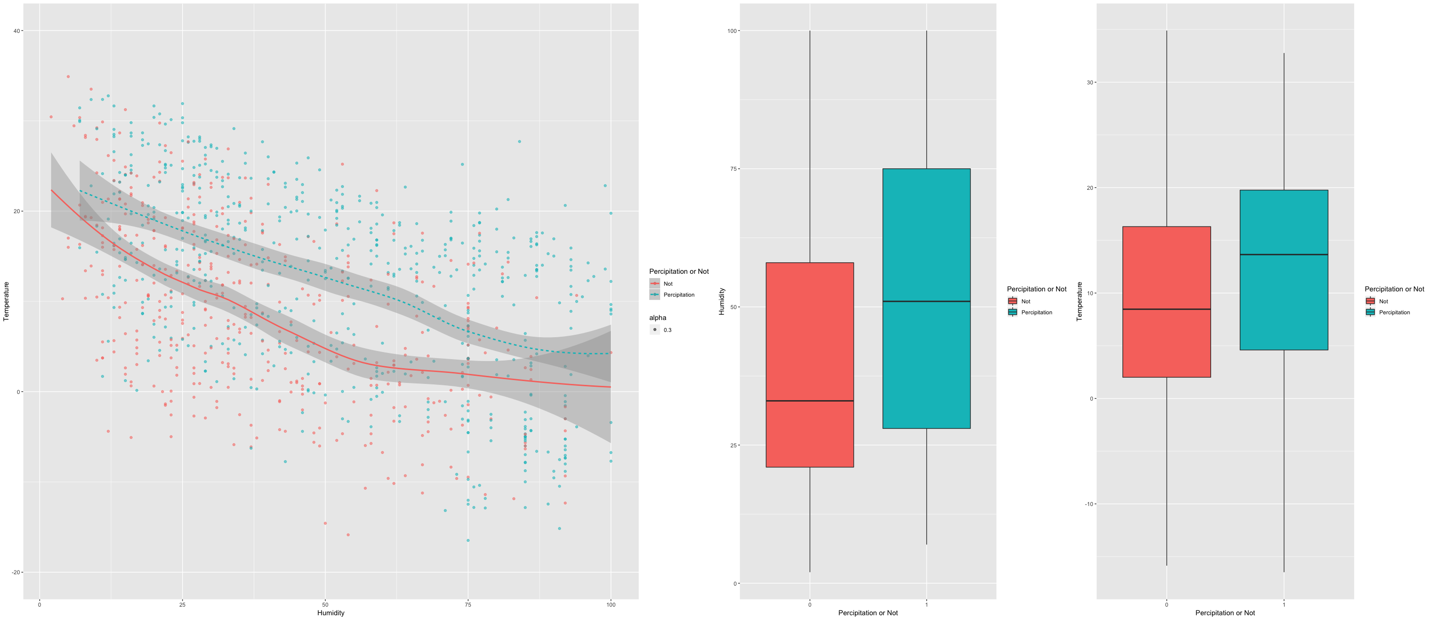

Slide 8
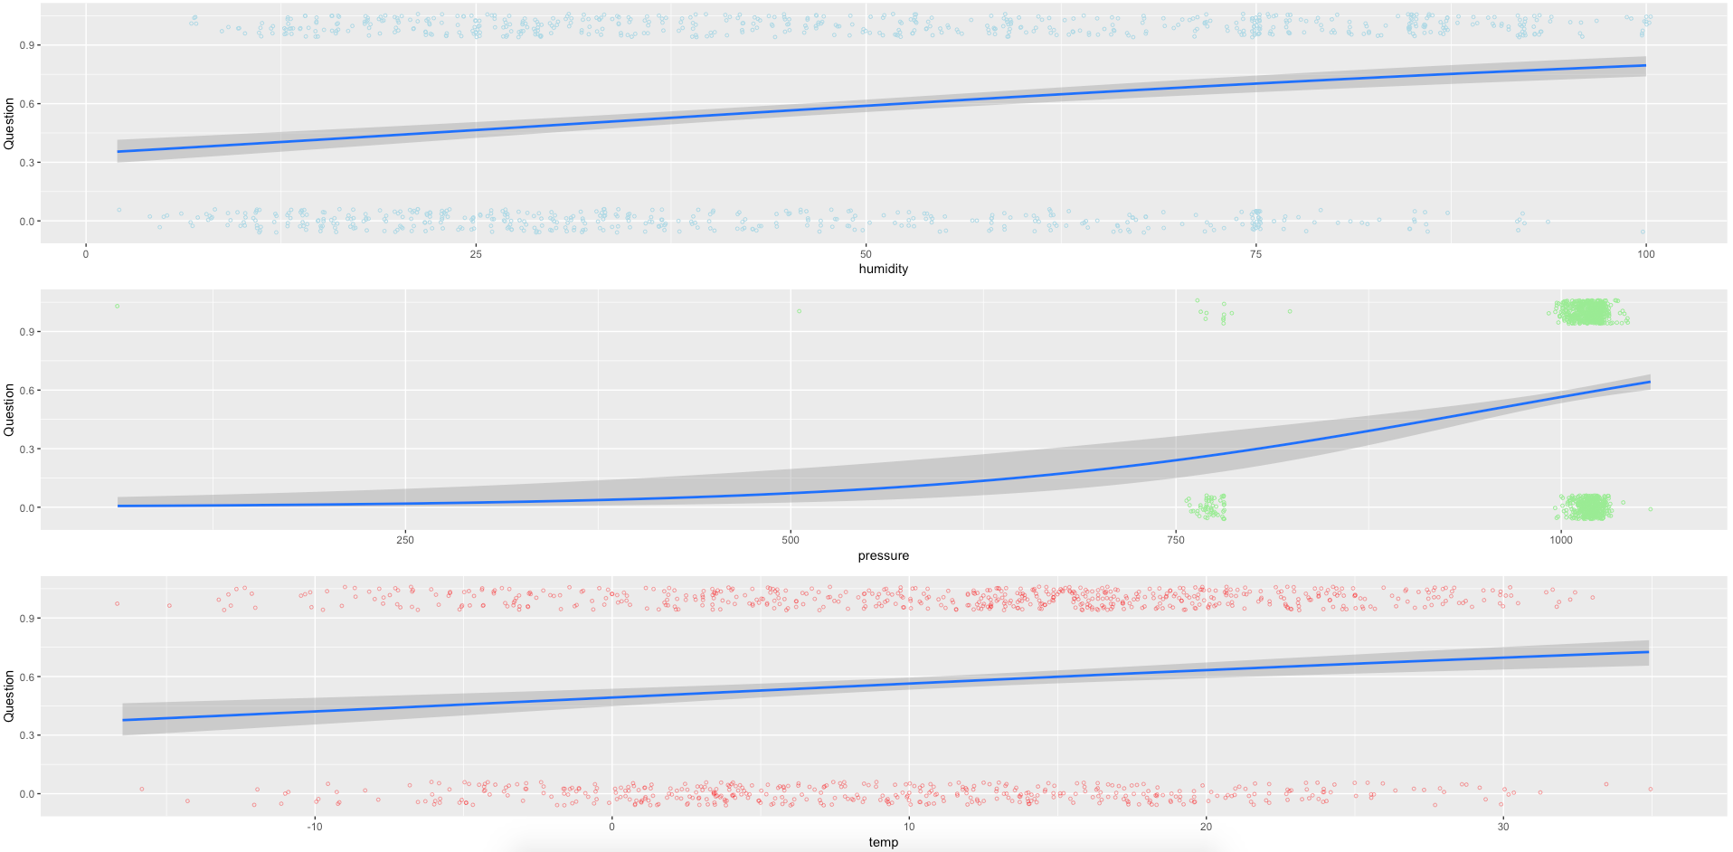

Slide 9

Data Cleaning
Interpolated missing x_{t} values where x_{t-1} and x_{t+1} are known.
Created variables for previous hourly readings at t₀-24, t₀-12, t₀-6, t₀-3, t₀-1
Conversion of wind direction from degrees to categorical variables (N, NNE, NE, ENE, E, etc.)
Converted temperature from Kelvin to Celsius
Created binary variables for no precipitation/ precipitation at all t
Created binary variable for precipitation in the next 24 hours for t₀
Remove all records with NAs.

Slide 10


Variables
x_{t} := temperature, pressure, humidity, wind speed, % cloud coverage, precipitation/no precipitation binary for all t.
Not used: wind direction, acculmulated precipitation (1 hr, 3 hr)
Linear rate of change between each previous reading and each current reading

Slide 11
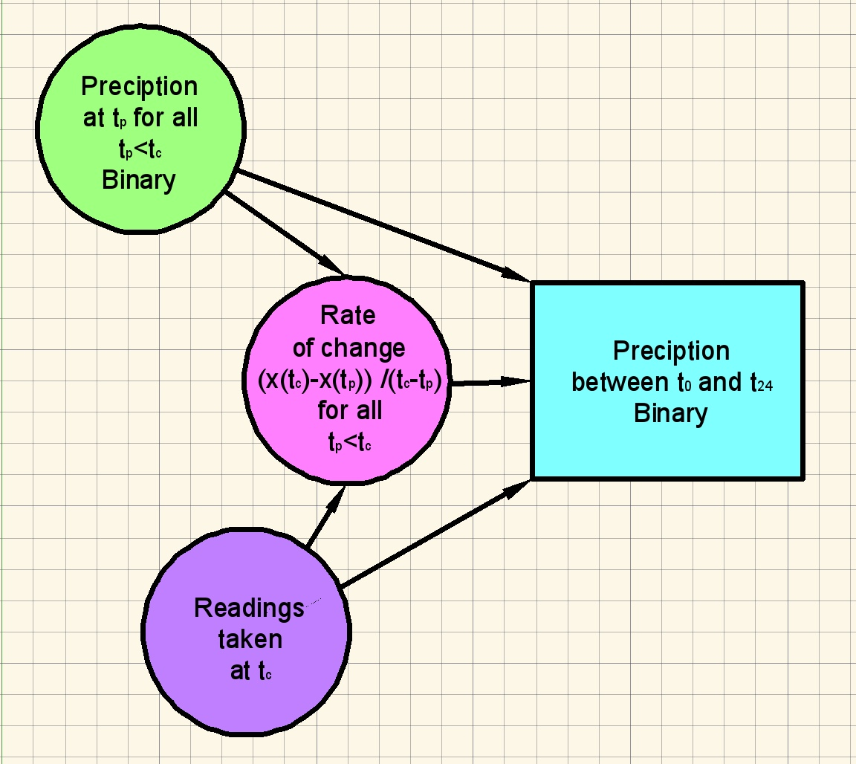
Basic Model

