Slide 1
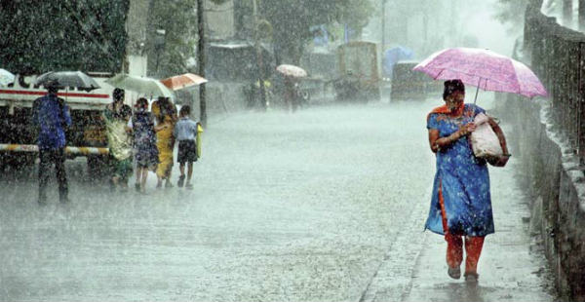
Will it Rain/ Snow Tomorrow?
A Logisitic Regression
Kathleen Gatliffe-Lee Panter-Leo Zhang
University of Colorado at Denver
MATH 6388 Professor Audrey Hendricks

