Slide 1
Assessing Model Accuracy-Further Selections
Randomly sampled training and test data sets defined on time-ordered data
Each model was tested against the training and test data for average accurate and inaccurate prediction rates
Average classification diagnostic accuracies were bounded by training accuracies, and were (generally) monotonically increasing in accuracy as the prediction range shrunk
Most average correct classification accuracies were bounded below by 0.50!

Slide 2
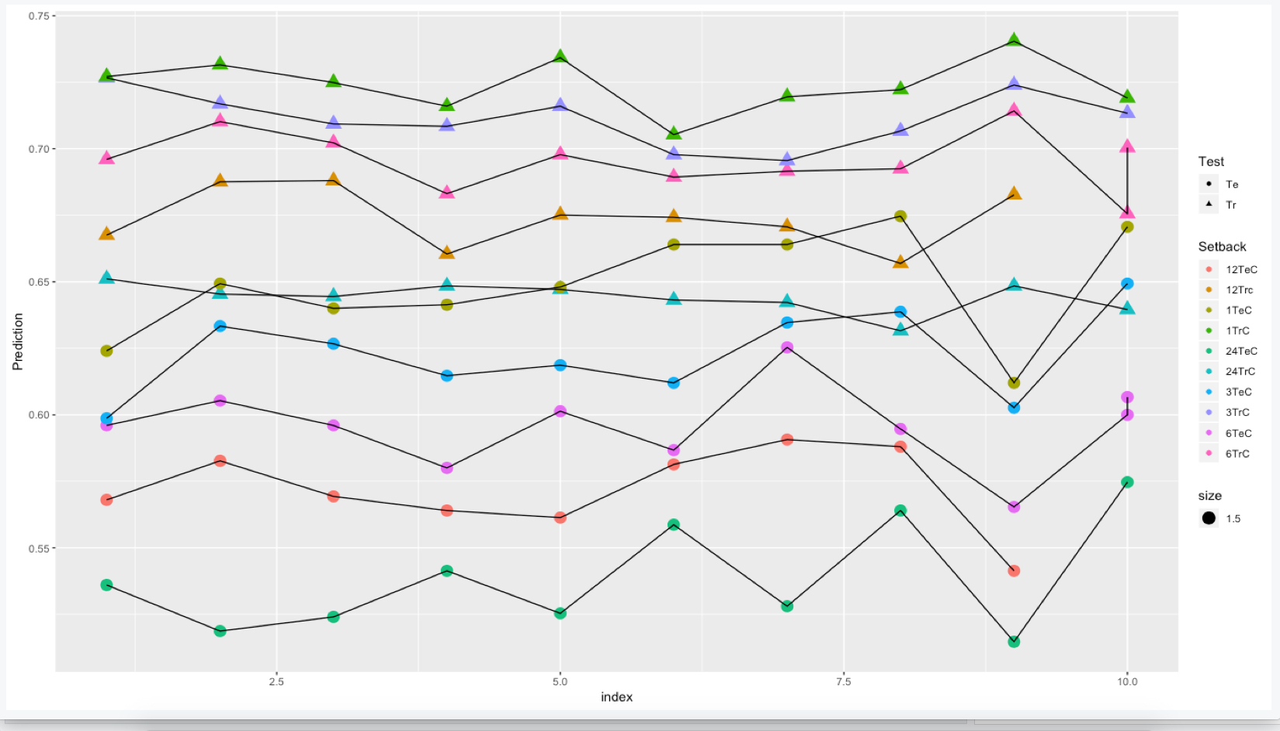
Classification Accuracy Over 10 Random Samples

Slide 3
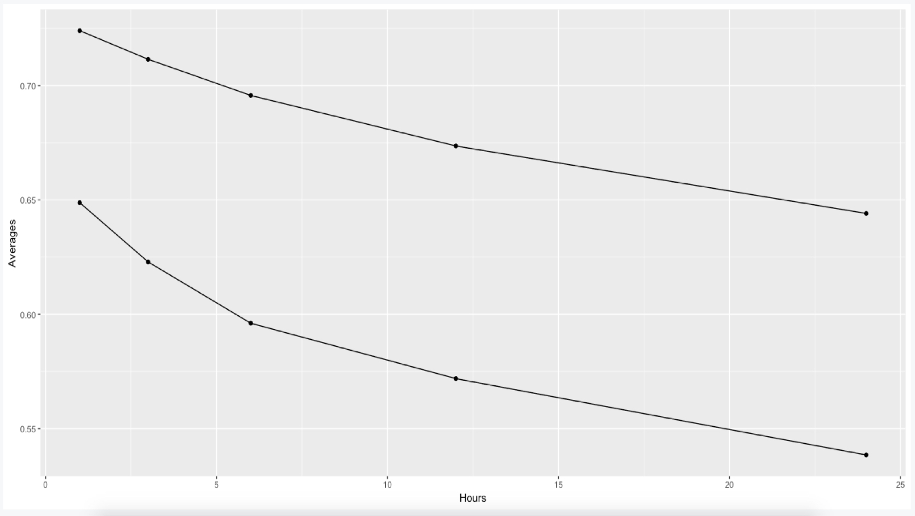
Average Classification Accuracy Over Random Samples

Slide 4
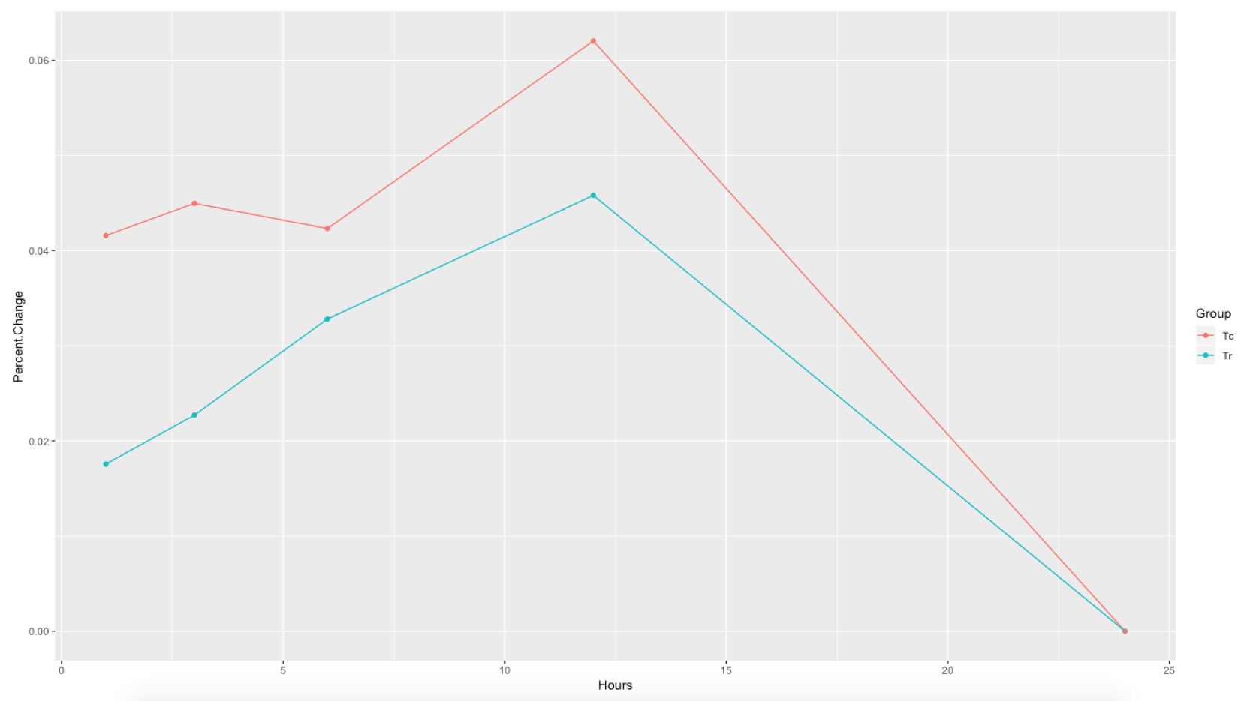
Percent Change in Classification Accuracy Over Time Change

