Slide 1
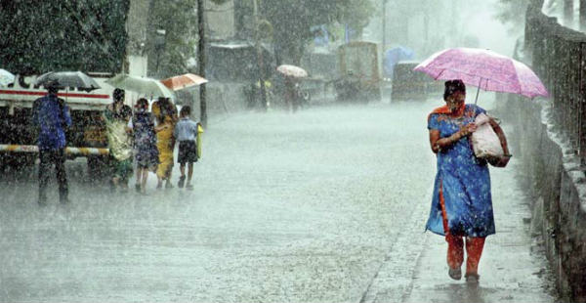
Will it Rain/ Snow Tomorrow?
A Logisitic Regression
Kathleen Gatliffe-Lee Panter-Leo Zhang
University of Colorado at Denver
MATH 6388 Professor Audrey Hendricks
Notes:
Lee

Slide 2

How far in advance can we successfully predict precipitation (yes/no) for the following day?
Notes:
Lee

Slide 3
The Data Set
Hourly readings from Denver International Airport taken between 1 September 2013 and 31 August 2018
Variables recorded include: temperature, pressure, humidity, wind speed and direction, precipitation accumulation, cloud cover and course and fine categorical descriptions.
Notes:
Lee

Slide 7
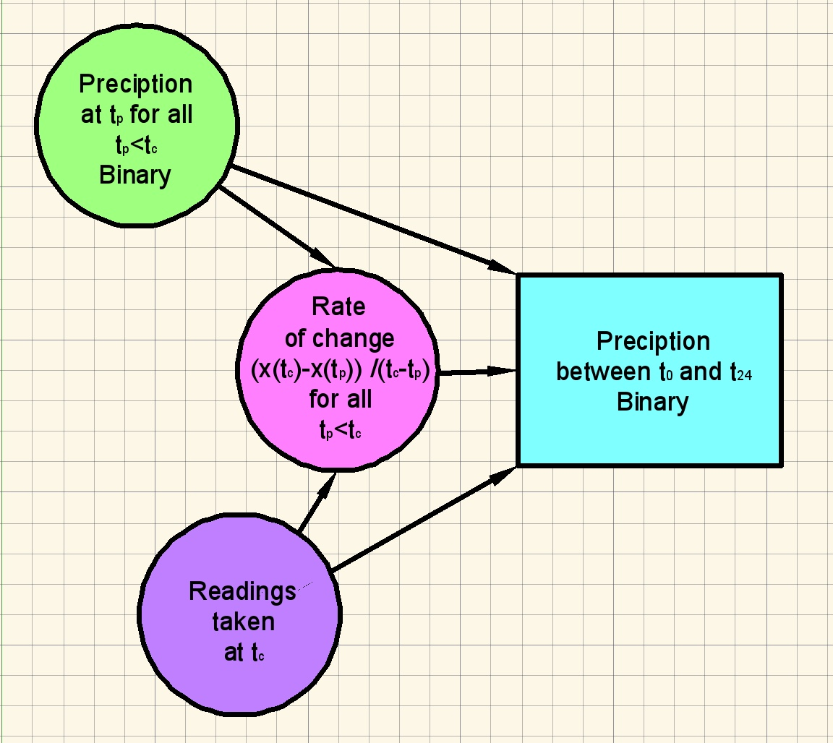
Basic Model

