Slide 1
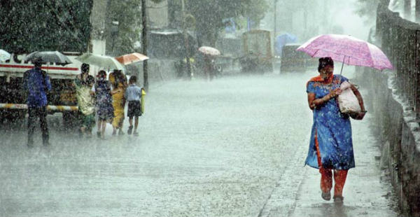
Will it Rain/ Snow Tomorrow?
A Logisitic Regression
Leo Dingxuan-Kathleen Gatliffe-Lee Panter
University of Colorado at Denver
MATH 6388 Professor Audrey Hendricks
Notes:
Lee

Slide 2

How far in advance can we successfully predict precipitation (yes/no) for the following day?
Notes:
Lee

Slide 3
The Data Set
Hourly readings from Denver International Airport taken between 1 September 2013 and 31 August 2018
Variables recorded include: temperature, pressure, humidity, wind speed and direction, precipitation accumulation, cloud cover and course and fine categorical descriptions.
Notes:
Lee

Slide 4
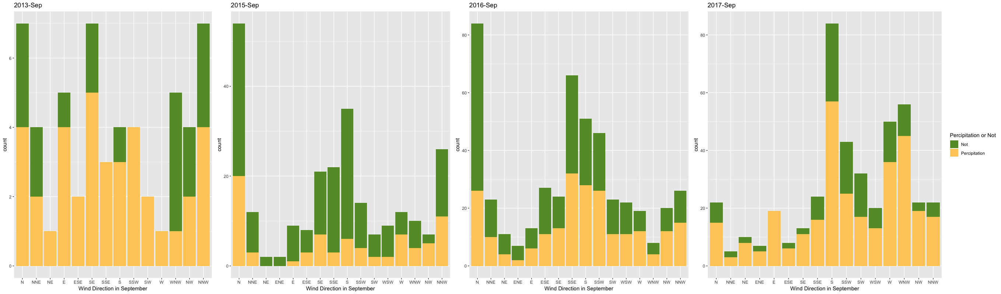

Slide 5
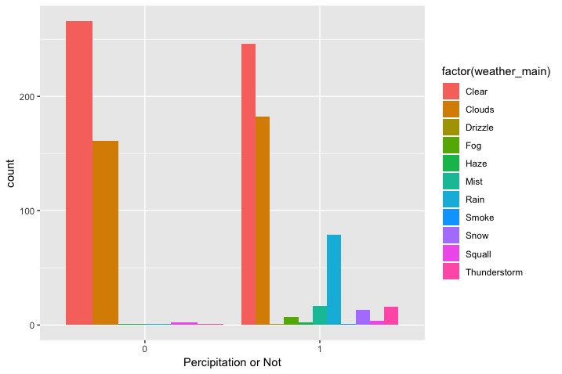

Slide 6
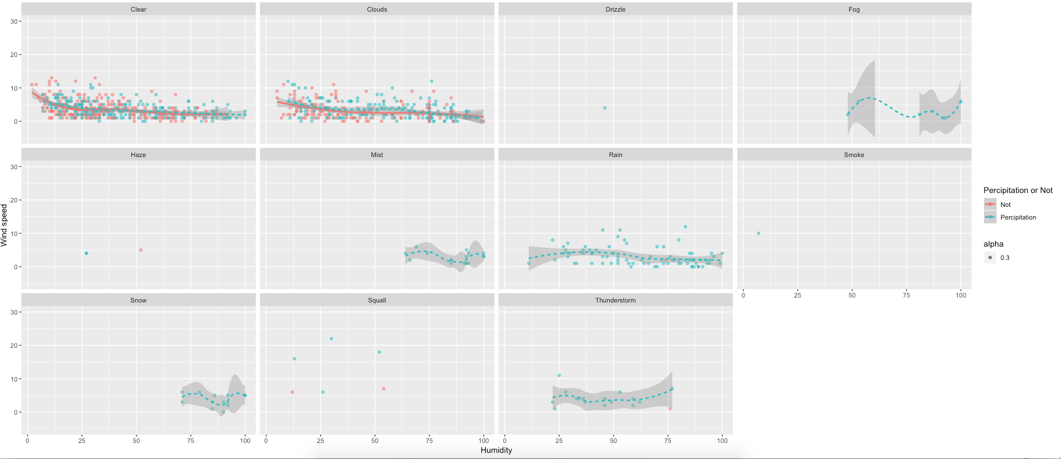

Slide 7
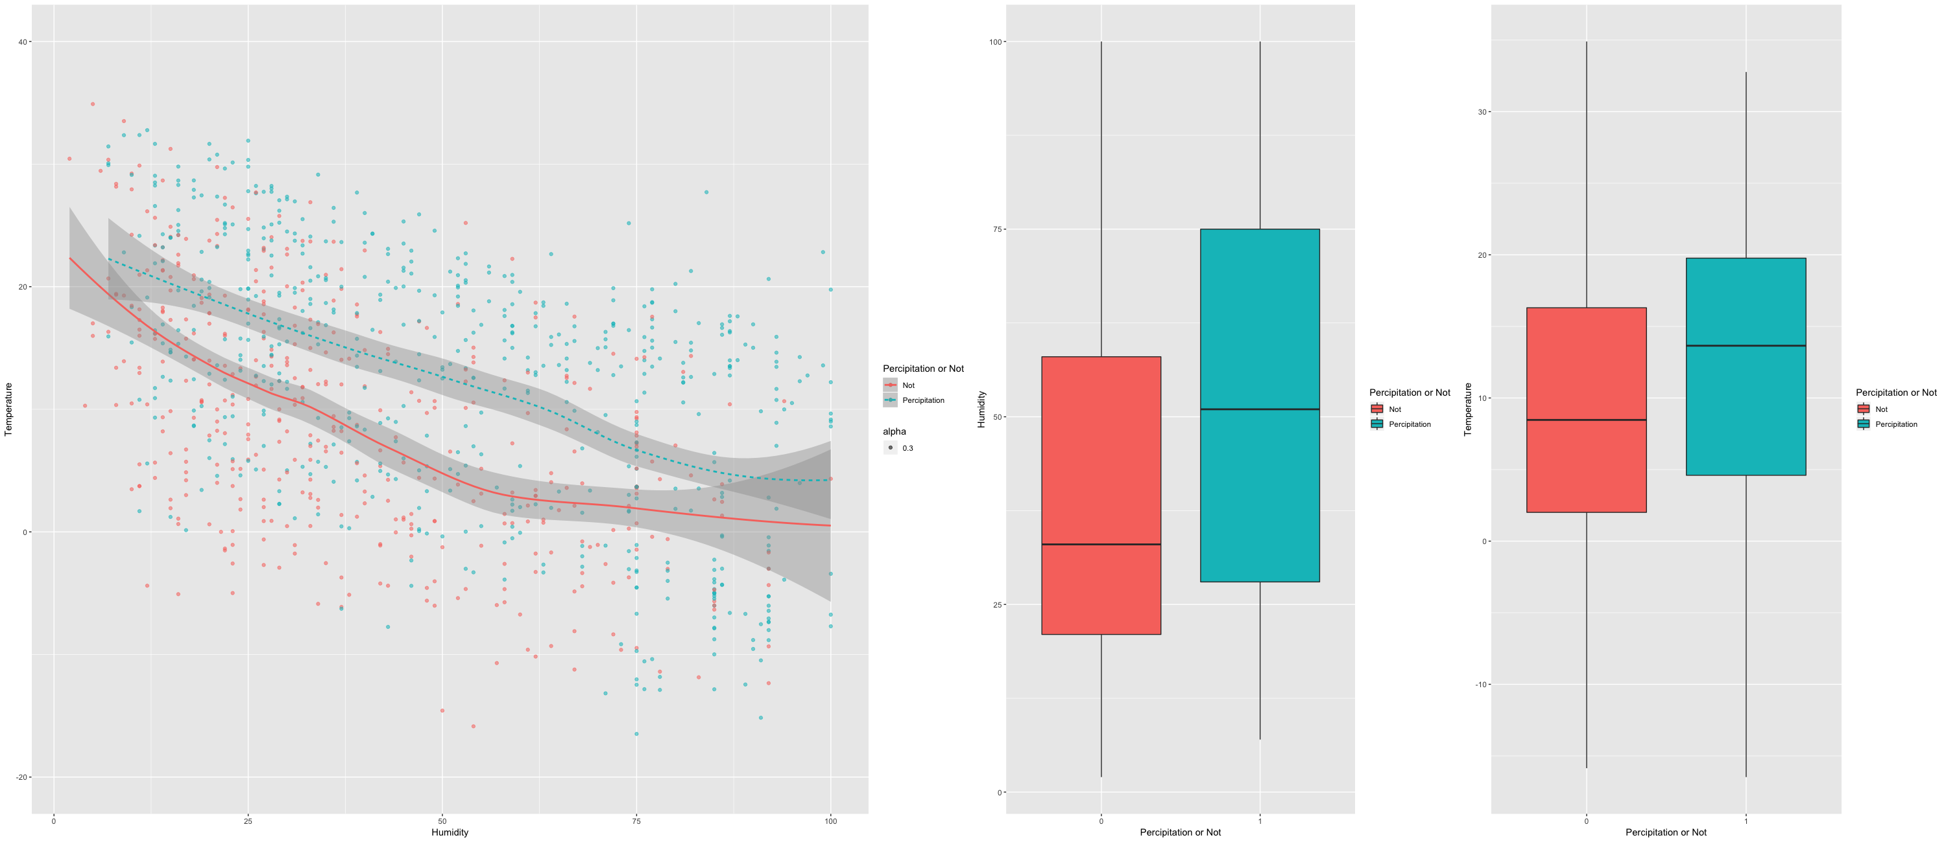

Slide 8
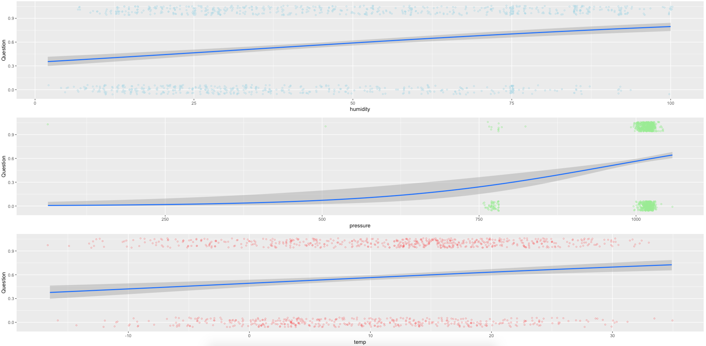

Slide 9

Data Cleaning
Interpolated missing x_{t} values where x_{t-1} and x_{t+1} are known.
Created variables for previous hourly readings at t₀-24, t₀-12, t₀-6, t₀-3, t₀-1
Conversion of wind direction from degrees to categorical variables (N, NNE, NE, ENE, E, etc.)
Converted temperature from Kelvin to Celsius
Created binary variables for no precipitation/ precipitation at all t
Created binary variable for precipitation in the next 24 hours for t₀
Remove all records with NAs.

Slide 10


Variables
x_{t} := temperature, pressure, humidity, wind speed, % cloud coverage, precipitation/no precipitation binary for all t.
Not used: wind direction, acculmulated precipitation (1 hr, 3 hr)
Linear rate of change between each previous reading and each current reading

Slide 11
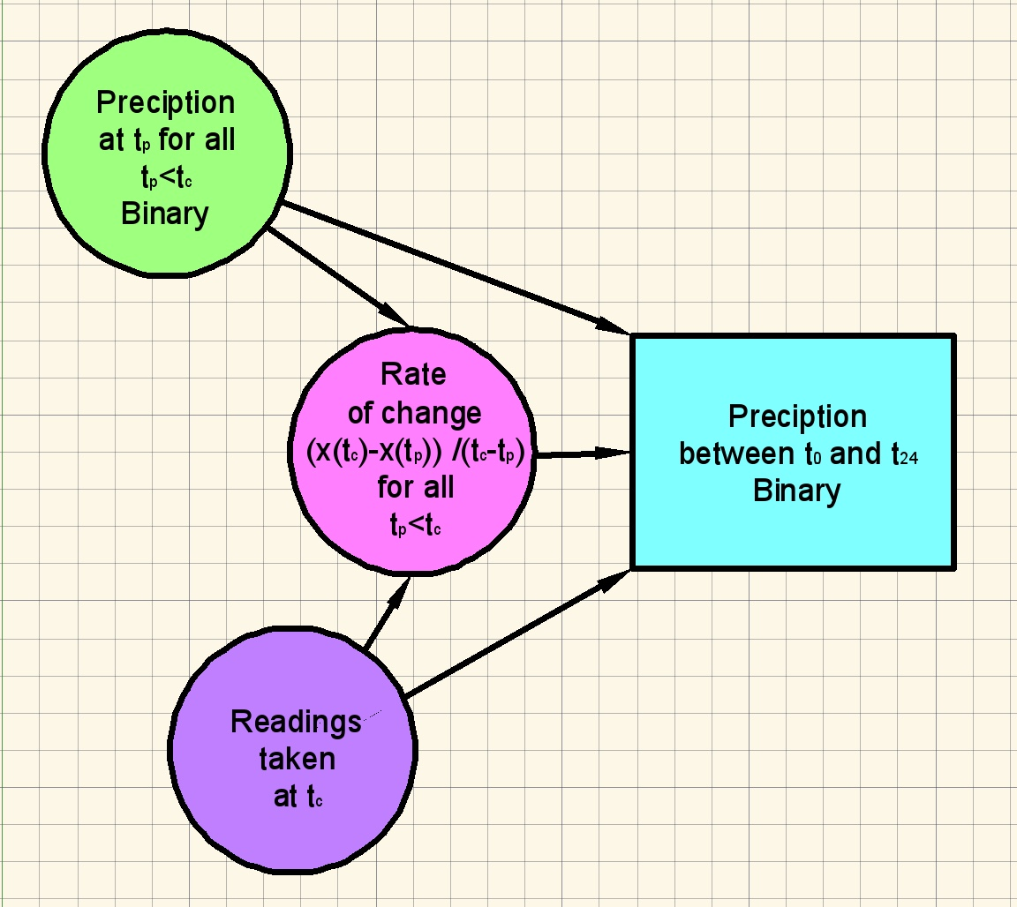
Basic Model

Slide 12
Assessing Model Accuracy-Further Selections
Randomly sampled training and test data sets defined on time-ordered data
Each model was tested against the training and test data for average accurate and inaccurate prediction rates
Average classification diagnostic accuracies were bounded by training accuracies, and were (generally) monotonically increasing in accuracy as the prediction range shrunk
Most average correct classification accuracies were bounded below by 0.50!

Slide 13
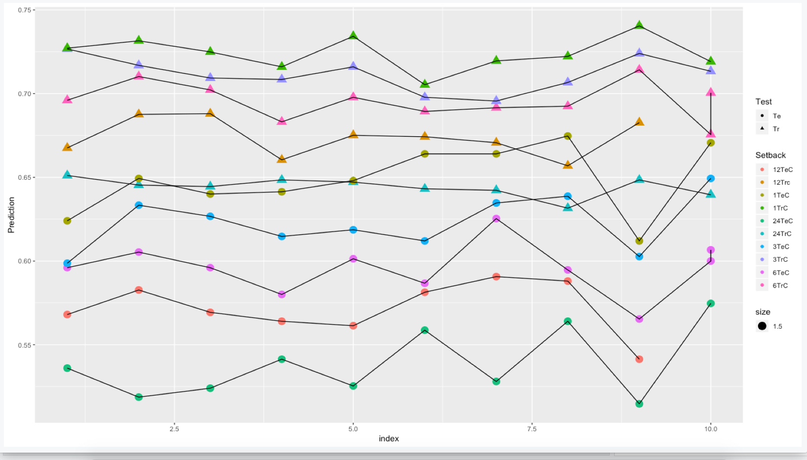
Classification Accuracy Over 10 Random Samples

Slide 14
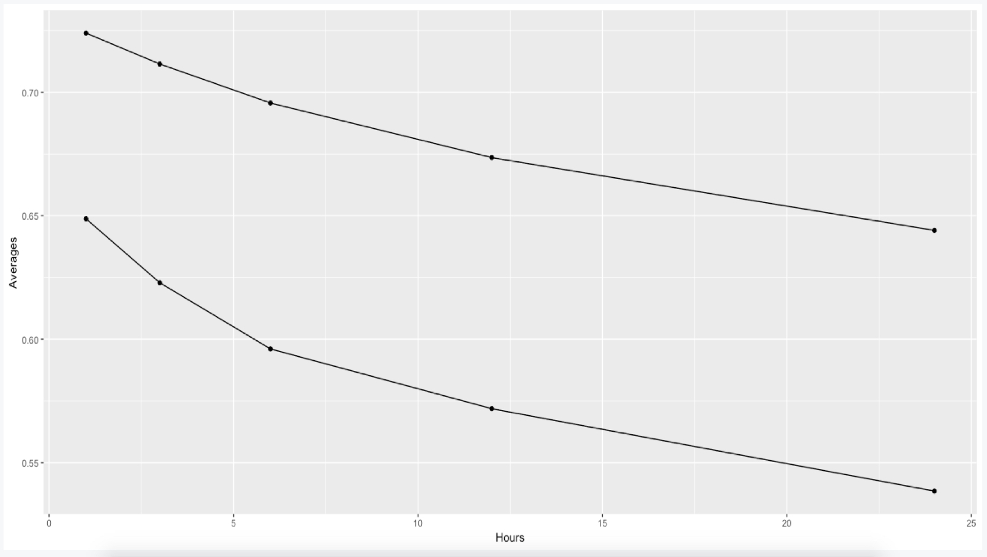
Average Classification Accuracy Over Random Samples

Slide 15
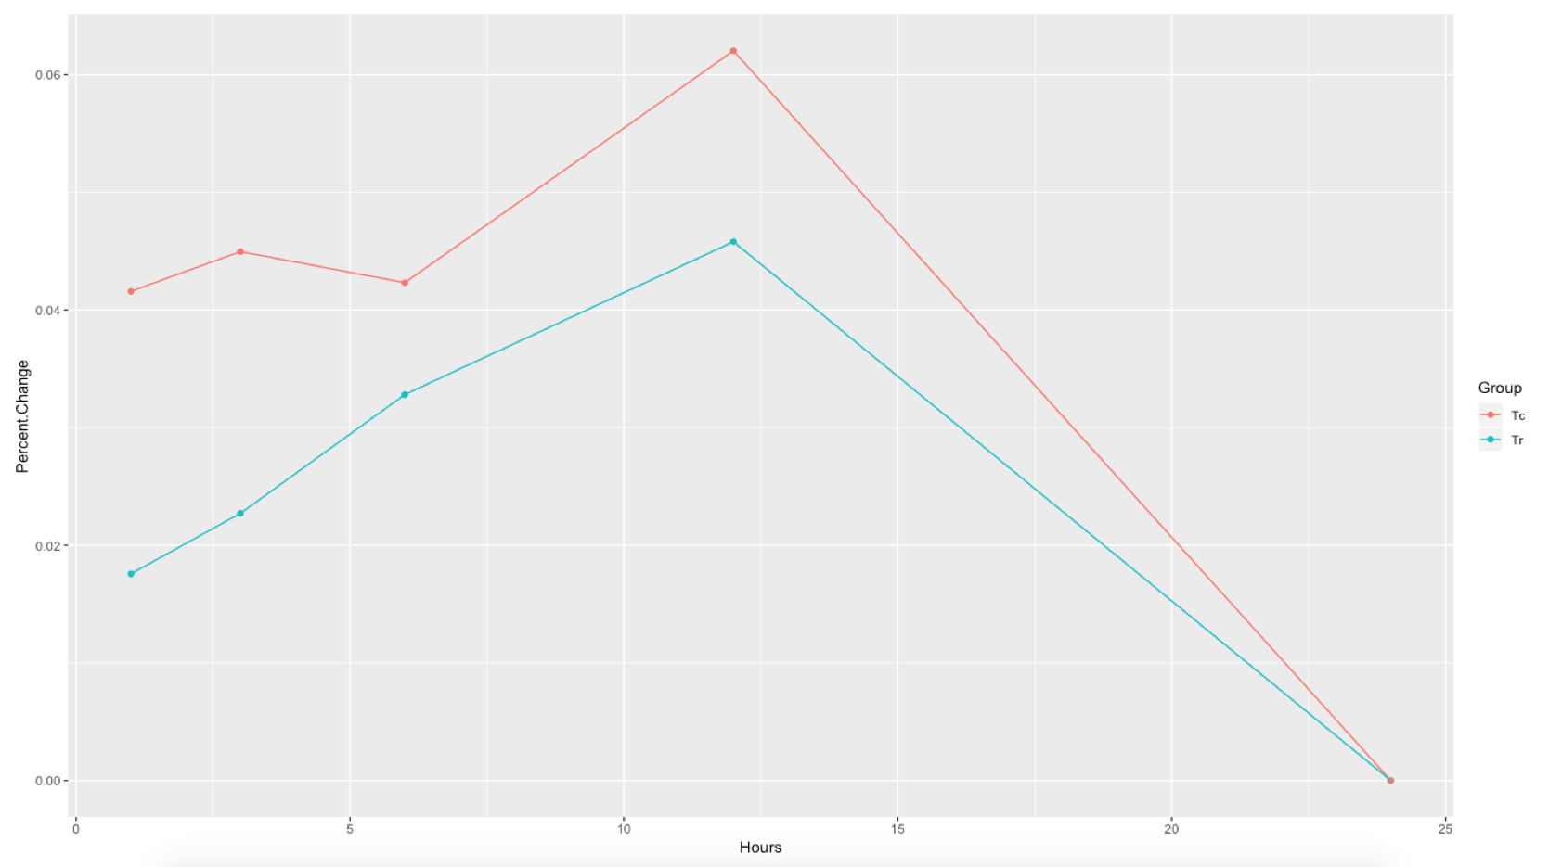
Percent Change in Classification Accuracy Over Time Change

