Slide 1


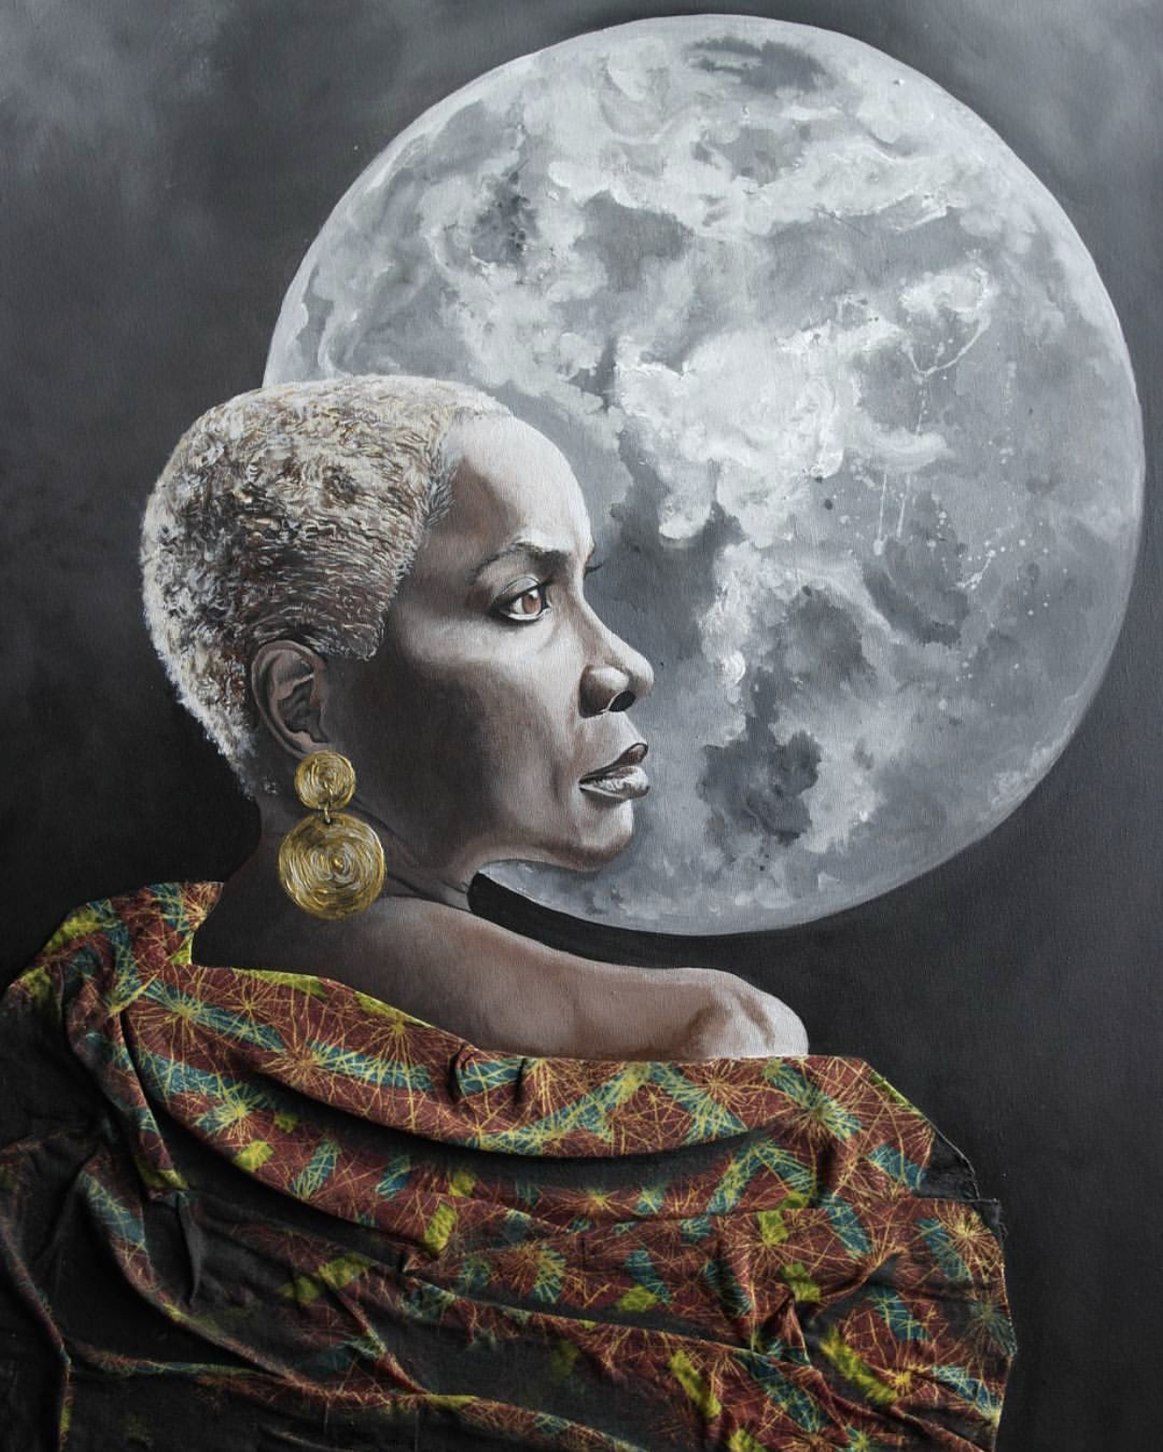

Slide 2
is opening up its doors
and walls to the visionaries. We are putting the spotlight on Curators
The 2020 exhibition calendar is open for proposals
Submissions

