Slide 1
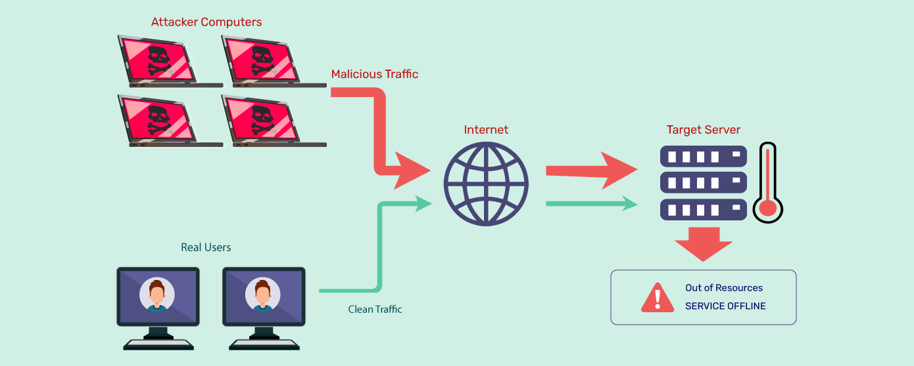
DoS Attack

Slide 2
Dos – Denial of Service attack
Hozefa Dhankot
MG23017
Jagdish Rajai
MG23019

Slide 3
Dos – Denial of service attack
Dos Stands For Denial Of Service Attack.
A Denial-of-service (Dos) Attack Is A Cyber Attack That Prevents Legitimate Users From Accessing Information Systems, Devices, Or Network Resources. Dos Attacks Can Be Malicious Or Caused By Systems Being Overloaded.
Dos Attacks Typically Function By Flooding A Targeted Machine With Requests Until Normal Traffic Is Unable To Be Processed, Resulting In Denial-of-service .

Slide 4
Dos – Denial of Service attack
There are 2 types of attacks:-
1) DoS attack
Denial of service attack
2)DDoS attack
Distributed denial of service attack

Slide 5
Dos – Denial of Service attack
Difference between a DDoS attack and a DOS attack
The distinguishing difference between DDoS and DoS is the number of connections utilized in the attack.
DoS utilizes a single connection, while a DDoS attack utilizes many sources of attack traffic, often in the form of a botnet. Generally speaking, many of the attacks are fundamentally similar and can be attempted using one more many sources of malicious traffic.

Slide 6
Dos – Denial of Service attack
Here are some ways DoS attacks can occur:
Flooding the target with traffic: The attacker sends several requests to the target server, overloading it with traffic.
Sending the target information that triggers a crash: The attacker sends information to the target that triggers a crash.
Buffer overflow attacks: This vulnerability can cause a machine to exhaust the capacity of available memory, hard disks, and CPU time

Slide 7
Dos – Denial of Service attack
DoS attacks can have many consequences for businesses, including:
Genuine users are not able to access resources
Businesses may not be able to carry out time critical actions
They may suffer reputational damage
Customers may choose to use a competitor

Slide 8
Dos – Denial of Service attack
Different Ways To Perform Dos Attack:
There Are Multiple Ways To Perform Denial Of Service Attack , here’s The List Of Mostly Used Methods
1) Ping Of Death
2) Buffer Overflow
3) SYN Attack

Slide 9
Dos – Denial of Service attack
PING
The ping command is usually used to test the availability of a network resource. It works by sending small data packets to the network resource. The ping of death takes advantage of this and sends data packets above the maximum limit (65,536 bytes) that TCP/IP allows. TCP/IP fragmentation breaks the packets into small chunks that are sent to the server. Since the sent data packages are larger than what the server can handle, the server can freeze, reboot, or crash.

Slide 10
Dos – Denial of Service attack
SYN
SYN is a short form for Synchronize. This type of attack takes advantage of the three-way handshake to establish communication using TCP. SYN attack works by flooding the victim with incomplete SYN messages. This causes the victim machine to allocate memory resources that are never used and deny access to legitimate users.

Slide 11
Dos – Denial of Service attack
Buffer Overflow
A buffer is a temporal storage location in RAM that is used to hold data so that the CPU can manipulate it before writing it back to the disc. Buffers have a size limit. This type of attack loads the buffer with more data that it can hold. This causes the buffer to overflow and corrupt the data it holds. An example of a buffer overflow is sending emails with file names that have 256 characters.

Slide 12


