Slide 1
EventHandling

Slide 2
What is an Event?
Change in the state of an object is known as event i.e. event describes the change in state of source. Events are generated as result of user interaction with the graphical user interface components.
For example, clicking on a button, moving the mouse, entering a character through keyboard, selecting an item from list, scrolling the page are the activities that causes an event to happen.

Slide 3
Types of Event
Foreground Events - Those events which require the direct interaction of user. For example, clicking on a button, moving the mouse, entering a character through keyboard,selecting an item from list, scrolling the page etc.
Background Events - Those events that require the interaction of end user are known as background events. Operating system interrupts, hardware or software failure, timer expires, an operation completion are the example of background events.

Slide 4
What is Event Handling?
Event Handling is the mechanism that controls the event and decides what should happen if an event occurs. This mechanism have the code which is known as event handler that is executed when an event occurs.
Java Uses the Delegation Event Model to handle the events. This model defines the standard mechanism to generate and handle the events.

Slide 5
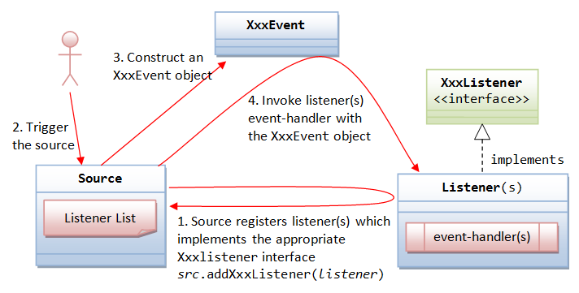

Slide 6
The Delegation Event Model has the following key participants namely:
Source - The source is an object on which event occurs. Source is responsible for providing information of the occurred event to it's handler. Java provide as with classes for source object.
Listener - It is also known as event handler. Listener is responsible for generating response to an event. From java implementation point of view the listener is also an object. Listener waits until it receives an event. Once the event is received , the listener process the event an then returns.

Slide 7
Steps involved in event handling
The User clicks the button and the event is generated.
Now the object of concerned event class is created automatically and information about the source and the event get populated with in same object.
Event object is forwarded to the method of registered listener class.
the method is now get executed and returns.

Slide 8
Event Classes
The Event classes represent the event. Java provides us various Event classes but we will discuss those which are more frequently used.
Following is the list of commonly used event classes.

Slide 9
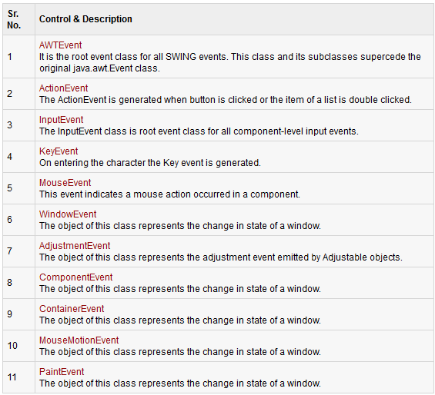

Slide 10
Event Listeners Interfaces
The Event listener represent the interfaces responsible to handle events. Java provides us various Event listener classes but we will discuss those which are more frequently used. Every method of an event listener method has a single argument as an object which is subclass of EventObject class. For example, mouse event listener methods will accept instance of MouseEvent, where MouseEvent derives from EventObject.
Following is the list of commonly used event listeners.

Slide 11
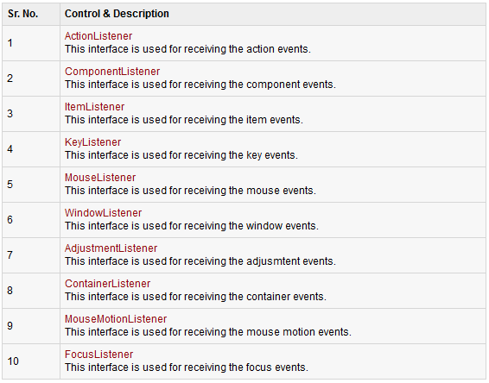

Slide 12
ActionListener Interface
The class which processes the ActionEvent should implement this interface.The object of that class must be registered with a component. The object can be registered using the addActionListener() method. When the action event occurs, that object's actionPerformed method is invoked.
Interface declaration
public interface ActionListener extends
EventListenerInterface methods
actionPerformed(ActionEvent e): Invoked when an action occurs.

Slide 13
ComponentListener Interface
Interface methods
void componentHidden(ComponentEvent e): Invoked when the component has been made invisible.
void componentMoved(ComponentEvent e): Invoked when the component's position changes.
void componentResized(ComponentEvent e): Invoked when the component's size changes.
void componentShown(ComponentEvent e): Invoked when the component has been made visible.

Slide 14
ItemListener Interface
The class which processes the ItemEvent should implement this interface. The object can be registered using the addItemListener() method. When the action event occurs, that object's itemStateChanged method is invoked.
Interface declaration
public interface ItemListener extends EventListenerInterface methods
void itemStateChanged(ItemEvent e): Invoked when an item has been selected or deselected by the user.

Slide 15
KeyListener Interface
Interface methods
void keyPressed(KeyEvent e): Invoked when a key has been pressed.
void keyReleased(KeyEvent e): Invoked when a key has been released.
void keyTyped(KeyEvent e): Invoked when a key has been typed.

Slide 16
MouseListener Interface
Interface methods
void mouseClicked(MouseEvent e): Invoked when the mouse button has been clicked (pressed and released) on a component.
void mouseEntered(MouseEvent e): Invoked when the mouse enters a component.
void mouseExited(MouseEvent e): Invoked when the mouse exits a component.
void mousePressed(MouseEvent e): Invoked when a mouse button has been pressed on a component.
void mouseReleased(MouseEvent e): Invoked when a mouse button has been released on a component.

Slide 17
TextListener Interface
The class which processes the TextEvent should implement this interface.The object of that class must be registered with a component. The object can be registered using the addTextListener() method.
Interface declaration
public interface TextListener extends EventListenerInterface methods
void textValueChanged(TextEvent e): Invoked when the value of the text has changed.

Slide 18
WindowListener Interface
Interface methods
voidwindowActivated(WindowEvent e): Invoked when the Window is set to be the active Window.
void windowClosed(WindowEvent e): Invoked when a window has been closed as the result of calling dispose on the window.
void windowClosing(WindowEvent e): Invoked when the user attempts to close the window from the window's system menu.
void windowDeactivated(WindowEvent e): Invoked when a Window is no longer the active Window.
void windowDeiconified(WindowEvent e): Invoked when a window is changed from a minimized to a normal state.
void windowIconified(WindowEvent e): Invoked when a window is changed from a normal to a minimized state.
void windowOpened(WindowEvent e): Invoked the first time a window is made visible.

Slide 19
AdjustmentListener Interface
The interfaceAdjustmentListener is used for receiving adjustment events. The class that process adjustment events needs to implements this interface.
Class declaration
public interface AdjustmentListener extends EventListenerInterface methods
void adjustmentValueChanged (AdjustmentEvent e): Invoked when the value of the adjustable has changed.

Slide 20
ContainerListener Interface
Interface methods
void componentAdded(ContainerEvent e): Invoked when a component has been added to the container.
void componentRemoved(ContainerEvent e): Invoked when a component has been removed from the container.

Slide 21
MouseMotionListener Interface
Interface methods
void mouseDragged(MouseEvent e): Invoked when a mouse button is pressed on a component and then dragged.
void mouseMoved(MouseEvent e): Invoked when the mouse cursor has been moved onto a component but no buttons have been pushed.

Slide 22
FocusListener Interface
Interface methods
void focusGained(FocusEvent e): Invoked when a component gains the keyboard focus.
void focusLost(FocusEvent e): Invoked when a component loses the keyboard focus.

Slide 23
Event Adapters
Adapters are abstract classes for receiving various events. The methods in these classes are empty. These classes exists as convenience for creating listener objects.
Following is the list of commonly used adapters while listening GUI events in SWING.

Slide 24
