Slide 1
ClaimSystem Web Application

Slide 2


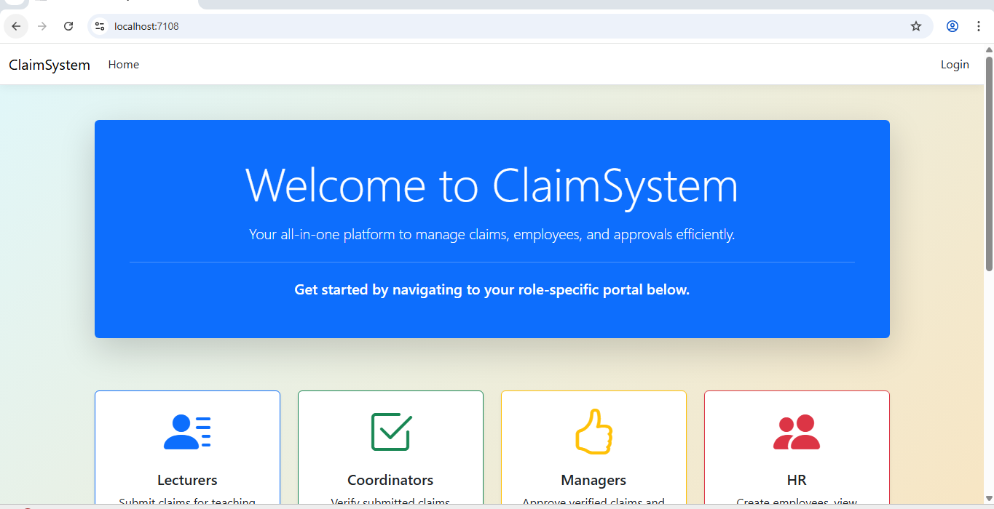



ClaimSystem Web Application

Slide 3
What is ClaimSystem?
A web application for managing lecturer and employee claims.
Streamlines claim submission, approval, and tracking.
Built with ASP.NET Core MVC, Entity Framework, and SQL Server.
Visual

Slide 4
Key Features
User authentication & role management (HR, Lecturers, Admin)
Submit and manage claims
Dashboard for HR to monitor claims
Secure database management

Slide 5
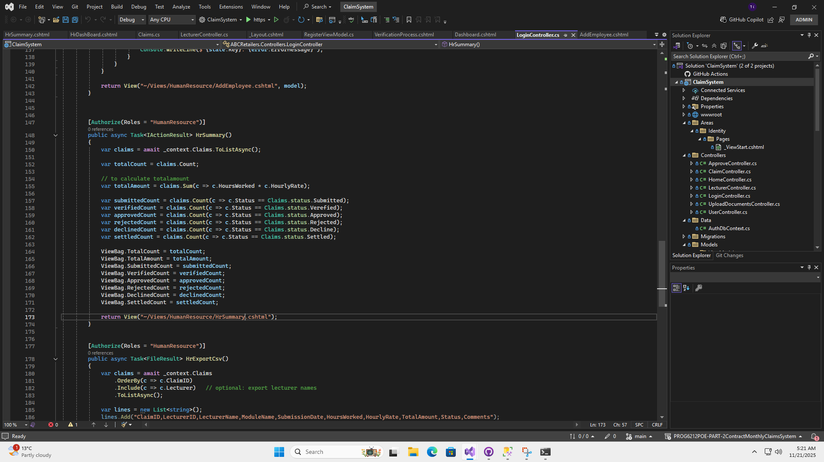
Feature Explanation: HR Summary
Purpose:
This method generates a summary of claims for HR users.
Only accessible by users in the HumanResource role ([Authorize(Roles = "HumanResource")])

Slide 6
HR Summary: Step-by-Step Breakdown
1.Fetch all claims from the database:
var claims = await _context.Claims.ToListAsync();
Retrieves all claim records simultaneously from the database
2.Count total claims:
var totalCount = claims.Count;
Calculates the total number of claims.

Slide 7
HR Summary: Step-by-Step Breakdown
3.Calculate total monetary amount:
var totalAmount = claims.Sum(c => c.HoursWorked * c.HourlyRate);
Sums up all claims using the formula hours worked × hourly rate.
4.Count claims by status:
var submittedCount = claims.Count(c => c.Status == Claims.status.Submitted);
Repeats for Verified, Approved, Rejected, Declined, Settled.
Provides HR with a status breakdown.

Slide 8
HR Summary: Step-by-Step Breakdown
5.Store results for the View:
ViewBag.TotalCount = totalCount;
ViewBag.TotalAmount = totalAmount;
...
Uses ViewBag to pass data to the Razor view.
6.Return the HR summary view:
return View("~/Views/HumanResource/HrSummary.cshtml");
Displays the summary on the HR dashboard page.

Slide 9
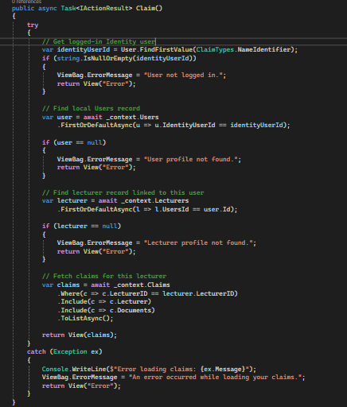
Feature Explanation: Claim
Purpose:
This method is to load and display all claims that belong to the currently logged-in lecturer.

Slide 10
Claim: Step-by-Step Breakdown
1. Get Identity user ID from the current request:
var identityUserId = User.FindFirstValue(ClaimTypes.NameIdentifier);
Retrieves the Identity User ID of the currently logged-in user
2. Validation check for identity user ID
if (string.IsNullOrEmpty(identityUserId)){ViewBag.ErrorMessage = "User not logged in.";eturn View("Error");}
This is a validation check that checks whether identityUserId is null or a empty string ("")

Slide 11
Claim: Step-by-Step Breakdown
3. Fetches User data from the database:
var user = await _context.Users.FirstOrDefaultAsync(u => u.IdentityUserId == identityUserId);
Retrieves data from database that corresponds with the identityuserid.
4. Validation check for User
if (user == null){ViewBag.ErrorMessage = "User profile not found.";
return View("Error");}
A validation that checks if user exist.

Slide 12
Claim: Step-by-Step Breakdown
5. Fetches Corresponding User data from the lecturer:
var lecturer = await _context.Lecturers.FirstOrDefaultAsync(l => l.UsersId == user.Id);
Retrieves the lecturerId that matches with UsersId from current logged-in user userID.
6. Validation check for Lecturer
if (lecturer == null){ViewBag.ErrorMessage = "Lecturer profile not found.";
return View("Error");}
A validation that checks if lecturer exist.

Slide 13
Claim: Step-by-Step Breakdown
7. Fetch claims for this lecturer:
var claims = await _context.Claims.Where(c => c.LecturerID == lecturer.LecturerID).Include(c => c.Lecturer).Include(c => c.Documents).ToListAsync();
Retrieves claims data for specified lectuer via lecturerID
8. Returns webpage to see
return View(claims);
Returns the webpage (view) to display the list of claims.

Slide 14
Claim: Step-by-Step Breakdown
9. Catches any exception that happens in try block
catch (Exception ex)
{
Console.WriteLine($"Error loading claims: {ex.Message}");
ViewBag.ErrorMessage = "An error occurred while loading your claims.";
return View("Error");
}
If anything goes wrong within the try block, it will show an error page with a message and a log error for debugging.

Slide 15
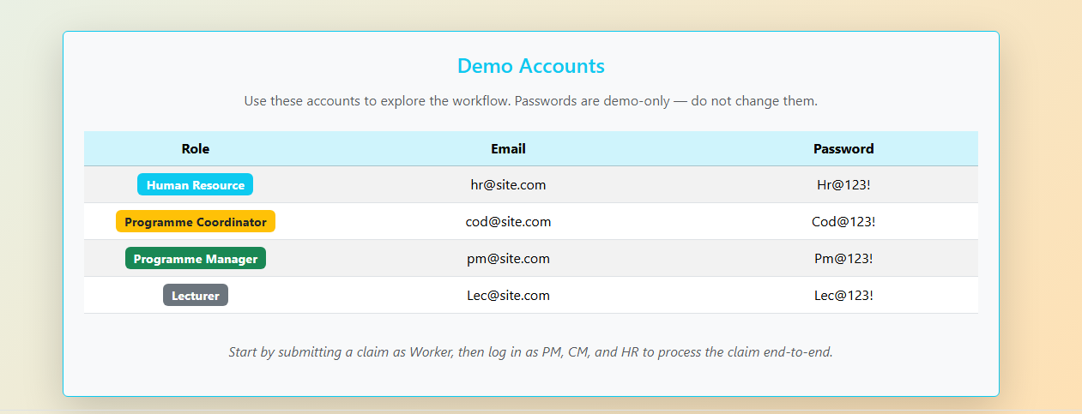
Demo Accounts to use

Slide 16
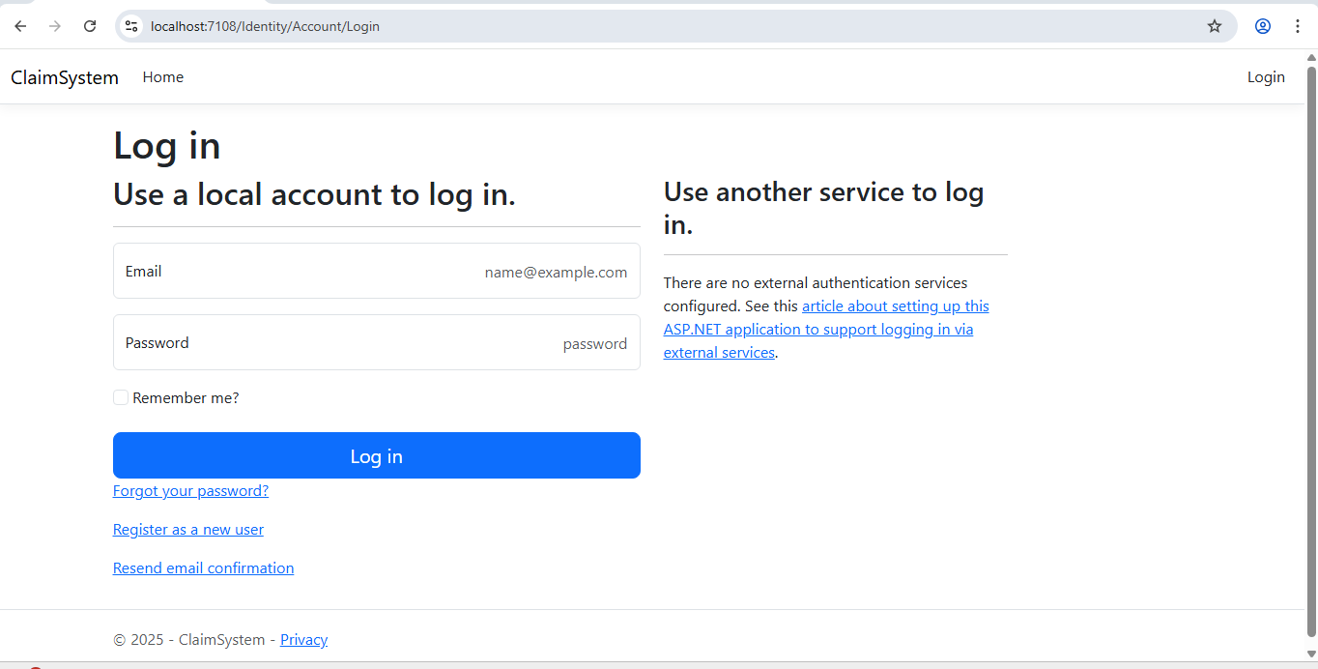
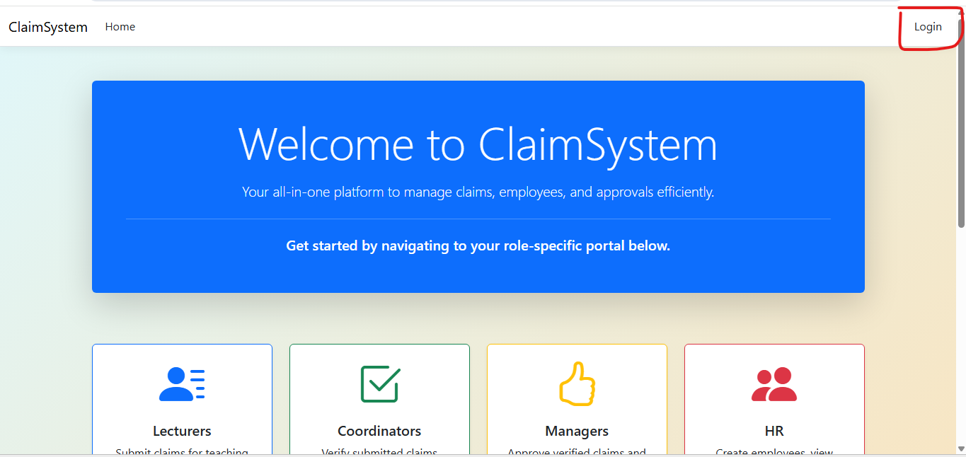
Feature Explanation: Login

Slide 17
Feature Explanation: Login
Feature : login
Purpose:
To Identify the User
Login confirms who you are by checking your: Email/Username and Password
This ensures the system is dealing with the correct person .

Slide 18
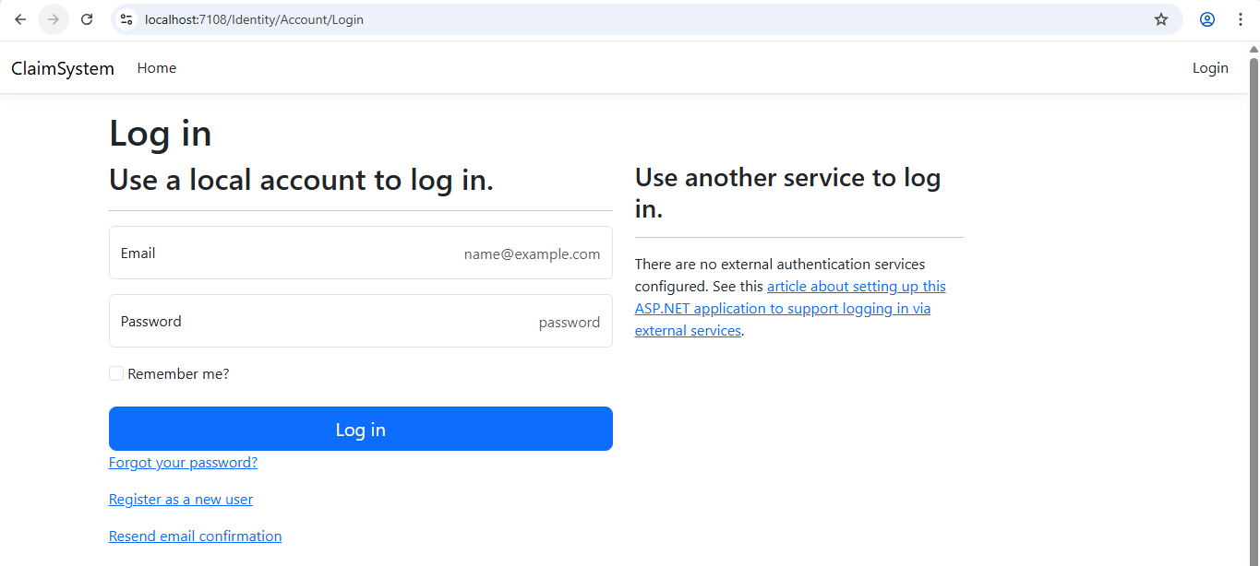
Feature Explanation: Login

Slide 19
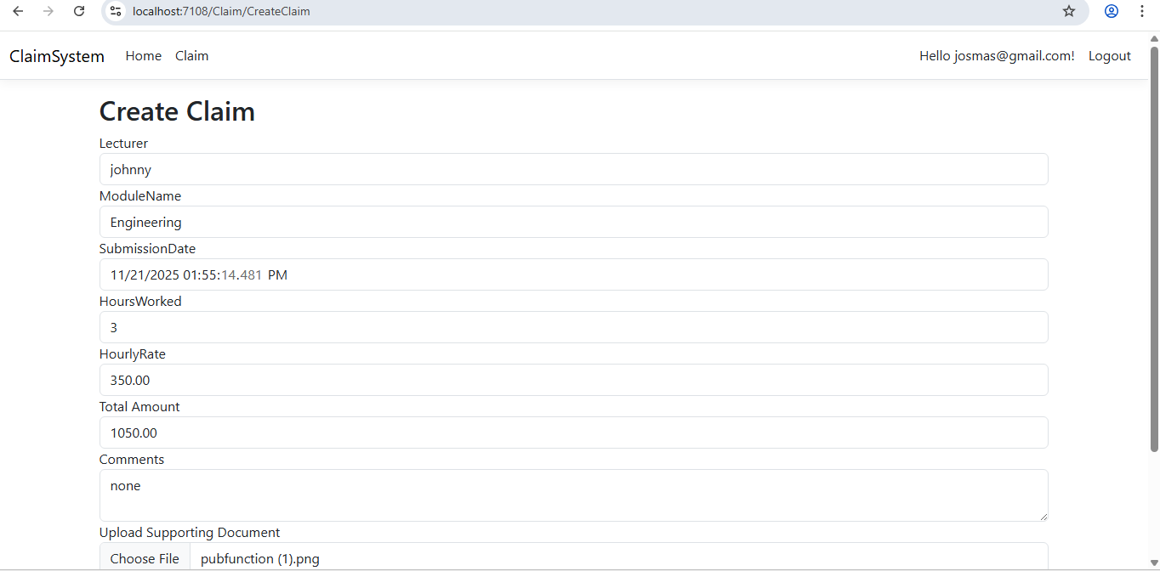
Feature Explanation: Lecturer View
CreateClaim
Function:
Auto-Populate Lecturer Claim Details
When a lecturer creates a new claim, the system automatically fills in the following information:
Lecturer Name, Department, Submission Date, Hourly Rate
The lecturer is only required to provide:
Hours Worked
Comments
Uploaded Documents

Slide 20
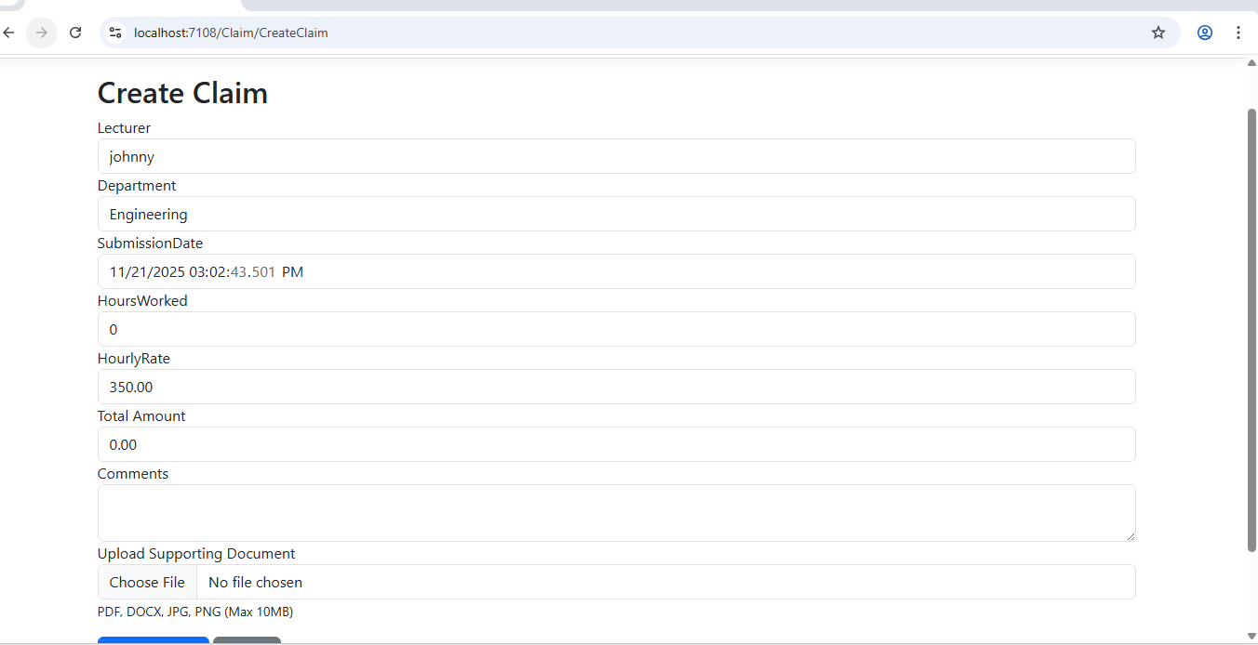
Feature Explanation: Lecturer View
CreateClaim

Slide 21
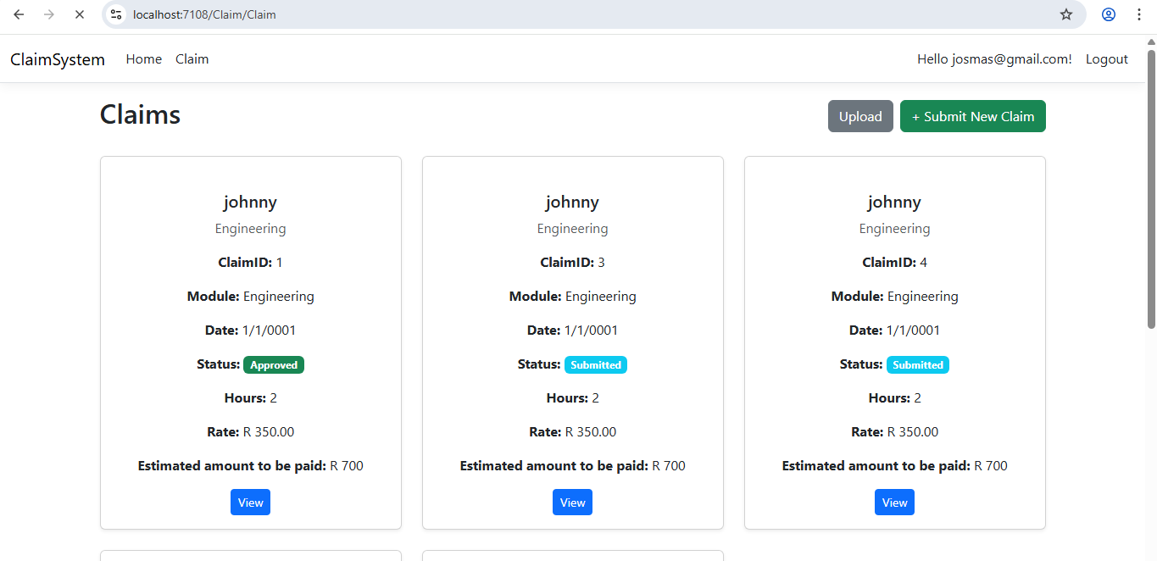
Feature Explanation: Lecturer View
Claims
Function:
Lecturer Claim Tracking Page
This view page allows a logged-in lecturer to track and monitor the status of all their submitted claims. Each claim displays its current stage in the workflow, using the following statuses:
Submitted – Claim has been created and sent for review
Verified – Claim has been checked and confirmed by Coordinators
Rejected – Claim did not pass the verification stage
Approved – Claim has been approved for payment by Manager
Declined – Claim has been reviewed but not approved
Lecturers can monitor the status of their claims through the available status options in the claims system. This provides a clear and organized overview of their claim progress at every step.

Slide 22
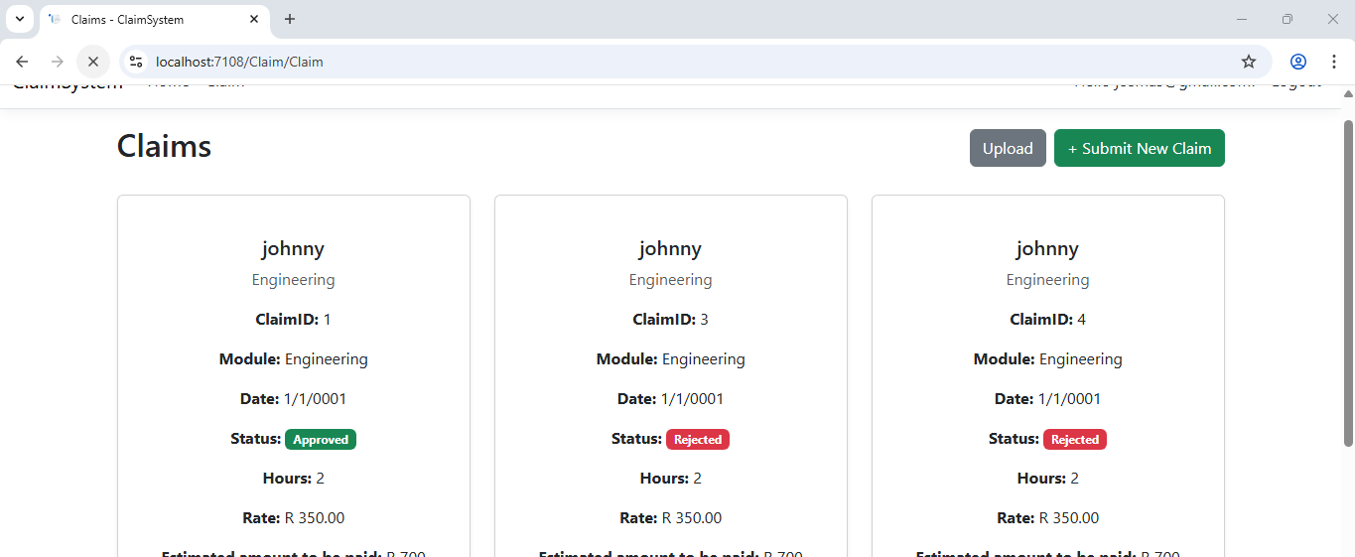
Feature Explanation: Lecturer View
Claims

Slide 23
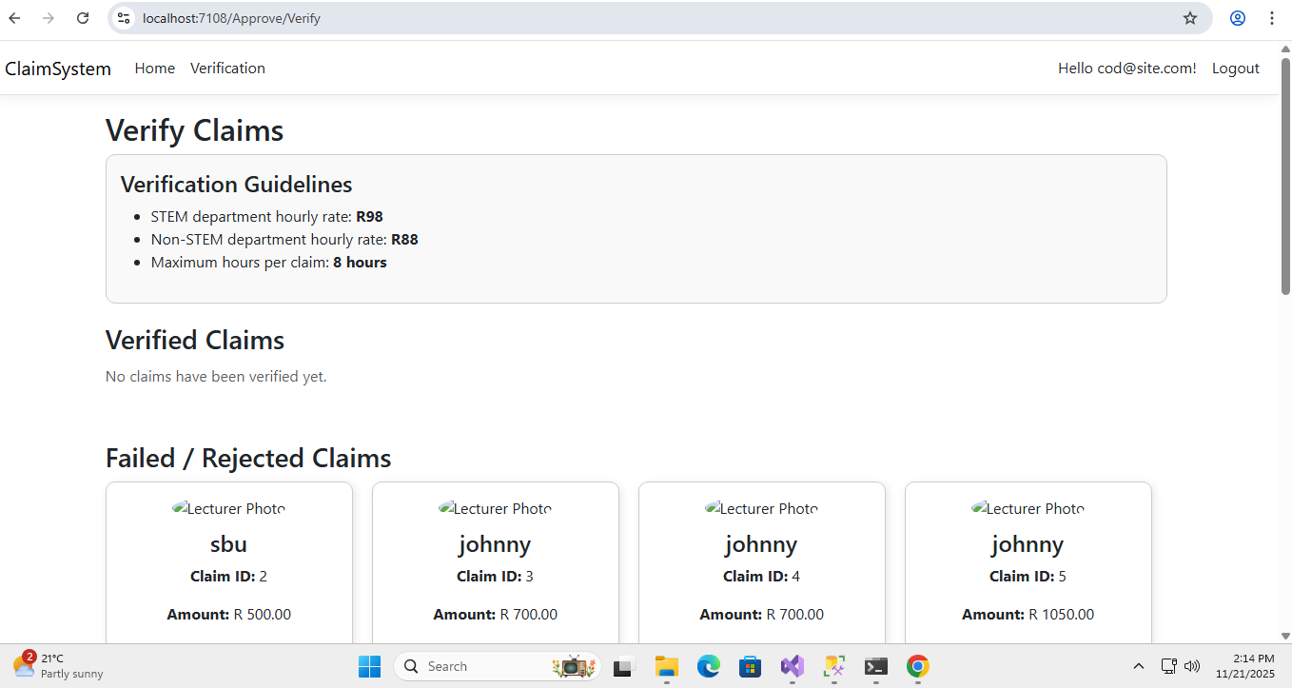
Feature Explanation: Verification View
Function: Automatic Verification Page for Coordinators
A dedicated verification page is provided for coordinators, allowing claims to be reviewed automatically based on predefined guidelines.
If a claim meets all guideline requirements, it is automatically verified.
If a claim fails to meet the guidelines, it is automatically rejected.
Coordinators also have the ability to manually review rejected claims, giving them the option to either verify the claim or keep it rejected.

Slide 24
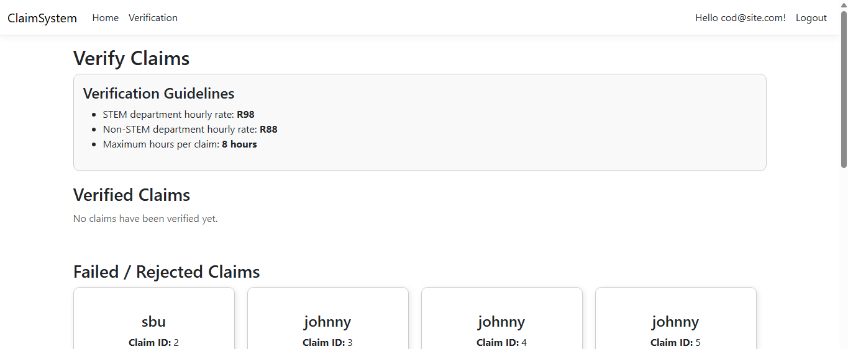
Feature Explanation: Verification View

Slide 25
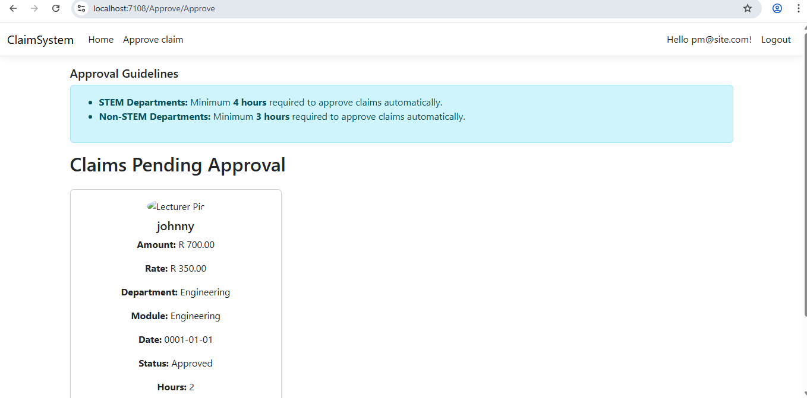
Feature Explanation: Approve View
Function: Automatic Approval Page for Managers
The system provides an automatic approval page for managers, where claims are evaluated based on predefined guidelines.
If a claim meets all guideline requirements, it is automatically approved.
If a claim does not meet the guidelines, it is automatically declined.
Managers also have the option to manually review declined claims, allowing them to either approve the claim or keep it declined.

Slide 26
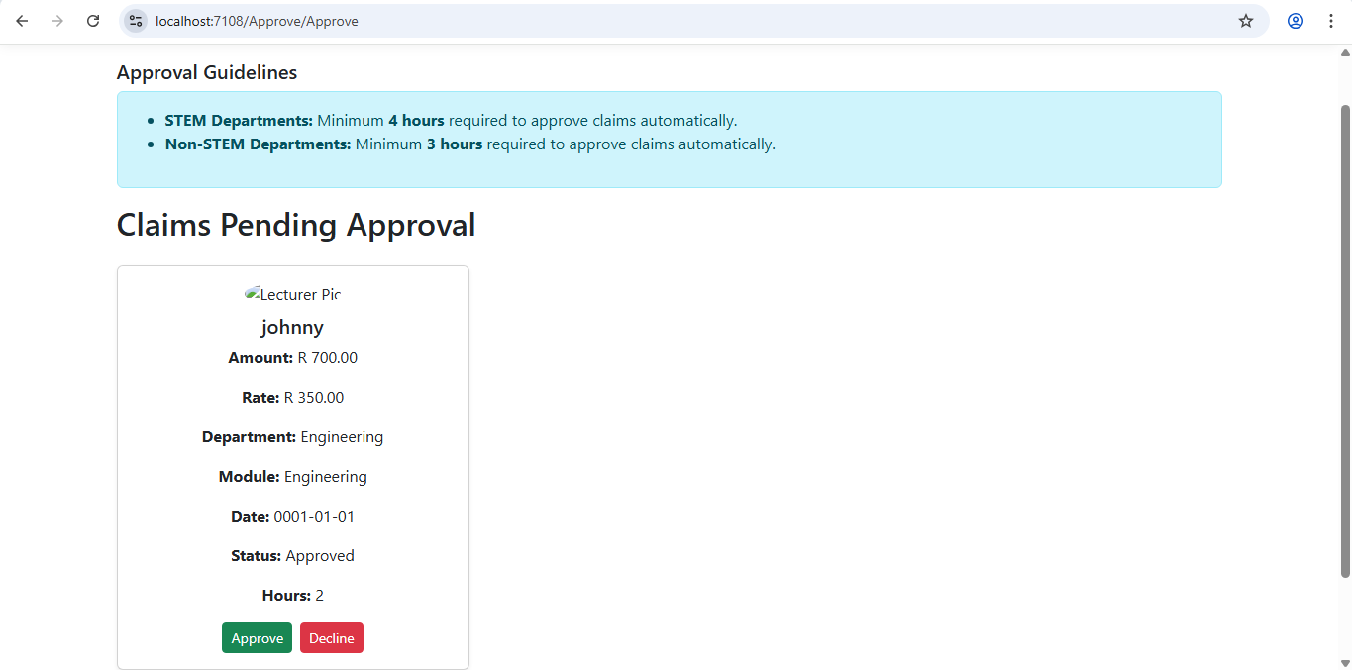
Feature Explanation: Approve View

Slide 27
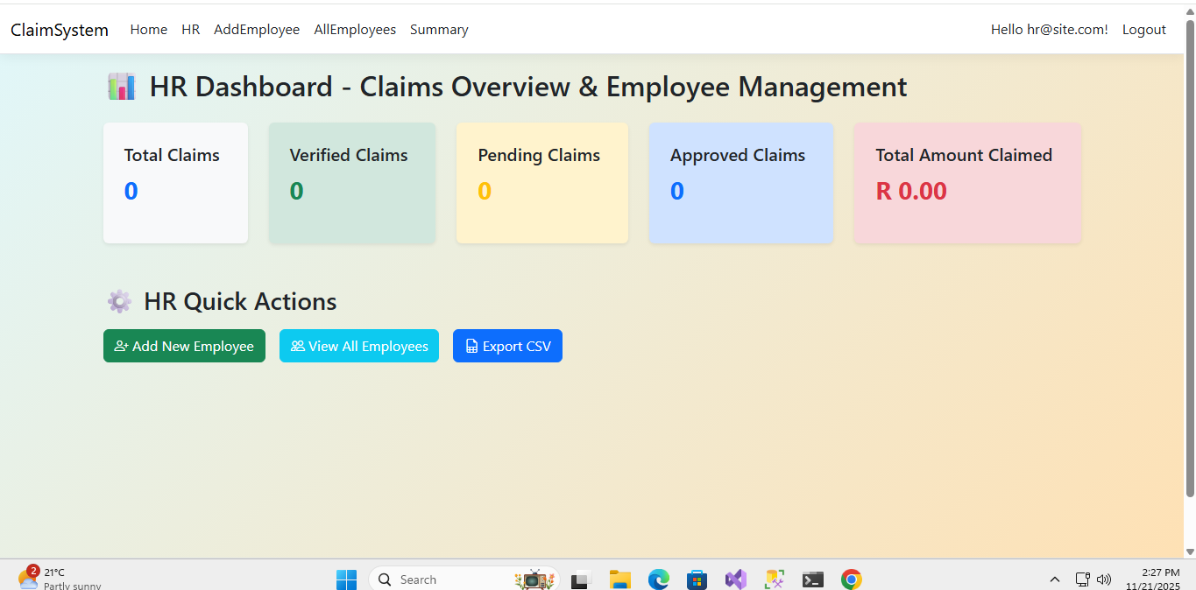
Feature Explanation: Human Resource View

Slide 28
Feature Explanation: Human Resource View Dashboard
Function: User-Friendly Dashboard for Human Resource Users
A user-friendly dashboard is provided for Human Resource role users, offering clear and easy navigation throughout the system.
The dashboard includes the following features:
Generate CSV Report – Allows users to export a brief summary of all claims and the number of users who have submitted claims.
Create Employee Button – Enables HR users to easily add new employees to the system.
List Employees Button – Provides quick access to a complete list of existing employees.
This ensures HR users can efficiently manage staff information and monitor claim activity.

Slide 29
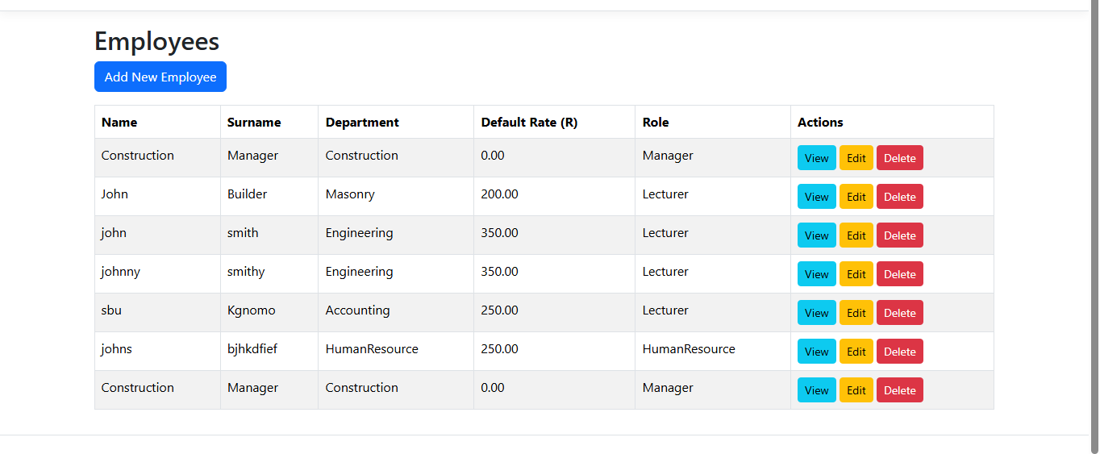
Feature Explanation: Human Resource View AddEmployee

Slide 30
Feature Explanation: Human Resource View AddEmployee
Function: HR User Employee Management
Human Resource users can add new employees to the Claim System based on predefined employee roles.
The four roles that HR can assign when creating an employee are:
Lecturer
Manager
Coordinator
HumanResource
Only users with the HumanResource role have permission to add new employees to the system, ensuring controlled and secure employee management.

Slide 31
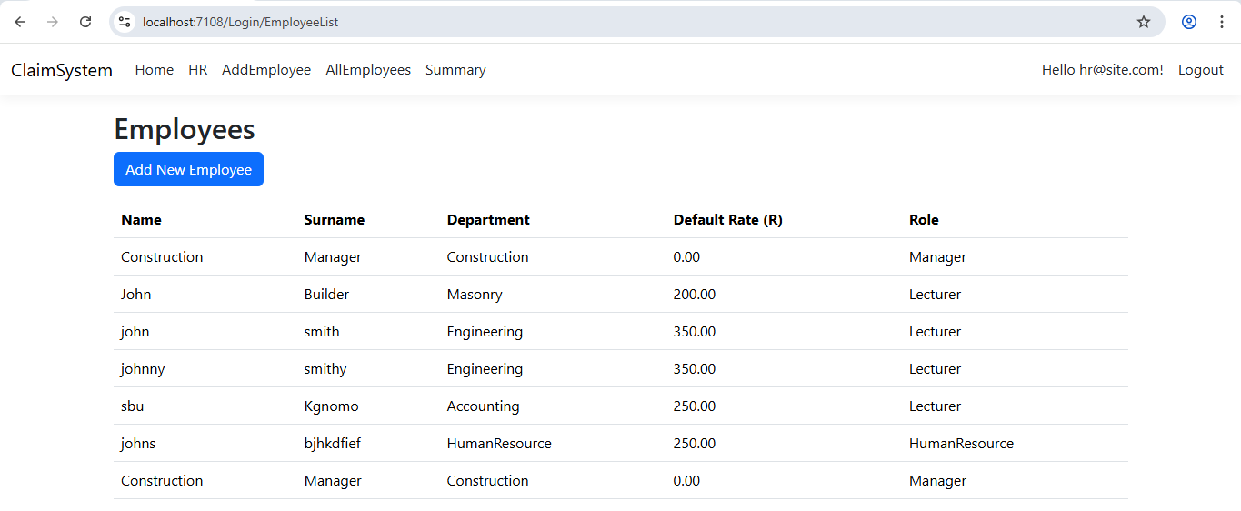
Feature Explanation: Human Resource View AllEmployee

Slide 32
Feature Explanation: Human Resource View AllEmployee
Function: HR-Only Employee Management Page
This view is only available to Human Resource users, displaying a complete list of all employees added to the system along with the rates they earn.
From this page, HR users can:
Update employee information – Ensure all staff details remain accurate and up to date.
Delete employees – Remove employees from the system when necessary.

Slide 33
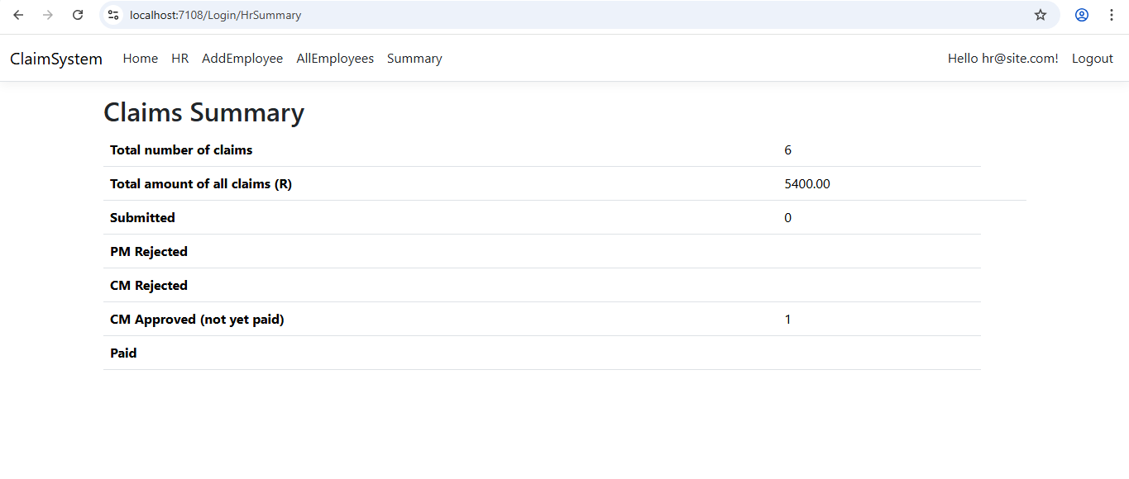
Feature Explanation: Human Resource View Summary

Slide 34
Feature Explanation: Human Resource View Summary
Function: HR Claims Summary Page
This view is only available to Human Resource users, displaying a summary of all claims submitted by employees along with their current statuses.
This allows HR to easily track and monitor claim progress across the organization.

Slide 35
Updates from Part 2
DocumentUpload in Claims – The Create Claim page now allows lecturers to upload supporting documents while submitting a claim.
Role-Based Views – Certain pages and features are now restricted based on user roles e.g Lecturer and Manager to ensure proper access security.
Role-Based Login – The login system has been added to work according to user roles, allowing each user to see only what they are authorized to access.
Database Migration – The system database has been migrated from SQLite to SQL Server.
Identity Framework Integration – Implemented ASP.NET Identity Framework for secure authentication, role management, and user login functionality.

Slide 36
Lecturer Feedback
Based on feedback received, the following improvements were made:
The document upload feature was previously inaccessible. This has been resolved by adding upload functionality directly into the Create Claim process, allowing lecturers to attach supporting files while submitting claims.

Slide 37
Challenges Encountered
Cascade Delete Conflicts – Resolved by setting ON DELETE NO ACTION to prevent multiple cascade paths in the database.
Duplicate Table Creation Errors – Fixed in SeedData to avoid creating existing tables again.
View Routing Across Folders – Configured proper View() paths in controllers to ensure pages render correctly.
Authentication Issues – Login functionality was currently not working and requires troubleshooting.

Slide 38
Tech Stack
Backend: ASP.NET Core MVC, C#
Frontend: Razor Views, HTML/CSS, Bootstrap
Database: SQL Server, Entity Framework Core
Tools: Visual Studio, Git

Slide 39
Links
GitHubLink: https://github.com/KgomoTokelo/PROG6212POE-PART-3-ContractMonthlyClaimsSystem.git
YouTubeLink: https://youtu.be/TRyGntZvh-4

