Slide 1



Lectuererclaims application
Best for every
user

Slide 2
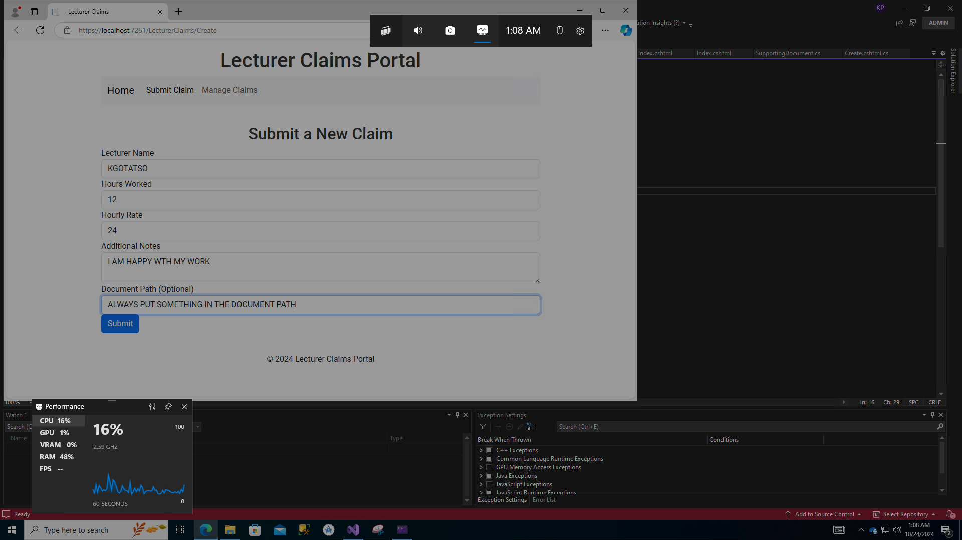
LecturerClaimApp: Streamlining Lecturer Claim Management
Slide 1
A smart solution for managing and processing lecturer claims with efficiency, transparency, and reliability.
Presented By:
Kgotatso phetoe

Slide 3

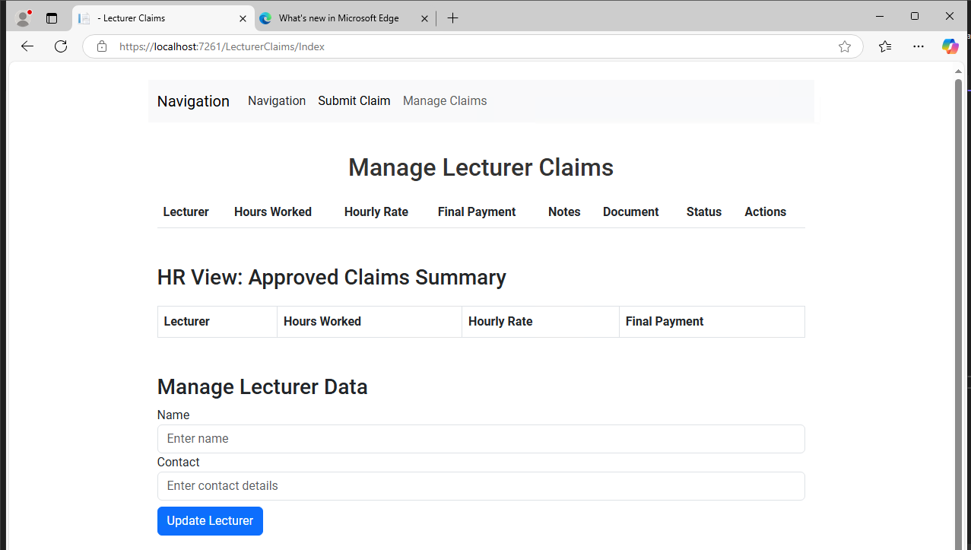
Slide 2:introduction
What is LecturerClaimApp?
LecturerClaimApp is a web-based application designed to simplify the process of submitting, verifying, approving, and managing lecturer claims.
Key Features:
Claim submission with supporting documents.
Automated approval and rejection workflows.
Real-time status tracking.
Secure and transparent information storage.
Objective:
To enhance productivity and reduce administrative burden for educational institutions.

Slide 4
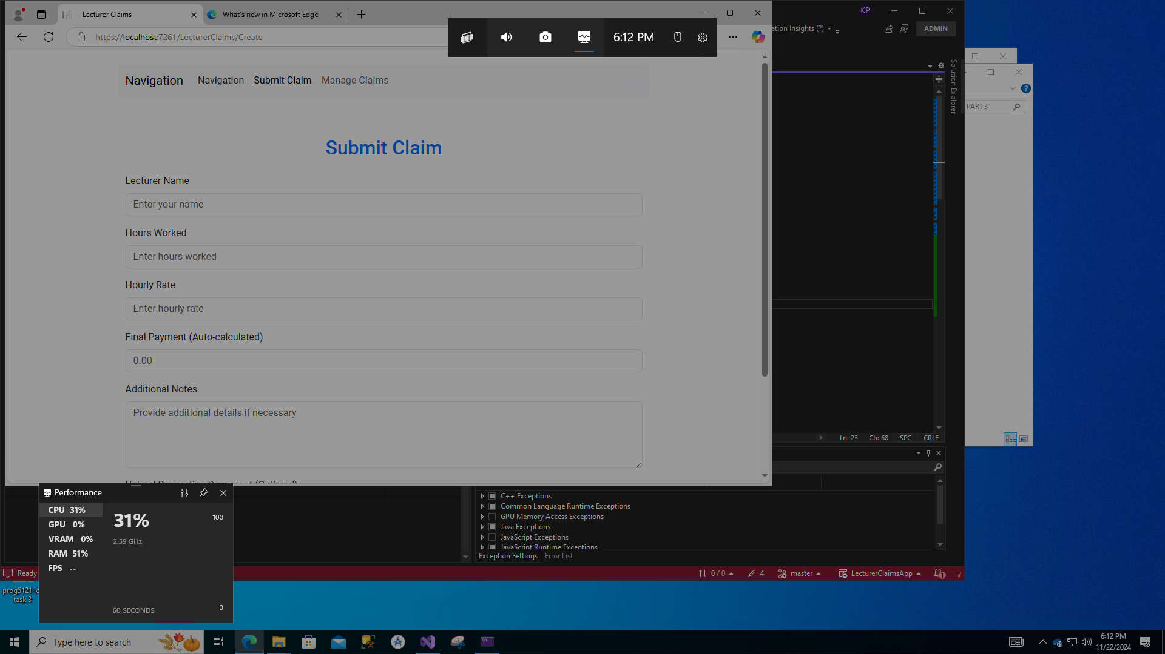
Slide 3: Features Overview
Claim Submission:
  Lecturers can easily submit claims online, specifying hours worked, hourly rate, and additional notes.
  Upload supporting documents directly within the platform.
Approval Workflow:
  Programme Coordinators and Academic Managers can review, approve, or reject claims seamlessly.
  Automates email notifications for status updates.
Real-Time Tracking:
  Lecturers can track the status of their claims (Pending, Approved, Rejected).
Data Security:
  Reliable storage and secure access using ASP.NET Identity for authentication and authorization.

Slide 5
Slide 4: Technology Stack
Backend:
ASP.NET Core MVC
Entity Framework Core for database interaction.
Frontend:
Razor Pages for dynamic UI generation.
Bootstrap for responsive design.
Database:
SQL Server
Reporting:
Crystal Reports or SQL Server Reporting Services (SSRS) for generating summaries of approved claims.
Security:
ASP.NET Identity for user authentication.

Slide 6
Slide 5: Benefits
Efficiency:
Automates manual claim submission and review processes.
Transparency:
Real-time tracking ensures clarity for lecturers and administrators.
Scalability:
Designed to handle multiple users and large volumes of claims.
Cost-Effectiveness:
Reduces paper-based workflows and minimizes administrative overhead.

Slide 7
Slide 6: System Workflow
1. Claim Submission:
Lecturers enter details like hours worked, rate, and upload documents.
2. Review and Approval:
Coordinators or Managers verify claims and approve or reject them.
3. Status Updates:
System notifies users about the decision and allows real-time tracking.
4. Reporting:
Generates summarized reports for financial processing.

Slide 8
Slide 7: Conclusion
Why LecturerClaimApp?
Saves time for both lecturers and administrators.
Increases transparency and reliability in claim management.
Scalable and adaptable for diverse educational institutions.
Thank You!
ANY Questions and Discussions?

