Slide 1
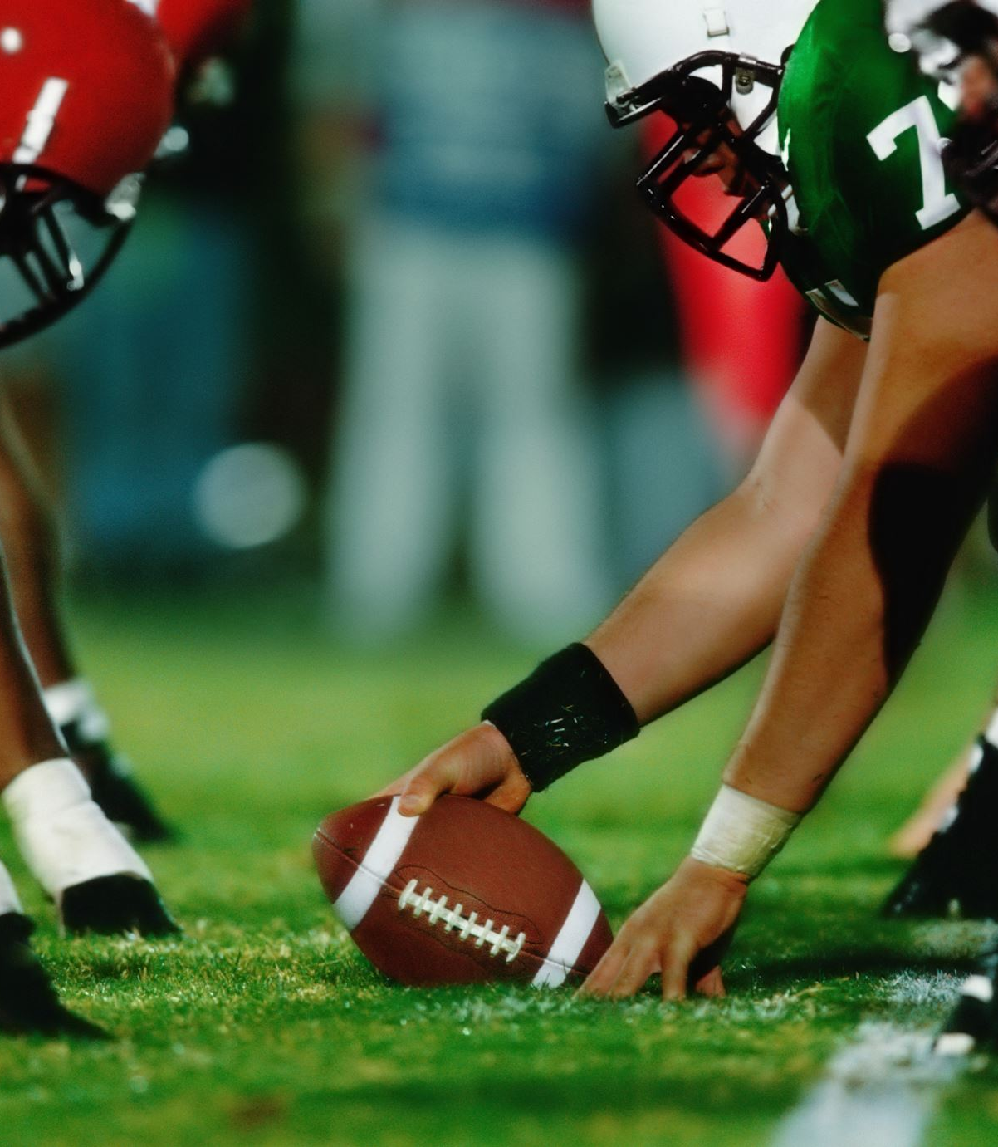
Predicting Fantasy Football Rankings
Kenneth Steadman
CINF499
Senior Project II
Advisor: Dr. Eckroth

Slide 2

What is Fantasy Football?
Virtual
Point System
Leagues
Hard to predict outcomes

Slide 3
Why do this project?
Difficulty of drafting, making decisions
Valuable
Add another resource to existing tools and analytics

Slide 4
Technologies Used
Coded in Python
Jupyter notebook
Libraries used:
Pytorch
Pandas
Numpy
Sklearn
Matplotlib
PyTorchViz
WANDB.AI

Slide 5
Why use AI for this task?
Sift through large amounts of data
Fast
Learn relationships
Relies on stats

Slide 6
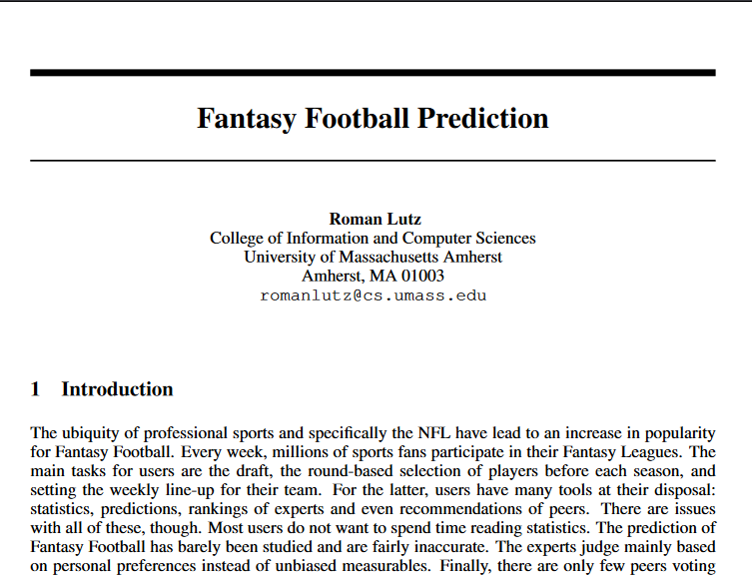
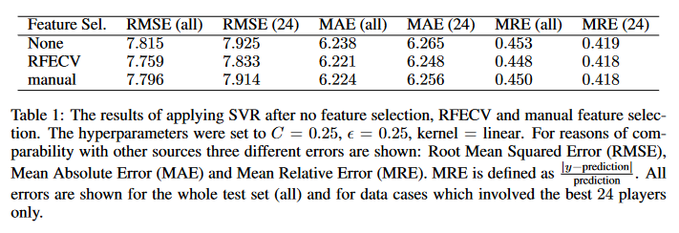
Related Works

Slide 7
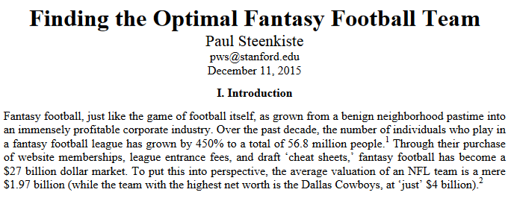
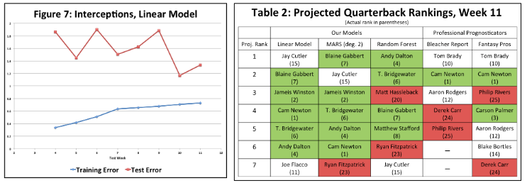
Related Works
Daily Fantasy Football
Three Models:
Linear Regression
Random Forest
Multivariate Adaptive Regression Splines (MARS)

Slide 8
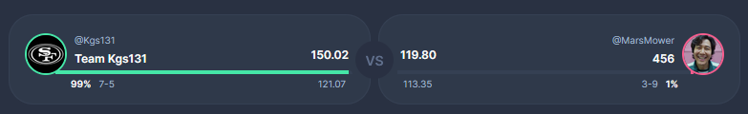
Fantasy Football Overview
First implementation in 1962
Estimated around 40 million people play fantasy football in the US
Draft
Head-to-Head Matchups
Playoffs and League champion
Gambling

Slide 9

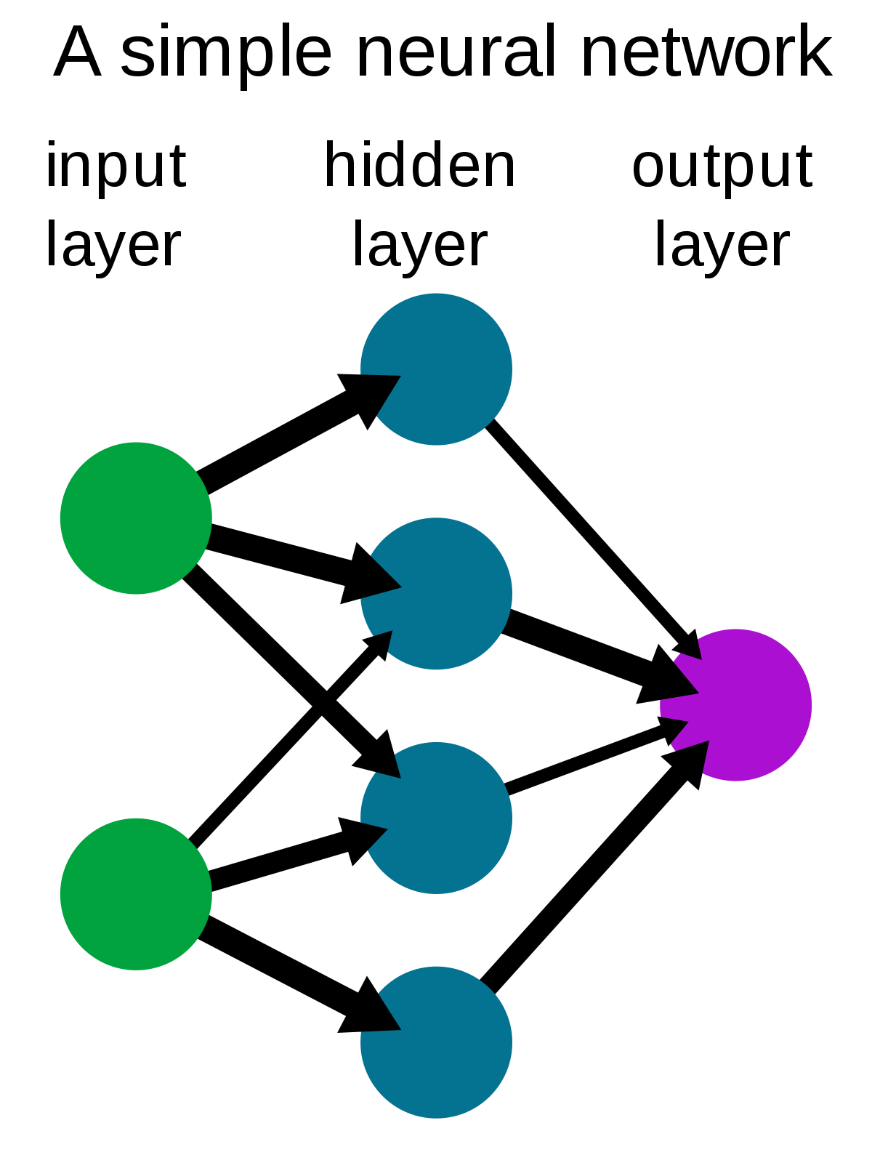
Neural Networks
Modeled after the way neurons work in the brain
Interconnected nodes that overtime can find relationships in raw data
Can learn and improve quickly
Components: Optimizer, Loss Function, Error Function, Epochs and Learning Rate

Slide 10
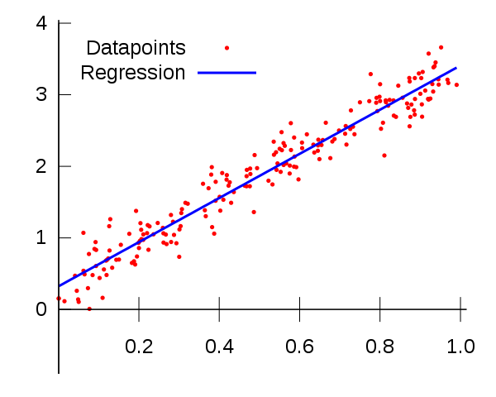
Regression
This is a regression task
Regression:
Finds the fit between two variables.
Using various in game stats to find the relationship to the fantasy point production.

Slide 11
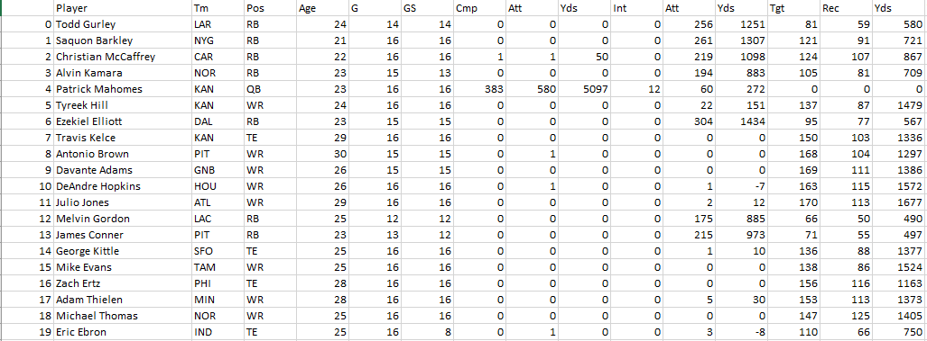
Dataset
From Fantasy Football Data Pros
Yearly Data going back to 1970
Weekly Data going back to 1999
Model is currently trained on 2000-2018 and 2019

Slide 12
Data Manipulation
Split into two subsets:
X: 2000-2018 relevant stats
Y: 2019 fantasy points
Classification Data
Position
Converted in OneHot columns
Concatenated onto existing subset
Normalization:
x values into a range between 0 and 1
Age, G, GS, Cmp, Att, Yds, Int, Tgt, Rec, Y/R, Fumbles, FumblesLost, PassingYds, PassingTD, PassingAtt, RushingYds, RushingTD, RushingAtt, ReceivingYds, ReceivingTD.
(x – xmean) / xrange

Slide 13
Train Validation Test
Dataset Splitting
80% Training
10% Validation
10% Testing
Evaluation

Slide 14
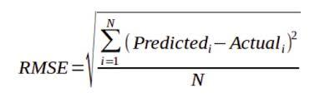
Root Square Mean Error (RSME)
Error Function.
Root of the mean of the squared differences between the predictions and the true fantasy points.
Provides a value that is easily comparable

Slide 15
Epochs and Learning Rate
Epochs: Number of cycles set for the model to go through the training set.
Learning Rate: How much the model is changed in response to updated model weights.
Our Model:
150 Epochs
0.01 Learning Rate
Why this many epochs?

Slide 16
Optimizer and Loss Function
Adam
Optimizer
Tried other optimizers like Standard Gradient Descent (SGD) but Adam proved to provide better results
SGD caused some overfitting and higher errors
MSELoss
Loss function
Mean Square Error
Finds the mean of the difference between the true and predicted values then squares it
Similar to Root Mean Square Error

Slide 17
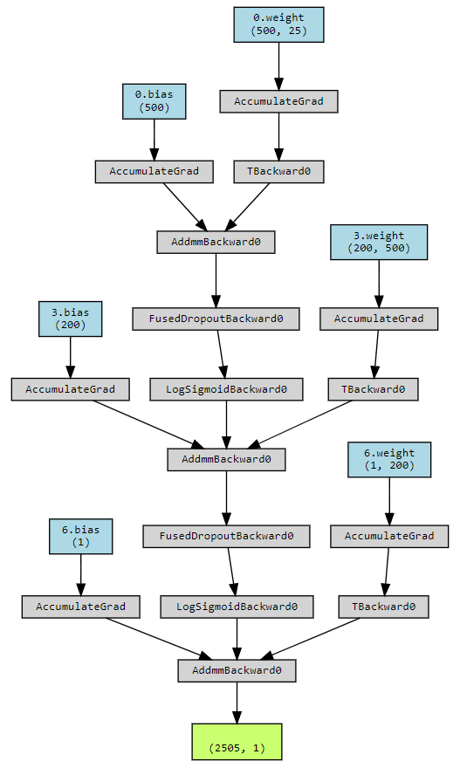
Network Architecture
25 inputs (25 columns in x dataset)
Transferred to hidden layers
Assigned weights and biases
Sent to activation function (LogSigmoid)
Output is 1
Flow:
In: 25 → Out: 500
LogSigmoid
Dropout
In: 500 → Out: 200
LogSigmoid
Dropout
In: 200 → Out: 1

Slide 18
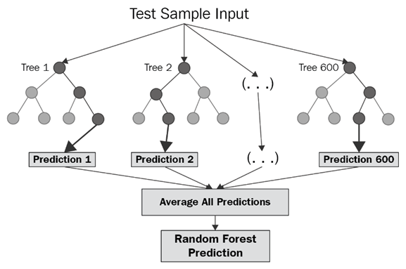
Random Forest
Combination of decision trees that can be modeled for prediction tasks
Capable of handling large datasets
Less reliant on relationships between columns
Does not need a large dataset
Used for a comparison to our model.

Slide 19
PERFORMANCE

Slide 20
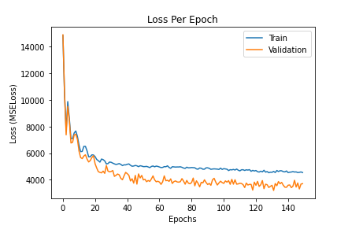
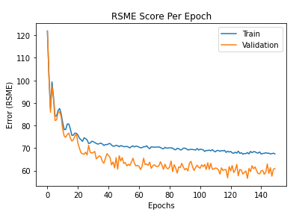
Loss and Error Per Epoch

Slide 21
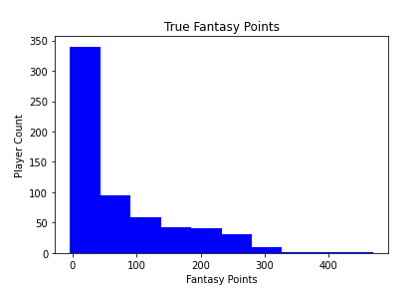
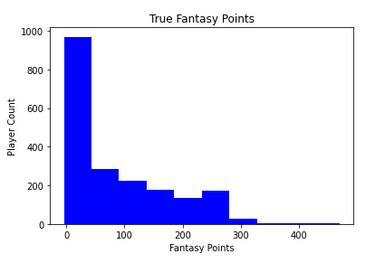
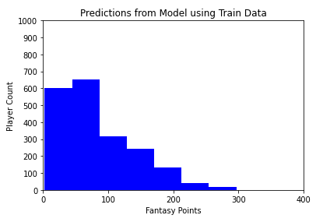
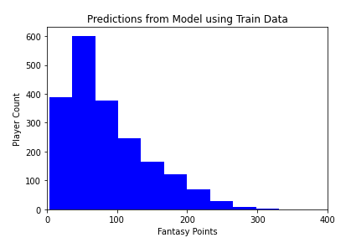
True Fantasy Points vs Predicted

Slide 22
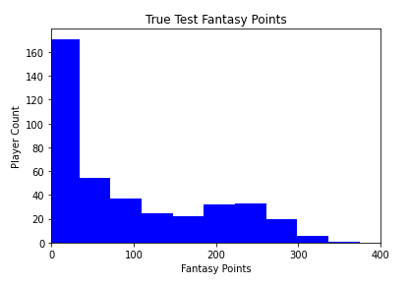
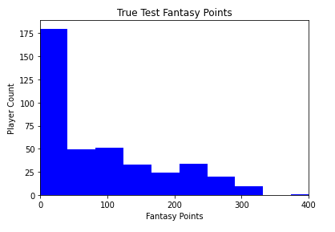
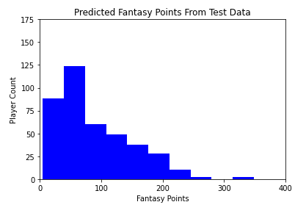
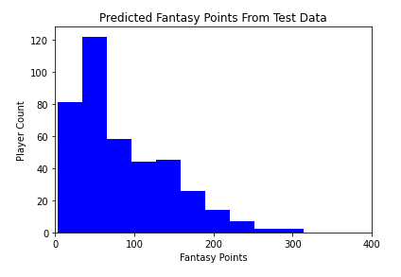
True Fantasy Points vs Predicted

Slide 23
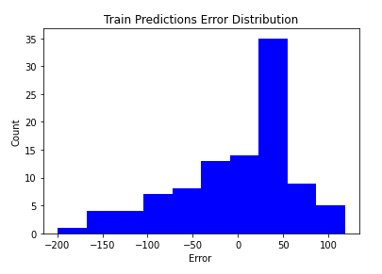
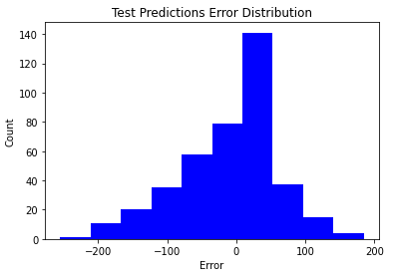
Train and Test Error Distribution

Slide 24
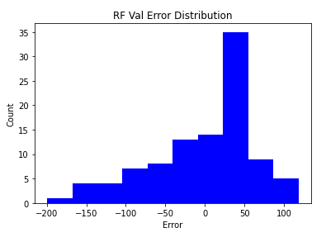
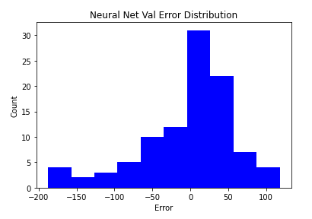
RF vs NN
Average Error: 52
Average Error: 48

Slide 25
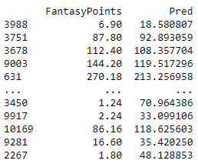
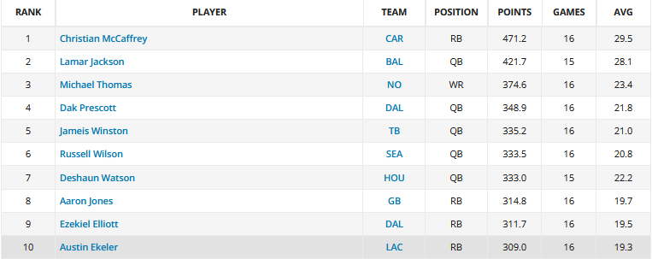
Results
Train Loss | Validation Loss | Train Error | Validation Error
4545.2095 | 3707.6855 | 67.1482 | 60.8908
Context
Usefulness

Slide 26
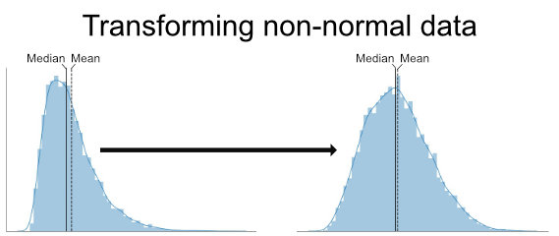
Model and Dataset Adjustments
Log Transformation:
Attempted to improve the skew in our predictions by transforming the input values with a log to achieve a more normal distribution.
Model became unstable
Subsets
Another solution we came up with was to remove all the players who did not score at least 50 fantasy points
No change
WANDB.AI

Slide 27
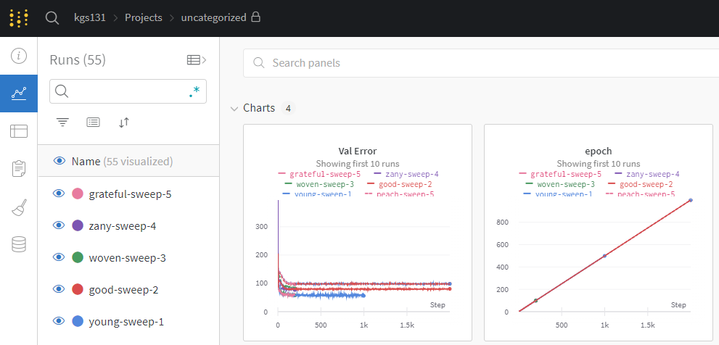
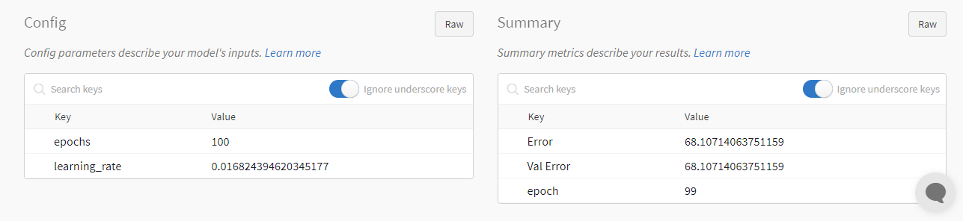
WANDB.AI
Weights and Biases
Hyperparameter tuning
Epochs, Learning Rate, Optimizer, Loss
Sweeps
Actually improved things

Slide 28
Summary
Attempted to predict fantasy football rankings with neural network
Improved over last semesters RSME score of 79
Improvements came from expanding the dataset, neural net modifications, and WANDB.AI
Did not predict with a low enough error to be useful
Did perform a little better than Random Forest
This is a very difficult problem due to randomness of the NFL
Even though we did not achieve a useful result this project has been an informative and interesting process where I learned a lot about using AI for problem solving and making predictions

Slide 29

Q & A

