Slide 1


SATBAYEV UNIVERSITY
Automation and Information Technology · Software Engineering
CSE6624
Introduction to Web Programming
Lecture 1
WWW, HTTP, and Development Setup
Shoiynbek Temirlan Armanuly
Senior Lecturer
Programme: 6B06102 Computer Science
Autumn 2026–2027 · Almaty
City University / Satbayev University · English-taught course
Notes:
(улыбнись — Hello + номер лекции + тема.)

Slide 2
CSE6624 · Lecture 01
Today's plan · 50 minutes
15 min
~15 min — I explain (diagrams + you listen)
I read the strips. You look at the diagrams. No typing yet.
5 min
~5 min — Demo on these slides
Code / UI is ON the slides. I only point. Do not open other folders.
25 min
~25 min — You do the task
Step-by-step ON the slides. Follow every click. If stuck: read the previous step again.
5 min
~5 min — What to submit / next lecture
Photo proof + show neighbour. One-line preview of next week.
Today's plan is fixed to fifty minutes. About fifteen minutes I explain with diagrams. About five minutes I point at demo code on these slides — you watch. About twenty-five minutes you follow the task steps on the slides. The last five minutes cover what to submit and what comes next. There is no separate questions block — if stuck, read the previous step again.
Satbayev University · CSE6624 · Lecture 1 · Autumn 2026–2027
2 / 22
Notes:
(прочитай полоску; укажи на 15/5/25/5)

Slide 3
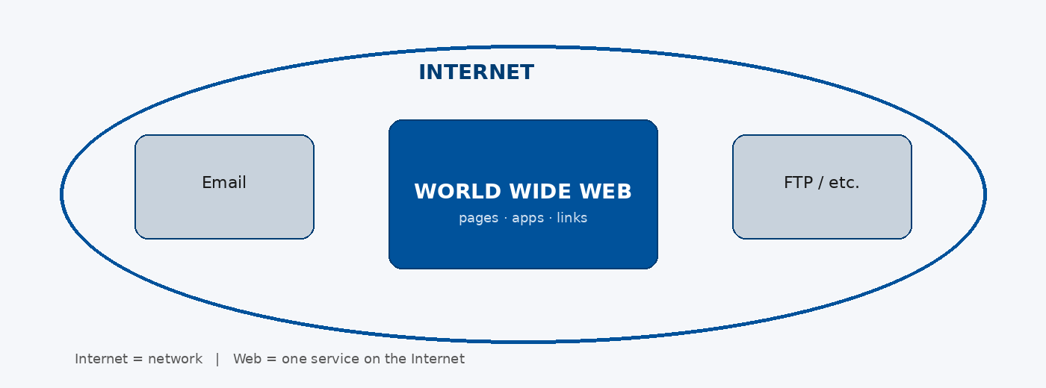
CSE6624 · Lecture 01
Internet vs Web
Today we separate two ideas students often mix. The Internet is the global network that connects hosts. The World Wide Web is one service on that network — alongside email, FTP, and others. This matters because we need the distinction before we talk about HTTP and documents.
Satbayev University · CSE6624 · Lecture 1 · Autumn 2026–2027
3 / 22
Notes:
(укажи на большой овал Internet, потом на синий Web)

Slide 4
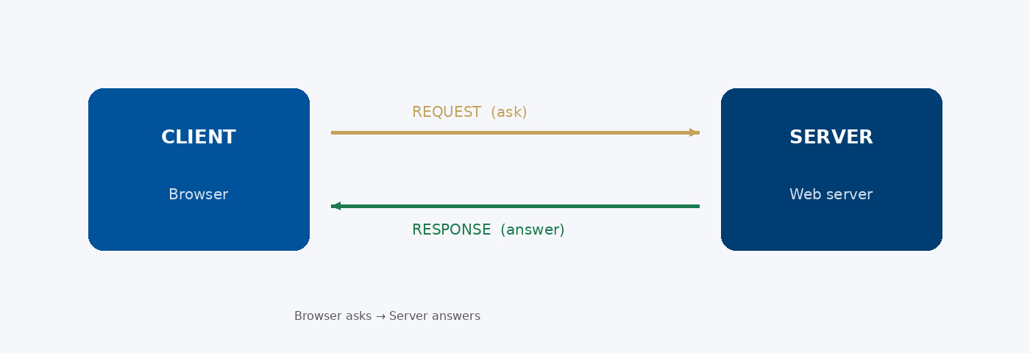
CSE6624 · Lecture 01
Client and Server
Today we start from the client–server model. The browser is the client — it sends an HTTP request for a resource. The server answers with an HTTP response, or with an error status if something went wrong. This exchange is the foundation for everything we build this semester.
Satbayev University · CSE6624 · Lecture 1 · Autumn 2026–2027
4 / 22
Notes:
(укажи на REQUEST стрелку, потом на RESPONSE)

Slide 5
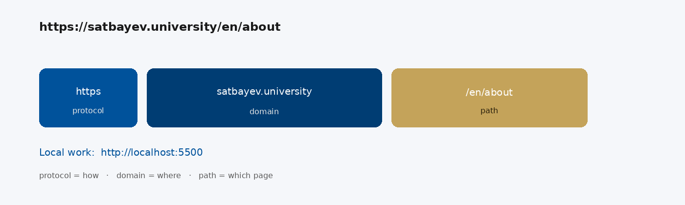
CSE6624 · Lecture 01
URL parts
Notice how a URL identifies a resource on the Web. Read it left to right: scheme — the protocol — then domain or host, then the path. So the key idea is URL literacy. It prevents mistakes when you preview locally and when you deploy.
Satbayev University · CSE6624 · Lecture 1 · Autumn 2026–2027
5 / 22
Notes:
(укажи по очереди на три цветных блока)

Slide 6
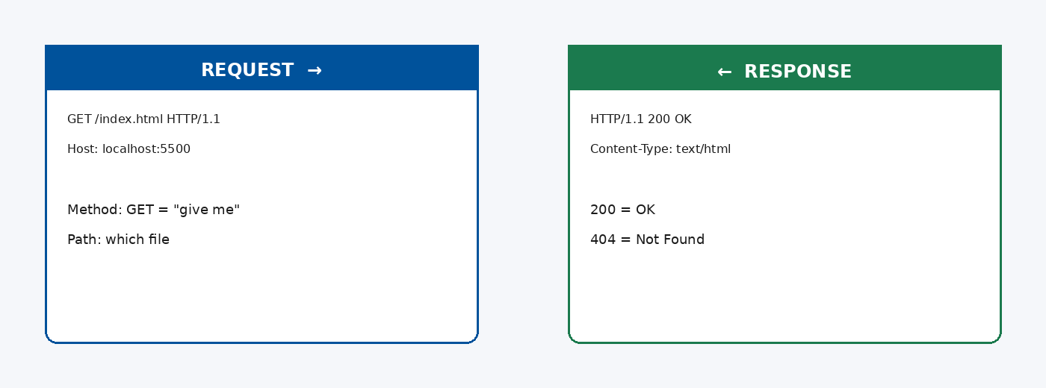
CSE6624 · Lecture 01
HTTP request and response
HTTP is a request–response protocol. The client sends a method and a target; the server replies with a status code and often a body. Status 200 means success; 404 means the resource was not found. In practice we lean on these codes constantly when debugging.
Satbayev University · CSE6624 · Lecture 1 · Autumn 2026–2027
6 / 22
Notes:
(укажи на левую карточку Request, потом Response)

Slide 7
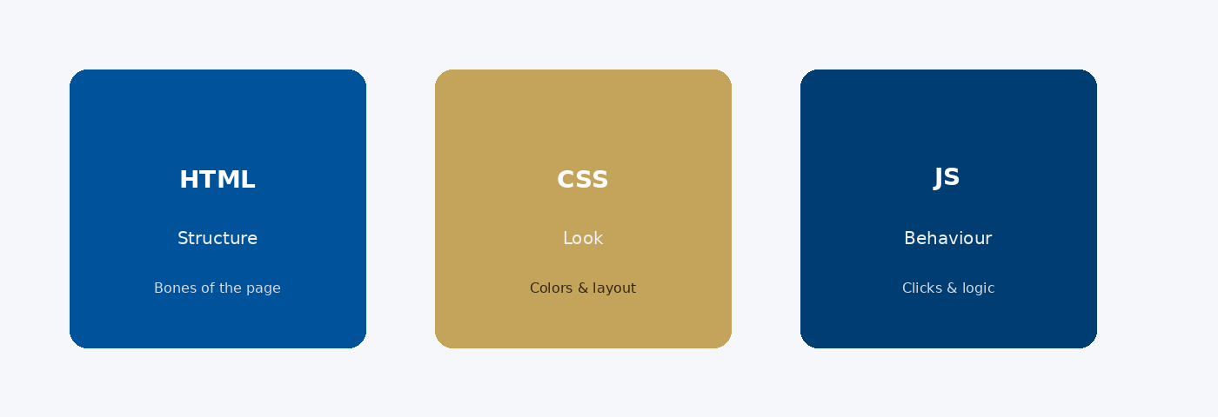
CSE6624 · Lecture 01
Front-end trio: HTML · CSS · JS
Today we meet the front-end trio. HTML defines structure and semantics. CSS controls look through the cascade. JavaScript adds behaviour. Keep the layers distinct in your folders and in your reasoning — mixing them early creates brittle pages.
Satbayev University · CSE6624 · Lecture 1 · Autumn 2026–2027
7 / 22
Notes:
(три слова: Structure — Look — Behaviour. Укажи на карточки.)

Slide 8
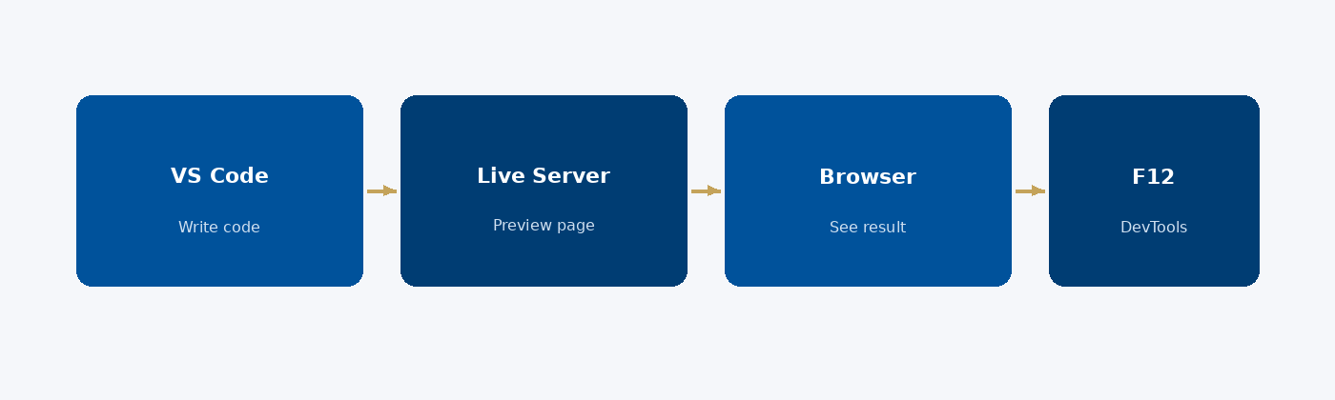
CSE6624 · Lecture 01
Your toolchain
Our toolchain this semester stays intentionally small. We author in VS Code, preview in the browser, and inspect with DevTools — F12. Treat editor, browser, and inspector as one continuous loop, not three unrelated programs.
Satbayev University · CSE6624 · Lecture 1 · Autumn 2026–2027
8 / 22
Notes:
(проведи пальцем по стрелкам слева направо)

Slide 9
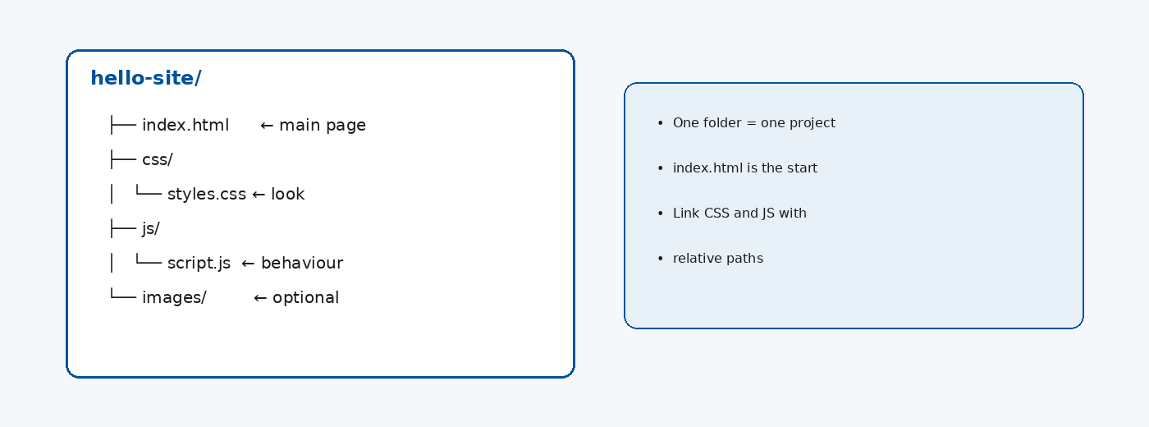
CSE6624 · Lecture 01
Project folder habit
Professional habit starts with folder discipline. One project equals one directory — usually index.html at the root, plus css/ and js/ folders. Prefer clear, lowercase names without spaces. A tidy tree is easier to demo, zip, and reopen weeks later.
Satbayev University · CSE6624 · Lecture 1 · Autumn 2026–2027
9 / 22
Notes:
(укажи на дерево папок слева)

Slide 10
CSE6624 · Lecture 01
DEMO 1/3 — Exact HTML you will type
<!DOCTYPE html>
<html lang="en">
<head>
<meta charset="UTF-8">
<title>Hello — Your Name</title>
</head>
<body>
<h1>Hello, Web!</h1>
<p>My name is Your Name.</p>
<p>Today is my first page.</p>
</body>
</html>
Instructor points at this code. Students look. Do not type yet.
Please watch this demo on the slide — do not type yet. I will point at the code so you see the exact target. In the task block you will reproduce these steps on your laptop. Everything you need is here; you do not leave this presentation.
Satbayev University · CSE6624 · Lecture 1 · Autumn 2026–2027
10 / 22
Notes:
(указывай на код/UI; не открывай другие файлы)

Slide 11
CSE6624 · Lecture 01
DEMO 2/3 — Where files live
Desktop/
lecture01-yourname/
index.html ← only this file today
One folder. One file. Name uses your name, lowercase, no spaces.
Please watch this demo on the slide — do not type yet. I will point at the code so you see the exact target. In the task block you will reproduce these steps on your laptop. Everything you need is here; you do not leave this presentation.
Satbayev University · CSE6624 · Lecture 1 · Autumn 2026–2027
11 / 22
Notes:
(указывай на код/UI; не открывай другие файлы)

Slide 12
CSE6624 · Lecture 01
DEMO 3/3 — What success looks like
┌─────────────────────────────────────┐
│ Hello — Your Name 🗕 🗗 ✕ │
├─────────────────────────────────────┤
│ │
│ Hello, Web! │
│ My name is Your Name. │
│ Today is my first page. │
│ │
└─────────────────────────────────────┘
If the browser is blank, you did not save the file, or you opened the wrong file.
Please watch this demo on the slide — do not type yet. I will point at the layout so you see the exact target. In the task block you will reproduce these steps on your laptop. Everything you need is here; you do not leave this presentation.
Satbayev University · CSE6624 · Lecture 1 · Autumn 2026–2027
12 / 22
Notes:
(указывай на код/UI; не открывай другие файлы)

Slide 13
CSE6624 · Lecture 01
TASK · ~25 min
TASK — Your first web page (~25 min)
Work on YOUR laptop now. Follow the numbered steps on the next slides.
Suggested folder name: lecture01-yourname
If stuck: read the previous step again. Do not skip steps.
AI is optional later — first follow the steps yourself.
Now you work. The next slides are idiot-proof steps — one action after another. I will walk the room while you build. If something fails, open the If it does not work slide after the steps. Do not invent your own path during these twenty-five minutes.
Satbayev University · CSE6624 · Lecture 1 · Autumn 2026–2027
13 / 22
Notes:
(25 мин. Ходи по рядам. Стой.)

Slide 14
CSE6624 · Lecture 01
Step 1 of 5 · Create the folder
1
Create the folder
→ On Desktop, right-click → New Folder.
→ Name it exactly: lecture01-yourname
→ Example: lecture01-aida
→ Open the empty folder so you can see inside.
This is step 1. Do only this step, then wait for the next slide. Click the menus named on the slide — File, Save As, Open with. When the action is done, look up. If it failed, do not jump ahead — reread this step slowly.
Satbayev University · CSE6624 · Lecture 1 · Autumn 2026–2027
14 / 22
Notes:
(шаг 1)

Slide 15
CSE6624 · Lecture 01
Step 2 of 5 · Open an editor
2
Open an editor
→ Open VS Code (or Notepad / any text editor).
→ File → New File.
→ You should see an empty editing window.
This is step 2. Do only this step, then wait for the next slide. Click the menus named on the slide — File, Save As, Open with. When the action is done, look up. If it failed, do not jump ahead — reread this step slowly.
Satbayev University · CSE6624 · Lecture 1 · Autumn 2026–2027
15 / 22
Notes:
(шаг 2)

Slide 16
CSE6624 · Lecture 01
Step 3 of 5 · Type EXACTLY this HTML
3
Type EXACTLY this HTML
→ Copy carefully from the DEMO slide. Change Your Name to your real name.
<!DOCTYPE html>
<html lang="en">
<head>
<meta charset="UTF-8">
<title>Hello — Your Name</title>
</head>
<body>
<h1>Hello, Web!</h1>
<p>My name is Your Name.</p>
<p>Today is my first page.</p>
</body>
</html>
This is step 3. Do only this step, then wait for the next slide. Click the menus named on the slide — File, Save As, Open with. When the action is done, look up. If it failed, do not jump ahead — reread this step slowly.
Satbayev University · CSE6624 · Lecture 1 · Autumn 2026–2027
16 / 22
Notes:
(шаг 3)

Slide 17
CSE6624 · Lecture 01
Step 4 of 5 · Save as index.html
4
Save as index.html
→ File → Save As…
→ Go into Desktop / lecture01-yourname /
→ File name: index.html (not index.html.txt)
→ Save.
This is step 4. Do only this step, then wait for the next slide. Click the menus named on the slide — File, Save As, Open with. When the action is done, look up. If it failed, do not jump ahead — reread this step slowly.
Satbayev University · CSE6624 · Lecture 1 · Autumn 2026–2027
17 / 22
Notes:
(шаг 4)

Slide 18
CSE6624 · Lecture 01
Step 5 of 5 · Open in the browser
5
Open in the browser
→ In the folder: right-click index.html → Open with → Chrome (or Edge/Firefox).
→ OR drag the file into a browser window.
→ You should SEE: big heading Hello, Web! and your two paragraphs.
→ If blank: go back to Step 4 — you probably did not save.
This is step 5. Do only this step, then wait for the next slide. Click the menus named on the slide — File, Save As, Open with. When the action is done, look up. If it failed, do not jump ahead — reread this step slowly.
Satbayev University · CSE6624 · Lecture 1 · Autumn 2026–2027
18 / 22
Notes:
(шаг 5)

Slide 19
CSE6624 · Lecture 01
If it does not work
Three common mistakes — fix these before asking for help:
Mistake 1
File is named index.html.txt → rename, remove .txt (Windows: show file extensions).
Mistake 2
You edited but did not Save → Ctrl+S, then refresh the browser (F5).
Mistake 3
You opened a different folder’s file → check the path: Desktop/lecture01-yourname/index.html.
Most failures are save mistakes, wrong file names, or skipped steps. Read these three mistakes aloud if needed. Fix one thing, save, refresh the browser, then re-check the success condition. Still stuck after that — raise your hand; bring your screen.
Satbayev University · CSE6624 · Lecture 1 · Autumn 2026–2027
19 / 22
Notes:
(три ошибки)

Slide 20
CSE6624 · Lecture 01
DONE — what to submit / show
☐
Photo of the browser window showing your page.
☐
Photo or screenshot of the folder with index.html visible.
☐
Show your neighbour for 10 seconds.
☐
Keep the folder — you will reuse it next weeks.
You are done when the checklist is true. Take a photo of the browser and of the file or folder. Show your neighbour for ten seconds. Upload later if the LMS asks — keep the folder on your Desktop.
Satbayev University · CSE6624 · Lecture 1 · Autumn 2026–2027
20 / 22
Notes:
(done checklist)

Slide 21
CSE6624 · Lecture 01
Next lecture + AI rule
Next lecture
Next lecture: HTML semantic structure (header, nav, main, footer).
AI rule (one line)
You may use AI, but you must still follow these steps yourself and explain your result.
After class rhythm: Practice & Lab
Next we continue with the topic on this slide. After the lecture block comes Practice & Lab. You may use AI, but you must still follow the slide steps yourself and explain your result. Pack your folder. See you next week.
Satbayev University · CSE6624 · Lecture 1 · Autumn 2026–2027
21 / 22
Notes:
(next + AI — без Questions)

Slide 22
See you next week.
Keep your folder. Re-read the last task steps if anything is unclear.
CSE6624 · Lecture 1 · WWW, HTTP, and Development Setup
Shoiynbek Temirlan Armanuly · Senior Lecturer
Satbayev University · Autumn 2026–2027 · Almaty
Notes:
(улыбка. Без Questions.)

