Slide 1


SATBAYEV UNIVERSITY
Automation and Information Technology · Software Engineering
CSE6624
Introduction to Web Programming
Lecture 2
HTML Semantic Structure
Shoiynbek Temirlan Armanuly
Senior Lecturer
Programme: 6B06102 Computer Science
Autumn 2026–2027 · Almaty
City University / Satbayev University · English-taught course
Notes:
(улыбнись — Hello + номер лекции + тема.)

Slide 2
CSE6624 · Lecture 02
Today's plan · 50 minutes
15 min
~15 min — I explain (diagrams + you listen)
I read the strips. You look at the diagrams. No typing yet.
5 min
~5 min — Demo on these slides
Code / UI is ON the slides. I only point. Do not open other folders.
25 min
~25 min — You do the task
Step-by-step ON the slides. Follow every click. If stuck: read the previous step again.
5 min
~5 min — What to submit / next lecture
Photo proof + show neighbour. One-line preview of next week.
Today's plan is fixed to fifty minutes. About fifteen minutes I explain with diagrams. About five minutes I point at demo code on these slides — you watch. About twenty-five minutes you follow the task steps on the slides. The last five minutes cover what to submit and what comes next. There is no separate questions block — if stuck, read the previous step again.
Satbayev University · CSE6624 · Lecture 2 · Autumn 2026–2027
2 / 19
Notes:
(прочитай полоску; укажи на 15/5/25/5)

Slide 3
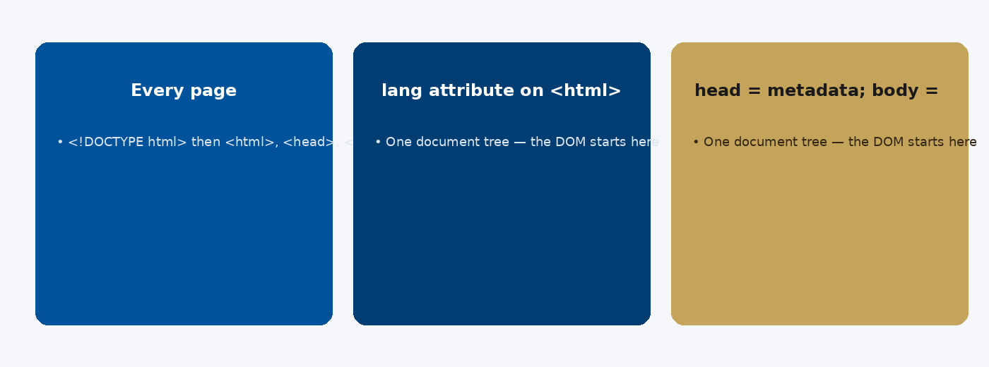
CSE6624 · Lecture 02
Document structure
Today we examine Document structure. First: Every page: <!DOCTYPE html> then <html>, <head>, <body>. Second: lang attribute on <html> helps a11y and SEO. Also notice: head = metadata; body = visible content. So the key idea is precise terminology — these distinctions return in demos, labs, and assessment.
Satbayev University · CSE6624 · Lecture 2 · Autumn 2026–2027
3 / 19
Notes:
(прочитай) Укажи на ключевые пункты: Document structure

Slide 4
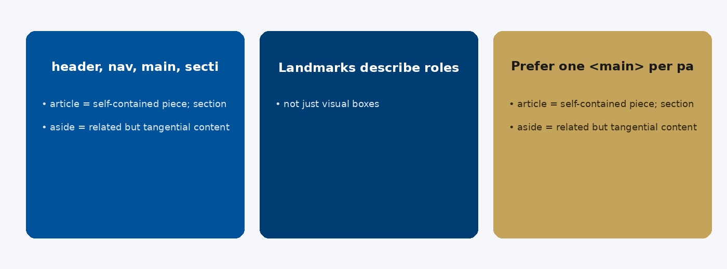
CSE6624 · Lecture 02
Semantic landmarks
Today we examine Semantic landmarks. First: header, nav, main, section, article, aside, footer. Second: Landmarks describe roles — not just visual boxes. Also notice: Prefer one <main> per page. So the key idea is precise terminology — these distinctions return in demos, labs, and assessment.
Satbayev University · CSE6624 · Lecture 2 · Autumn 2026–2027
4 / 19
Notes:
(прочитай) Укажи на ключевые пункты: Semantic landmarks

Slide 5
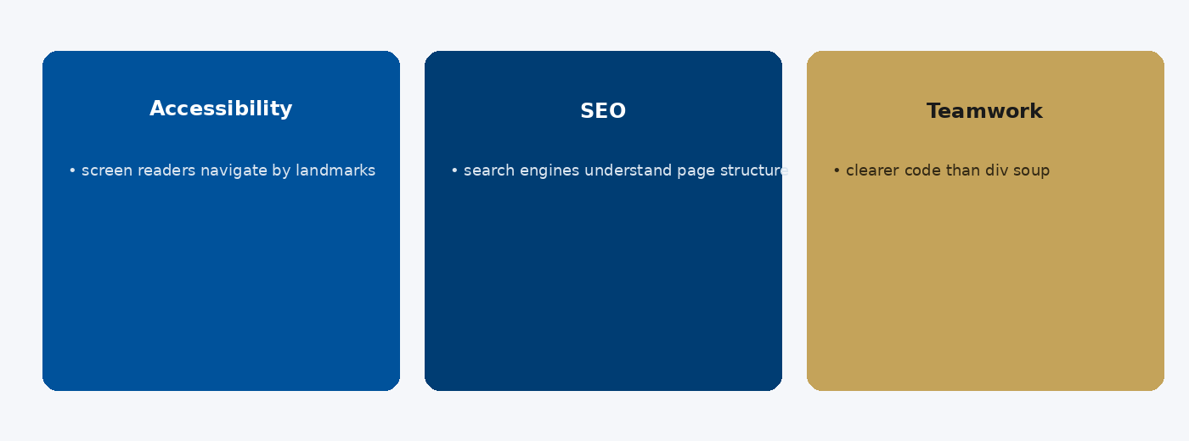
CSE6624 · Lecture 02
Why semantics matter
Today we examine Why semantics matter. First: Accessibility: screen readers navigate by landmarks. Second: SEO: search engines understand page structure. Also notice: Teamwork: clearer code than div soup. So the key idea is precise terminology — these distinctions return in demos, labs, and assessment.
Satbayev University · CSE6624 · Lecture 2 · Autumn 2026–2027
5 / 19
Notes:
(прочитай) Укажи на ключевые пункты: Why semantics matter

Slide 6
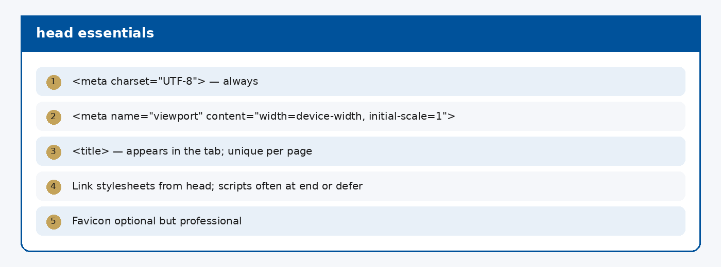
CSE6624 · Lecture 02
head essentials
Today we examine head essentials. First: <meta charset="UTF-8"> — always. Second: <meta name="viewport" content="width=device-width, initial-scale=1">. Also notice: <title> — appears in the tab; unique per page. So the key idea is precise terminology — these distinctions return in demos, labs, and assessment.
Satbayev University · CSE6624 · Lecture 2 · Autumn 2026–2027
6 / 19
Notes:
(прочитай) Укажи на ключевые пункты: head essentials

Slide 7
CSE6624 · Lecture 02
DEMO 1/3 — Bad: div soup
<div id="top">Site</div>
<div class="menu">Home</div>
<div class="content">
<div class="title">Hello</div>
</div>
<div id="bottom">© 2026</div>
This works visually — but machines and screen readers cannot see the structure.
Please watch this demo on the slide — do not type yet. I will point at the code so you see the exact target. In the task block you will reproduce these steps on your laptop. Everything you need is here; you do not leave this presentation.
Satbayev University · CSE6624 · Lecture 2 · Autumn 2026–2027
7 / 19
Notes:
(указывай на код/UI; не открывай другие файлы)

Slide 8
CSE6624 · Lecture 02
DEMO 2/3 — Good: landmarks
<!DOCTYPE html>
<html lang="en">
<head>
<meta charset="UTF-8">
<title>Semantic Demo</title>
</head>
<body>
<header><h1>My Site</h1></header>
<nav><a href="#">Home</a> · <a href="#">About</a></nav>
<main>
<h2>Welcome</h2>
<p>Main content lives here.</p>
</main>
<footer><p>© 2026</p></footer>
</body>
</html>
header · nav · main · footer — remember these four words.
Please watch this demo on the slide — do not type yet. I will point at the code so you see the exact target. In the task block you will reproduce these steps on your laptop. Everything you need is here; you do not leave this presentation.
Satbayev University · CSE6624 · Lecture 2 · Autumn 2026–2027
8 / 19
Notes:
(указывай на код/UI; не открывай другие файлы)

Slide 9
CSE6624 · Lecture 02
DEMO 3/3 — Browser outline idea
Document outline
H1 My Site
H2 Welcome
Landmarks: banner · navigation · main · contentinfo
One h1. Main holds the primary content. Footer is last.
Please watch this demo on the slide — do not type yet. I will point at the layout so you see the exact target. In the task block you will reproduce these steps on your laptop. Everything you need is here; you do not leave this presentation.
Satbayev University · CSE6624 · Lecture 2 · Autumn 2026–2027
9 / 19
Notes:
(указывай на код/UI; не открывай другие файлы)

Slide 10
CSE6624 · Lecture 02
TASK · ~25 min
TASK — Rebuild with semantic landmarks (~25 min)
Work on YOUR laptop now. Follow the numbered steps on the next slides.
Suggested folder name: lecture02-yourname
If stuck: read the previous step again. Do not skip steps.
AI is optional later — first follow the steps yourself.
Now you work. The next slides are idiot-proof steps — one action after another. I will walk the room while you build. If something fails, open the If it does not work slide after the steps. Do not invent your own path during these twenty-five minutes.
Satbayev University · CSE6624 · Lecture 2 · Autumn 2026–2027
10 / 19
Notes:
(25 мин. Ходи по рядам. Стой.)

Slide 11
CSE6624 · Lecture 02
Step 1 of 5 · New folder + new file
1
New folder + new file
→ Desktop → New Folder → lecture02-yourname
→ Open VS Code → File → New File.
This is step 1. Do only this step, then wait for the next slide. Click the menus named on the slide — File, Save As, Open with. When the action is done, look up. If it failed, do not jump ahead — reread this step slowly.
Satbayev University · CSE6624 · Lecture 2 · Autumn 2026–2027
11 / 19
Notes:
(шаг 1)

Slide 12
CSE6624 · Lecture 02
Step 2 of 5 · Type the full semantic page
2
Type the full semantic page
→ Type EXACTLY this (change text to your name/topic if you want):
<!DOCTYPE html>
<html lang="en">
<head>
<meta charset="UTF-8">
<title>Lecture 02 — Semantic</title>
</head>
<body>
<header><h1>My Site</h1></header>
<nav>
<a href="#">Home</a> |
<a href="#">About</a>
</nav>
<main>
<h2>Welcome</h2>
<p>This is the main content.</p>
<h2>About me</h2>
<p>I am learning HTML structure.</p>
</main>
<footer><p>© 2026 Your Name</p></footer>
</body>
</html>
This is step 2. Do only this step, then wait for the next slide. Click the menus named on the slide — File, Save As, Open with. When the action is done, look up. If it failed, do not jump ahead — reread this step slowly.
Satbayev University · CSE6624 · Lecture 2 · Autumn 2026–2027
12 / 19
Notes:
(шаг 2)

Slide 13
CSE6624 · Lecture 02
Step 3 of 5 · Save as index.html
3
Save as index.html
→ File → Save As… → Desktop/lecture02-yourname/index.html
→ Confirm the name ends with .html not .txt
This is step 3. Do only this step, then wait for the next slide. Click the menus named on the slide — File, Save As, Open with. When the action is done, look up. If it failed, do not jump ahead — reread this step slowly.
Satbayev University · CSE6624 · Lecture 2 · Autumn 2026–2027
13 / 19
Notes:
(шаг 3)

Slide 14
CSE6624 · Lecture 02
Step 4 of 5 · Open in Chrome
4
Open in Chrome
→ Right-click index.html → Open with Chrome.
→ You should SEE: title, two links, two sections, footer.
This is step 4. Do only this step, then wait for the next slide. Click the menus named on the slide — File, Save As, Open with. When the action is done, look up. If it failed, do not jump ahead — reread this step slowly.
Satbayev University · CSE6624 · Lecture 2 · Autumn 2026–2027
14 / 19
Notes:
(шаг 4)

Slide 15
CSE6624 · Lecture 02
Step 5 of 5 · Self-check landmarks
5
Self-check landmarks
→ Look at your code: do you have <header>, <nav>, <main>, <footer>?
→ Is there exactly one <h1>?
→ If a tag is missing — add it, Save (Ctrl+S), refresh browser (F5).
This is step 5. Do only this step, then wait for the next slide. Click the menus named on the slide — File, Save As, Open with. When the action is done, look up. If it failed, do not jump ahead — reread this step slowly.
Satbayev University · CSE6624 · Lecture 2 · Autumn 2026–2027
15 / 19
Notes:
(шаг 5)

Slide 16
CSE6624 · Lecture 02
If it does not work
Three common mistakes — fix these before asking for help:
Mistake 1
Used only <div> — replace with header/nav/main/footer.
Mistake 2
Several <h1> tags — keep one h1; use h2 inside main.
Mistake 3
Saved as .txt — rename to index.html and reopen in browser.
Most failures are save mistakes, wrong file names, or skipped steps. Read these three mistakes aloud if needed. Fix one thing, save, refresh the browser, then re-check the success condition. Still stuck after that — raise your hand; bring your screen.
Satbayev University · CSE6624 · Lecture 2 · Autumn 2026–2027
16 / 19
Notes:
(три ошибки)

Slide 17
CSE6624 · Lecture 02
DONE — what to submit / show
☐
Browser photo showing the page.
☐
Editor photo showing header/nav/main/footer tags.
☐
Show neighbour your landmarks.
You are done when the checklist is true. Take a photo of the browser and of the file or folder. Show your neighbour for ten seconds. Upload later if the LMS asks — keep the folder on your Desktop.
Satbayev University · CSE6624 · Lecture 2 · Autumn 2026–2027
17 / 19
Notes:
(done checklist)

Slide 18
CSE6624 · Lecture 02
Next lecture + AI rule
Next lecture
Next lecture: text, lists, links, and media.
AI rule (one line)
You may use AI, but you must still follow these steps yourself and explain your result.
After class rhythm: Practice & Lab
Next we continue with the topic on this slide. After the lecture block comes Practice & Lab. You may use AI, but you must still follow the slide steps yourself and explain your result. Pack your folder. See you next week.
Satbayev University · CSE6624 · Lecture 2 · Autumn 2026–2027
18 / 19
Notes:
(next + AI — без Questions)

Slide 19
See you next week.
Keep your folder. Re-read the last task steps if anything is unclear.
CSE6624 · Lecture 2 · HTML Semantic Structure
Shoiynbek Temirlan Armanuly · Senior Lecturer
Satbayev University · Autumn 2026–2027 · Almaty
Notes:
(улыбка. Без Questions.)

