Slide 1


SATBAYEV UNIVERSITY
Automation and Information Technology · Software Engineering
CSE6624
Introduction to Web Programming
Lecture 3
Text, Lists, Links, and Media
Shoiynbek Temirlan Armanuly
Senior Lecturer
Programme: 6B06102 Computer Science
Autumn 2026–2027 · Almaty
City University / Satbayev University · English-taught course
Notes:
(улыбнись — Hello + номер лекции + тема.)

Slide 2
CSE6624 · Lecture 03
Today's plan · 50 minutes
15 min
~15 min — I explain (diagrams + you listen)
I read the strips. You look at the diagrams. No typing yet.
5 min
~5 min — Demo on these slides
Code / UI is ON the slides. I only point. Do not open other folders.
25 min
~25 min — You do the task
Step-by-step ON the slides. Follow every click. If stuck: read the previous step again.
5 min
~5 min — What to submit / next lecture
Photo proof + show neighbour. One-line preview of next week.
Today's plan is fixed to fifty minutes. About fifteen minutes I explain with diagrams. About five minutes I point at demo code on these slides — you watch. About twenty-five minutes you follow the task steps on the slides. The last five minutes cover what to submit and what comes next. There is no separate questions block — if stuck, read the previous step again.
Satbayev University · CSE6624 · Lecture 3 · Autumn 2026–2027
2 / 18
Notes:
(прочитай полоску; укажи на 15/5/25/5)

Slide 3
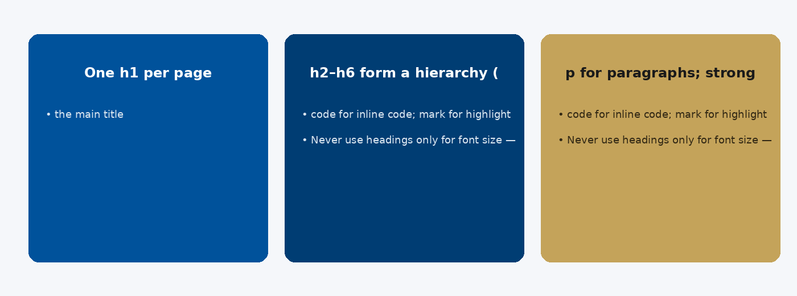
CSE6624 · Lecture 03
Headings and text
Today we examine Headings and text. First: One h1 per page — the main title. Second: h2–h6 form a hierarchy (do not skip levels casually). Also notice: p for paragraphs; strong / em for importance / stress. So the key idea is precise terminology — these distinctions return in demos, labs, and assessment.
Satbayev University · CSE6624 · Lecture 3 · Autumn 2026–2027
3 / 18
Notes:
(прочитай) Укажи на ключевые пункты: Headings and text

Slide 4
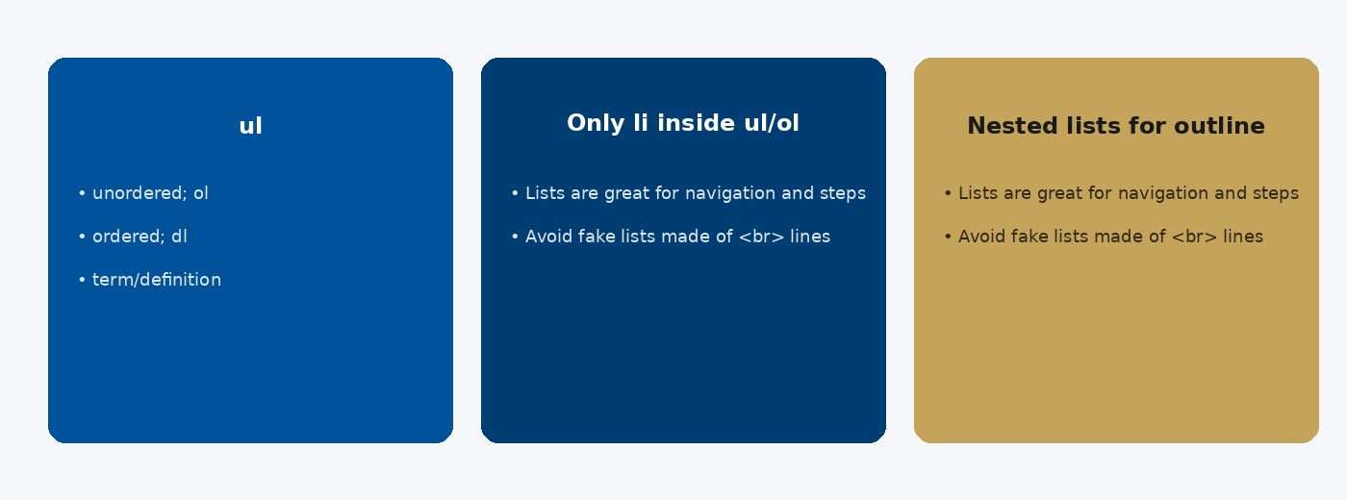
CSE6624 · Lecture 03
Lists
Today we examine Lists. First: ul — unordered; ol — ordered; dl — term/definition. Second: Only li inside ul/ol. Also notice: Nested lists for outlines and menus. So the key idea is precise terminology — these distinctions return in demos, labs, and assessment.
Satbayev University · CSE6624 · Lecture 3 · Autumn 2026–2027
4 / 18
Notes:
(прочитай) Укажи на ключевые пункты: Lists

Slide 5
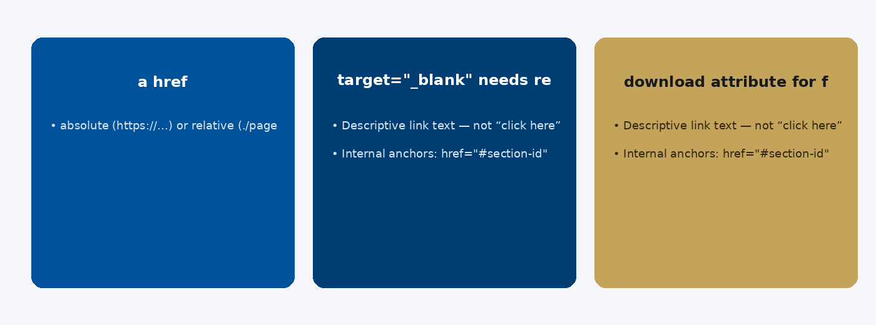
CSE6624 · Lecture 03
Links
Today we examine Links. First: a href — absolute (https://…) or relative (./page.html). Second: target="_blank" needs rel="noopener noreferrer". Also notice: download attribute for file links. So the key idea is precise terminology — these distinctions return in demos, labs, and assessment.
Satbayev University · CSE6624 · Lecture 3 · Autumn 2026–2027
5 / 18
Notes:
(прочитай) Укажи на ключевые пункты: Links

Slide 6
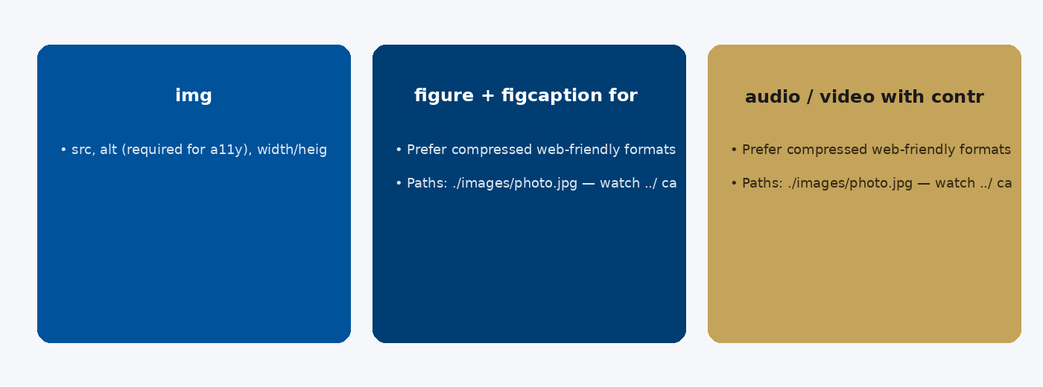
CSE6624 · Lecture 03
Images and media
Today we examine Images and media. First: img: src, alt (required for a11y), width/height optional. Second: figure + figcaption for captioned images. Also notice: audio / video with controls attribute. So the key idea is precise terminology — these distinctions return in demos, labs, and assessment.
Satbayev University · CSE6624 · Lecture 3 · Autumn 2026–2027
6 / 18
Notes:
(прочитай) Укажи на ключевые пункты: Images and media

Slide 7
CSE6624 · Lecture 03
DEMO 1/2 — Article HTML
<main>
<h1>My Hobby: Photography</h1>
<p>I like taking photos in Almaty.</p>
<p>Three places I visit:</p>
<ul>
<li>Kok-Tobe</li>
<li>Medeu</li>
<li>Panfilov Park</li>
</ul>
<p>
<a href="#tips">Tips</a> ·
<a href="https://satbayev.university" target="_blank">University</a>
</p>
<img src="https://via.placeholder.com/300x150" alt="Sample landscape photo">
<h2 id="tips">Tips</h2>
<p>Charge the battery before you go.</p>
</main>
List · internal link (#tips) · external link · img with alt.
Please watch this demo on the slide — do not type yet. I will point at the code so you see the exact target. In the task block you will reproduce these steps on your laptop. Everything you need is here; you do not leave this presentation.
Satbayev University · CSE6624 · Lecture 3 · Autumn 2026–2027
7 / 18
Notes:
(указывай на код/UI; не открывай другие файлы)

Slide 8
CSE6624 · Lecture 03
DEMO 2/2 — What you must see
Heading
Two paragraphs
• bullet · bullet · bullet
Links work (click Tips → jumps down)
Image with meaningful alt text
If the image is broken, alt text still explains it — that is OK for today.
Please watch this demo on the slide — do not type yet. I will point at the layout so you see the exact target. In the task block you will reproduce these steps on your laptop. Everything you need is here; you do not leave this presentation.
Satbayev University · CSE6624 · Lecture 3 · Autumn 2026–2027
8 / 18
Notes:
(указывай на код/UI; не открывай другие файлы)

Slide 9
CSE6624 · Lecture 03
TASK · ~25 min
TASK — Build a short article page (~25 min)
Work on YOUR laptop now. Follow the numbered steps on the next slides.
Suggested folder name: lecture03-yourname
If stuck: read the previous step again. Do not skip steps.
AI is optional later — first follow the steps yourself.
Now you work. The next slides are idiot-proof steps — one action after another. I will walk the room while you build. If something fails, open the If it does not work slide after the steps. Do not invent your own path during these twenty-five minutes.
Satbayev University · CSE6624 · Lecture 3 · Autumn 2026–2027
9 / 18
Notes:
(25 мин. Ходи по рядам. Стой.)

Slide 10
CSE6624 · Lecture 03
Step 1 of 5 · Folder + file
1
Folder + file
→ Create Desktop/lecture03-yourname
→ New File in VS Code.
This is step 1. Do only this step, then wait for the next slide. Click the menus named on the slide — File, Save As, Open with. When the action is done, look up. If it failed, do not jump ahead — reread this step slowly.
Satbayev University · CSE6624 · Lecture 3 · Autumn 2026–2027
10 / 18
Notes:
(шаг 1)

Slide 11
CSE6624 · Lecture 03
Step 2 of 5 · Type full page skeleton + article
2
Type full page skeleton + article
→ Include DOCTYPE, html, head, body. Put the article inside <main>.
<!DOCTYPE html>
<html lang="en">
<head>
<meta charset="UTF-8">
<title>My Article</title>
</head>
<body>
<main>
<h1>My Hobby: …</h1>
<p>Write 2–3 sentences.</p>
<ul>
<li>Item one</li>
<li>Item two</li>
<li>Item three</li>
</ul>
<p><a href="#end">Jump to end</a> ·
<a href="https://satbayev.university">External</a></p>
<img src="https://via.placeholder.com/300x150"
alt="Describe the image in words">
<h2 id="end">The end</h2>
<p>Thank you for reading.</p>
</main>
</body>
</html>
This is step 2. Do only this step, then wait for the next slide. Click the menus named on the slide — File, Save As, Open with. When the action is done, look up. If it failed, do not jump ahead — reread this step slowly.
Satbayev University · CSE6624 · Lecture 3 · Autumn 2026–2027
11 / 18
Notes:
(шаг 2)

Slide 12
CSE6624 · Lecture 03
Step 3 of 5 · Save + open
3
Save + open
→ Save as index.html in lecture03-yourname.
→ Open with Chrome.
This is step 3. Do only this step, then wait for the next slide. Click the menus named on the slide — File, Save As, Open with. When the action is done, look up. If it failed, do not jump ahead — reread this step slowly.
Satbayev University · CSE6624 · Lecture 3 · Autumn 2026–2027
12 / 18
Notes:
(шаг 3)

Slide 13
CSE6624 · Lecture 03
Step 4 of 5 · Click-test links
4
Click-test links
→ Click the Jump to end link — page should move to The end.
→ Click External — university site opens (or new tab).
This is step 4. Do only this step, then wait for the next slide. Click the menus named on the slide — File, Save As, Open with. When the action is done, look up. If it failed, do not jump ahead — reread this step slowly.
Satbayev University · CSE6624 · Lecture 3 · Autumn 2026–2027
13 / 18
Notes:
(шаг 4)

Slide 14
CSE6624 · Lecture 03
Step 5 of 5 · Check alt
5
Check alt
→ In code, img must have alt="…" with real words.
→ alt="" only if decorative — not today.
This is step 5. Do only this step, then wait for the next slide. Click the menus named on the slide — File, Save As, Open with. When the action is done, look up. If it failed, do not jump ahead — reread this step slowly.
Satbayev University · CSE6624 · Lecture 3 · Autumn 2026–2027
14 / 18
Notes:
(шаг 5)

Slide 15
CSE6624 · Lecture 03
If it does not work
Three common mistakes — fix these before asking for help:
Mistake 1
List used wrong tags — use <ul><li>…</li></ul>.
Mistake 2
Internal link href="tips" missing # — use href="#end".
Mistake 3
Image has no alt — add alt="…" before >.
Most failures are save mistakes, wrong file names, or skipped steps. Read these three mistakes aloud if needed. Fix one thing, save, refresh the browser, then re-check the success condition. Still stuck after that — raise your hand; bring your screen.
Satbayev University · CSE6624 · Lecture 3 · Autumn 2026–2027
15 / 18
Notes:
(три ошибки)

Slide 16
CSE6624 · Lecture 03
DONE — what to submit / show
☐
Browser photo
☐
Show neighbour list + both links
☐
Keep folder
You are done when the checklist is true. Take a photo of the browser and of the file or folder. Show your neighbour for ten seconds. Upload later if the LMS asks — keep the folder on your Desktop.
Satbayev University · CSE6624 · Lecture 3 · Autumn 2026–2027
16 / 18
Notes:
(done checklist)

Slide 17
CSE6624 · Lecture 03
Next lecture + AI rule
Next lecture
Next lecture: tables and forms.
AI rule (one line)
You may use AI, but you must still follow these steps yourself and explain your result.
After class rhythm: Practice & Lab
Next we continue with the topic on this slide. After the lecture block comes Practice & Lab. You may use AI, but you must still follow the slide steps yourself and explain your result. Pack your folder. See you next week.
Satbayev University · CSE6624 · Lecture 3 · Autumn 2026–2027
17 / 18
Notes:
(next + AI — без Questions)

Slide 18
See you next week.
Keep your folder. Re-read the last task steps if anything is unclear.
CSE6624 · Lecture 3 · Text, Lists, Links, and Media
Shoiynbek Temirlan Armanuly · Senior Lecturer
Satbayev University · Autumn 2026–2027 · Almaty
Notes:
(улыбка. Без Questions.)

