Slide 1


SATBAYEV UNIVERSITY
Automation and Information Technology · Software Engineering
CSE6624
Introduction to Web Programming
Lecture 4
Tables and Forms
Shoiynbek Temirlan Armanuly
Senior Lecturer
Programme: 6B06102 Computer Science
Autumn 2026–2027 · Almaty
City University / Satbayev University · English-taught course
Notes:
(улыбнись — Hello + номер лекции + тема.)

Slide 2
CSE6624 · Lecture 04
Today's plan · 50 minutes
15 min
~15 min — I explain (diagrams + you listen)
I read the strips. You look at the diagrams. No typing yet.
5 min
~5 min — Demo on these slides
Code / UI is ON the slides. I only point. Do not open other folders.
25 min
~25 min — You do the task
Step-by-step ON the slides. Follow every click. If stuck: read the previous step again.
5 min
~5 min — What to submit / next lecture
Photo proof + show neighbour. One-line preview of next week.
Today's plan is fixed to fifty minutes. About fifteen minutes I explain with diagrams. About five minutes I point at demo code on these slides — you watch. About twenty-five minutes you follow the task steps on the slides. The last five minutes cover what to submit and what comes next. There is no separate questions block — if stuck, read the previous step again.
Satbayev University · CSE6624 · Lecture 4 · Autumn 2026–2027
2 / 18
Notes:
(прочитай полоску; укажи на 15/5/25/5)

Slide 3
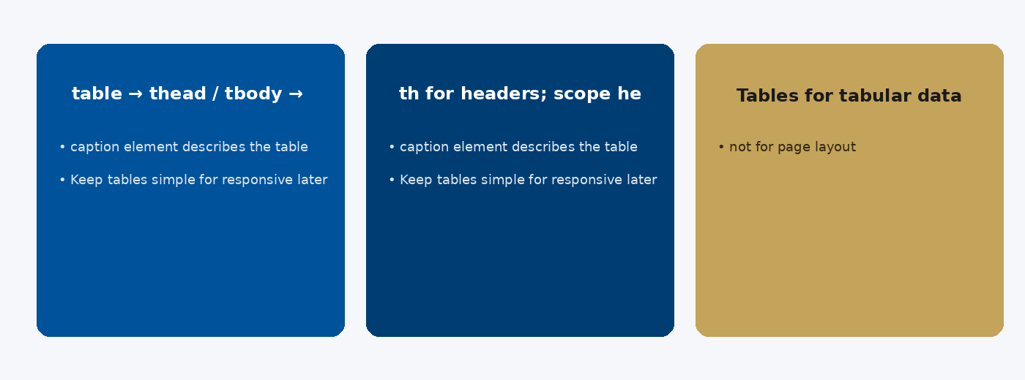
CSE6624 · Lecture 04
Tables
Today we examine Tables. First: table → thead / tbody → tr → th / td. Second: th for headers; scope helps screen readers. Also notice: Tables for tabular data — not for page layout. So the key idea is precise terminology — these distinctions return in demos, labs, and assessment.
Satbayev University · CSE6624 · Lecture 4 · Autumn 2026–2027
3 / 18
Notes:
(прочитай) Укажи на ключевые пункты: Tables

Slide 4
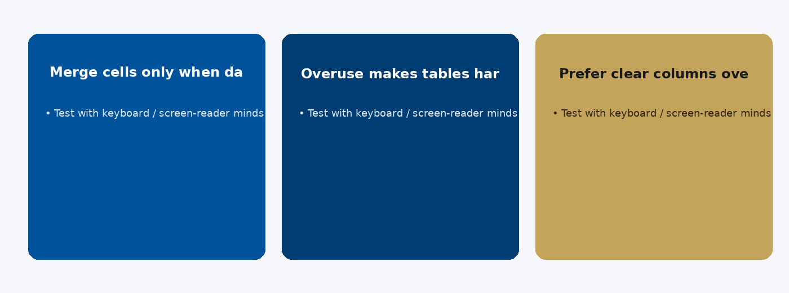
CSE6624 · Lecture 04
colspan and rowspan
Today we examine colspan and rowspan. First: Merge cells only when data truly spans. Second: Overuse makes tables hard to maintain. Also notice: Prefer clear columns over complex merges. So the key idea is precise terminology — these distinctions return in demos, labs, and assessment.
Satbayev University · CSE6624 · Lecture 4 · Autumn 2026–2027
4 / 18
Notes:
(прочитай) Укажи на ключевые пункты: colspan and rowspan

Slide 5
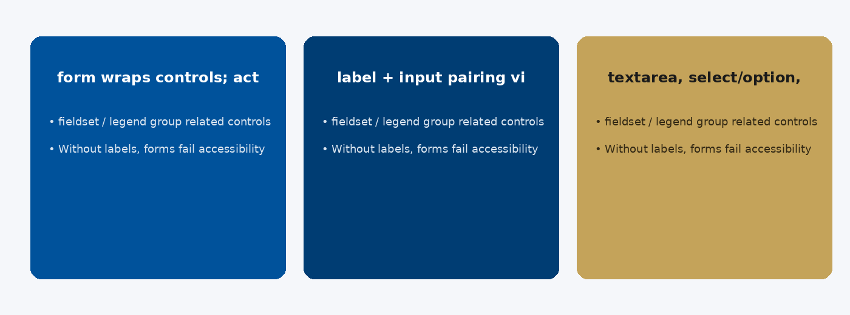
CSE6624 · Lecture 04
Form anatomy
Today we examine Form anatomy. First: form wraps controls; action/method for submit target. Second: label + input pairing via for/id. Also notice: textarea, select/option, button. So the key idea is precise terminology — these distinctions return in demos, labs, and assessment.
Satbayev University · CSE6624 · Lecture 4 · Autumn 2026–2027
5 / 18
Notes:
(прочитай) Укажи на ключевые пункты: Form anatomy

Slide 6
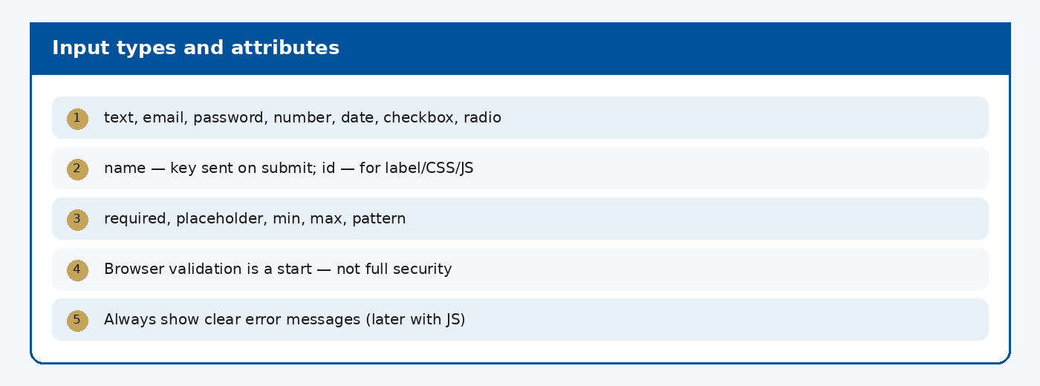
CSE6624 · Lecture 04
Input types and attributes
Today we examine Input types and attributes. First: text, email, password, number, date, checkbox, radio. Second: name — key sent on submit; id — for label/CSS/JS. Also notice: required, placeholder, min, max, pattern. So the key idea is precise terminology — these distinctions return in demos, labs, and assessment.
Satbayev University · CSE6624 · Lecture 4 · Autumn 2026–2027
6 / 18
Notes:
(прочитай) Укажи на ключевые пункты: Input types and attributes

Slide 7
CSE6624 · Lecture 04
DEMO 1/2 — Labeled form
<form>
<label for="name">Name</label>
<input id="name" name="name" type="text" required>
<label for="email">Email</label>
<input id="email" name="email" type="email" required>
<label for="role">Role</label>
<select id="role" name="role">
<option>Student</option>
<option>Teacher</option>
</select>
<button type="submit">Send</button>
</form>
Every input has a matching label (for= and id= must match).
Please watch this demo on the slide — do not type yet. I will point at the code so you see the exact target. In the task block you will reproduce these steps on your laptop. Everything you need is here; you do not leave this presentation.
Satbayev University · CSE6624 · Lecture 4 · Autumn 2026–2027
7 / 18
Notes:
(указывай на код/UI; не открывай другие файлы)

Slide 8
CSE6624 · Lecture 04
DEMO 2/2 — Small table
<table border="1">
<thead>
<tr><th>Name</th><th>Score</th></tr>
</thead>
<tbody>
<tr><td>Aida</td><td>18</td></tr>
<tr><td>Nur</td><td>16</td></tr>
</tbody>
</table>
thead = header row. th = column titles.
Please watch this demo on the slide — do not type yet. I will point at the code so you see the exact target. In the task block you will reproduce these steps on your laptop. Everything you need is here; you do not leave this presentation.
Satbayev University · CSE6624 · Lecture 4 · Autumn 2026–2027
8 / 18
Notes:
(указывай на код/UI; не открывай другие файлы)

Slide 9
CSE6624 · Lecture 04
TASK · ~25 min
TASK — Mini form + tiny table (~25 min)
Work on YOUR laptop now. Follow the numbered steps on the next slides.
Suggested folder name: lecture04-yourname
If stuck: read the previous step again. Do not skip steps.
AI is optional later — first follow the steps yourself.
Now you work. The next slides are idiot-proof steps — one action after another. I will walk the room while you build. If something fails, open the If it does not work slide after the steps. Do not invent your own path during these twenty-five minutes.
Satbayev University · CSE6624 · Lecture 4 · Autumn 2026–2027
9 / 18
Notes:
(25 мин. Ходи по рядам. Стой.)

Slide 10
CSE6624 · Lecture 04
Step 1 of 5 · Folder + blank page
1
Folder + blank page
→ Create lecture04-yourname/index.html with DOCTYPE + html/head/body.
This is step 1. Do only this step, then wait for the next slide. Click the menus named on the slide — File, Save As, Open with. When the action is done, look up. If it failed, do not jump ahead — reread this step slowly.
Satbayev University · CSE6624 · Lecture 4 · Autumn 2026–2027
10 / 18
Notes:
(шаг 1)

Slide 11
CSE6624 · Lecture 04
Step 2 of 5 · Add the form (copy from DEMO)
2
Add the form (copy from DEMO)
→ Paste the labeled form inside <main>.
→ Change nothing about for=/id= pairing.
This is step 2. Do only this step, then wait for the next slide. Click the menus named on the slide — File, Save As, Open with. When the action is done, look up. If it failed, do not jump ahead — reread this step slowly.
Satbayev University · CSE6624 · Lecture 4 · Autumn 2026–2027
11 / 18
Notes:
(шаг 2)

Slide 12
CSE6624 · Lecture 04
Step 3 of 5 · Add the table under the form
3
Add the table under the form
→ Paste the table. Change names to classmates if you want.
This is step 3. Do only this step, then wait for the next slide. Click the menus named on the slide — File, Save As, Open with. When the action is done, look up. If it failed, do not jump ahead — reread this step slowly.
Satbayev University · CSE6624 · Lecture 4 · Autumn 2026–2027
12 / 18
Notes:
(шаг 3)

Slide 13
CSE6624 · Lecture 04
Step 4 of 5 · Save + open in browser
4
Save + open in browser
→ Save → Open with Chrome.
→ Click Send — page may reload; that is OK (no backend).
This is step 4. Do only this step, then wait for the next slide. Click the menus named on the slide — File, Save As, Open with. When the action is done, look up. If it failed, do not jump ahead — reread this step slowly.
Satbayev University · CSE6624 · Lecture 4 · Autumn 2026–2027
13 / 18
Notes:
(шаг 4)

Slide 14
CSE6624 · Lecture 04
Step 5 of 5 · Label check
5
Label check
→ Click the word Name — the name field should focus.
→ If not: for="name" and id="name" must be identical.
This is step 5. Do only this step, then wait for the next slide. Click the menus named on the slide — File, Save As, Open with. When the action is done, look up. If it failed, do not jump ahead — reread this step slowly.
Satbayev University · CSE6624 · Lecture 4 · Autumn 2026–2027
14 / 18
Notes:
(шаг 5)

Slide 15
CSE6624 · Lecture 04
If it does not work
Three common mistakes — fix these before asking for help:
Mistake 1
label without for= — add for="…" matching input id.
Mistake 2
table has no <th> — put titles in <thead><tr><th>…
Mistake 3
Forgot </form> or </table> — fix closing tags, Save, F5.
Most failures are save mistakes, wrong file names, or skipped steps. Read these three mistakes aloud if needed. Fix one thing, save, refresh the browser, then re-check the success condition. Still stuck after that — raise your hand; bring your screen.
Satbayev University · CSE6624 · Lecture 4 · Autumn 2026–2027
15 / 18
Notes:
(три ошибки)

Slide 16
CSE6624 · Lecture 04
DONE — what to submit / show
☐
Browser photo of form + table
☐
Show neighbour label focus works
☐
Keep folder
You are done when the checklist is true. Take a photo of the browser and of the file or folder. Show your neighbour for ten seconds. Upload later if the LMS asks — keep the folder on your Desktop.
Satbayev University · CSE6624 · Lecture 4 · Autumn 2026–2027
16 / 18
Notes:
(done checklist)

Slide 17
CSE6624 · Lecture 04
Next lecture + AI rule
Next lecture
Next lecture: CSS basics.
AI rule (one line)
You may use AI, but you must still follow these steps yourself and explain your result.
After class rhythm: Practice & Lab
Next we continue with the topic on this slide. After the lecture block comes Practice & Lab. You may use AI, but you must still follow the slide steps yourself and explain your result. Pack your folder. See you next week.
Satbayev University · CSE6624 · Lecture 4 · Autumn 2026–2027
17 / 18
Notes:
(next + AI — без Questions)

Slide 18
See you next week.
Keep your folder. Re-read the last task steps if anything is unclear.
CSE6624 · Lecture 4 · Tables and Forms
Shoiynbek Temirlan Armanuly · Senior Lecturer
Satbayev University · Autumn 2026–2027 · Almaty
Notes:
(улыбка. Без Questions.)

