Slide 1


SATBAYEV UNIVERSITY
Automation and Information Technology · Software Engineering
CSE6624
Introduction to Web Programming
Lecture 5
CSS Basics
Shoiynbek Temirlan Armanuly
Senior Lecturer
Programme: 6B06102 Computer Science
Autumn 2026–2027 · Almaty
City University / Satbayev University · English-taught course
Notes:
(улыбнись — Hello + номер лекции + тема.)

Slide 2
CSE6624 · Lecture 05
Today's plan · 50 minutes
15 min
~15 min — I explain (diagrams + you listen)
I read the strips. You look at the diagrams. No typing yet.
5 min
~5 min — Demo on these slides
Code / UI is ON the slides. I only point. Do not open other folders.
25 min
~25 min — You do the task
Step-by-step ON the slides. Follow every click. If stuck: read the previous step again.
5 min
~5 min — What to submit / next lecture
Photo proof + show neighbour. One-line preview of next week.
Today's plan is fixed to fifty minutes. About fifteen minutes I explain with diagrams. About five minutes I point at demo code on these slides — you watch. About twenty-five minutes you follow the task steps on the slides. The last five minutes cover what to submit and what comes next. There is no separate questions block — if stuck, read the previous step again.
Satbayev University · CSE6624 · Lecture 5 · Autumn 2026–2027
2 / 19
Notes:
(прочитай полоску; укажи на 15/5/25/5)

Slide 3
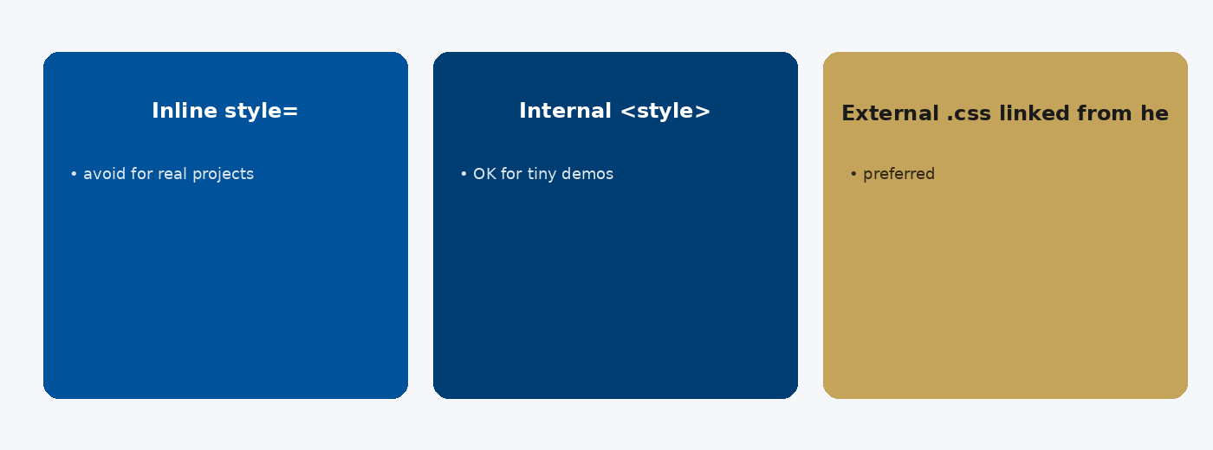
CSE6624 · Lecture 05
Ways to add CSS
Today we examine Ways to add CSS. First: Inline style= — avoid for real projects. Second: Internal <style> — OK for tiny demos. Also notice: External .css linked from head — preferred. So the key idea is precise terminology — these distinctions return in demos, labs, and assessment.
Satbayev University · CSE6624 · Lecture 5 · Autumn 2026–2027
3 / 19
Notes:
(прочитай) Укажи на ключевые пункты: Ways to add CSS

Slide 4
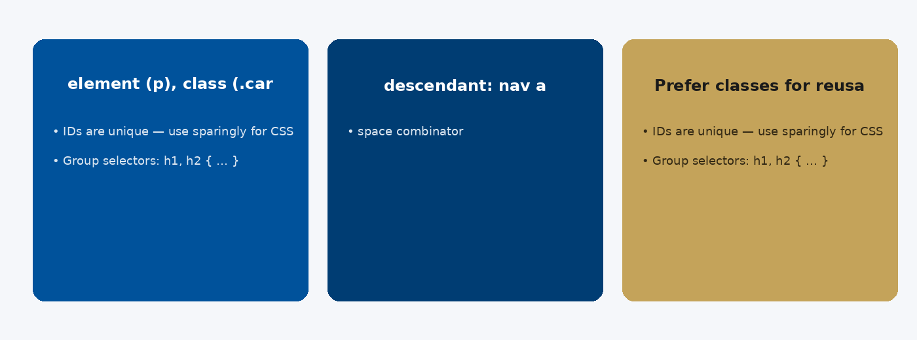
CSE6624 · Lecture 05
Selectors
Today we examine Selectors. First: element (p), class (.card), id (#hero). Second: descendant: nav a — space combinator. Also notice: Prefer classes for reusable styling. So the key idea is precise terminology — these distinctions return in demos, labs, and assessment.
Satbayev University · CSE6624 · Lecture 5 · Autumn 2026–2027
4 / 19
Notes:
(прочитай) Укажи на ключевые пункты: Selectors

Slide 5
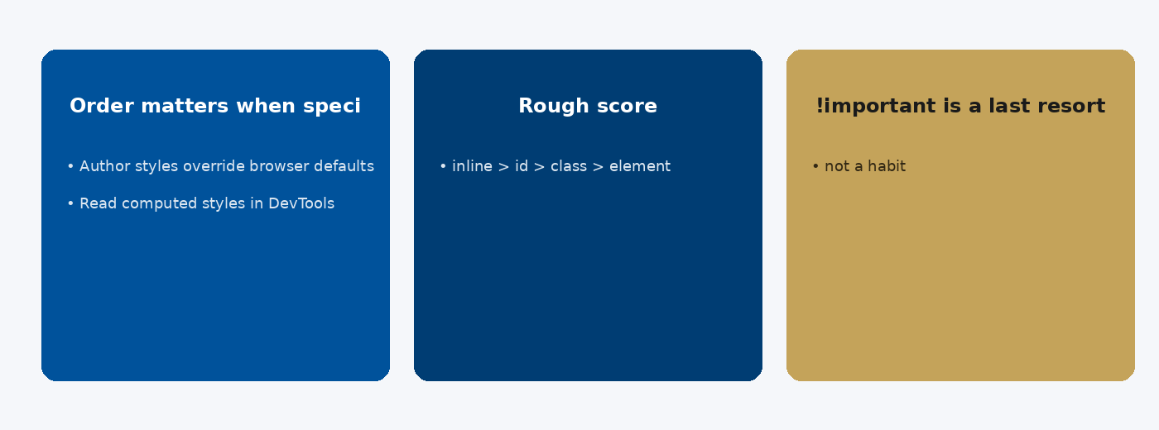
CSE6624 · Lecture 05
Cascade and specificity
Today we examine Cascade and specificity. First: Order matters when specificity is equal. Second: Rough score: inline > id > class > element. Also notice: !important is a last resort — not a habit. So the key idea is precise terminology — these distinctions return in demos, labs, and assessment.
Satbayev University · CSE6624 · Lecture 5 · Autumn 2026–2027
5 / 19
Notes:
(прочитай) Укажи на ключевые пункты: Cascade and specificity

Slide 6

CSE6624 · Lecture 05
Box model
Today we examine Box model. First: content → padding → border → margin. Second: box-sizing: border-box — modern default habit. Also notice: Margin collapses vertically between blocks. So the key idea is precise terminology — these distinctions return in demos, labs, and assessment.
Satbayev University · CSE6624 · Lecture 5 · Autumn 2026–2027
6 / 19
Notes:
(прочитай) Укажи на ключевые пункты: Box model

Slide 7
CSE6624 · Lecture 05
DEMO 1/3 — Link the CSS file
<!-- inside <head> of index.html -->
<link rel="stylesheet" href="css/styles.css">
href path is relative to the HTML file.
Please watch this demo on the slide — do not type yet. I will point at the code so you see the exact target. In the task block you will reproduce these steps on your laptop. Everything you need is here; you do not leave this presentation.
Satbayev University · CSE6624 · Lecture 5 · Autumn 2026–2027
7 / 19
Notes:
(указывай на код/UI; не открывай другие файлы)

Slide 8
CSE6624 · Lecture 05
DEMO 2/3 — HTML card
<div class="card">
<h1>CSS Card</h1>
<p>Styled from an external file.</p>
</div>
class="card" connects HTML to the .card rule in CSS.
Please watch this demo on the slide — do not type yet. I will point at the code so you see the exact target. In the task block you will reproduce these steps on your laptop. Everything you need is here; you do not leave this presentation.
Satbayev University · CSE6624 · Lecture 5 · Autumn 2026–2027
8 / 19
Notes:
(указывай на код/UI; не открывай другие файлы)

Slide 9
CSE6624 · Lecture 05
DEMO 3/3 — css/styles.css
body {
font-family: Arial, sans-serif;
background: #F5F7FA;
}
.card {
max-width: 360px;
margin: 2rem auto;
padding: 1.25rem;
border-radius: 12px;
box-shadow: 0 8px 24px rgba(0,0,0,.12);
background: white;
}
.card h1 { color: #00529B; }
No style="…" inline styles today.
Please watch this demo on the slide — do not type yet. I will point at the code so you see the exact target. In the task block you will reproduce these steps on your laptop. Everything you need is here; you do not leave this presentation.
Satbayev University · CSE6624 · Lecture 5 · Autumn 2026–2027
9 / 19
Notes:
(указывай на код/UI; не открывай другие файлы)

Slide 10
CSE6624 · Lecture 05
TASK · ~25 min
TASK — Style a card with external CSS (~25 min)
Work on YOUR laptop now. Follow the numbered steps on the next slides.
Suggested folder name: lecture05-yourname
If stuck: read the previous step again. Do not skip steps.
AI is optional later — first follow the steps yourself.
Now you work. The next slides are idiot-proof steps — one action after another. I will walk the room while you build. If something fails, open the If it does not work slide after the steps. Do not invent your own path during these twenty-five minutes.
Satbayev University · CSE6624 · Lecture 5 · Autumn 2026–2027
10 / 19
Notes:
(25 мин. Ходи по рядам. Стой.)

Slide 11
CSE6624 · Lecture 05
Step 1 of 5 · Create folder structure
1
Create folder structure
→ Desktop/lecture05-yourname/
→ Inside it: create folder css/
→ You will have: index.html and css/styles.css
This is step 1. Do only this step, then wait for the next slide. Click the menus named on the slide — File, Save As, Open with. When the action is done, look up. If it failed, do not jump ahead — reread this step slowly.
Satbayev University · CSE6624 · Lecture 5 · Autumn 2026–2027
11 / 19
Notes:
(шаг 1)

Slide 12
CSE6624 · Lecture 05
Step 2 of 5 · Write index.html
2
Write index.html
→ Include the <link> in head and the .card div in body (from DEMO).
This is step 2. Do only this step, then wait for the next slide. Click the menus named on the slide — File, Save As, Open with. When the action is done, look up. If it failed, do not jump ahead — reread this step slowly.
Satbayev University · CSE6624 · Lecture 5 · Autumn 2026–2027
12 / 19
Notes:
(шаг 2)

Slide 13
CSE6624 · Lecture 05
Step 3 of 5 · Write css/styles.css
3
Write css/styles.css
→ New File → paste DEMO CSS → Save As css/styles.css
This is step 3. Do only this step, then wait for the next slide. Click the menus named on the slide — File, Save As, Open with. When the action is done, look up. If it failed, do not jump ahead — reread this step slowly.
Satbayev University · CSE6624 · Lecture 5 · Autumn 2026–2027
13 / 19
Notes:
(шаг 3)

Slide 14
CSE6624 · Lecture 05
Step 4 of 5 · Open + inspect
4
Open + inspect
→ Open index.html in Chrome.
→ Press F12 → Elements → click the card → Styles panel.
→ Change padding live to see the cascade.
This is step 4. Do only this step, then wait for the next slide. Click the menus named on the slide — File, Save As, Open with. When the action is done, look up. If it failed, do not jump ahead — reread this step slowly.
Satbayev University · CSE6624 · Lecture 5 · Autumn 2026–2027
14 / 19
Notes:
(шаг 4)

Slide 15
CSE6624 · Lecture 05
Step 5 of 5 · Done check
5
Done check
→ Card is centered-ish, rounded, with shadow.
→ If unstyled: check link href="css/styles.css" and file location.
This is step 5. Do only this step, then wait for the next slide. Click the menus named on the slide — File, Save As, Open with. When the action is done, look up. If it failed, do not jump ahead — reread this step slowly.
Satbayev University · CSE6624 · Lecture 5 · Autumn 2026–2027
15 / 19
Notes:
(шаг 5)

Slide 16
CSE6624 · Lecture 05
If it does not work
Three common mistakes — fix these before asking for help:
Mistake 1
CSS file in wrong place — must be lecture05-yourname/css/styles.css.
Mistake 2
Typo in class name card vs .Card — names are case-sensitive.
Mistake 3
Used inline style= — move rules into styles.css.
Most failures are save mistakes, wrong file names, or skipped steps. Read these three mistakes aloud if needed. Fix one thing, save, refresh the browser, then re-check the success condition. Still stuck after that — raise your hand; bring your screen.
Satbayev University · CSE6624 · Lecture 5 · Autumn 2026–2027
16 / 19
Notes:
(три ошибки)

Slide 17
CSE6624 · Lecture 05
DONE — what to submit / show
☐
Browser photo of styled card
☐
DevTools Styles photo optional
☐
Show neighbour
You are done when the checklist is true. Take a photo of the browser and of the file or folder. Show your neighbour for ten seconds. Upload later if the LMS asks — keep the folder on your Desktop.
Satbayev University · CSE6624 · Lecture 5 · Autumn 2026–2027
17 / 19
Notes:
(done checklist)

Slide 18
CSE6624 · Lecture 05
Next lecture + AI rule
Next lecture
Next lecture: Flexbox.
AI rule (one line)
You may use AI, but you must still follow these steps yourself and explain your result.
After class rhythm: Practice & Lab
Next we continue with the topic on this slide. After the lecture block comes Practice & Lab. You may use AI, but you must still follow the slide steps yourself and explain your result. Pack your folder. See you next week.
Satbayev University · CSE6624 · Lecture 5 · Autumn 2026–2027
18 / 19
Notes:
(next + AI — без Questions)

Slide 19
See you next week.
Keep your folder. Re-read the last task steps if anything is unclear.
CSE6624 · Lecture 5 · CSS Basics
Shoiynbek Temirlan Armanuly · Senior Lecturer
Satbayev University · Autumn 2026–2027 · Almaty
Notes:
(улыбка. Без Questions.)

