Slide 1


SATBAYEV UNIVERSITY
Automation and Information Technology · Software Engineering
CSE6624
Introduction to Web Programming
Lecture 6
Flexbox
Shoiynbek Temirlan Armanuly
Senior Lecturer
Programme: 6B06102 Computer Science
Autumn 2026–2027 · Almaty
City University / Satbayev University · English-taught course
Notes:
(улыбнись — Hello + номер лекции + тема.)

Slide 2
CSE6624 · Lecture 06
Today's plan · 50 minutes
15 min
~15 min — I explain (diagrams + you listen)
I read the strips. You look at the diagrams. No typing yet.
5 min
~5 min — Demo on these slides
Code / UI is ON the slides. I only point. Do not open other folders.
25 min
~25 min — You do the task
Step-by-step ON the slides. Follow every click. If stuck: read the previous step again.
5 min
~5 min — What to submit / next lecture
Photo proof + show neighbour. One-line preview of next week.
Today's plan is fixed to fifty minutes. About fifteen minutes I explain with diagrams. About five minutes I point at demo code on these slides — you watch. About twenty-five minutes you follow the task steps on the slides. The last five minutes cover what to submit and what comes next. There is no separate questions block — if stuck, read the previous step again.
Satbayev University · CSE6624 · Lecture 6 · Autumn 2026–2027
2 / 18
Notes:
(прочитай полоску; укажи на 15/5/25/5)

Slide 3
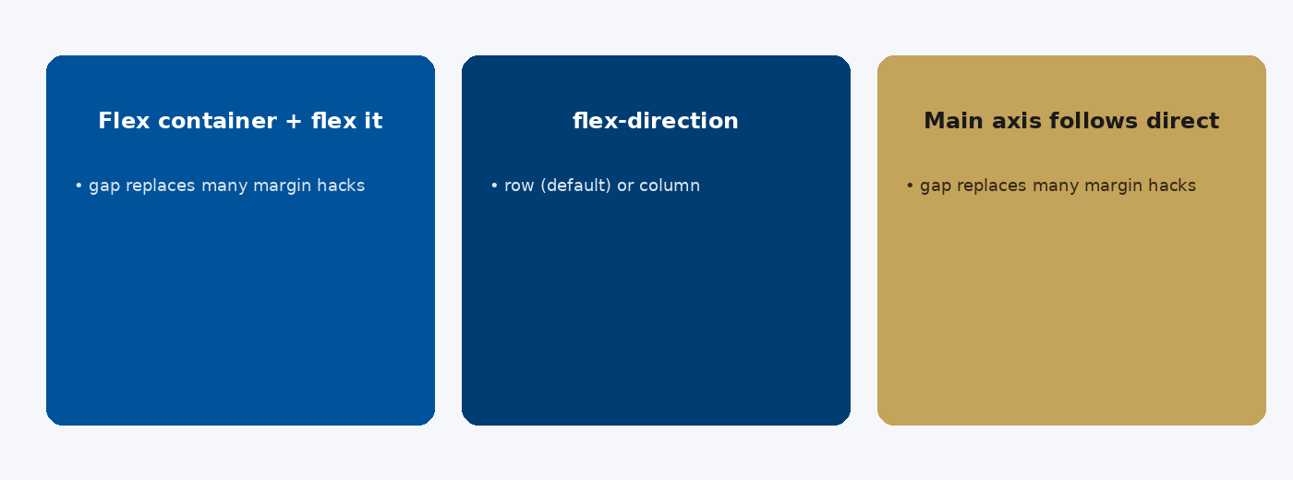
CSE6624 · Lecture 06
Flexbox mental model
Today we examine Flexbox mental model. First: Flex container + flex items. Second: flex-direction: row (default) or column. Also notice: Main axis follows direction; cross axis is perpendicular. So the key idea is precise terminology — these distinctions return in demos, labs, and assessment.
Satbayev University · CSE6624 · Lecture 6 · Autumn 2026–2027
3 / 18
Notes:
(прочитай) Укажи на ключевые пункты: Flexbox mental model

Slide 4
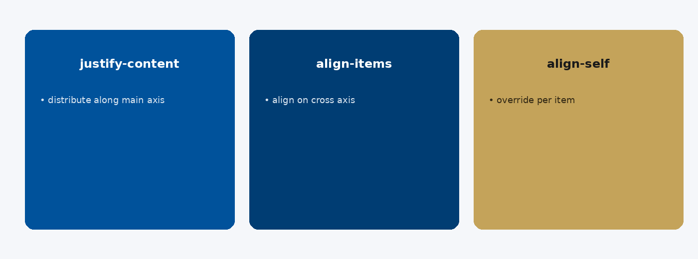
CSE6624 · Lecture 06
Alignment controls
Today we examine Alignment controls. First: justify-content — distribute along main axis. Second: align-items — align on cross axis. Also notice: align-self — override per item. So the key idea is precise terminology — these distinctions return in demos, labs, and assessment.
Satbayev University · CSE6624 · Lecture 6 · Autumn 2026–2027
4 / 18
Notes:
(прочитай) Укажи на ключевые пункты: Alignment controls

Slide 5
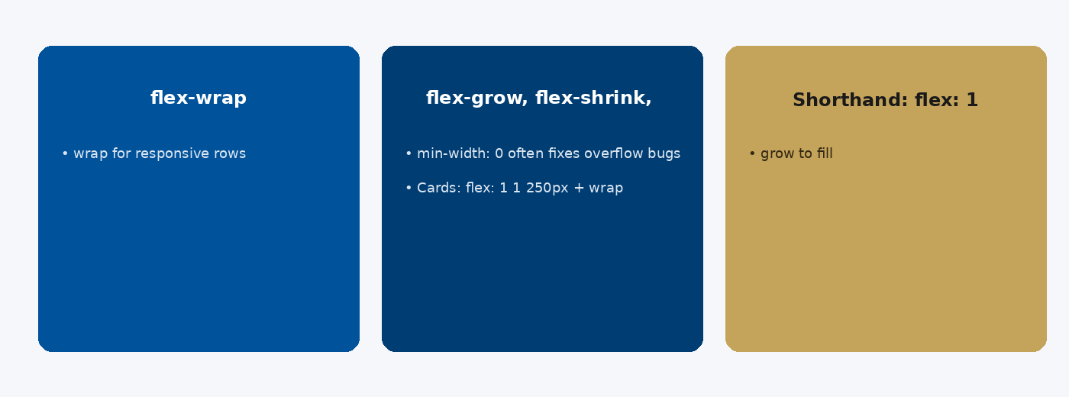
CSE6624 · Lecture 06
Wrapping and growth
Today we examine Wrapping and growth. First: flex-wrap: wrap for responsive rows. Second: flex-grow, flex-shrink, flex-basis. Also notice: Shorthand: flex: 1 — grow to fill. So the key idea is precise terminology — these distinctions return in demos, labs, and assessment.
Satbayev University · CSE6624 · Lecture 6 · Autumn 2026–2027
5 / 18
Notes:
(прочитай) Укажи на ключевые пункты: Wrapping and growth

Slide 6
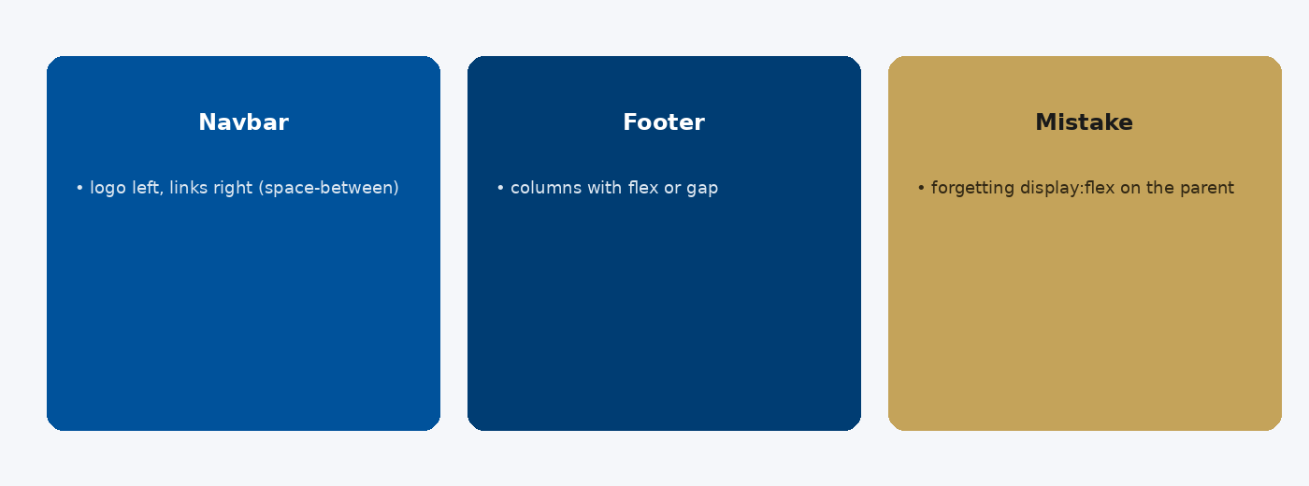
CSE6624 · Lecture 06
Patterns and pitfalls
Today we examine Patterns and pitfalls. First: Navbar: logo left, links right (space-between). Second: Footer: columns with flex or gap. Also notice: Mistake: forgetting display:flex on the parent. So the key idea is precise terminology — these distinctions return in demos, labs, and assessment.
Satbayev University · CSE6624 · Lecture 6 · Autumn 2026–2027
6 / 18
Notes:
(прочитай) Укажи на ключевые пункты: Patterns and pitfalls

Slide 7
CSE6624 · Lecture 06
DEMO 1/2 — Flex CSS
.header {
display: flex;
justify-content: space-between;
align-items: center;
padding: 0.75rem 1rem;
background: #00529B;
color: white;
}
.row {
display: flex;
gap: 1rem;
flex-wrap: wrap;
}
.card { flex: 1 1 180px; padding: 1rem; background: #E8F0F8; }
display:flex · justify-content · gap · flex-wrap.
Please watch this demo on the slide — do not type yet. I will point at the code so you see the exact target. In the task block you will reproduce these steps on your laptop. Everything you need is here; you do not leave this presentation.
Satbayev University · CSE6624 · Lecture 6 · Autumn 2026–2027
7 / 18
Notes:
(указывай на код/UI; не открывай другие файлы)

Slide 8
CSE6624 · Lecture 06
DEMO 2/2 — HTML structure
<header class="header">
<strong>Logo</strong>
<nav>Home · About · Contact</nav>
</header>
<section class="row">
<div class="card">Card 1</div>
<div class="card">Card 2</div>
<div class="card">Card 3</div>
</section>
Resize the window — cards should wrap.
Please watch this demo on the slide — do not type yet. I will point at the code so you see the exact target. In the task block you will reproduce these steps on your laptop. Everything you need is here; you do not leave this presentation.
Satbayev University · CSE6624 · Lecture 6 · Autumn 2026–2027
8 / 18
Notes:
(указывай на код/UI; не открывай другие файлы)

Slide 9
CSE6624 · Lecture 06
TASK · ~25 min
TASK — Navbar + card row with Flexbox (~25 min)
Work on YOUR laptop now. Follow the numbered steps on the next slides.
Suggested folder name: lecture06-yourname
If stuck: read the previous step again. Do not skip steps.
AI is optional later — first follow the steps yourself.
Now you work. The next slides are idiot-proof steps — one action after another. I will walk the room while you build. If something fails, open the If it does not work slide after the steps. Do not invent your own path during these twenty-five minutes.
Satbayev University · CSE6624 · Lecture 6 · Autumn 2026–2027
9 / 18
Notes:
(25 мин. Ходи по рядам. Стой.)

Slide 10
CSE6624 · Lecture 06
Step 1 of 5 · Folder + files
1
Folder + files
→ lecture06-yourname/index.html + css/styles.css linked from head.
This is step 1. Do only this step, then wait for the next slide. Click the menus named on the slide — File, Save As, Open with. When the action is done, look up. If it failed, do not jump ahead — reread this step slowly.
Satbayev University · CSE6624 · Lecture 6 · Autumn 2026–2027
10 / 18
Notes:
(шаг 1)

Slide 11
CSE6624 · Lecture 06
Step 2 of 5 · Paste HTML from DEMO
2
Paste HTML from DEMO
→ header.header + section.row with 3 cards.
This is step 2. Do only this step, then wait for the next slide. Click the menus named on the slide — File, Save As, Open with. When the action is done, look up. If it failed, do not jump ahead — reread this step slowly.
Satbayev University · CSE6624 · Lecture 6 · Autumn 2026–2027
11 / 18
Notes:
(шаг 2)

Slide 12
CSE6624 · Lecture 06
Step 3 of 5 · Paste Flex CSS
3
Paste Flex CSS
→ Put DEMO rules into styles.css. Save both files.
This is step 3. Do only this step, then wait for the next slide. Click the menus named on the slide — File, Save As, Open with. When the action is done, look up. If it failed, do not jump ahead — reread this step slowly.
Satbayev University · CSE6624 · Lecture 6 · Autumn 2026–2027
12 / 18
Notes:
(шаг 3)

Slide 13
CSE6624 · Lecture 06
Step 4 of 5 · Open and resize
4
Open and resize
→ Open in Chrome.
→ Drag window narrow — cards wrap to next line.
→ If no wrap: check flex-wrap: wrap;
This is step 4. Do only this step, then wait for the next slide. Click the menus named on the slide — File, Save As, Open with. When the action is done, look up. If it failed, do not jump ahead — reread this step slowly.
Satbayev University · CSE6624 · Lecture 6 · Autumn 2026–2027
13 / 18
Notes:
(шаг 4)

Slide 14
CSE6624 · Lecture 06
Step 5 of 5 · Point to properties
5
Point to properties
→ Show neighbour: display:flex and justify-content on .header.
→ Say one sentence: Flexbox is for one-direction layout.
This is step 5. Do only this step, then wait for the next slide. Click the menus named on the slide — File, Save As, Open with. When the action is done, look up. If it failed, do not jump ahead — reread this step slowly.
Satbayev University · CSE6624 · Lecture 6 · Autumn 2026–2027
14 / 18
Notes:
(шаг 5)

Slide 15
CSE6624 · Lecture 06
If it does not work
Three common mistakes — fix these before asking for help:
Mistake 1
Forgot display:flex — nothing aligns.
Mistake 2
flex-wrap missing — cards never wrap.
Mistake 3
CSS not linked — page looks plain.
Most failures are save mistakes, wrong file names, or skipped steps. Read these three mistakes aloud if needed. Fix one thing, save, refresh the browser, then re-check the success condition. Still stuck after that — raise your hand; bring your screen.
Satbayev University · CSE6624 · Lecture 6 · Autumn 2026–2027
15 / 18
Notes:
(три ошибки)

Slide 16
CSE6624 · Lecture 06
DONE — what to submit / show
☐
Browser photo wide + narrow
☐
Show neighbour wrap
☐
Keep folder
You are done when the checklist is true. Take a photo of the browser and of the file or folder. Show your neighbour for ten seconds. Upload later if the LMS asks — keep the folder on your Desktop.
Satbayev University · CSE6624 · Lecture 6 · Autumn 2026–2027
16 / 18
Notes:
(done checklist)

Slide 17
CSE6624 · Lecture 06
Next lecture + AI rule
Next lecture
Next lecture: CSS Grid and responsive design.
AI rule (one line)
You may use AI, but you must still follow these steps yourself and explain your result.
After class rhythm: Practice & Lab
Next we continue with the topic on this slide. After the lecture block comes Practice & Lab. You may use AI, but you must still follow the slide steps yourself and explain your result. Pack your folder. See you next week.
Satbayev University · CSE6624 · Lecture 6 · Autumn 2026–2027
17 / 18
Notes:
(next + AI — без Questions)

Slide 18
See you next week.
Keep your folder. Re-read the last task steps if anything is unclear.
CSE6624 · Lecture 6 · Flexbox
Shoiynbek Temirlan Armanuly · Senior Lecturer
Satbayev University · Autumn 2026–2027 · Almaty
Notes:
(улыбка. Без Questions.)

