Slide 1


SATBAYEV UNIVERSITY
Automation and Information Technology · Software Engineering
CSE6624
Introduction to Web Programming
Lecture 7
CSS Grid and Responsive Design
Shoiynbek Temirlan Armanuly
Senior Lecturer
Programme: 6B06102 Computer Science
Autumn 2026–2027 · Almaty
City University / Satbayev University · English-taught course
Notes:
(улыбнись — Hello + номер лекции + тема.)

Slide 2
CSE6624 · Lecture 07
Today's plan · 50 minutes
15 min
~15 min — I explain (diagrams + you listen)
I read the strips. You look at the diagrams. No typing yet.
5 min
~5 min — Demo on these slides
Code / UI is ON the slides. I only point. Do not open other folders.
25 min
~25 min — You do the task
Step-by-step ON the slides. Follow every click. If stuck: read the previous step again.
5 min
~5 min — What to submit / next lecture
Photo proof + show neighbour. One-line preview of next week.
Today's plan is fixed to fifty minutes. About fifteen minutes I explain with diagrams. About five minutes I point at demo code on these slides — you watch. About twenty-five minutes you follow the task steps on the slides. The last five minutes cover what to submit and what comes next. There is no separate questions block — if stuck, read the previous step again.
Satbayev University · CSE6624 · Lecture 7 · Autumn 2026–2027
2 / 18
Notes:
(прочитай полоску; укажи на 15/5/25/5)

Slide 3
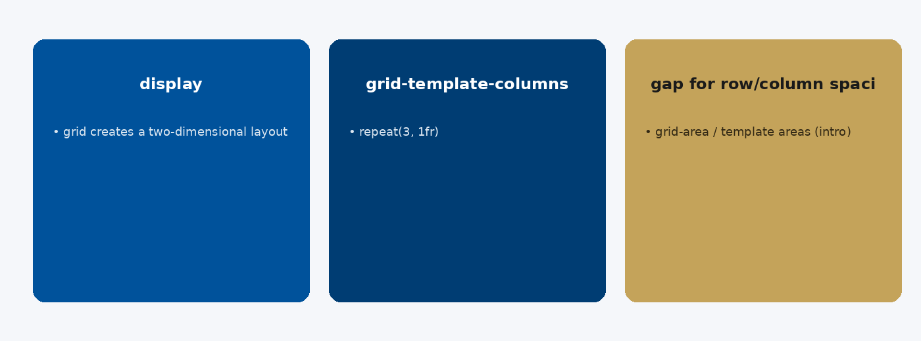
CSE6624 · Lecture 07
CSS Grid basics
Today we examine CSS Grid basics. First: display: grid creates a two-dimensional layout. Second: grid-template-columns: repeat(3, 1fr). Also notice: gap for row/column spacing. So the key idea is precise terminology — these distinctions return in demos, labs, and assessment.
Satbayev University · CSE6624 · Lecture 7 · Autumn 2026–2027
3 / 18
Notes:
(прочитай) Укажи на ключевые пункты: CSS Grid basics

Slide 4
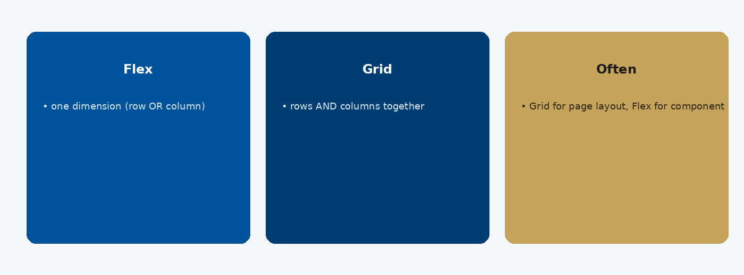
CSE6624 · Lecture 07
Grid vs Flex
Today we examine Grid vs Flex. First: Flex — one dimension (row OR column). Second: Grid — rows AND columns together. Also notice: Often: Grid for page layout, Flex for components. So the key idea is precise terminology — these distinctions return in demos, labs, and assessment.
Satbayev University · CSE6624 · Lecture 7 · Autumn 2026–2027
4 / 18
Notes:
(прочитай) Укажи на ключевые пункты: Grid vs Flex

Slide 5
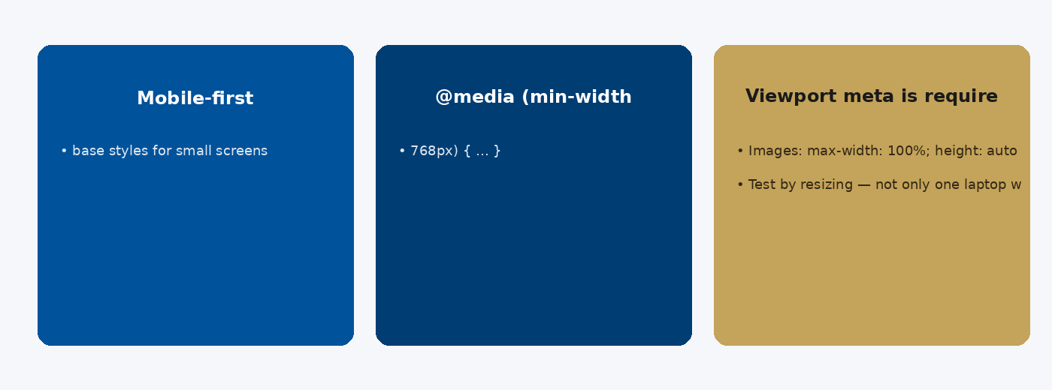
CSE6624 · Lecture 07
Responsive design
Today we examine Responsive design. First: Mobile-first: base styles for small screens. Second: @media (min-width: 768px) { … }. Also notice: Viewport meta is required for mobile browsers. So the key idea is precise terminology — these distinctions return in demos, labs, and assessment.
Satbayev University · CSE6624 · Lecture 7 · Autumn 2026–2027
5 / 18
Notes:
(прочитай) Укажи на ключевые пункты: Responsive design

Slide 6
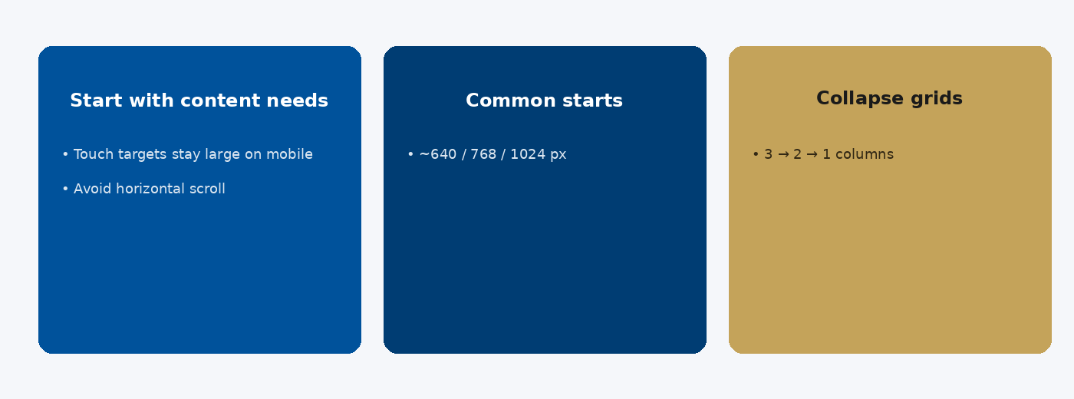
CSE6624 · Lecture 07
Breakpoints strategy
Today we examine Breakpoints strategy. First: Start with content needs, not device names. Second: Common starts: ~640 / 768 / 1024 px. Also notice: Collapse grids: 3 → 2 → 1 columns. So the key idea is precise terminology — these distinctions return in demos, labs, and assessment.
Satbayev University · CSE6624 · Lecture 7 · Autumn 2026–2027
6 / 18
Notes:
(прочитай) Укажи на ключевые пункты: Breakpoints strategy

Slide 7
CSE6624 · Lecture 07
DEMO 1/2 — Grid + media query
.gallery {
display: grid;
grid-template-columns: repeat(3, 1fr);
gap: 1rem;
}
.item {
background: #E8F0F8;
padding: 1.5rem;
text-align: center;
}
@media (max-width: 600px) {
.gallery { grid-template-columns: 1fr; }
}
3 columns on desktop → 1 column under 600px.
Please watch this demo on the slide — do not type yet. I will point at the code so you see the exact target. In the task block you will reproduce these steps on your laptop. Everything you need is here; you do not leave this presentation.
Satbayev University · CSE6624 · Lecture 7 · Autumn 2026–2027
7 / 18
Notes:
(указывай на код/UI; не открывай другие файлы)

Slide 8
CSE6624 · Lecture 07
DEMO 2/2 — Six items
<div class="gallery">
<div class="item">1</div><div class="item">2</div>
<div class="item">3</div><div class="item">4</div>
<div class="item">5</div><div class="item">6</div>
</div>
Prove the breakpoint by resizing — do not guess.
Please watch this demo on the slide — do not type yet. I will point at the code so you see the exact target. In the task block you will reproduce these steps on your laptop. Everything you need is here; you do not leave this presentation.
Satbayev University · CSE6624 · Lecture 7 · Autumn 2026–2027
8 / 18
Notes:
(указывай на код/UI; не открывай другие файлы)

Slide 9
CSE6624 · Lecture 07
TASK · ~25 min
TASK — Responsive grid gallery (~25 min)
Work on YOUR laptop now. Follow the numbered steps on the next slides.
Suggested folder name: lecture07-yourname
If stuck: read the previous step again. Do not skip steps.
AI is optional later — first follow the steps yourself.
Now you work. The next slides are idiot-proof steps — one action after another. I will walk the room while you build. If something fails, open the If it does not work slide after the steps. Do not invent your own path during these twenty-five minutes.
Satbayev University · CSE6624 · Lecture 7 · Autumn 2026–2027
9 / 18
Notes:
(25 мин. Ходи по рядам. Стой.)

Slide 10
CSE6624 · Lecture 07
Step 1 of 5 · Setup
1
Setup
→ lecture07-yourname with index.html + css/styles.css.
This is step 1. Do only this step, then wait for the next slide. Click the menus named on the slide — File, Save As, Open with. When the action is done, look up. If it failed, do not jump ahead — reread this step slowly.
Satbayev University · CSE6624 · Lecture 7 · Autumn 2026–2027
10 / 18
Notes:
(шаг 1)

Slide 11
CSE6624 · Lecture 07
Step 2 of 5 · HTML gallery
2
HTML gallery
→ Paste 6 .item divs inside .gallery.
This is step 2. Do only this step, then wait for the next slide. Click the menus named on the slide — File, Save As, Open with. When the action is done, look up. If it failed, do not jump ahead — reread this step slowly.
Satbayev University · CSE6624 · Lecture 7 · Autumn 2026–2027
11 / 18
Notes:
(шаг 2)

Slide 12
CSE6624 · Lecture 07
Step 3 of 5 · CSS grid + @media
3
CSS grid + @media
→ Paste DEMO CSS. Save.
This is step 3. Do only this step, then wait for the next slide. Click the menus named on the slide — File, Save As, Open with. When the action is done, look up. If it failed, do not jump ahead — reread this step slowly.
Satbayev University · CSE6624 · Lecture 7 · Autumn 2026–2027
12 / 18
Notes:
(шаг 3)

Slide 13
CSE6624 · Lecture 07
Step 4 of 5 · Prove breakpoint
4
Prove breakpoint
→ Open Chrome → resize under 600px width.
→ You should SEE one column.
→ Widen again → three columns.
This is step 4. Do only this step, then wait for the next slide. Click the menus named on the slide — File, Save As, Open with. When the action is done, look up. If it failed, do not jump ahead — reread this step slowly.
Satbayev University · CSE6624 · Lecture 7 · Autumn 2026–2027
13 / 18
Notes:
(шаг 4)

Slide 14
CSE6624 · Lecture 07
Step 5 of 5 · Neighbour check
5
Neighbour check
→ Show both layouts. Point at @media in your CSS.
This is step 5. Do only this step, then wait for the next slide. Click the menus named on the slide — File, Save As, Open with. When the action is done, look up. If it failed, do not jump ahead — reread this step slowly.
Satbayev University · CSE6624 · Lecture 7 · Autumn 2026–2027
14 / 18
Notes:
(шаг 5)

Slide 15
CSE6624 · Lecture 07
If it does not work
Three common mistakes — fix these before asking for help:
Mistake 1
@media typed wrong — needs @media (max-width: 600px) { … }
Mistake 2
Only 3 items — add 6.
Mistake 3
Grid not applied — display:grid missing.
Most failures are save mistakes, wrong file names, or skipped steps. Read these three mistakes aloud if needed. Fix one thing, save, refresh the browser, then re-check the success condition. Still stuck after that — raise your hand; bring your screen.
Satbayev University · CSE6624 · Lecture 7 · Autumn 2026–2027
15 / 18
Notes:
(три ошибки)

Slide 16
CSE6624 · Lecture 07
DONE — what to submit / show
☐
Photo wide + narrow
☐
Show neighbour
☐
Keep folder
You are done when the checklist is true. Take a photo of the browser and of the file or folder. Show your neighbour for ten seconds. Upload later if the LMS asks — keep the folder on your Desktop.
Satbayev University · CSE6624 · Lecture 7 · Autumn 2026–2027
16 / 18
Notes:
(done checklist)

Slide 17
CSE6624 · Lecture 07
Next lecture + AI rule
Next lecture
Next lecture: midterm workshop / attestation prep.
AI rule (one line)
You may use AI, but you must still follow these steps yourself and explain your result.
After class rhythm: Practice & Lab
Next we continue with the topic on this slide. After the lecture block comes Practice & Lab. You may use AI, but you must still follow the slide steps yourself and explain your result. Pack your folder. See you next week.
Satbayev University · CSE6624 · Lecture 7 · Autumn 2026–2027
17 / 18
Notes:
(next + AI — без Questions)

Slide 18
See you next week.
Keep your folder. Re-read the last task steps if anything is unclear.
CSE6624 · Lecture 7 · CSS Grid and Responsive Design
Shoiynbek Temirlan Armanuly · Senior Lecturer
Satbayev University · Autumn 2026–2027 · Almaty
Notes:
(улыбка. Без Questions.)

