Slide 1


SATBAYEV UNIVERSITY
Automation and Information Technology · Software Engineering
CSE6624
Introduction to Web Programming
Lecture 8
Midterm Workshop / Attestation 1 Prep
Shoiynbek Temirlan Armanuly
Senior Lecturer
Programme: 6B06102 Computer Science
Autumn 2026–2027 · Almaty
City University / Satbayev University · English-taught course
Notes:
(улыбнись — Hello + номер лекции + тема.)

Slide 2
CSE6624 · Lecture 08
Today's plan · 50 minutes
15 min
~15 min — I explain (diagrams + you listen)
I read the strips. You look at the diagrams. No typing yet.
5 min
~5 min — Demo on these slides
Code / UI is ON the slides. I only point. Do not open other folders.
25 min
~25 min — You do the task
Step-by-step ON the slides. Follow every click. If stuck: read the previous step again.
5 min
~5 min — What to submit / next lecture
Photo proof + show neighbour. One-line preview of next week.
Today's plan is fixed to fifty minutes. About fifteen minutes I explain with diagrams. About five minutes I point at demo code on these slides — you watch. About twenty-five minutes you follow the task steps on the slides. The last five minutes cover what to submit and what comes next. There is no separate questions block — if stuck, read the previous step again.
Satbayev University · CSE6624 · Lecture 8 · Autumn 2026–2027
2 / 18
Notes:
(прочитай полоску; укажи на 15/5/25/5)

Slide 3
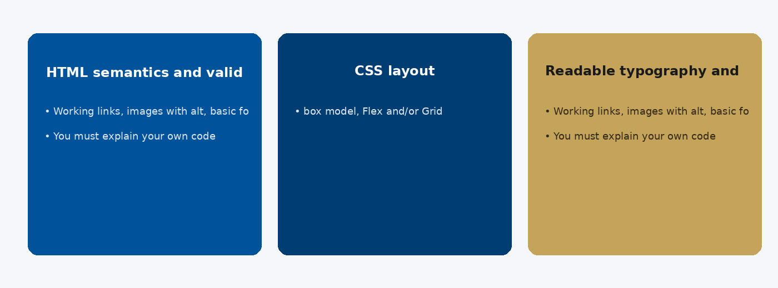
CSE6624 · Lecture 08
Attestation 1 scope
Today we examine Attestation 1 scope. First: HTML semantics and valid structure. Second: CSS layout: box model, Flex and/or Grid. Also notice: Readable typography and consistent spacing. So the key idea is precise terminology — these distinctions return in demos, labs, and assessment.
Satbayev University · CSE6624 · Lecture 8 · Autumn 2026–2027
3 / 18
Notes:
(прочитай) Укажи на ключевые пункты: Attestation 1 scope

Slide 4
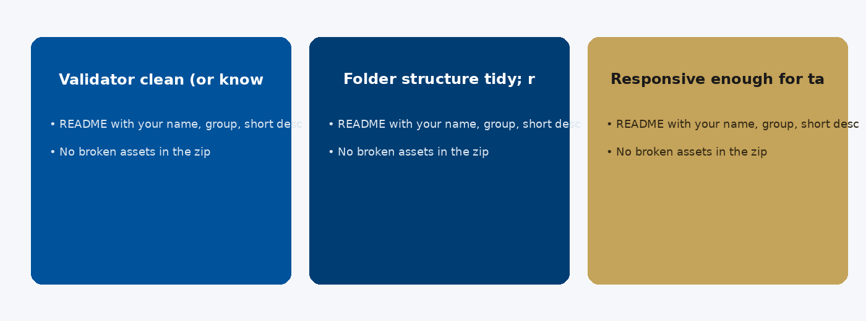
CSE6624 · Lecture 08
Checklist before submit
Today we examine Checklist before submit. First: Validator clean (or known minor warnings only). Second: Folder structure tidy; relative paths work. Also notice: Responsive enough for tablet/phone smoke test. So the key idea is precise terminology — these distinctions return in demos, labs, and assessment.
Satbayev University · CSE6624 · Lecture 8 · Autumn 2026–2027
4 / 18
Notes:
(прочитай) Укажи на ключевые пункты: Checklist before submit

Slide 5
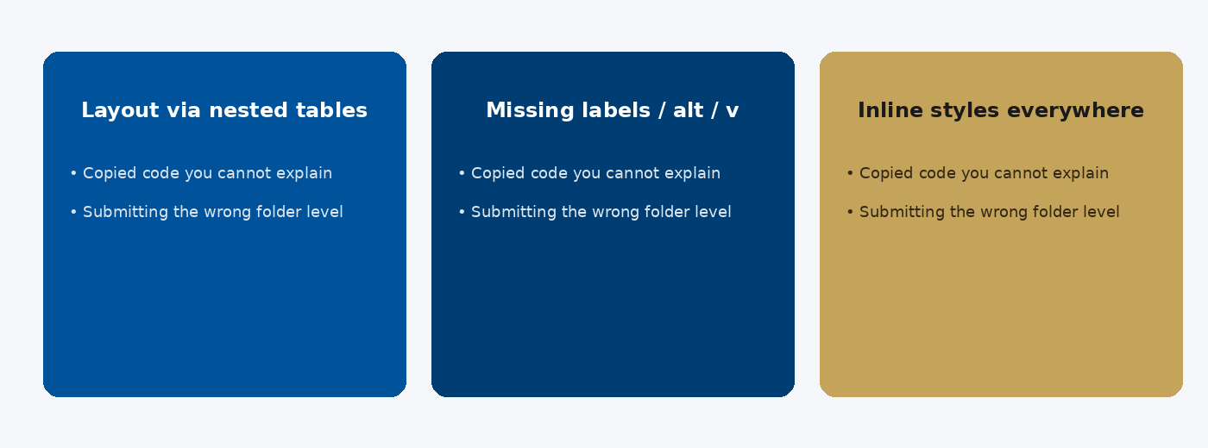
CSE6624 · Lecture 08
Common mistakes
Today we examine Common mistakes. First: Layout via nested tables or absolute chaos. Second: Missing labels / alt / viewport. Also notice: Inline styles everywhere; unused CSS. So the key idea is precise terminology — these distinctions return in demos, labs, and assessment.
Satbayev University · CSE6624 · Lecture 8 · Autumn 2026–2027
5 / 18
Notes:
(прочитай) Укажи на ключевые пункты: Common mistakes

Slide 6
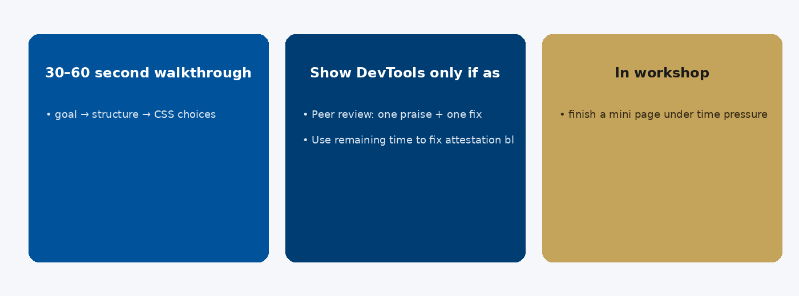
CSE6624 · Lecture 08
Presenting and timeboxing
Today we examine Presenting and timeboxing. First: 30–60 second walkthrough: goal → structure → CSS choices. Second: Show DevTools only if asked. Also notice: In workshop: finish a mini page under time pressure. So the key idea is precise terminology — these distinctions return in demos, labs, and assessment.
Satbayev University · CSE6624 · Lecture 8 · Autumn 2026–2027
6 / 18
Notes:
(прочитай) Укажи на ключевые пункты: Presenting and timeboxing

Slide 7
CSE6624 · Lecture 08
DEMO 1/2 — What examiners look for
☐ Semantic HTML (header/nav/main/footer)
☐ External CSS linked
☐ At least one layout technique (flex or grid)
☐ Forms/labels OR media with alt (as required)
☐ Folder tidy: index.html + css/ (+ js/ if any)
This is the audit list — not a new project from zero.
Please watch this demo on the slide — do not type yet. I will point at the layout so you see the exact target. In the task block you will reproduce these steps on your laptop. Everything you need is here; you do not leave this presentation.
Satbayev University · CSE6624 · Lecture 8 · Autumn 2026–2027
7 / 18
Notes:
(указывай на код/UI; не открывай другие файлы)

Slide 8
CSE6624 · Lecture 08
DEMO 2/2 — Gap list template
My gaps (write on paper or in a .txt):
1. …
2. …
3. …
4. …
5. …
One gap I will fix in the next 10 minutes: #___
Written gaps beat vague worry.
Please watch this demo on the slide — do not type yet. I will point at the code so you see the exact target. In the task block you will reproduce these steps on your laptop. Everything you need is here; you do not leave this presentation.
Satbayev University · CSE6624 · Lecture 8 · Autumn 2026–2027
8 / 18
Notes:
(указывай на код/UI; не открывай другие файлы)

Slide 9
CSE6624 · Lecture 08
TASK · ~25 min
TASK — Midterm self-audit (~25 min)
Work on YOUR laptop now. Follow the numbered steps on the next slides.
Suggested folder name: your-project-folder
If stuck: read the previous step again. Do not skip steps.
AI is optional later — first follow the steps yourself.
Now you work. The next slides are idiot-proof steps — one action after another. I will walk the room while you build. If something fails, open the If it does not work slide after the steps. Do not invent your own path during these twenty-five minutes.
Satbayev University · CSE6624 · Lecture 8 · Autumn 2026–2027
9 / 18
Notes:
(25 мин. Ходи по рядам. Стой.)

Slide 10
CSE6624 · Lecture 08
Step 1 of 5 · Open YOUR best project folder
1
Open YOUR best project folder
→ Not a new folder — open the project you will submit.
This is step 1. Do only this step, then wait for the next slide. Click the menus named on the slide — File, Save As, Open with. When the action is done, look up. If it failed, do not jump ahead — reread this step slowly.
Satbayev University · CSE6624 · Lecture 8 · Autumn 2026–2027
10 / 18
Notes:
(шаг 1)

Slide 11
CSE6624 · Lecture 08
Step 2 of 5 · Tick the checklist
2
Tick the checklist
→ On paper, mark each DEMO checkbox yes/no.
This is step 2. Do only this step, then wait for the next slide. Click the menus named on the slide — File, Save As, Open with. When the action is done, look up. If it failed, do not jump ahead — reread this step slowly.
Satbayev University · CSE6624 · Lecture 8 · Autumn 2026–2027
11 / 18
Notes:
(шаг 2)

Slide 12
CSE6624 · Lecture 08
Step 3 of 5 · Write 5 gaps
3
Write 5 gaps
→ Concrete gaps only (example: no flex-wrap on cards).
This is step 3. Do only this step, then wait for the next slide. Click the menus named on the slide — File, Save As, Open with. When the action is done, look up. If it failed, do not jump ahead — reread this step slowly.
Satbayev University · CSE6624 · Lecture 8 · Autumn 2026–2027
12 / 18
Notes:
(шаг 3)

Slide 13
CSE6624 · Lecture 08
Step 4 of 5 · Fix ONE gap live
4
Fix ONE gap live
→ Edit → Save → refresh browser. Prove the fix.
This is step 4. Do only this step, then wait for the next slide. Click the menus named on the slide — File, Save As, Open with. When the action is done, look up. If it failed, do not jump ahead — reread this step slowly.
Satbayev University · CSE6624 · Lecture 8 · Autumn 2026–2027
13 / 18
Notes:
(шаг 4)

Slide 14
CSE6624 · Lecture 08
Step 5 of 5 · Share
5
Share
→ Show neighbour your gap list + the one fix.
This is step 5. Do only this step, then wait for the next slide. Click the menus named on the slide — File, Save As, Open with. When the action is done, look up. If it failed, do not jump ahead — reread this step slowly.
Satbayev University · CSE6624 · Lecture 8 · Autumn 2026–2027
14 / 18
Notes:
(шаг 5)

Slide 15
CSE6624 · Lecture 08
If it does not work
Three common mistakes — fix these before asking for help:
Mistake 1
Started a brand-new empty page — wrong; audit your real project.
Mistake 2
Gaps too vague ("CSS bad") — write a specific missing property/file.
Mistake 3
Fixed nothing — you must close one gap today.
Most failures are save mistakes, wrong file names, or skipped steps. Read these three mistakes aloud if needed. Fix one thing, save, refresh the browser, then re-check the success condition. Still stuck after that — raise your hand; bring your screen.
Satbayev University · CSE6624 · Lecture 8 · Autumn 2026–2027
15 / 18
Notes:
(три ошибки)

Slide 16
CSE6624 · Lecture 08
DONE — what to submit / show
☐
Photo of gap list
☐
Show neighbour the fix
☐
Keep working after class if needed
You are done when the checklist is true. Take a photo of the browser and of the file or folder. Show your neighbour for ten seconds. Upload later if the LMS asks — keep the folder on your Desktop.
Satbayev University · CSE6624 · Lecture 8 · Autumn 2026–2027
16 / 18
Notes:
(done checklist)

Slide 17
CSE6624 · Lecture 08
Next lecture + AI rule
Next lecture
Next lecture: Bootstrap.
AI rule (one line)
You may use AI, but you must still follow these steps yourself and explain your result.
After class rhythm: Practice & Lab
Next we continue with the topic on this slide. After the lecture block comes Practice & Lab. You may use AI, but you must still follow the slide steps yourself and explain your result. Pack your folder. See you next week.
Satbayev University · CSE6624 · Lecture 8 · Autumn 2026–2027
17 / 18
Notes:
(next + AI — без Questions)

Slide 18
See you next week.
Keep your folder. Re-read the last task steps if anything is unclear.
CSE6624 · Lecture 8 · Midterm Workshop / Attestation 1 Prep
Shoiynbek Temirlan Armanuly · Senior Lecturer
Satbayev University · Autumn 2026–2027 · Almaty
Notes:
(улыбка. Без Questions.)

