Slide 1


SATBAYEV UNIVERSITY
Automation and Information Technology · Software Engineering
CSE6624
Introduction to Web Programming
Lecture 9
Bootstrap
Shoiynbek Temirlan Armanuly
Senior Lecturer
Programme: 6B06102 Computer Science
Autumn 2026–2027 · Almaty
City University / Satbayev University · English-taught course
Notes:
(улыбнись — Hello + номер лекции + тема.)

Slide 2
CSE6624 · Lecture 09
Today's plan · 50 minutes
15 min
~15 min — I explain (diagrams + you listen)
I read the strips. You look at the diagrams. No typing yet.
5 min
~5 min — Demo on these slides
Code / UI is ON the slides. I only point. Do not open other folders.
25 min
~25 min — You do the task
Step-by-step ON the slides. Follow every click. If stuck: read the previous step again.
5 min
~5 min — What to submit / next lecture
Photo proof + show neighbour. One-line preview of next week.
Today's plan is fixed to fifty minutes. About fifteen minutes I explain with diagrams. About five minutes I point at demo code on these slides — you watch. About twenty-five minutes you follow the task steps on the slides. The last five minutes cover what to submit and what comes next. There is no separate questions block — if stuck, read the previous step again.
Satbayev University · CSE6624 · Lecture 9 · Autumn 2026–2027
2 / 18
Notes:
(прочитай полоску; укажи на 15/5/25/5)

Slide 3
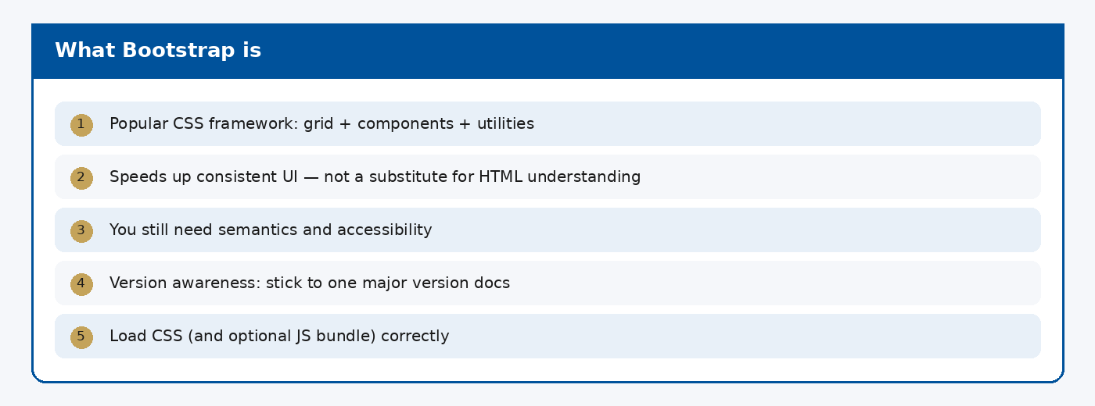
CSE6624 · Lecture 09
What Bootstrap is
Today we examine What Bootstrap is. First: Popular CSS framework: grid + components + utilities. Second: Speeds up consistent UI — not a substitute for HTML understanding. Also notice: You still need semantics and accessibility. So the key idea is precise terminology — these distinctions return in demos, labs, and assessment.
Satbayev University · CSE6624 · Lecture 9 · Autumn 2026–2027
3 / 18
Notes:
(прочитай) Укажи на ключевые пункты: What Bootstrap is

Slide 4
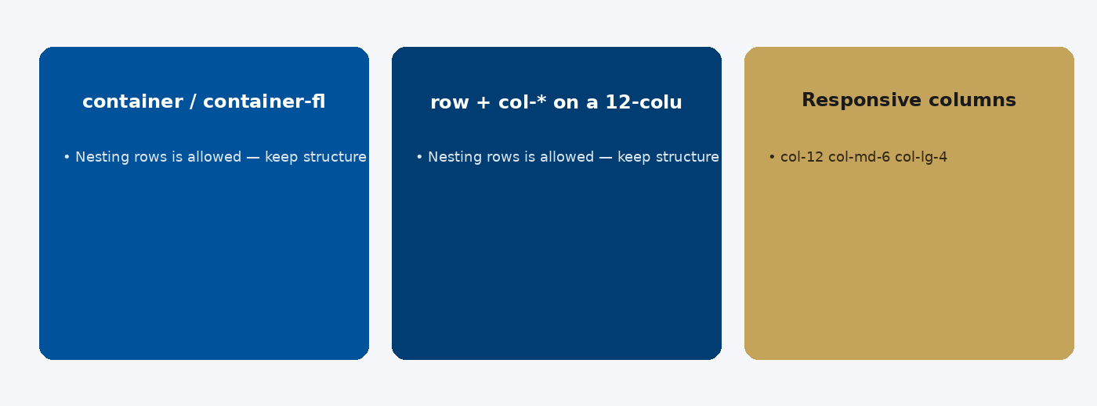
CSE6624 · Lecture 09
Grid system
Today we examine Grid system. First: container / container-fluid. Second: row + col-* on a 12-column grid. Also notice: Responsive columns: col-12 col-md-6 col-lg-4. So the key idea is precise terminology — these distinctions return in demos, labs, and assessment.
Satbayev University · CSE6624 · Lecture 9 · Autumn 2026–2027
4 / 18
Notes:
(прочитай) Укажи на ключевые пункты: Grid system

Slide 5
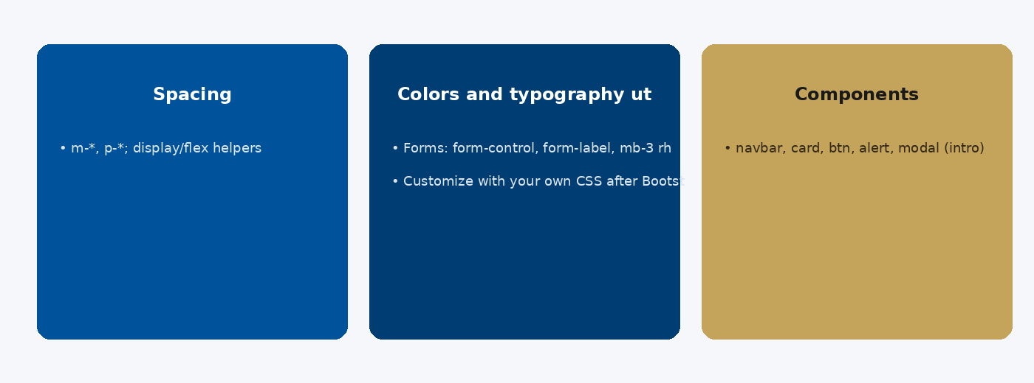
CSE6624 · Lecture 09
Utilities and components
Today we examine Utilities and components. First: Spacing: m-*, p-*; display/flex helpers. Second: Colors and typography utilities. Also notice: Components: navbar, card, btn, alert, modal (intro). So the key idea is precise terminology — these distinctions return in demos, labs, and assessment.
Satbayev University · CSE6624 · Lecture 9 · Autumn 2026–2027
5 / 18
Notes:
(прочитай) Укажи на ключевые пункты: Utilities and components

Slide 6
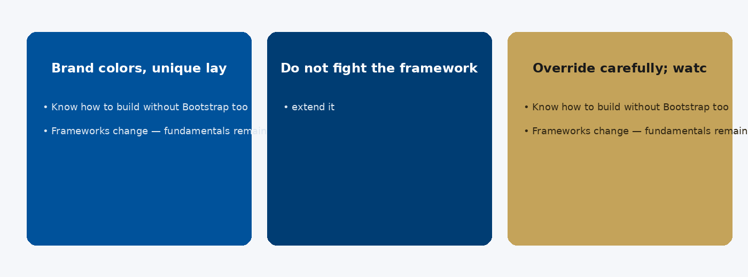
CSE6624 · Lecture 09
Custom CSS still matters
Today we examine Custom CSS still matters. First: Brand colors, unique layouts, fine-tuning. Second: Do not fight the framework — extend it. Also notice: Override carefully; watch specificity. So the key idea is precise terminology — these distinctions return in demos, labs, and assessment.
Satbayev University · CSE6624 · Lecture 9 · Autumn 2026–2027
6 / 18
Notes:
(прочитай) Укажи на ключевые пункты: Custom CSS still matters

Slide 7
CSE6624 · Lecture 09
DEMO 1/2 — CDN in head
<link href="https://cdn.jsdelivr.net/npm/bootstrap@5.3.3/dist/css/bootstrap.min.css"
rel="stylesheet">
Internet needed once to load CDN CSS.
Please watch this demo on the slide — do not type yet. I will point at the code so you see the exact target. In the task block you will reproduce these steps on your laptop. Everything you need is here; you do not leave this presentation.
Satbayev University · CSE6624 · Lecture 9 · Autumn 2026–2027
7 / 18
Notes:
(указывай на код/UI; не открывай другие файлы)

Slide 8
CSE6624 · Lecture 09
DEMO 2/2 — Navbar + cards
<nav class="navbar navbar-dark bg-primary px-3">
<a class="navbar-brand" href="#">MyApp</a>
<div>
<a class="nav-link d-inline text-white" href="#">Home</a>
<a class="nav-link d-inline text-white" href="#">About</a>
</div>
</nav>
<div class="container mt-4">
<div class="row g-3">
<div class="col-md-4"><div class="card p-3">A</div></div>
<div class="col-md-4"><div class="card p-3">B</div></div>
<div class="col-md-4"><div class="card p-3">C</div></div>
</div>
</div>
Resize — col-md-4 columns stack on small screens.
Please watch this demo on the slide — do not type yet. I will point at the code so you see the exact target. In the task block you will reproduce these steps on your laptop. Everything you need is here; you do not leave this presentation.
Satbayev University · CSE6624 · Lecture 9 · Autumn 2026–2027
8 / 18
Notes:
(указывай на код/UI; не открывай другие файлы)

Slide 9
CSE6624 · Lecture 09
TASK · ~25 min
TASK — Bootstrap starter layout (~25 min)
Work on YOUR laptop now. Follow the numbered steps on the next slides.
Suggested folder name: lecture09-yourname
If stuck: read the previous step again. Do not skip steps.
AI is optional later — first follow the steps yourself.
Now you work. The next slides are idiot-proof steps — one action after another. I will walk the room while you build. If something fails, open the If it does not work slide after the steps. Do not invent your own path during these twenty-five minutes.
Satbayev University · CSE6624 · Lecture 9 · Autumn 2026–2027
9 / 18
Notes:
(25 мин. Ходи по рядам. Стой.)

Slide 10
CSE6624 · Lecture 09
Step 1 of 5 · New page
1
New page
→ lecture09-yourname/index.html with DOCTYPE + head + body.
This is step 1. Do only this step, then wait for the next slide. Click the menus named on the slide — File, Save As, Open with. When the action is done, look up. If it failed, do not jump ahead — reread this step slowly.
Satbayev University · CSE6624 · Lecture 9 · Autumn 2026–2027
10 / 18
Notes:
(шаг 1)

Slide 11
CSE6624 · Lecture 09
Step 2 of 5 · Paste CDN link in head
2
Paste CDN link in head
→ Exact link from DEMO 1.
This is step 2. Do only this step, then wait for the next slide. Click the menus named on the slide — File, Save As, Open with. When the action is done, look up. If it failed, do not jump ahead — reread this step slowly.
Satbayev University · CSE6624 · Lecture 9 · Autumn 2026–2027
11 / 18
Notes:
(шаг 2)

Slide 12
CSE6624 · Lecture 09
Step 3 of 5 · Paste navbar + container row
3
Paste navbar + container row
→ From DEMO 2. Save.
This is step 3. Do only this step, then wait for the next slide. Click the menus named on the slide — File, Save As, Open with. When the action is done, look up. If it failed, do not jump ahead — reread this step slowly.
Satbayev University · CSE6624 · Lecture 9 · Autumn 2026–2027
12 / 18
Notes:
(шаг 3)

Slide 13
CSE6624 · Lecture 09
Step 4 of 5 · Open + resize
4
Open + resize
→ Chrome → narrow window → cards stack.
This is step 4. Do only this step, then wait for the next slide. Click the menus named on the slide — File, Save As, Open with. When the action is done, look up. If it failed, do not jump ahead — reread this step slowly.
Satbayev University · CSE6624 · Lecture 9 · Autumn 2026–2027
13 / 18
Notes:
(шаг 4)

Slide 14
CSE6624 · Lecture 09
Step 5 of 5 · Utility check
5
Utility check
→ Point at mt-4 or p-3 — that is a Bootstrap utility class.
This is step 5. Do only this step, then wait for the next slide. Click the menus named on the slide — File, Save As, Open with. When the action is done, look up. If it failed, do not jump ahead — reread this step slowly.
Satbayev University · CSE6624 · Lecture 9 · Autumn 2026–2027
14 / 18
Notes:
(шаг 5)

Slide 15
CSE6624 · Lecture 09
If it does not work
Three common mistakes — fix these before asking for help:
Mistake 1
CDN link broken/typo — page unstyled; re-copy DEMO 1.
Mistake 2
No internet — CDN will not load; ask instructor for offline CSS if needed.
Mistake 3
Forgot container/row/col — layout will not stack correctly.
Most failures are save mistakes, wrong file names, or skipped steps. Read these three mistakes aloud if needed. Fix one thing, save, refresh the browser, then re-check the success condition. Still stuck after that — raise your hand; bring your screen.
Satbayev University · CSE6624 · Lecture 9 · Autumn 2026–2027
15 / 18
Notes:
(три ошибки)

Slide 16
CSE6624 · Lecture 09
DONE — what to submit / show
☐
Browser photo stacked + wide
☐
Show neighbour
☐
Keep folder
You are done when the checklist is true. Take a photo of the browser and of the file or folder. Show your neighbour for ten seconds. Upload later if the LMS asks — keep the folder on your Desktop.
Satbayev University · CSE6624 · Lecture 9 · Autumn 2026–2027
16 / 18
Notes:
(done checklist)

Slide 17
CSE6624 · Lecture 09
Next lecture + AI rule
Next lecture
Next lecture: JavaScript basics.
AI rule (one line)
You may use AI, but you must still follow these steps yourself and explain your result.
After class rhythm: Practice & Lab
Next we continue with the topic on this slide. After the lecture block comes Practice & Lab. You may use AI, but you must still follow the slide steps yourself and explain your result. Pack your folder. See you next week.
Satbayev University · CSE6624 · Lecture 9 · Autumn 2026–2027
17 / 18
Notes:
(next + AI — без Questions)

Slide 18
See you next week.
Keep your folder. Re-read the last task steps if anything is unclear.
CSE6624 · Lecture 9 · Bootstrap
Shoiynbek Temirlan Armanuly · Senior Lecturer
Satbayev University · Autumn 2026–2027 · Almaty
Notes:
(улыбка. Без Questions.)

