Slide 1


SATBAYEV UNIVERSITY
Automation and Information Technology · Software Engineering
CSE6624
Introduction to Web Programming
Lecture 10
JavaScript Basics
Shoiynbek Temirlan Armanuly
Senior Lecturer
Programme: 6B06102 Computer Science
Autumn 2026–2027 · Almaty
City University / Satbayev University · English-taught course
Notes:
(улыбнись — Hello + номер лекции + тема.)

Slide 2
CSE6624 · Lecture 10
Today's plan · 50 minutes
15 min
~15 min — I explain (diagrams + you listen)
I read the strips. You look at the diagrams. No typing yet.
5 min
~5 min — Demo on these slides
Code / UI is ON the slides. I only point. Do not open other folders.
25 min
~25 min — You do the task
Step-by-step ON the slides. Follow every click. If stuck: read the previous step again.
5 min
~5 min — What to submit / next lecture
Photo proof + show neighbour. One-line preview of next week.
Today's plan is fixed to fifty minutes. About fifteen minutes I explain with diagrams. About five minutes I point at demo code on these slides — you watch. About twenty-five minutes you follow the task steps on the slides. The last five minutes cover what to submit and what comes next. There is no separate questions block — if stuck, read the previous step again.
Satbayev University · CSE6624 · Lecture 10 · Autumn 2026–2027
2 / 19
Notes:
(прочитай полоску; укажи на 15/5/25/5)

Slide 3
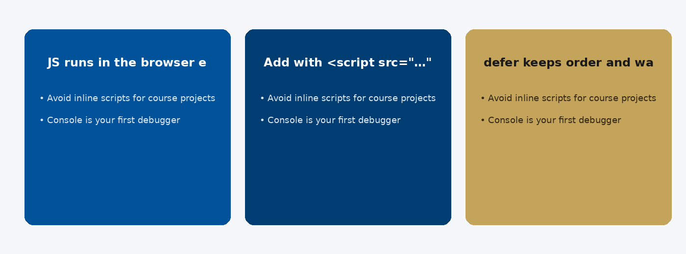
CSE6624 · Lecture 10
JavaScript in the browser
Today we examine JavaScript in the browser. First: JS runs in the browser engine (V8, SpiderMonkey…). Second: Add with <script src="…" defer></script>. Also notice: defer keeps order and waits for HTML parse. So the key idea is precise terminology — these distinctions return in demos, labs, and assessment.
Satbayev University · CSE6624 · Lecture 10 · Autumn 2026–2027
3 / 19
Notes:
(прочитай) Укажи на ключевые пункты: JavaScript in the browser

Slide 4
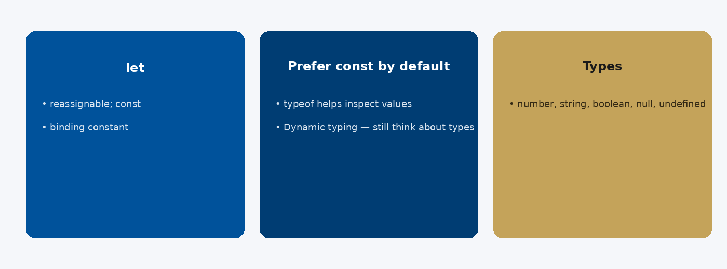
CSE6624 · Lecture 10
Variables and types
Today we examine Variables and types. First: let — reassignable; const — binding constant. Second: Prefer const by default. Also notice: Types: number, string, boolean, null, undefined, object. So the key idea is precise terminology — these distinctions return in demos, labs, and assessment.
Satbayev University · CSE6624 · Lecture 10 · Autumn 2026–2027
4 / 19
Notes:
(прочитай) Укажи на ключевые пункты: Variables and types

Slide 5
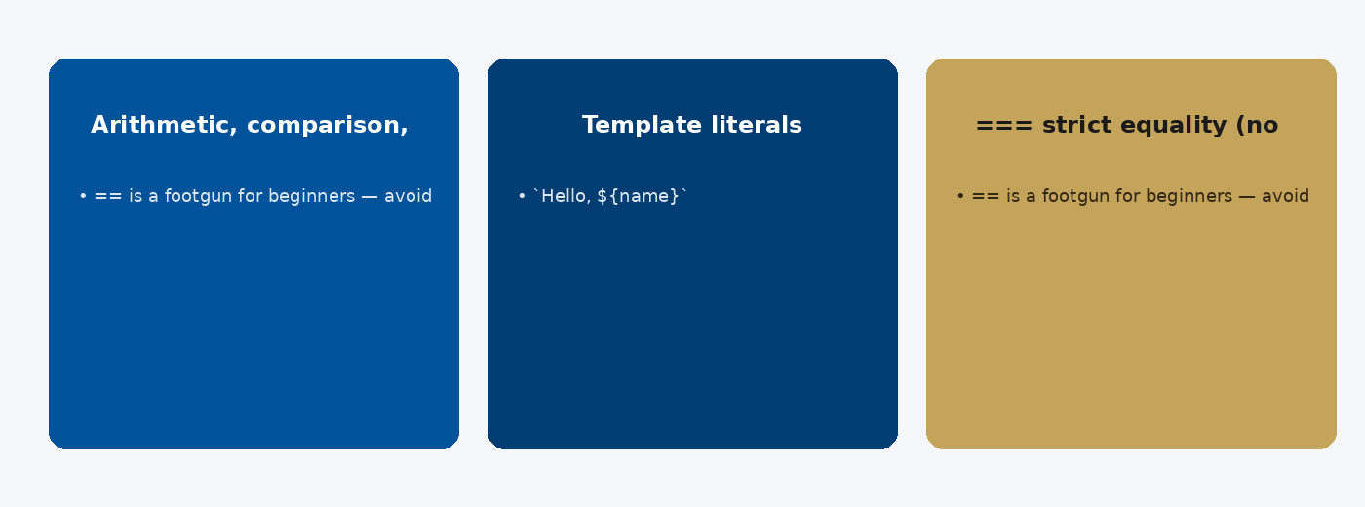
CSE6624 · Lecture 10
Operators and strings
Today we examine Operators and strings. First: Arithmetic, comparison, logical && || !. Second: Template literals: `Hello, ${name}`. Also notice: === strict equality (no silent coercion). So the key idea is precise terminology — these distinctions return in demos, labs, and assessment.
Satbayev University · CSE6624 · Lecture 10 · Autumn 2026–2027
5 / 19
Notes:
(прочитай) Укажи на ключевые пункты: Operators and strings

Slide 6
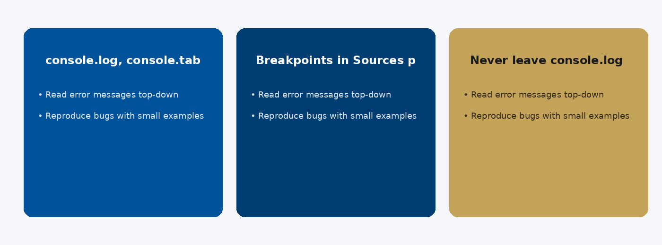
CSE6624 · Lecture 10
Console habits
Today we examine Console habits. First: console.log, console.table, console.error. Second: Breakpoints in Sources panel. Also notice: Never leave console.log spam in final submit. So the key idea is precise terminology — these distinctions return in demos, labs, and assessment.
Satbayev University · CSE6624 · Lecture 10 · Autumn 2026–2027
6 / 19
Notes:
(прочитай) Укажи на ключевые пункты: Console habits

Slide 7
CSE6624 · Lecture 10
DEMO 1/3 — HTML + button
<h1>JS Hello</h1>
<p id="out">Click the button…</p>
<button id="btn">Say hello</button>
<script src="js/script.js"></script>
script at end of body so elements exist.
Please watch this demo on the slide — do not type yet. I will point at the code so you see the exact target. In the task block you will reproduce these steps on your laptop. Everything you need is here; you do not leave this presentation.
Satbayev University · CSE6624 · Lecture 10 · Autumn 2026–2027
7 / 19
Notes:
(указывай на код/UI; не открывай другие файлы)

Slide 8
CSE6624 · Lecture 10
DEMO 2/3 — js/script.js
const name = "Your Name";
console.log("Hello, " + name);
const btn = document.querySelector("#btn");
const out = document.querySelector("#out");
btn.addEventListener("click", () => {
out.textContent = "Hello, " + name + "!";
});
console.log + click updates the page.
Please watch this demo on the slide — do not type yet. I will point at the code so you see the exact target. In the task block you will reproduce these steps on your laptop. Everything you need is here; you do not leave this presentation.
Satbayev University · CSE6624 · Lecture 10 · Autumn 2026–2027
8 / 19
Notes:
(указывай на код/UI; не открывай другие файлы)

Slide 9
CSE6624 · Lecture 10
DEMO 3/3 — Success
F12 → Console shows: Hello, Your Name
Click button → paragraph changes to greeting
If click does nothing: check script path and ids.
Please watch this demo on the slide — do not type yet. I will point at the layout so you see the exact target. In the task block you will reproduce these steps on your laptop. Everything you need is here; you do not leave this presentation.
Satbayev University · CSE6624 · Lecture 10 · Autumn 2026–2027
9 / 19
Notes:
(указывай на код/UI; не открывай другие файлы)

Slide 10
CSE6624 · Lecture 10
TASK · ~25 min
TASK — variables + console + button (~25 min)
Work on YOUR laptop now. Follow the numbered steps on the next slides.
Suggested folder name: lecture10-yourname
If stuck: read the previous step again. Do not skip steps.
AI is optional later — first follow the steps yourself.
Now you work. The next slides are idiot-proof steps — one action after another. I will walk the room while you build. If something fails, open the If it does not work slide after the steps. Do not invent your own path during these twenty-five minutes.
Satbayev University · CSE6624 · Lecture 10 · Autumn 2026–2027
10 / 19
Notes:
(25 мин. Ходи по рядам. Стой.)

Slide 11
CSE6624 · Lecture 10
Step 1 of 5 · Folders
1
Folders
→ lecture10-yourname/index.html and js/script.js
This is step 1. Do only this step, then wait for the next slide. Click the menus named on the slide — File, Save As, Open with. When the action is done, look up. If it failed, do not jump ahead — reread this step slowly.
Satbayev University · CSE6624 · Lecture 10 · Autumn 2026–2027
11 / 19
Notes:
(шаг 1)

Slide 12
CSE6624 · Lecture 10
Step 2 of 5 · HTML from DEMO 1
2
HTML from DEMO 1
→ Save index.html with button + script tag.
This is step 2. Do only this step, then wait for the next slide. Click the menus named on the slide — File, Save As, Open with. When the action is done, look up. If it failed, do not jump ahead — reread this step slowly.
Satbayev University · CSE6624 · Lecture 10 · Autumn 2026–2027
12 / 19
Notes:
(шаг 2)

Slide 13
CSE6624 · Lecture 10
Step 3 of 5 · script.js from DEMO 2
3
script.js from DEMO 2
→ Put your real name in the const. Save.
This is step 3. Do only this step, then wait for the next slide. Click the menus named on the slide — File, Save As, Open with. When the action is done, look up. If it failed, do not jump ahead — reread this step slowly.
Satbayev University · CSE6624 · Lecture 10 · Autumn 2026–2027
13 / 19
Notes:
(шаг 3)

Slide 14
CSE6624 · Lecture 10
Step 4 of 5 · Console check
4
Console check
→ Open in Chrome → F12 → Console → see Hello log.
This is step 4. Do only this step, then wait for the next slide. Click the menus named on the slide — File, Save As, Open with. When the action is done, look up. If it failed, do not jump ahead — reread this step slowly.
Satbayev University · CSE6624 · Lecture 10 · Autumn 2026–2027
14 / 19
Notes:
(шаг 4)

Slide 15
CSE6624 · Lecture 10
Step 5 of 5 · Click check
5
Click check
→ Click Say hello → paragraph updates. Show neighbour.
This is step 5. Do only this step, then wait for the next slide. Click the menus named on the slide — File, Save As, Open with. When the action is done, look up. If it failed, do not jump ahead — reread this step slowly.
Satbayev University · CSE6624 · Lecture 10 · Autumn 2026–2027
15 / 19
Notes:
(шаг 5)

Slide 16
CSE6624 · Lecture 10
If it does not work
Three common mistakes — fix these before asking for help:
Mistake 1
script in <head> without defer — move script to end of body.
Mistake 2
Wrong path js/script.js — file missing → check folder.
Mistake 3
Typo in id btn vs #Btn — querySelector finds nothing.
Most failures are save mistakes, wrong file names, or skipped steps. Read these three mistakes aloud if needed. Fix one thing, save, refresh the browser, then re-check the success condition. Still stuck after that — raise your hand; bring your screen.
Satbayev University · CSE6624 · Lecture 10 · Autumn 2026–2027
16 / 19
Notes:
(три ошибки)

Slide 17
CSE6624 · Lecture 10
DONE — what to submit / show
☐
Console photo
☐
Click demo to neighbour
☐
Keep folder
You are done when the checklist is true. Take a photo of the browser and of the file or folder. Show your neighbour for ten seconds. Upload later if the LMS asks — keep the folder on your Desktop.
Satbayev University · CSE6624 · Lecture 10 · Autumn 2026–2027
17 / 19
Notes:
(done checklist)

Slide 18
CSE6624 · Lecture 10
Next lecture + AI rule
Next lecture
Next lecture: functions, arrays, objects.
AI rule (one line)
You may use AI, but you must still follow these steps yourself and explain your result.
After class rhythm: Practice & Lab
Next we continue with the topic on this slide. After the lecture block comes Practice & Lab. You may use AI, but you must still follow the slide steps yourself and explain your result. Pack your folder. See you next week.
Satbayev University · CSE6624 · Lecture 10 · Autumn 2026–2027
18 / 19
Notes:
(next + AI — без Questions)

Slide 19
See you next week.
Keep your folder. Re-read the last task steps if anything is unclear.
CSE6624 · Lecture 10 · JavaScript Basics
Shoiynbek Temirlan Armanuly · Senior Lecturer
Satbayev University · Autumn 2026–2027 · Almaty
Notes:
(улыбка. Без Questions.)

