Slide 1


SATBAYEV UNIVERSITY
Automation and Information Technology · Software Engineering
CSE6624
Introduction to Web Programming
Lecture 11
Functions, Arrays, Objects
Shoiynbek Temirlan Armanuly
Senior Lecturer
Programme: 6B06102 Computer Science
Autumn 2026–2027 · Almaty
City University / Satbayev University · English-taught course
Notes:
(улыбнись — Hello + номер лекции + тема.)

Slide 2
CSE6624 · Lecture 11
Today's plan · 50 minutes
15 min
~15 min — I explain (diagrams + you listen)
I read the strips. You look at the diagrams. No typing yet.
5 min
~5 min — Demo on these slides
Code / UI is ON the slides. I only point. Do not open other folders.
25 min
~25 min — You do the task
Step-by-step ON the slides. Follow every click. If stuck: read the previous step again.
5 min
~5 min — What to submit / next lecture
Photo proof + show neighbour. One-line preview of next week.
Today's plan is fixed to fifty minutes. About fifteen minutes I explain with diagrams. About five minutes I point at demo code on these slides — you watch. About twenty-five minutes you follow the task steps on the slides. The last five minutes cover what to submit and what comes next. There is no separate questions block — if stuck, read the previous step again.
Satbayev University · CSE6624 · Lecture 11 · Autumn 2026–2027
2 / 18
Notes:
(прочитай полоску; укажи на 15/5/25/5)

Slide 3
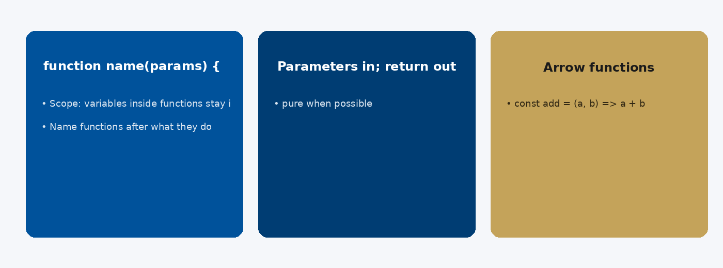
CSE6624 · Lecture 11
Functions
Today we examine Functions. First: function name(params) { return value; }. Second: Parameters in; return out — pure when possible. Also notice: Arrow functions: const add = (a, b) => a + b. So the key idea is precise terminology — these distinctions return in demos, labs, and assessment.
Satbayev University · CSE6624 · Lecture 11 · Autumn 2026–2027
3 / 18
Notes:
(прочитай) Укажи на ключевые пункты: Functions

Slide 4
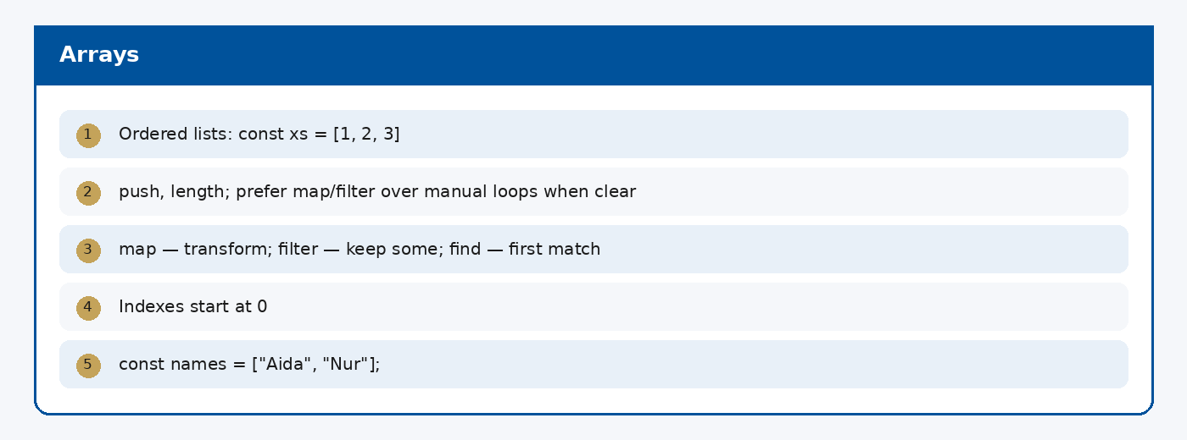
CSE6624 · Lecture 11
Arrays
Today we examine Arrays. First: Ordered lists: const xs = [1, 2, 3]. Second: push, length; prefer map/filter over manual loops when clear. Also notice: map — transform; filter — keep some; find — first match. So the key idea is precise terminology — these distinctions return in demos, labs, and assessment.
Satbayev University · CSE6624 · Lecture 11 · Autumn 2026–2027
4 / 18
Notes:
(прочитай) Укажи на ключевые пункты: Arrays

Slide 5
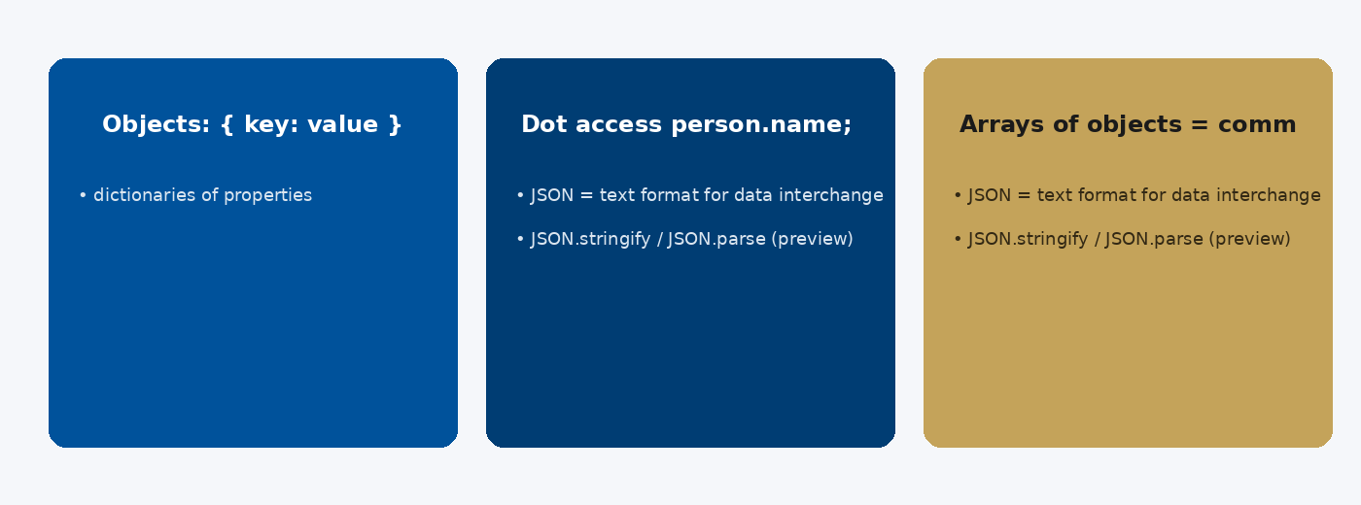
CSE6624 · Lecture 11
Objects and JSON
Today we examine Objects and JSON. First: Objects: { key: value } — dictionaries of properties. Second: Dot access person.name; brackets person["name"]. Also notice: Arrays of objects = common UI data shape. So the key idea is precise terminology — these distinctions return in demos, labs, and assessment.
Satbayev University · CSE6624 · Lecture 11 · Autumn 2026–2027
5 / 18
Notes:
(прочитай) Укажи на ключевые пункты: Objects and JSON

Slide 6
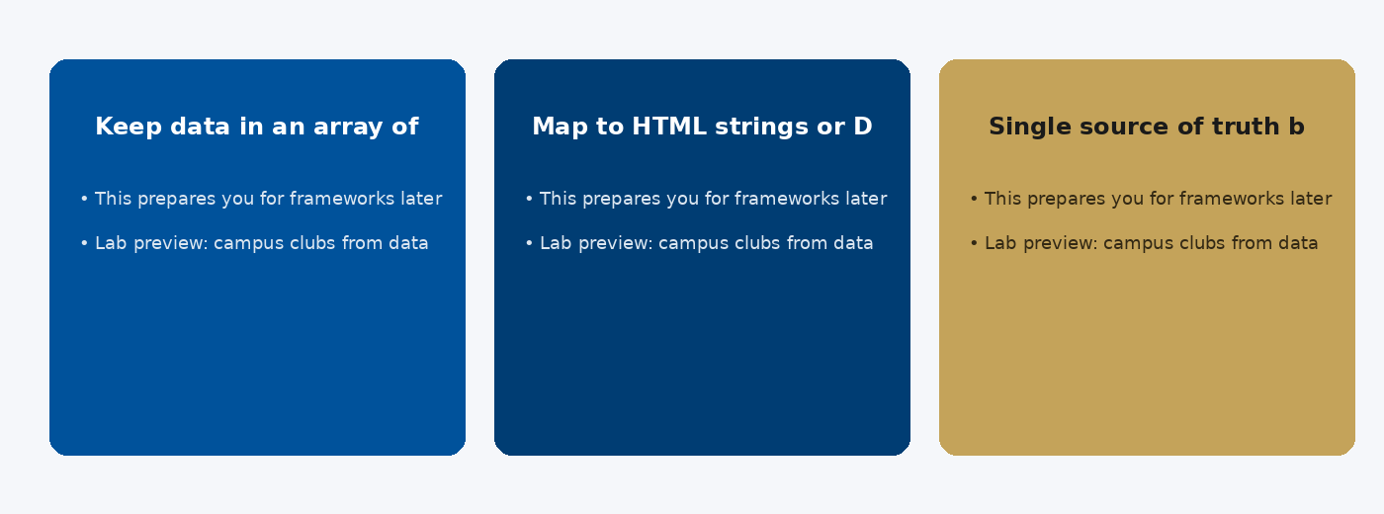
CSE6624 · Lecture 11
Pattern: data → UI list
Today we examine Pattern: data → UI list. First: Keep data in an array of objects. Second: Map to HTML strings or DOM nodes (next week). Also notice: Single source of truth beats copy-paste cards. So the key idea is precise terminology — these distinctions return in demos, labs, and assessment.
Satbayev University · CSE6624 · Lecture 11 · Autumn 2026–2027
6 / 18
Notes:
(прочитай) Укажи на ключевые пункты: Pattern: data → UI list

Slide 7
CSE6624 · Lecture 11
DEMO 1/2 — Data + function
const cities = ["Almaty", "Astana", "Shymkent", "Karaganda"];
function line(city) {
return "• " + city.toUpperCase();
}
const btn = document.querySelector("#btn");
const out = document.querySelector("#out");
btn.addEventListener("click", () => {
out.textContent = cities.map(line).join("\n");
});
Function formats one item; map builds the list.
Please watch this demo on the slide — do not type yet. I will point at the code so you see the exact target. In the task block you will reproduce these steps on your laptop. Everything you need is here; you do not leave this presentation.
Satbayev University · CSE6624 · Lecture 11 · Autumn 2026–2027
7 / 18
Notes:
(указывай на код/UI; не открывай другие файлы)

Slide 8
CSE6624 · Lecture 11
DEMO 2/2 — HTML shell
<button id="btn">Show cities</button>
<pre id="out"></pre>
<script src="js/script.js"></script>
pre keeps line breaks visible.
Please watch this demo on the slide — do not type yet. I will point at the code so you see the exact target. In the task block you will reproduce these steps on your laptop. Everything you need is here; you do not leave this presentation.
Satbayev University · CSE6624 · Lecture 11 · Autumn 2026–2027
8 / 18
Notes:
(указывай на код/UI; не открывай другие файлы)

Slide 9
CSE6624 · Lecture 11
TASK · ~25 min
TASK — functions + array mini (~25 min)
Work on YOUR laptop now. Follow the numbered steps on the next slides.
Suggested folder name: lecture11-yourname
If stuck: read the previous step again. Do not skip steps.
AI is optional later — first follow the steps yourself.
Now you work. The next slides are idiot-proof steps — one action after another. I will walk the room while you build. If something fails, open the If it does not work slide after the steps. Do not invent your own path during these twenty-five minutes.
Satbayev University · CSE6624 · Lecture 11 · Autumn 2026–2027
9 / 18
Notes:
(25 мин. Ходи по рядам. Стой.)

Slide 10
CSE6624 · Lecture 11
Step 1 of 5 · Setup lecture11-yourname
1
Setup lecture11-yourname
→ index.html + js/script.js linked at end of body.
This is step 1. Do only this step, then wait for the next slide. Click the menus named on the slide — File, Save As, Open with. When the action is done, look up. If it failed, do not jump ahead — reread this step slowly.
Satbayev University · CSE6624 · Lecture 11 · Autumn 2026–2027
10 / 18
Notes:
(шаг 1)

Slide 11
CSE6624 · Lecture 11
Step 2 of 5 · Paste HTML shell
2
Paste HTML shell
→ Button + pre#out from DEMO.
This is step 2. Do only this step, then wait for the next slide. Click the menus named on the slide — File, Save As, Open with. When the action is done, look up. If it failed, do not jump ahead — reread this step slowly.
Satbayev University · CSE6624 · Lecture 11 · Autumn 2026–2027
11 / 18
Notes:
(шаг 2)

Slide 12
CSE6624 · Lecture 11
Step 3 of 5 · Paste JS — change cities to yours
3
Paste JS — change cities to yours
→ 4 strings. Keep the function + map pattern.
This is step 3. Do only this step, then wait for the next slide. Click the menus named on the slide — File, Save As, Open with. When the action is done, look up. If it failed, do not jump ahead — reread this step slowly.
Satbayev University · CSE6624 · Lecture 11 · Autumn 2026–2027
12 / 18
Notes:
(шаг 3)

Slide 13
CSE6624 · Lecture 11
Step 4 of 5 · Run
4
Run
→ Open Chrome → click → see 4 uppercased lines.
This is step 4. Do only this step, then wait for the next slide. Click the menus named on the slide — File, Save As, Open with. When the action is done, look up. If it failed, do not jump ahead — reread this step slowly.
Satbayev University · CSE6624 · Lecture 11 · Autumn 2026–2027
13 / 18
Notes:
(шаг 4)

Slide 14
CSE6624 · Lecture 11
Step 5 of 5 · Explain
5
Explain
→ Tell neighbour in one sentence what map does.
This is step 5. Do only this step, then wait for the next slide. Click the menus named on the slide — File, Save As, Open with. When the action is done, look up. If it failed, do not jump ahead — reread this step slowly.
Satbayev University · CSE6624 · Lecture 11 · Autumn 2026–2027
14 / 18
Notes:
(шаг 5)

Slide 15
CSE6624 · Lecture 11
If it does not work
Three common mistakes — fix these before asking for help:
Mistake 1
Used for-loop incorrectly and broke syntax — start from DEMO JS again.
Mistake 2
out is null — id mismatch.
Mistake 3
Clicked nothing appears — open Console for red errors.
Most failures are save mistakes, wrong file names, or skipped steps. Read these three mistakes aloud if needed. Fix one thing, save, refresh the browser, then re-check the success condition. Still stuck after that — raise your hand; bring your screen.
Satbayev University · CSE6624 · Lecture 11 · Autumn 2026–2027
15 / 18
Notes:
(три ошибки)

Slide 16
CSE6624 · Lecture 11
DONE — what to submit / show
☐
Browser photo of list
☐
Neighbour heard your map sentence
☐
Keep folder
You are done when the checklist is true. Take a photo of the browser and of the file or folder. Show your neighbour for ten seconds. Upload later if the LMS asks — keep the folder on your Desktop.
Satbayev University · CSE6624 · Lecture 11 · Autumn 2026–2027
16 / 18
Notes:
(done checklist)

Slide 17
CSE6624 · Lecture 11
Next lecture + AI rule
Next lecture
Next lecture: DOM and events.
AI rule (one line)
You may use AI, but you must still follow these steps yourself and explain your result.
After class rhythm: Practice & Lab
Next we continue with the topic on this slide. After the lecture block comes Practice & Lab. You may use AI, but you must still follow the slide steps yourself and explain your result. Pack your folder. See you next week.
Satbayev University · CSE6624 · Lecture 11 · Autumn 2026–2027
17 / 18
Notes:
(next + AI — без Questions)

Slide 18
See you next week.
Keep your folder. Re-read the last task steps if anything is unclear.
CSE6624 · Lecture 11 · Functions, Arrays, Objects
Shoiynbek Temirlan Armanuly · Senior Lecturer
Satbayev University · Autumn 2026–2027 · Almaty
Notes:
(улыбка. Без Questions.)

