Slide 1


SATBAYEV UNIVERSITY
Automation and Information Technology · Software Engineering
CSE6624
Introduction to Web Programming
Lecture 12
DOM and Events
Shoiynbek Temirlan Armanuly
Senior Lecturer
Programme: 6B06102 Computer Science
Autumn 2026–2027 · Almaty
City University / Satbayev University · English-taught course
Notes:
(улыбнись — Hello + номер лекции + тема.)

Slide 2
CSE6624 · Lecture 12
Today's plan · 50 minutes
15 min
~15 min — I explain (diagrams + you listen)
I read the strips. You look at the diagrams. No typing yet.
5 min
~5 min — Demo on these slides
Code / UI is ON the slides. I only point. Do not open other folders.
25 min
~25 min — You do the task
Step-by-step ON the slides. Follow every click. If stuck: read the previous step again.
5 min
~5 min — What to submit / next lecture
Photo proof + show neighbour. One-line preview of next week.
Today's plan is fixed to fifty minutes. About fifteen minutes I explain with diagrams. About five minutes I point at demo code on these slides — you watch. About twenty-five minutes you follow the task steps on the slides. The last five minutes cover what to submit and what comes next. There is no separate questions block — if stuck, read the previous step again.
Satbayev University · CSE6624 · Lecture 12 · Autumn 2026–2027
2 / 18
Notes:
(прочитай полоску; укажи на 15/5/25/5)

Slide 3
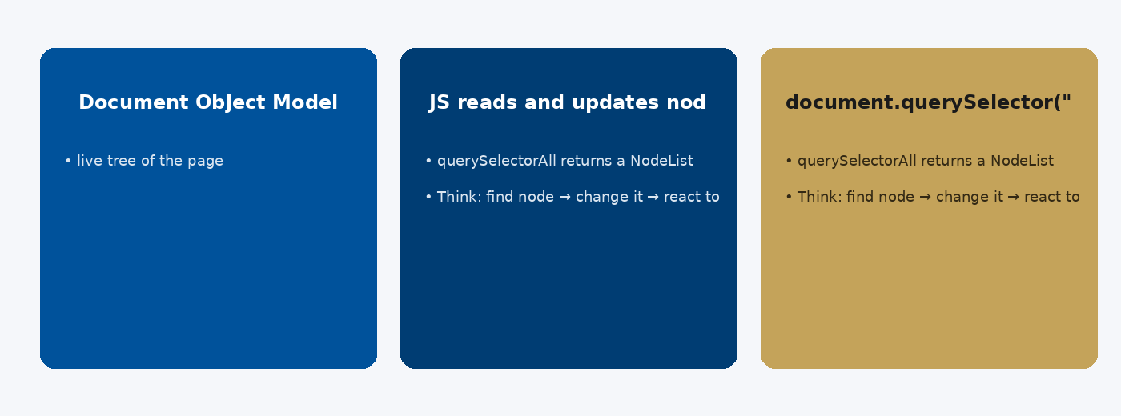
CSE6624 · Lecture 12
DOM basics
Today we examine DOM basics. First: Document Object Model — live tree of the page. Second: JS reads and updates nodes; browser repaints. Also notice: document.querySelector(".card"). So the key idea is precise terminology — these distinctions return in demos, labs, and assessment.
Satbayev University · CSE6624 · Lecture 12 · Autumn 2026–2027
3 / 18
Notes:
(прочитай) Укажи на ключевые пункты: DOM basics

Slide 4
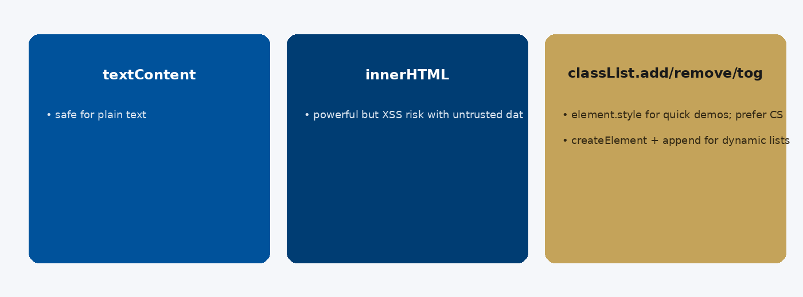
CSE6624 · Lecture 12
Updating content safely
Today we examine Updating content safely. First: textContent — safe for plain text. Second: innerHTML — powerful but XSS risk with untrusted data. Also notice: classList.add/remove/toggle for CSS state. So the key idea is precise terminology — these distinctions return in demos, labs, and assessment.
Satbayev University · CSE6624 · Lecture 12 · Autumn 2026–2027
4 / 18
Notes:
(прочитай) Укажи на ключевые пункты: Updating content safely

Slide 5
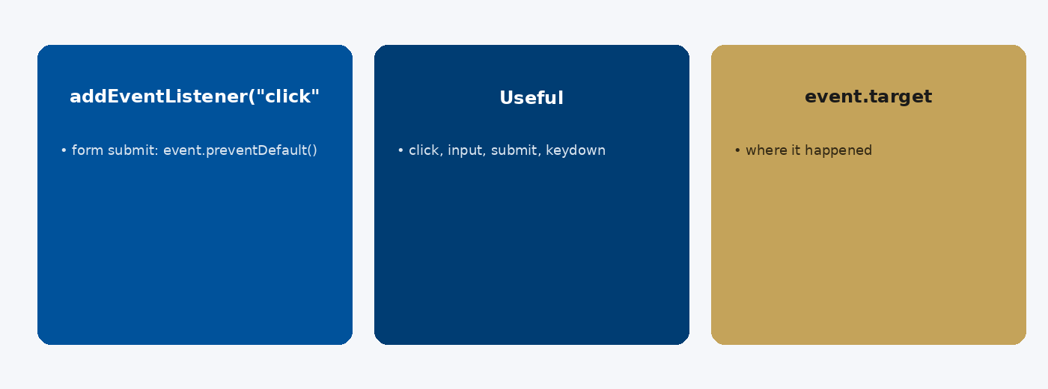
CSE6624 · Lecture 12
Events
Today we examine Events. First: addEventListener("click", handler). Second: Useful: click, input, submit, keydown. Also notice: event.target — where it happened. So the key idea is precise terminology — these distinctions return in demos, labs, and assessment.
Satbayev University · CSE6624 · Lecture 12 · Autumn 2026–2027
5 / 18
Notes:
(прочитай) Укажи на ключевые пункты: Events

Slide 6
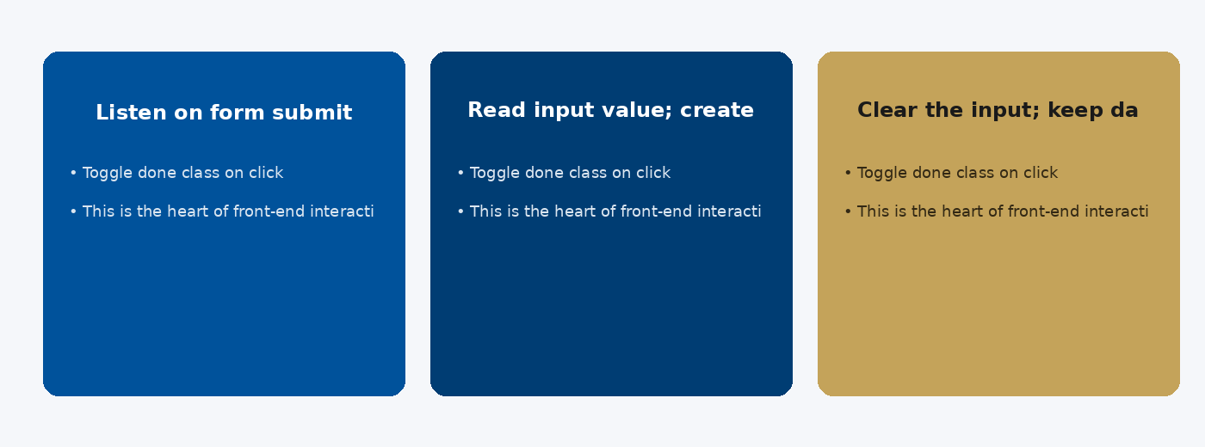
CSE6624 · Lecture 12
Todo-lite pattern
Today we examine Todo-lite pattern. First: Listen on form submit. Second: Read input value; create li; append to ul. Also notice: Clear the input; keep data in an array too. So the key idea is precise terminology — these distinctions return in demos, labs, and assessment.
Satbayev University · CSE6624 · Lecture 12 · Autumn 2026–2027
6 / 18
Notes:
(прочитай) Укажи на ключевые пункты: Todo-lite pattern

Slide 7
CSE6624 · Lecture 12
DEMO 1/2 — Toggle + live mirror
const box = document.querySelector("#box");
const toggleBtn = document.querySelector("#toggle");
const field = document.querySelector("#field");
const mirror = document.querySelector("#mirror");
const form = document.querySelector("#form");
const msg = document.querySelector("#msg");
toggleBtn.addEventListener("click", () => {
box.classList.toggle("on");
});
field.addEventListener("input", () => {
mirror.textContent = field.value;
});
form.addEventListener("submit", (e) => {
e.preventDefault();
msg.textContent = "Submit blocked — good.";
});
addEventListener only — no onclick= attributes.
Please watch this demo on the slide — do not type yet. I will point at the code so you see the exact target. In the task block you will reproduce these steps on your laptop. Everything you need is here; you do not leave this presentation.
Satbayev University · CSE6624 · Lecture 12 · Autumn 2026–2027
7 / 18
Notes:
(указывай на код/UI; не открывай другие файлы)

Slide 8
CSE6624 · Lecture 12
DEMO 2/2 — HTML + tiny CSS
<div id="box" class="box">Box</div>
<button id="toggle">Toggle</button>
<input id="field" placeholder="Type here">
<p id="mirror"></p>
<form id="form">
<button type="submit">Submit</button>
</form>
<p id="msg"></p>
<style>
.box { padding:1rem; background:#E8F0F8; }
.box.on { background:#C4A35A; }
</style>
Three behaviours: toggle · mirror · preventDefault.
Please watch this demo on the slide — do not type yet. I will point at the code so you see the exact target. In the task block you will reproduce these steps on your laptop. Everything you need is here; you do not leave this presentation.
Satbayev University · CSE6624 · Lecture 12 · Autumn 2026–2027
8 / 18
Notes:
(указывай на код/UI; не открывай другие файлы)

Slide 9
CSE6624 · Lecture 12
TASK · ~25 min
TASK — toggle + input + prevent submit (~25 min)
Work on YOUR laptop now. Follow the numbered steps on the next slides.
Suggested folder name: lecture12-yourname
If stuck: read the previous step again. Do not skip steps.
AI is optional later — first follow the steps yourself.
Now you work. The next slides are idiot-proof steps — one action after another. I will walk the room while you build. If something fails, open the If it does not work slide after the steps. Do not invent your own path during these twenty-five minutes.
Satbayev University · CSE6624 · Lecture 12 · Autumn 2026–2027
9 / 18
Notes:
(25 мин. Ходи по рядам. Стой.)

Slide 10
CSE6624 · Lecture 12
Step 1 of 5 · Setup lecture12-yourname
1
Setup lecture12-yourname
→ One index.html is enough today (CSS in <style> OK).
This is step 1. Do only this step, then wait for the next slide. Click the menus named on the slide — File, Save As, Open with. When the action is done, look up. If it failed, do not jump ahead — reread this step slowly.
Satbayev University · CSE6624 · Lecture 12 · Autumn 2026–2027
10 / 18
Notes:
(шаг 1)

Slide 11
CSE6624 · Lecture 12
Step 2 of 5 · Paste HTML/CSS from DEMO 2
2
Paste HTML/CSS from DEMO 2
→ Save.
This is step 2. Do only this step, then wait for the next slide. Click the menus named on the slide — File, Save As, Open with. When the action is done, look up. If it failed, do not jump ahead — reread this step slowly.
Satbayev University · CSE6624 · Lecture 12 · Autumn 2026–2027
11 / 18
Notes:
(шаг 2)

Slide 12
CSE6624 · Lecture 12
Step 3 of 5 · Add script (inline or js/script.js)
3
Add script (inline or js/script.js)
→ Paste DEMO 1. Prefer <script src="js/script.js">.
This is step 3. Do only this step, then wait for the next slide. Click the menus named on the slide — File, Save As, Open with. When the action is done, look up. If it failed, do not jump ahead — reread this step slowly.
Satbayev University · CSE6624 · Lecture 12 · Autumn 2026–2027
12 / 18
Notes:
(шаг 3)

Slide 13
CSE6624 · Lecture 12
Step 4 of 5 · Test all three
4
Test all three
→ Toggle color · type to mirror · submit shows message, no reload.
This is step 4. Do only this step, then wait for the next slide. Click the menus named on the slide — File, Save As, Open with. When the action is done, look up. If it failed, do not jump ahead — reread this step slowly.
Satbayev University · CSE6624 · Lecture 12 · Autumn 2026–2027
13 / 18
Notes:
(шаг 4)

Slide 14
CSE6624 · Lecture 12
Step 5 of 5 · Demo to neighbour
5
Demo to neighbour
→ Show all three interactions in 20 seconds.
This is step 5. Do only this step, then wait for the next slide. Click the menus named on the slide — File, Save As, Open with. When the action is done, look up. If it failed, do not jump ahead — reread this step slowly.
Satbayev University · CSE6624 · Lecture 12 · Autumn 2026–2027
14 / 18
Notes:
(шаг 5)

Slide 15
CSE6624 · Lecture 12
If it does not work
Three common mistakes — fix these before asking for help:
Mistake 1
Page reloads on submit — you forgot e.preventDefault().
Mistake 2
Toggle does nothing — .on class missing in CSS.
Mistake 3
Inline onclick= used — remove; use addEventListener.
Most failures are save mistakes, wrong file names, or skipped steps. Read these three mistakes aloud if needed. Fix one thing, save, refresh the browser, then re-check the success condition. Still stuck after that — raise your hand; bring your screen.
Satbayev University · CSE6624 · Lecture 12 · Autumn 2026–2027
15 / 18
Notes:
(три ошибки)

Slide 16
CSE6624 · Lecture 12
DONE — what to submit / show
☐
Browser demo to neighbour
☐
Optional Console clean (no red)
☐
Keep folder
You are done when the checklist is true. Take a photo of the browser and of the file or folder. Show your neighbour for ten seconds. Upload later if the LMS asks — keep the folder on your Desktop.
Satbayev University · CSE6624 · Lecture 12 · Autumn 2026–2027
16 / 18
Notes:
(done checklist)

Slide 17
CSE6624 · Lecture 12
Next lecture + AI rule
Next lecture
Next lecture: storage, fetch, DevTools.
AI rule (one line)
You may use AI, but you must still follow these steps yourself and explain your result.
After class rhythm: Practice & Lab
Next we continue with the topic on this slide. After the lecture block comes Practice & Lab. You may use AI, but you must still follow the slide steps yourself and explain your result. Pack your folder. See you next week.
Satbayev University · CSE6624 · Lecture 12 · Autumn 2026–2027
17 / 18
Notes:
(next + AI — без Questions)

Slide 18
See you next week.
Keep your folder. Re-read the last task steps if anything is unclear.
CSE6624 · Lecture 12 · DOM and Events
Shoiynbek Temirlan Armanuly · Senior Lecturer
Satbayev University · Autumn 2026–2027 · Almaty
Notes:
(улыбка. Без Questions.)

