Slide 1


SATBAYEV UNIVERSITY
Automation and Information Technology · Software Engineering
CSE6624
Introduction to Web Programming
Lecture 13
Storage, Fetch, and DevTools
Shoiynbek Temirlan Armanuly
Senior Lecturer
Programme: 6B06102 Computer Science
Autumn 2026–2027 · Almaty
City University / Satbayev University · English-taught course
Notes:
(улыбнись — Hello + номер лекции + тема.)

Slide 2
CSE6624 · Lecture 13
Today's plan · 50 minutes
15 min
~15 min — I explain (diagrams + you listen)
I read the strips. You look at the diagrams. No typing yet.
5 min
~5 min — Demo on these slides
Code / UI is ON the slides. I only point. Do not open other folders.
25 min
~25 min — You do the task
Step-by-step ON the slides. Follow every click. If stuck: read the previous step again.
5 min
~5 min — What to submit / next lecture
Photo proof + show neighbour. One-line preview of next week.
Today's plan is fixed to fifty minutes. About fifteen minutes I explain with diagrams. About five minutes I point at demo code on these slides — you watch. About twenty-five minutes you follow the task steps on the slides. The last five minutes cover what to submit and what comes next. There is no separate questions block — if stuck, read the previous step again.
Satbayev University · CSE6624 · Lecture 13 · Autumn 2026–2027
2 / 18
Notes:
(прочитай полоску; укажи на 15/5/25/5)

Slide 3
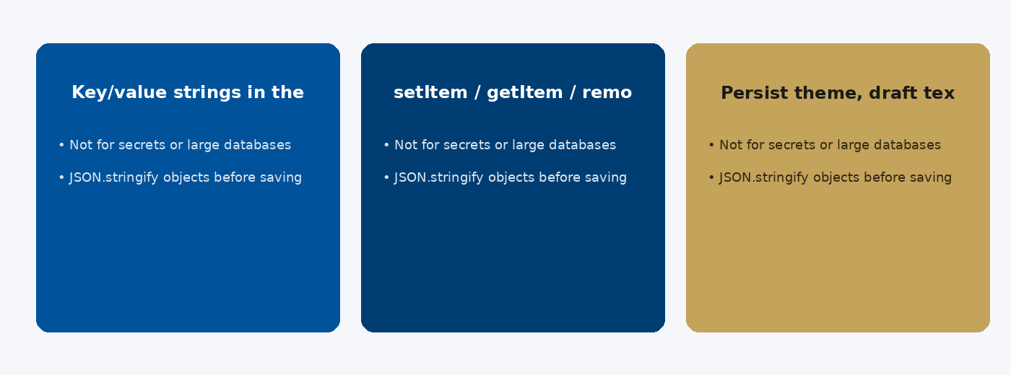
CSE6624 · Lecture 13
localStorage
Today we examine localStorage. First: Key/value strings in the browser. Second: setItem / getItem / removeItem. Also notice: Persist theme, draft text, small prefs. So the key idea is precise terminology — these distinctions return in demos, labs, and assessment.
Satbayev University · CSE6624 · Lecture 13 · Autumn 2026–2027
3 / 18
Notes:
(прочитай) Укажи на ключевые пункты: localStorage

Slide 4
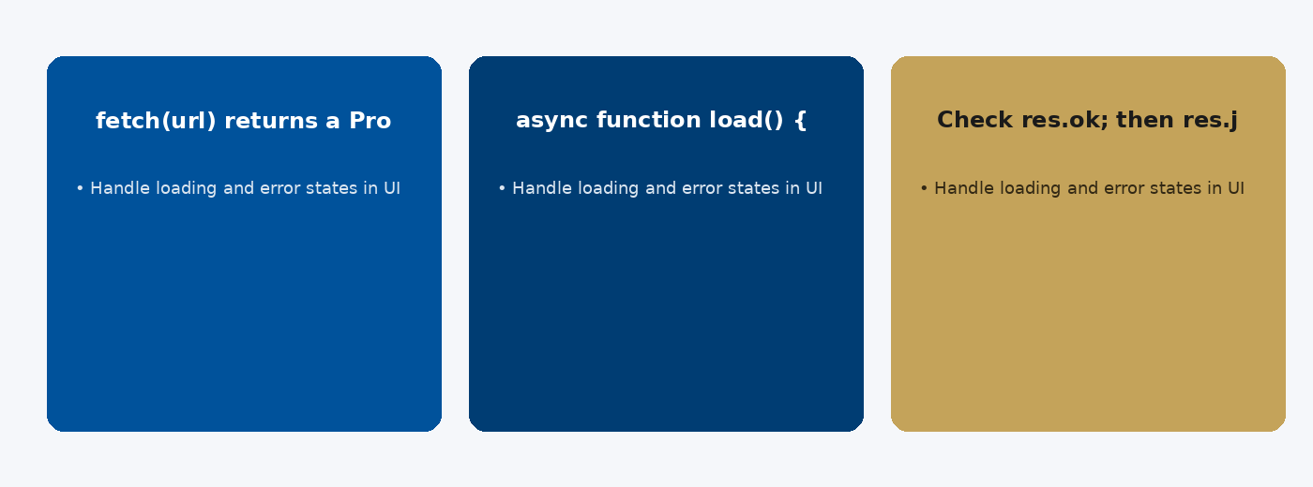
CSE6624 · Lecture 13
fetch and async
Today we examine fetch and async. First: fetch(url) returns a Promise. Second: async function load() { const res = await fetch(url); }. Also notice: Check res.ok; then res.json(). So the key idea is precise terminology — these distinctions return in demos, labs, and assessment.
Satbayev University · CSE6624 · Lecture 13 · Autumn 2026–2027
4 / 18
Notes:
(прочитай) Укажи на ключевые пункты: fetch and async

Slide 5
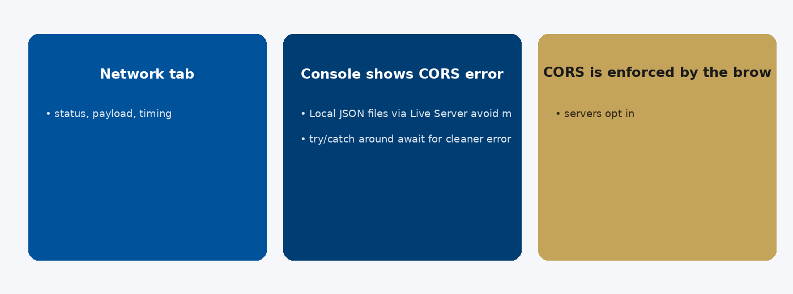
CSE6624 · Lecture 13
DevTools and CORS
Today we examine DevTools and CORS. First: Network tab: status, payload, timing. Second: Console shows CORS errors when origins differ. Also notice: CORS is enforced by the browser — servers opt in. So the key idea is precise terminology — these distinctions return in demos, labs, and assessment.
Satbayev University · CSE6624 · Lecture 13 · Autumn 2026–2027
5 / 18
Notes:
(прочитай) Укажи на ключевые пункты: DevTools and CORS

Slide 6
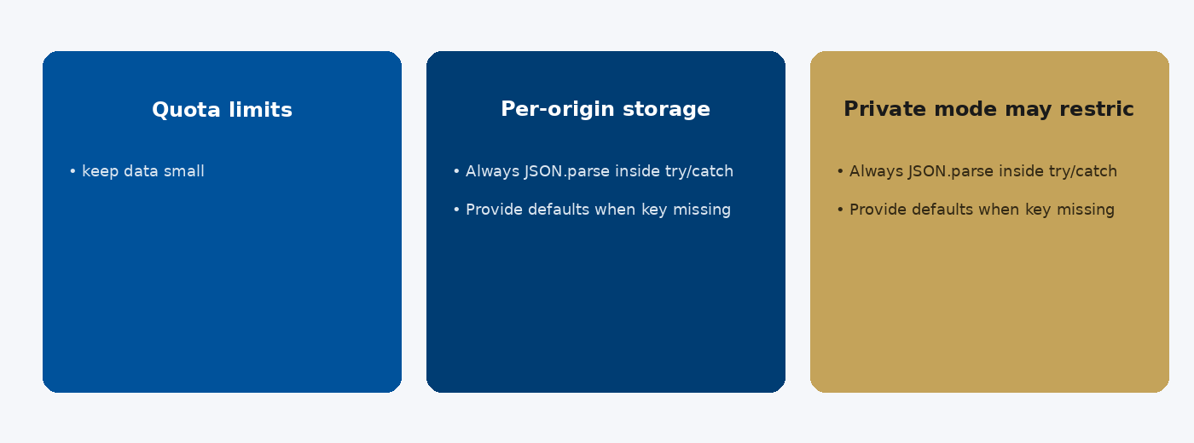
CSE6624 · Lecture 13
localStorage details
Today we examine localStorage details. First: Quota limits — keep data small. Second: Per-origin storage. Also notice: Private mode may restrict persistence. So the key idea is precise terminology — these distinctions return in demos, labs, and assessment.
Satbayev University · CSE6624 · Lecture 13 · Autumn 2026–2027
6 / 18
Notes:
(прочитай) Укажи на ключевые пункты: localStorage details

Slide 7
CSE6624 · Lecture 13
DEMO 1/2 — Save / restore note
const note = document.querySelector("#note");
const saveBtn = document.querySelector("#save");
const status = document.querySelector("#status");
note.value = localStorage.getItem("myNote") || "";
saveBtn.addEventListener("click", () => {
localStorage.setItem("myNote", note.value);
status.textContent = "Saved.";
});
Refresh the page — text should return.
Please watch this demo on the slide — do not type yet. I will point at the code so you see the exact target. In the task block you will reproduce these steps on your laptop. Everything you need is here; you do not leave this presentation.
Satbayev University · CSE6624 · Lecture 13 · Autumn 2026–2027
7 / 18
Notes:
(указывай на код/UI; не открывай другие файлы)

Slide 8
CSE6624 · Lecture 13
DEMO 2/2 — fetch status pattern
async function load() {
status.textContent = "Loading…";
try {
const res = await fetch("https://jsonplaceholder.typicode.com/todos/1");
if (!res.ok) throw new Error("HTTP " + res.status);
const data = await res.json();
status.textContent = "OK: " + data.title;
} catch (err) {
status.textContent = "Error: " + err.message;
}
}
document.querySelector("#load").addEventListener("click", load);
F12 → Network tab while you click Load.
Please watch this demo on the slide — do not type yet. I will point at the code so you see the exact target. In the task block you will reproduce these steps on your laptop. Everything you need is here; you do not leave this presentation.
Satbayev University · CSE6624 · Lecture 13 · Autumn 2026–2027
8 / 18
Notes:
(указывай на код/UI; не открывай другие файлы)

Slide 9
CSE6624 · Lecture 13
TASK · ~25 min
TASK — note + fetch (~25 min)
Work on YOUR laptop now. Follow the numbered steps on the next slides.
Suggested folder name: lecture13-yourname
If stuck: read the previous step again. Do not skip steps.
AI is optional later — first follow the steps yourself.
Now you work. The next slides are idiot-proof steps — one action after another. I will walk the room while you build. If something fails, open the If it does not work slide after the steps. Do not invent your own path during these twenty-five minutes.
Satbayev University · CSE6624 · Lecture 13 · Autumn 2026–2027
9 / 18
Notes:
(25 мин. Ходи по рядам. Стой.)

Slide 10
CSE6624 · Lecture 13
Step 1 of 5 · HTML controls
1
HTML controls
→ lecture13-yourname/index.html with:
→ textarea#note, button#save, button#load, p#status
This is step 1. Do only this step, then wait for the next slide. Click the menus named on the slide — File, Save As, Open with. When the action is done, look up. If it failed, do not jump ahead — reread this step slowly.
Satbayev University · CSE6624 · Lecture 13 · Autumn 2026–2027
10 / 18
Notes:
(шаг 1)

Slide 11
CSE6624 · Lecture 13
Step 2 of 5 · Add localStorage script
2
Add localStorage script
→ From DEMO 1. Save. Test refresh persistence.
This is step 2. Do only this step, then wait for the next slide. Click the menus named on the slide — File, Save As, Open with. When the action is done, look up. If it failed, do not jump ahead — reread this step slowly.
Satbayev University · CSE6624 · Lecture 13 · Autumn 2026–2027
11 / 18
Notes:
(шаг 2)

Slide 12
CSE6624 · Lecture 13
Step 3 of 5 · Add fetch script
3
Add fetch script
→ From DEMO 2. Need internet.
This is step 3. Do only this step, then wait for the next slide. Click the menus named on the slide — File, Save As, Open with. When the action is done, look up. If it failed, do not jump ahead — reread this step slowly.
Satbayev University · CSE6624 · Lecture 13 · Autumn 2026–2027
12 / 18
Notes:
(шаг 3)

Slide 13
CSE6624 · Lecture 13
Step 4 of 5 · DevTools
4
DevTools
→ F12 → Application → Local Storage → see myNote
→ Network → see the request
This is step 4. Do only this step, then wait for the next slide. Click the menus named on the slide — File, Save As, Open with. When the action is done, look up. If it failed, do not jump ahead — reread this step slowly.
Satbayev University · CSE6624 · Lecture 13 · Autumn 2026–2027
13 / 18
Notes:
(шаг 4)

Slide 14
CSE6624 · Lecture 13
Step 5 of 5 · Show neighbour both
5
Show neighbour both
→ Saved note survives refresh; fetch shows OK or Error.
This is step 5. Do only this step, then wait for the next slide. Click the menus named on the slide — File, Save As, Open with. When the action is done, look up. If it failed, do not jump ahead — reread this step slowly.
Satbayev University · CSE6624 · Lecture 13 · Autumn 2026–2027
14 / 18
Notes:
(шаг 5)

Slide 15
CSE6624 · Lecture 13
If it does not work
Three common mistakes — fix these before asking for help:
Mistake 1
fetch fails offline — show Error path; that still counts.
Mistake 2
Note does not persist — check setItem key spelling myNote.
Mistake 3
Forgot async/await — start from DEMO 2 again.
Most failures are save mistakes, wrong file names, or skipped steps. Read these three mistakes aloud if needed. Fix one thing, save, refresh the browser, then re-check the success condition. Still stuck after that — raise your hand; bring your screen.
Satbayev University · CSE6624 · Lecture 13 · Autumn 2026–2027
15 / 18
Notes:
(три ошибки)

Slide 16
CSE6624 · Lecture 13
DONE — what to submit / show
☐
Application tab photo
☐
Network photo optional
☐
Show neighbour
You are done when the checklist is true. Take a photo of the browser and of the file or folder. Show your neighbour for ten seconds. Upload later if the LMS asks — keep the folder on your Desktop.
Satbayev University · CSE6624 · Lecture 13 · Autumn 2026–2027
16 / 18
Notes:
(done checklist)

Slide 17
CSE6624 · Lecture 13
Next lecture + AI rule
Next lecture
Next lecture: accessibility, performance, polish.
AI rule (one line)
You may use AI, but you must still follow these steps yourself and explain your result.
After class rhythm: Practice & Lab
Next we continue with the topic on this slide. After the lecture block comes Practice & Lab. You may use AI, but you must still follow the slide steps yourself and explain your result. Pack your folder. See you next week.
Satbayev University · CSE6624 · Lecture 13 · Autumn 2026–2027
17 / 18
Notes:
(next + AI — без Questions)

Slide 18
See you next week.
Keep your folder. Re-read the last task steps if anything is unclear.
CSE6624 · Lecture 13 · Storage, Fetch, and DevTools
Shoiynbek Temirlan Armanuly · Senior Lecturer
Satbayev University · Autumn 2026–2027 · Almaty
Notes:
(улыбка. Без Questions.)

