Slide 1


SATBAYEV UNIVERSITY
Automation and Information Technology · Software Engineering
CSE6624
Introduction to Web Programming
Lecture 14
Accessibility, Performance, and Polish
Shoiynbek Temirlan Armanuly
Senior Lecturer
Programme: 6B06102 Computer Science
Autumn 2026–2027 · Almaty
City University / Satbayev University · English-taught course
Notes:
(улыбнись — Hello + номер лекции + тема.)

Slide 2
CSE6624 · Lecture 14
Today's plan · 50 minutes
15 min
~15 min — I explain (diagrams + you listen)
I read the strips. You look at the diagrams. No typing yet.
5 min
~5 min — Demo on these slides
Code / UI is ON the slides. I only point. Do not open other folders.
25 min
~25 min — You do the task
Step-by-step ON the slides. Follow every click. If stuck: read the previous step again.
5 min
~5 min — What to submit / next lecture
Photo proof + show neighbour. One-line preview of next week.
Today's plan is fixed to fifty minutes. About fifteen minutes I explain with diagrams. About five minutes I point at demo code on these slides — you watch. About twenty-five minutes you follow the task steps on the slides. The last five minutes cover what to submit and what comes next. There is no separate questions block — if stuck, read the previous step again.
Satbayev University · CSE6624 · Lecture 14 · Autumn 2026–2027
2 / 18
Notes:
(прочитай полоску; укажи на 15/5/25/5)

Slide 3
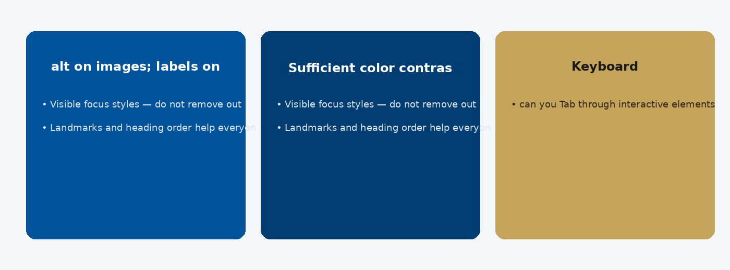
CSE6624 · Lecture 14
Accessibility essentials
Today we examine Accessibility essentials. First: alt on images; labels on inputs. Second: Sufficient color contrast. Also notice: Keyboard: can you Tab through interactive elements?. So the key idea is precise terminology — these distinctions return in demos, labs, and assessment.
Satbayev University · CSE6624 · Lecture 14 · Autumn 2026–2027
3 / 18
Notes:
(прочитай) Укажи на ключевые пункты: Accessibility essentials

Slide 4
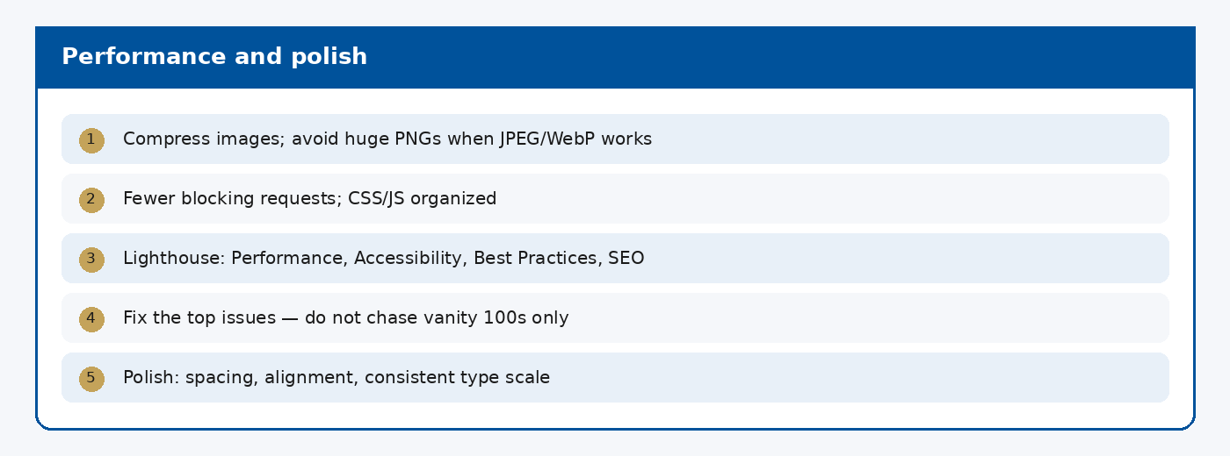
CSE6624 · Lecture 14
Performance and polish
Today we examine Performance and polish. First: Compress images; avoid huge PNGs when JPEG/WebP works. Second: Fewer blocking requests; CSS/JS organized. Also notice: Lighthouse: Performance, Accessibility, Best Practices, SEO. So the key idea is precise terminology — these distinctions return in demos, labs, and assessment.
Satbayev University · CSE6624 · Lecture 14 · Autumn 2026–2027
4 / 18
Notes:
(прочитай) Укажи на ключевые пункты: Performance and polish

Slide 5
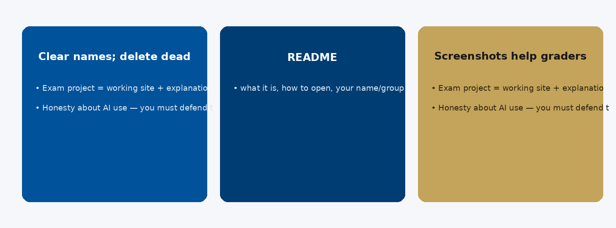
CSE6624 · Lecture 14
Professional delivery
Today we examine Professional delivery. First: Clear names; delete dead code. Second: README: what it is, how to open, your name/group. Also notice: Screenshots help graders and your portfolio. So the key idea is precise terminology — these distinctions return in demos, labs, and assessment.
Satbayev University · CSE6624 · Lecture 14 · Autumn 2026–2027
5 / 18
Notes:
(прочитай) Укажи на ключевые пункты: Professional delivery

Slide 6
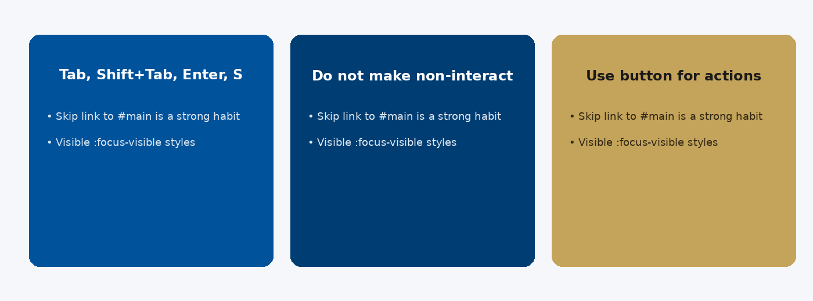
CSE6624 · Lecture 14
Keyboard and focus
Today we examine Keyboard and focus. First: Tab, Shift+Tab, Enter, Space on controls. Second: Do not make non-interactive divs clickable without keyboard support. Also notice: Use button for actions. So the key idea is precise terminology — these distinctions return in demos, labs, and assessment.
Satbayev University · CSE6624 · Lecture 14 · Autumn 2026–2027
6 / 18
Notes:
(прочитай) Укажи на ключевые пункты: Keyboard and focus

Slide 7
CSE6624 · Lecture 14
DEMO 1/2 — Common fixes
<!-- Bad -->
<img src="hero.jpg">
<a href="#" style="outline:none">Skip</a>
<!-- Good -->
<img src="hero.jpg" alt="Students at Satbayev campus">
a:focus { outline: 3px solid #C4A35A; }
Alt text · visible focus · heading order.
Please watch this demo on the slide — do not type yet. I will point at the code so you see the exact target. In the task block you will reproduce these steps on your laptop. Everything you need is here; you do not leave this presentation.
Satbayev University · CSE6624 · Lecture 14 · Autumn 2026–2027
7 / 18
Notes:
(указывай на код/UI; не открывай другие файлы)

Slide 8
CSE6624 · Lecture 14
DEMO 2/2 — Heading order
Good: H1 → H2 → H2 → H3
Bad: H1 → H3 (skipped H2)
Fix: do not skip levels
Screen reader users navigate by headings.
Please watch this demo on the slide — do not type yet. I will point at the layout so you see the exact target. In the task block you will reproduce these steps on your laptop. Everything you need is here; you do not leave this presentation.
Satbayev University · CSE6624 · Lecture 14 · Autumn 2026–2027
8 / 18
Notes:
(указывай на код/UI; не открывай другие файлы)

Slide 9
CSE6624 · Lecture 14
TASK · ~25 min
TASK — a11y + polish pass (~25 min)
Work on YOUR laptop now. Follow the numbered steps on the next slides.
Suggested folder name: your-best-page
If stuck: read the previous step again. Do not skip steps.
AI is optional later — first follow the steps yourself.
Now you work. The next slides are idiot-proof steps — one action after another. I will walk the room while you build. If something fails, open the If it does not work slide after the steps. Do not invent your own path during these twenty-five minutes.
Satbayev University · CSE6624 · Lecture 14 · Autumn 2026–2027
9 / 18
Notes:
(25 мин. Ходи по рядам. Стой.)

Slide 10
CSE6624 · Lecture 14
Step 1 of 5 · Open an existing page of yours
1
Open an existing page of yours
→ Any previous lecture page with an image or links.
This is step 1. Do only this step, then wait for the next slide. Click the menus named on the slide — File, Save As, Open with. When the action is done, look up. If it failed, do not jump ahead — reread this step slowly.
Satbayev University · CSE6624 · Lecture 14 · Autumn 2026–2027
10 / 18
Notes:
(шаг 1)

Slide 11
CSE6624 · Lecture 14
Step 2 of 5 · Fix images
2
Fix images
→ Every <img> gets meaningful alt="…".
This is step 2. Do only this step, then wait for the next slide. Click the menus named on the slide — File, Save As, Open with. When the action is done, look up. If it failed, do not jump ahead — reread this step slowly.
Satbayev University · CSE6624 · Lecture 14 · Autumn 2026–2027
11 / 18
Notes:
(шаг 2)

Slide 12
CSE6624 · Lecture 14
Step 3 of 5 · Fix headings
3
Fix headings
→ One h1; no skipped levels.
This is step 3. Do only this step, then wait for the next slide. Click the menus named on the slide — File, Save As, Open with. When the action is done, look up. If it failed, do not jump ahead — reread this step slowly.
Satbayev University · CSE6624 · Lecture 14 · Autumn 2026–2027
12 / 18
Notes:
(шаг 3)

Slide 13
CSE6624 · Lecture 14
Step 4 of 5 · Focus style
4
Focus style
→ Add a:focus, button:focus { outline: 3px solid #C4A35A; }
This is step 4. Do only this step, then wait for the next slide. Click the menus named on the slide — File, Save As, Open with. When the action is done, look up. If it failed, do not jump ahead — reread this step slowly.
Satbayev University · CSE6624 · Lecture 14 · Autumn 2026–2027
13 / 18
Notes:
(шаг 4)

Slide 14
CSE6624 · Lecture 14
Step 5 of 5 · Write 2 fixes
5
Write 2 fixes
→ On paper: Fix1 … Fix2 … Show neighbour.
This is step 5. Do only this step, then wait for the next slide. Click the menus named on the slide — File, Save As, Open with. When the action is done, look up. If it failed, do not jump ahead — reread this step slowly.
Satbayev University · CSE6624 · Lecture 14 · Autumn 2026–2027
14 / 18
Notes:
(шаг 5)

Slide 15
CSE6624 · Lecture 14
If it does not work
Three common mistakes — fix these before asking for help:
Mistake 1
alt="image" — too vague; describe content.
Mistake 2
Removed outline and added nothing — focus must stay visible.
Mistake 3
Edited wrong file — open the file you actually show in browser.
Most failures are save mistakes, wrong file names, or skipped steps. Read these three mistakes aloud if needed. Fix one thing, save, refresh the browser, then re-check the success condition. Still stuck after that — raise your hand; bring your screen.
Satbayev University · CSE6624 · Lecture 14 · Autumn 2026–2027
15 / 18
Notes:
(три ошибки)

Slide 16
CSE6624 · Lecture 14
DONE — what to submit / show
☐
Before/after note on paper
☐
Show neighbour focus ring
☐
Keep folder
You are done when the checklist is true. Take a photo of the browser and of the file or folder. Show your neighbour for ten seconds. Upload later if the LMS asks — keep the folder on your Desktop.
Satbayev University · CSE6624 · Lecture 14 · Autumn 2026–2027
16 / 18
Notes:
(done checklist)

Slide 17
CSE6624 · Lecture 14
Next lecture + AI rule
Next lecture
Next lecture: presentations and project defence prep.
AI rule (one line)
You may use AI, but you must still follow these steps yourself and explain your result.
After class rhythm: Practice & Lab
Next we continue with the topic on this slide. After the lecture block comes Practice & Lab. You may use AI, but you must still follow the slide steps yourself and explain your result. Pack your folder. See you next week.
Satbayev University · CSE6624 · Lecture 14 · Autumn 2026–2027
17 / 18
Notes:
(next + AI — без Questions)

Slide 18
See you next week.
Keep your folder. Re-read the last task steps if anything is unclear.
CSE6624 · Lecture 14 · Accessibility, Performance, and Polish
Shoiynbek Temirlan Armanuly · Senior Lecturer
Satbayev University · Autumn 2026–2027 · Almaty
Notes:
(улыбка. Без Questions.)

