Slide 1


SATBAYEV UNIVERSITY
Automation and Information Technology · Software Engineering
CSE6624
Introduction to Web Programming
Lecture 15
Presentations and Project Defence Prep
Shoiynbek Temirlan Armanuly
Senior Lecturer
Programme: 6B06102 Computer Science
Autumn 2026–2027 · Almaty
City University / Satbayev University · English-taught course
Notes:
(улыбнись — Hello + номер лекции + тема.)

Slide 2
CSE6624 · Lecture 15
Today's plan · 50 minutes
15 min
~15 min — I explain (diagrams + you listen)
I read the strips. You look at the diagrams. No typing yet.
5 min
~5 min — Demo on these slides
Code / UI is ON the slides. I only point. Do not open other folders.
25 min
~25 min — You do the task
Step-by-step ON the slides. Follow every click. If stuck: read the previous step again.
5 min
~5 min — What to submit / next lecture
Photo proof + show neighbour. One-line preview of next week.
Today's plan is fixed to fifty minutes. About fifteen minutes I explain with diagrams. About five minutes I point at demo code on these slides — you watch. About twenty-five minutes you follow the task steps on the slides. The last five minutes cover what to submit and what comes next. There is no separate questions block — if stuck, read the previous step again.
Satbayev University · CSE6624 · Lecture 15 · Autumn 2026–2027
2 / 18
Notes:
(прочитай полоску; укажи на 15/5/25/5)

Slide 3
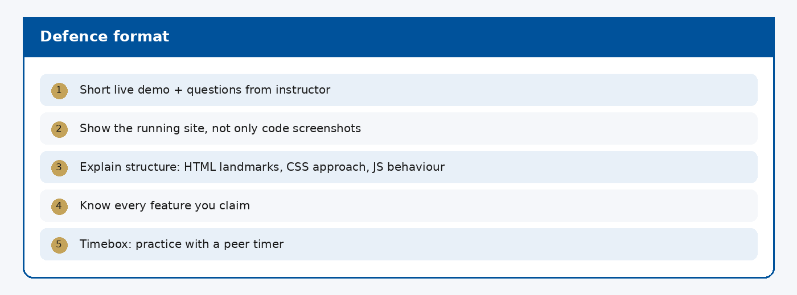
CSE6624 · Lecture 15
Defence format
Today we examine Defence format. First: Short live demo + questions from instructor. Second: Show the running site, not only code screenshots. Also notice: Explain structure: HTML landmarks, CSS approach, JS behaviour. So the key idea is precise terminology — these distinctions return in demos, labs, and assessment.
Satbayev University · CSE6624 · Lecture 15 · Autumn 2026–2027
3 / 18
Notes:
(прочитай) Укажи на ключевые пункты: Defence format

Slide 4
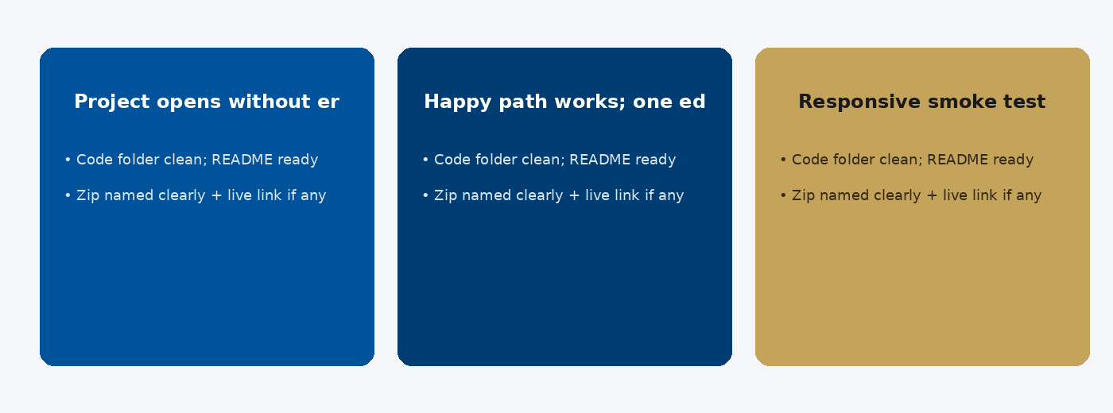
CSE6624 · Lecture 15
Demo checklist
Today we examine Demo checklist. First: Project opens without errors. Second: Happy path works; one edge case handled. Also notice: Responsive smoke test. So the key idea is precise terminology — these distinctions return in demos, labs, and assessment.
Satbayev University · CSE6624 · Lecture 15 · Autumn 2026–2027
4 / 18
Notes:
(прочитай) Укажи на ключевые пункты: Demo checklist

Slide 5
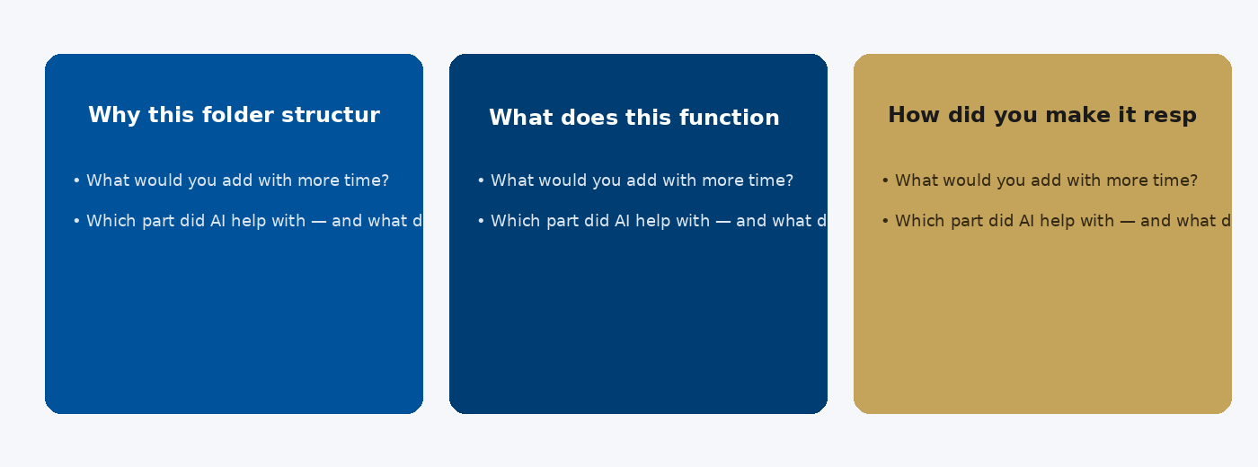
CSE6624 · Lecture 15
Common questions
Today we examine Common questions. First: Why this folder structure?. Second: What does this function do?. Also notice: How did you make it responsive?. So the key idea is precise terminology — these distinctions return in demos, labs, and assessment.
Satbayev University · CSE6624 · Lecture 15 · Autumn 2026–2027
5 / 18
Notes:
(прочитай) Укажи на ключевые пункты: Common questions

Slide 6
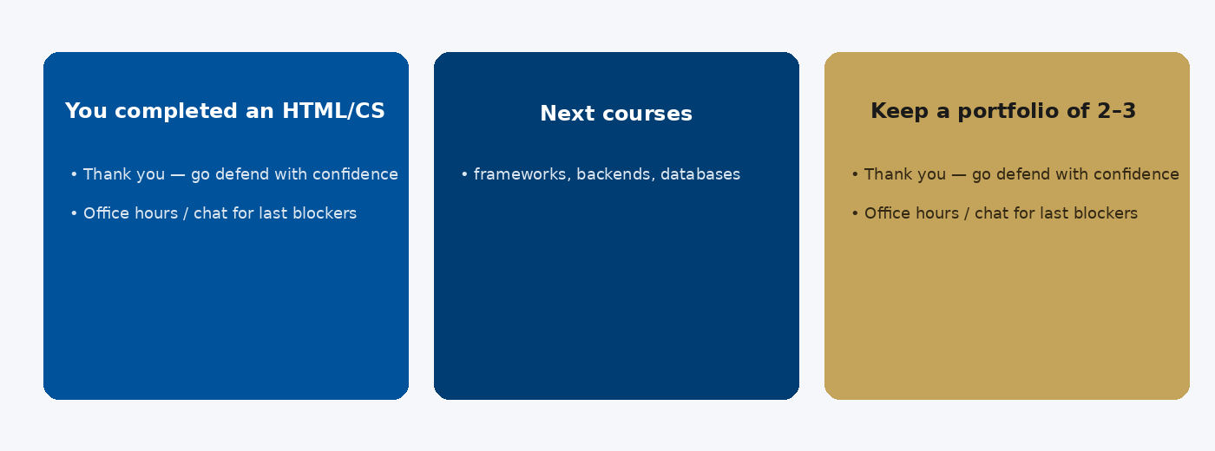
CSE6624 · Lecture 15
Wrap-up
Today we examine Wrap-up. First: You completed an HTML/CSS/JS foundation. Second: Next courses: frameworks, backends, databases. Also notice: Keep a portfolio of 2–3 clean projects. So the key idea is precise terminology — these distinctions return in demos, labs, and assessment.
Satbayev University · CSE6624 · Lecture 15 · Autumn 2026–2027
6 / 18
Notes:
(прочитай) Укажи на ключевые пункты: Wrap-up

Slide 7
CSE6624 · Lecture 15
DEMO 1/2 — 5-bullet pitch
1. Problem I solved
2. Demo path (what I click)
3. Tech used (HTML/CSS/JS/…)
4. Hardest bug + how I fixed it
5. Next step if I had one more week
Say this in 2–3 minutes. No essay.
Please watch this demo on the slide — do not type yet. I will point at the layout so you see the exact target. In the task block you will reproduce these steps on your laptop. Everything you need is here; you do not leave this presentation.
Satbayev University · CSE6624 · Lecture 15 · Autumn 2026–2027
7 / 18
Notes:
(указывай на код/UI; не открывай другие файлы)

Slide 8
CSE6624 · Lecture 15
DEMO 2/2 — Examiner questions to prepare
Q: Why this structure?
Q: Where is your CSS linked?
Q: What does this function do?
Write short answers now.
If you cannot answer, revise that part of the project.
Please watch this demo on the slide — do not type yet. I will point at the layout so you see the exact target. In the task block you will reproduce these steps on your laptop. Everything you need is here; you do not leave this presentation.
Satbayev University · CSE6624 · Lecture 15 · Autumn 2026–2027
8 / 18
Notes:
(указывай на код/UI; не открывай другие файлы)

Slide 9
CSE6624 · Lecture 15
TASK · ~25 min
TASK — defence dry-run (~25 min)
Work on YOUR laptop now. Follow the numbered steps on the next slides.
Suggested folder name: your-project
If stuck: read the previous step again. Do not skip steps.
AI is optional later — first follow the steps yourself.
Now you work. The next slides are idiot-proof steps — one action after another. I will walk the room while you build. If something fails, open the If it does not work slide after the steps. Do not invent your own path during these twenty-five minutes.
Satbayev University · CSE6624 · Lecture 15 · Autumn 2026–2027
9 / 18
Notes:
(25 мин. Ходи по рядам. Стой.)

Slide 10
CSE6624 · Lecture 15
Step 1 of 5 · Write 5 bullets
1
Write 5 bullets
→ Paper or pitch.txt in your project folder.
This is step 1. Do only this step, then wait for the next slide. Click the menus named on the slide — File, Save As, Open with. When the action is done, look up. If it failed, do not jump ahead — reread this step slowly.
Satbayev University · CSE6624 · Lecture 15 · Autumn 2026–2027
10 / 18
Notes:
(шаг 1)

Slide 11
CSE6624 · Lecture 15
Step 2 of 5 · Click the happy path once
2
Click the happy path once
→ Open project → demonstrate main feature without talking.
This is step 2. Do only this step, then wait for the next slide. Click the menus named on the slide — File, Save As, Open with. When the action is done, look up. If it failed, do not jump ahead — reread this step slowly.
Satbayev University · CSE6624 · Lecture 15 · Autumn 2026–2027
11 / 18
Notes:
(шаг 2)

Slide 12
CSE6624 · Lecture 15
Step 3 of 5 · Timed explain to neighbour
3
Timed explain to neighbour
→ 2–3 minutes. Neighbour holds phone timer.
This is step 3. Do only this step, then wait for the next slide. Click the menus named on the slide — File, Save As, Open with. When the action is done, look up. If it failed, do not jump ahead — reread this step slowly.
Satbayev University · CSE6624 · Lecture 15 · Autumn 2026–2027
12 / 18
Notes:
(шаг 3)

Slide 13
CSE6624 · Lecture 15
Step 4 of 5 · Prepare 3 Q&A notes
4
Prepare 3 Q&A notes
→ Question + one-sentence answer each.
This is step 4. Do only this step, then wait for the next slide. Click the menus named on the slide — File, Save As, Open with. When the action is done, look up. If it failed, do not jump ahead — reread this step slowly.
Satbayev University · CSE6624 · Lecture 15 · Autumn 2026–2027
13 / 18
Notes:
(шаг 4)

Slide 14
CSE6624 · Lecture 15
Step 5 of 5 · Zip check
5
Zip check
→ Folder name Surname_Name_Project if required. No node_modules junk.
This is step 5. Do only this step, then wait for the next slide. Click the menus named on the slide — File, Save As, Open with. When the action is done, look up. If it failed, do not jump ahead — reread this step slowly.
Satbayev University · CSE6624 · Lecture 15 · Autumn 2026–2027
14 / 18
Notes:
(шаг 5)

Slide 15
CSE6624 · Lecture 15
If it does not work
Three common mistakes — fix these before asking for help:
Mistake 1
Read slides to neighbour — wrong; explain YOUR project.
Mistake 2
Happy path broken — fix before defence day.
Mistake 3
No answers for Q&A — write them now.
Most failures are save mistakes, wrong file names, or skipped steps. Read these three mistakes aloud if needed. Fix one thing, save, refresh the browser, then re-check the success condition. Still stuck after that — raise your hand; bring your screen.
Satbayev University · CSE6624 · Lecture 15 · Autumn 2026–2027
15 / 18
Notes:
(три ошибки)

Slide 16
CSE6624 · Lecture 15
DONE — what to submit / show
☐
Pitch bullets photo
☐
Neighbour confirms timing
☐
Zip ready if required
You are done when the checklist is true. Take a photo of the browser and of the file or folder. Show your neighbour for ten seconds. Upload later if the LMS asks — keep the folder on your Desktop.
Satbayev University · CSE6624 · Lecture 15 · Autumn 2026–2027
16 / 18
Notes:
(done checklist)

Slide 17
CSE6624 · Lecture 15
Next lecture + AI rule
Next lecture
Next: practice/lab defence slot — bring the same pitch.
AI rule (one line)
You may use AI, but you must still follow these steps yourself and explain your result.
After class rhythm: Practice & Lab
Next we continue with the topic on this slide. After the lecture block comes Practice & Lab. You may use AI, but you must still follow the slide steps yourself and explain your result. Pack your folder. See you next week.
Satbayev University · CSE6624 · Lecture 15 · Autumn 2026–2027
17 / 18
Notes:
(next + AI — без Questions)

Slide 18
See you next week.
Keep your folder. Re-read the last task steps if anything is unclear.
CSE6624 · Lecture 15 · Presentations and Project Defence Prep
Shoiynbek Temirlan Armanuly · Senior Lecturer
Satbayev University · Autumn 2026–2027 · Almaty
Notes:
(улыбка. Без Questions.)

