Slide 1
Project

Slide 2
Bin Packing Problem
The bin packing problem (BPP) can be informally defined in a very simple way.
We are given n items, each having an integer weight w_{j} (j = 1, ..., n), and an unlimited number of identical bins of integer capacity c.
The objective is to pack all the items into the minimum number of bins so that the total weight packed in any bin does not exceed the capacity.
装箱问题（BPP）可以用一种非常简单的方式定义。
我们得到了n个物品，每个物品都有一个整数权重wj（j=1，…，n），以及无限数量的整数容量的相同箱子。
其目的是将所有物品装入最少数量的箱子中，以使任何箱子中包装的总重量不超过容量

Slide 3
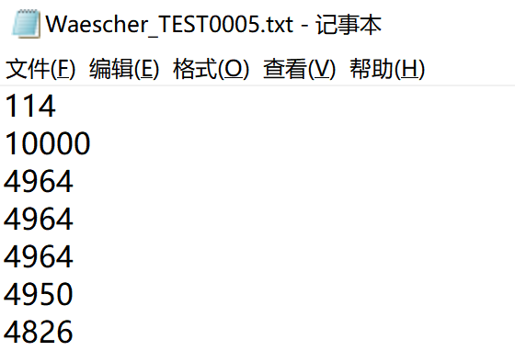
Data Format
Number of items (n)
Capacity of the bins (c)
For each item j (j = 1,...,n):
Weight (w_{j})

Slide 4
What to submit
A word / pdf (Deadline: 2020/8/31)
Report
Codes
Result table
Your report should include
At least four algorithms
At least two metaheuristics
Comparisons
Results and analysis
Instance | Result | Time
Waescher_TEST0005
Waescher_TEST0014
Waescher_TEST0022
Waescher_TEST0030
Waescher_TEST0044
Waescher_TEST0049
Waescher_TEST0054
Waescher_TEST0055A
Waescher_TEST0055B
Waescher_TEST0058
Waescher_TEST0065
Waescher_TEST0068
Waescher_TEST0075
Waescher_TEST0082
Waescher_TEST0084
Waescher_TEST0095
Waescher_TEST0097

Slide 5

Thank you!

