Slide 1




Topic Analysis Report
Blo Blow Bar Topic Map
August 2025

Slide 2


Objective Scope & Approach Framework
Summary
Beauty Services Landscape (Editorial & Social)
  Category Landscape
  Brand Analysis
Editorial Analysis (Beauty Services - Hair / Make-up)
  Key Topics
  Trendline of Topics (MoM percentage increases for context)
  Top Occasions
Social Conversations Analysis (Beauty Services - Hair / Make-up)
  Celebrities trending because of hair/make-up
  Most-Used Tags
  Other Social Conversations
Table of
Contents

Slide 3

Objective & Scope
Research Objective
Understand the top editorial themes, hair and make-up service occasions and/or cultural moments (weddings, holidays, prom, etc.), and trending social topics (e.g., celebrities trending because of hair/make-up, key hashtags used with hair/make-up content, any relevant topics and/or hashtags associated with hair/make-up occasions, etc.
Research Focus Areas
Industry Research
Top editorial themes
Hair and make-up service occasions and/or cultural moments (weddings, holidays, prom, etc.),
Trending Social Topics: Hashtags, Celebrities, etc.
Competitive Research: DryBar Salons, Blushington, Benefit Brow Bar, Glamsquad
Target Audience: Primary W25-54; Secondary: Teens (specifically during prom and homecoming season)
Sources / Tools: Meltwater, Quid Discover and Quid Monitor
Geography: US only
Time period: 12 Months (August 6, 2024 – August 6, 2025)
© InfoVision | InfoVision.com

Slide 4

Hunter Intelligence
Consumer
“Occasion-Ready Crowd”, mostly female, urban/suburban
Mindset: Need quick, no-stress styling for proms, weddings, holidays
Key Influences: Influenced by TikTok before after reels, prom & quinceañera boards, creator tutorials
Values: Speed, consistent quality, friendly prices, cruelty-free products.
Key Interests / Communities: They follow hair-and-beauty subreddits and Instagram channels, campus style pages, wedding-planning groups, and TikTok channels that post quick hairstyle and makeup hacks.
SUMMARY
Client: Blo Blow Dry Bar
Category: Beauty Services
Competitors: DryBar Salons, Blushington, Benefit Brow Bar, Glamsquad
Coverage · Conversation · Search
Share of Voice: ≈13% of beauty services (3rd after Benefit Brow Bar, DryBar)
Sentiment: 59% positive · 39% neutral · 2% negative
Themes: bridal & permanent makeup services; trending colours (butterscotch blonde, silver highlights); celebrity/influencer campaigns (e.g. NYX with Paris Hilton & Saweetie); rising costs and tipping debates; inclusive & gender affirming services plus tech led convenience (AI booking, mobile salons)
Top hashtags: #skincare · #haircolor · #hairstylist · #hairstyles · #beauty
Seasonal peaks: holiday season (November–December) and back to school (September)

Slide 5

Beauty Services Landscape
(Editorial & Social)

Slide 6
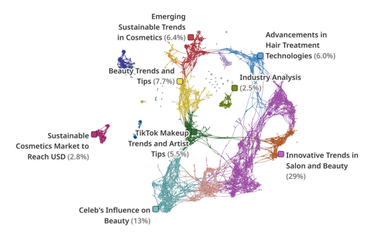
BEAUTY SERVICES
Category Landscape
Beauty Services
Coverage: Cluster Map
Clusters
● | Innovative Trends in Salon and Beauty | 29%
● | Celeb's Influence on Beauty | 13%
● | Beauty Trends and Tips | 7.7%
● | Influential Makeup Artists in Entertainment | 7.5%
● | Emerging Sustainable Trends in Cosmetics | 6.4%
● | Advancements in Hair Treatment Technologies | 6.0%
● | TikTok Makeup Trends and Artist Tips | 5.5%
● | Bridal Makeup: Trends and Artist Roles | 4.9%
● | Cosmetic Chemicals: Health Risks and Regulation | 4.2%
● | Innovative Trends in Hair Care Brands | 2.8%
● | Eco Beauty Market | 2.8%
● | Forecast and Trends in Cosmetic Industry | 2.5%
The beauty service industry is evolving through tech driven salon innovations, celebrity influence, and social media trends, particularly on TikTok, while also embracing natural treatments, AI, and noninvasive hair technologies. Industry players are navigating rising operational costs and regulatory changes, with shifting consumer expectations being shaped by digital platforms and evolving beauty standards.
Innovative Trends in Salon and Beauty: The beauty and salon industry features new openings, AI advancements, and community initiatives. Notable are holistic therapies, the rise of natural hair salons, and impactful social media strategies. Challenges include increased rents and regulatory shifts.
Celeb's Influence on Beauty: This cluster explores celebrity beauty trends at high-profile events, focusing on Pamela Anderson's makeup-free approach and Nicole Kidman's standout looks. It examines trends like 'Contrast Makeup Theory', the impact of social media, and minimal makeup strategies for mature celebrities.
Influential Makeup Artists in Entertainment: This cluster examines the impact of makeup artists and hairstylists in the entertainment sector, highlighting industry luminaries and their contributions to iconic looks in film and TV. It includes discussions on major awards and the influence of celebrity beauty standards.
Advancements in Hair Treatment Technologies: This cluster highlights advancements in hair treatment and cosmetics, including innovative products like Keranet, Bello Hair Helper Spray, and non-surgical restoration techniques. It also covers the impact of K-beauty and tech-enhanced salon experiences.
TikTok Makeup Trends and Artist Tips: This cluster focuses on makeup trends like 'sunburnt' and 'contrast makeup' from TikTok, offering product selection tips for various skin types. It provides expert advice on occasion-specific makeup, discusses environmental impacts on beauty routines, and includes skincare and hair care tips.
SOURCE: QUID DISCOVER | AUGUST 2024 – AUGUST 2025

Slide 7
BEAUTY SERVICES
Brand Analysis
Benefit Brow Bar dominated brand conversation, fueled by viral creator content, strategic product collaborations, and memorable service experiences. Drybar followed with trend-led buzz and the popularity of its styling tools, despite pockets of user concern. Blo Blow Dry Bar, Glamsquad, and Blushington generated targeted attention through expansion announcements, milestone makeovers, and inclusive beauty initiatives, each receiving varied levels of service feedback.
SOV Analysis
N = 3,023
Sentiment Analysis
N = 3,023
Benefit Brow Bar led the media attention, driven by discussions around its Mighty Fine Brow Pen featured in beauty makeup tutorials; its campaign featuring TXT's Yeonjun for POREfessional line; and gained traction across TikTok and Instagram through creator-led transformations, seasonal promotions, loyalty rewards.
Drybar saw the second-highest volume of mentions, driven by trending styles like “MomTok Waves,” holiday gift card promotions, new franchise expansions, and founder Alli Webb’s pivot to her new brand Messy, which embraces natural textures and an anti-blowout approach.
Blo Blow Dry Bar gained buzz for its strong growth trajectory, marked by 21 new franchise units sold, new salon openings in Plano, Canton, and Argyle, the acquisition of LashBar, and CEO Vanessa Yakobson being named 'CEO of the Year' by NewSpring.
Glamsquad drew media attention with “Prom Squad” makeovers and GlamLy TV reels, highlighting prom and quinceañera transformations, cancer recovery glam, and earning praise for artist reliability, long-lasting styles, and flash-proof makeup.
Blushington saw lower mention volumes, with most buzz centered on franchising momentum through investor webinars and CEO Natasha Cornstein’s media features highlighting accessible luxury and women-led entrepreneurship.
Benefit Brow Bar at Ulta received praise for its precise brow sculpting and warm, attentive service. Enthusiasm spiked around Taeyeon’s brow pen collaboration and the Cookie Highlighter’s glossy finish, which inspired viral TikTok content. However, some beauty editors noted comparable dupes under $12, sparking mild pushback on pricing.
Drybar gained momentum through tools like the Double Shot and Brush Crush, featured in at-home styling tutorials for creating voluminous, frizz-free looks. While many appreciated the professional-grade results, critical reviews on Reddit and Amazon highlighted issues such as tool malfunctions, excessive heat damage on fine hair, and failures occurring just after warranty expiration.
Blo Blow Dry Bar was recognized for its convenient pairing of hair and makeup services, as well as community-driven salon launches and themed offerings like kids’ tinsel parties. Positive conversations were also fueled by the acquisition of LashBar, which signaled strategic expansion and strengthened brand positioning.
Glamsquad earned admiration for nostalgic glam experiences tied to events like proms and quinceañeras, with many celebrating its polished blowouts and sharp contouring. However, some criticism emerged around overly dramatic makeup and awkward hair extensions, particularly in influencer-led looks seen during red-carpet appearances or livestreams.
Blushington was celebrated for its compassionate lace-front wig applications during chemo makeovers, with users praising the “realistic hairlines” and “seamless tinting.” Prom attendees also highlighted the “cry-proof” airbrushed foundation and soft-glam contouring that held up beautifully in photos.
SOURCE: MELTWATER| AUGUST 2024 – AUGUST 2025
The above insights are based on analysis of a representative sample of data.

Slide 8
Editorial Analysis
(Beauty Services - Hair / Make-up)

Slide 9

BEAUTY SERVICES
Key Topics (1/2)
Hair and makeup services reflect a blend of specialized expertise, trending products, and celebrity driven inspiration, ranging from bridal styling to viral red carpet looks. Alongside business growth and economic shifts, salons increasingly serve as community anchors, offering inclusive, confidence-boosting support to underserved groups.
The Beauty Breakdown: Hot Topics in Hair & Makeup Services
Specialized Hair & Makeup Services
  Specialized hair and makeup services are a key topic of discussion in the beauty space, with consumers increasingly seeking expert-led offerings for significant life events such as weddings and formal occasions. Bridal styling, permanent makeup, and personalized care for textured hair are especially in demand. There is a clear shift toward tailored, high-skill services that reflect both aesthetic preferences and cultural needs.
Product Trends & Recommendations
  Product trends and recommendations have emerged as a key topic among beauty consumers, influencing their purchase decisions and brand preferences. Social media and influencer endorsements amplify these trends, making them more impactful. Consumers use trending products to express personal style and stay relevant. Trusted recommendations also encourage confident experimentation in an oversaturated market.
Celebrity & Influencer Culture
  Celebrity and influencer collaborations are observed to be a major topic of discussion among beauty consumers, often sparking buzz around new launches and limited-edition products. These partnerships resonate due to their authenticity and aspirational appeal, making them highly shareable on social platforms. Consumers frequently engage with and seek out products tied to familiar, trusted faces. As a result, such collaborations play a key role in driving brand engagement and shaping beauty trends.
Economic & Business Aspects
Discussions around the economic and business aspects of the beauty industry are gaining momentum, with rising costs and inflation emerging as key concerns. Conversations increasingly highlight challenges facing franchising models, mobile beauty services, and salon expansions. Many view the hairdressing and beauty sector as facing an existential crisis, driven by shrinking margins and shifting consumer behavior.
Community & Social Impact
  Discussions on how beauty services are driving community and social impact have become key topics within the industry. Salons are being recognized not just as service providers, but as spaces that foster belonging, confidence, and empowerment, particularly in marginalized communities. Initiatives like free services for cancer patients or disaster-affected individuals reflect a growing commitment to inclusivity and care.

Slide 10
BEAUTY SERVICES
Key Topics (2/2)
Beauty services are becoming more inclusive, wellness focused, and tech forward, blending cultural sensitivity, health-conscious care, and innovative tools to meet modern needs. From gender-affirming treatments and mobile salons to AI booking and expert led training, the industry is evolving to offer safer, smarter, and more accessible experiences for all.
The Beauty Breakdown: Hot Topics in Hair & Makeup Services
Inclusive & Culturally Rooted Beauty Care
  Inclusive and Culturally Rooted Beauty Care is gaining increased attention as beauty consumers and professionals push for services that reflect diverse identities, experiences, and needs. The conversation is expanding beyond aesthetics to prioritize care that is affirming and culturally sensitive. This includes gender-affirming hairstyles, trauma-informed services, and medically adaptive treatments for individuals recovering from illness, such as cancer survivors.
Health, Wellness & Safety
  Health, Wellness & Safety is emerging as a key area of discussion in the beauty industry, driven by consumers' increasing demand for transparency, safety, and sustainability. Salons are responding by adopting cleaner chemical alternatives, enhancing hygiene protocols, and integrating wellness practices into their services. This shift signals a more holistic approach, where beauty goes hand in hand with mental well-being, scalp and skin health, and environmental responsibility.
Technology & Innovation
  Technology & Innovation is increasingly among beauty conversations, signaling a shift toward smarter, more personalized experiences. Salons are rapidly adopting AI-powered booking platforms, which streamline scheduling, manage inventory, and offer tailored recommendations based on client history. Augmented Reality (AR) tools are revolutionizing how consumers explore new looks, allowing them to virtually try on hairstyles, makeup, and even brow shapes before committing.
Professional Expertise & Education
  Professional Expertise & Education is a core topic in the beauty industry, reflecting the growing emphasis on skill development and service excellence. Ongoing education, through certifications, brand training, and expert-led masterclasses by professionals is raising industry standards. These programs empower stylists and beauty professionals to stay current with trends, techniques, and safety protocols. By prioritizing continuous learning, the industry ensures clients receive informed, high-quality, and personalized care in an ever-evolving beauty landscape.
Convenience & Accessibility
  The beauty service industry is driven by discussions around Convenience & Accessibility, as consumer demand grows for flexible, location-based solutions. Mobile salons and at-home beauty services are gaining traction, addressing challenges like mobility limitations, busy schedules, and salon access in underserved areas. This evolution marks a larger industry shift toward hyper-personalized, client-centric beauty experiences that meet consumers where they are.

Slide 11


BEAUTY SERVICES
Trendline - Topics
Beauty content sees seasonal spikes driven by holidays and cultural moments, while core themes like wellness and convenience remain steady year-round. Emerging interest in inclusivity, innovation, and self-care reflects a shift toward more conscious and tech-savvy beauty consumption.
N ~ 983K
Holiday season drives major spikes in beauty content, especially around celebrity trends, product guides, and business focused stories, fueled by party looks, gifting, and New Year resolutions.
September brings a back-to-school boost, with increased interest in new products and professional tools, tied to fresh routines, beauty resets, and tech-savvy upgrades.
Celebrity and influencer-driven content remains volatile, often spiking around high-profile events, new launches, or viral moments, highlighting how reactive this category is to cultural buzz.
Health, Wellness & Convenience topics remain stable, pointing to their role as reliable, evergreen pillars in beauty conversations
There’s growing momentum around inclusive beauty, wellness, and innovation, signaling a shift in consumer priorities toward ethical choices, self-care, and cutting-edge beauty solutions.
SOURCE: MELTWATER| AUGUST 6, 2024 – AUGUST 6, 2025
The above insights are based on analysis of a representative sample of data.

Slide 12
BEAUTY SERVICES
Top Occasions
Hair and makeup services have transformed from service providers into cultural hubs that celebrate personal milestones and identity through occasion-based experiences. These businesses now blend artistry, wellness, and community connection to create transformative moments spanning bridal glam to drag competitions and holiday makeovers.
Beauty by the Moment: Cultural Events Fueling Hair & Makeup Demand
Special Events & Milestones
Holiday & Festive Makeovers
Community-Driven Events
Pageant / Competition Glam
Pop Culture Glam
Wellness-Inspired Makeovers
  Salons and beauty professionals are increasingly leveraging milestone occasions, from Back-to-School and prom season to bridal celebrations, ‘Gorgeous Grandma Day,’ and salon anniversaries, to drive community goodwill, showcase expertise and strengthen brand storytelling.
  Holiday and festive seasons have become prime opportunities for salons and beauty bars to offer tailored, quick-turnaround glam services, from Blo Blow Dry Bar’s “last-minute party” hair menus to Trim Salon’s beachy waves for Comedy Night and Southern Serenity Spa’s lived-in color for relaxed holiday gatherings.
  Community-led beauty events are emerging as key moments for hair and makeup engagement, offering professionals opportunities to connect through free pop-ups, skill-building workshops, and inclusive services that foster empowerment, education, and accessibility.
  High-profile competitions like pageants, drag balls, dance showcases, and televised talent shows are key moments for transformative hair and makeup, sparking passionate conversations around artistry, technique, and performance-ready glam.
  Pop culture events, from red carpets to streaming releases, serve as major glam moments, driving demand for viral hair and makeup trends, product “dupes,” and fan-fueled recreations that fuel tutorials and brand collaborations.
  Wellness-inspired makeovers are emerging as key occasions where beauty meets self-care, offering clients rejuvenating experiences that prioritize skin health, stress relief, and confidence through gentle techniques, nourishing products, and holistic transformations.

Slide 13
Social Conversations Analysis
(Beauty Services - Hair/ Make-up)

Slide 14










Celebrity mentions are increasingly functioning as conversion drivers rather than mere content, directly influencing consumer actions such as salon bookings and specific service requests. The data reveals a professional amplification effect where audiences leverage celebrity associations to access expert beauty knowledge and premium services, indicating high commercial intent.
BEAUTY SERVICES
Celebrity
Jennifer Lopez
Renée Zellweger
Jamie Lee Curtis
Christina Aguilera
Reese Witherspoon
Appears as direct salon business driver, with her "shiny blowout" and "caramel blonde color" specifically mentioned as "inspiring salon visits.“
"...caramel blonde color that has us considering ringing our hair salons. Lopez debuted the ultra-sophisticated look at the photo call for…"
Featured as elegant occasion styling inspiration, with her "Chignon Hairstyle" described as "Perfect for Valentine's Day.“
“Renée Zellweger’s Chignon Hairstyle Is Perfect for Valentine’s Day”
Mentioned primarily to showcase her "celebrity hairstylist Sean James" who created her "elegant hair look," highlighting professional styling skills.
"Jamie Lee Curtis' Elegant Hair Look Celebrity hairstylist Sean James brought Jamie Lee Curtis' hair look to …"
Referenced for casually hiring "professional makeup artist Lora Arellano for Halloween costume," demonstrating how celebrities bring in experts for specific projects.
"...a macabre touch to the look, Christina also hired professional makeup artist Lora Arellano to make it look like she was bleeding from her…"
Generated conversation for her surprising "rare makeup-free look for 49th birthday" since she's usually "done up to the nines with professional makeup.“
"...Reese Witherspoon is usually done up to the nines with professional makeup, elegant gowns and stiletto heels when on the red carpet…"
Blake Lively
Paris Hilton
Leslie Bibb
Katharine McPhee
Tracee Ellis Ross
Used as an example of celebrity privilege in beauty, specifically mentioned for having access to "professional makeup artists" that regular people cannot afford.
"...on Watch W ith access to a team of professional makeup artists, it comes as no surprise that Blake Lively looked flawless posing on the…"
Appears as a beauty brand ambassador actively promoting NYX Professional Makeup products alongside Saweetie.
"Paris Hilton, Saweetie come together to highlight NYX Professional Makeup products“
Referenced as the go-to example for "blunt bob" versatility, with conversations emphasizing how her cut can be styled multiple ways.
“Leslie Bibb's Latest Hairstyle Proves There Isn't Just One Way to Style a Blunt Bob”
Mentioned for maintaining beauty industry relationships by attending the "NYX Professional Makeup Decade+1 Anniversary Party.“
"Katharine McPhee celebrated the NYX Professional Makeup Decade+1 Anniversary Party in Hollywood in 2010, stepping out in a spirited…"
Mentioned both as hair styling inspiration for her "simple slick back" look and as industry educator who hosted the hair show "Black Hair Reimagined.“
"...on Beyoncé to Tracee Ellis Ross’s simple slick back , even Hollywood’s rich and famous are cutting costs when it comes to hair."
SOURCE: MELTWATER| AUGUST 6, 2024 – AUGUST 6, 2025

Slide 15
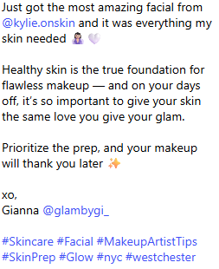
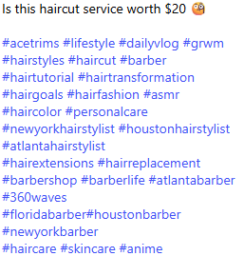
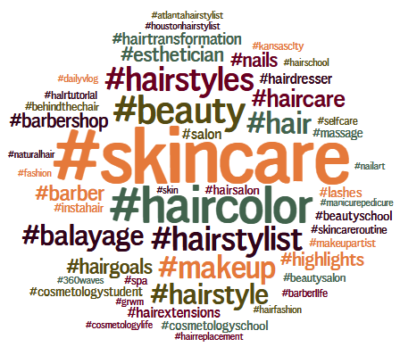
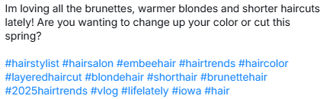

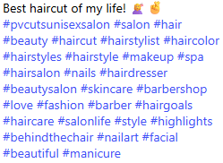


BEAUTY SERVICES
Most-Used Tags
The hashtag hierarchy demonstrates cross-category engagement with #skincare dominating conversation volume while hair-specific tags (#haircolor, #hairstyles) show concentrated audience engagement around service-oriented content.
Top Hashtags
SOURCE: QUID MONITOR | AUGUST 2024 – AUGUST 2025

Slide 16

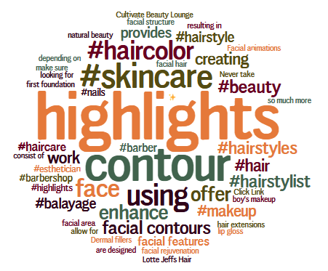
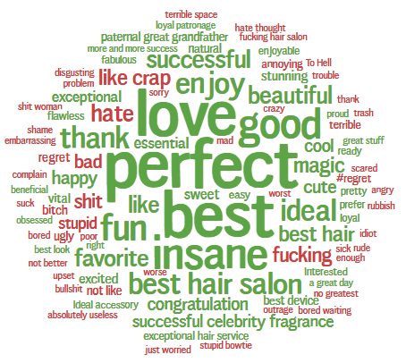

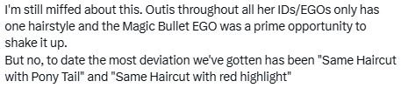

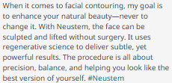


BEAUTY SERVICES
Other Social Conversation
The sentiments reveals high-value audience engagement with positive emotional indicators (love, beautiful, perfect) driving organic conversation amplification rather than manufactured hype.
Top Terms
Top Emotions
SOURCE: QUID MONITOR | AUGUST 2024 – AUGUST 2025

Slide 17


THANK YOU
Rajesh Kari
Global Business Leader,
Vice President – Digital Media
Contact:
+1 (469) 360-1750
Email: Rajesh.Kari@Infovision.com
Address:
800 E. Campbell Road, Suite 388
Richardson TX 75081

