Slide 1

IoT and Computer Vision for Analysing the players on the IISERB Badminton court
PAI
Alli khadga joyth – 19014
Anushka Sanjay Shelke -19290
Yasmin Manavar Tadavi - 19321

Slide 2
Motivation
Computer vision and IoT is evolving faster in various fields including sport analysis.
As computer vision is used in player detection, tracking etc.
Used by coaches for performance enhancement of team.
This model will be used in IISERB badminton Court for players to analyse their performance.
We are trying to make them accessible to everyone.

Slide 3
Research Gap
In the paper by T.Kamiyama et.al. they used a TLD model for player detection, which is very susceptible to sharp gradients, so they proposed a image pixel compensation method to solve the problem of player occlusion by the net, which is very common to have for badminton especially due to heavy use of monocular cameras used to record the matches. But this method is not perfect, and TLD can incorrectly learn the foreground objects and background objects as lines if they have sharp gradients. Which means it cannot detect the player.
In the paper by Rahmad et.al. they added a new local CNN extractor before the feature extraction by the DL model, which considerably increased the accuracy of HIT/NONHIT detection of the shuttlecock. This paper showed that global extraction for features is not efficient.

Slide 4
Objective
Make a lightweight model for detection, occupancy and tracking of players.
Make a Image classification model for classification of games.
Creating our own custom model for sports classification

Slide 5
Methodology
Part I
Used YOLO for object detection
Studied CNN and DNN and for object detection we dived into some pretrained models like YOLO, ImageNet, Alexnet
Selected YOLO V3 after evaluating all of them
We have used OpenCV as model’s backend
We also tried to transfer learning on YOLO V3 model to create our own custom player detection model
We created our own labeled dataset but unable to train the model due to time constraint
Part II
For sports classification, we have created our own model using TensorFlow
Created a large dataset of sport images then cleaned and trained our CNN model on it
Accuracy of model was greater than 90% with validation accuracy of >70%

Slide 6
Results and Discussions
Results:
Part I:- Player Detection
Players were successfully detected in the video we have processed below.
This model can be used on images, pre-recorded videos and live footage.

Slide 7
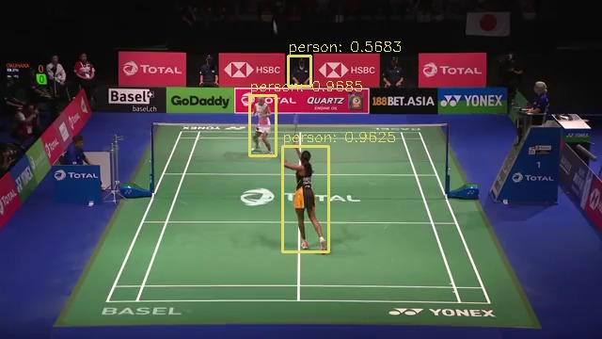
Result: Part I(Player Detection)

Slide 8
Part II:-Sports classification
This model was able to classify between five different sports.
It gave us the accuracy of > 90% with validation accuracy of >70%.
It gave us a loss of less than 0.25 within just 20 epochs.

Slide 9
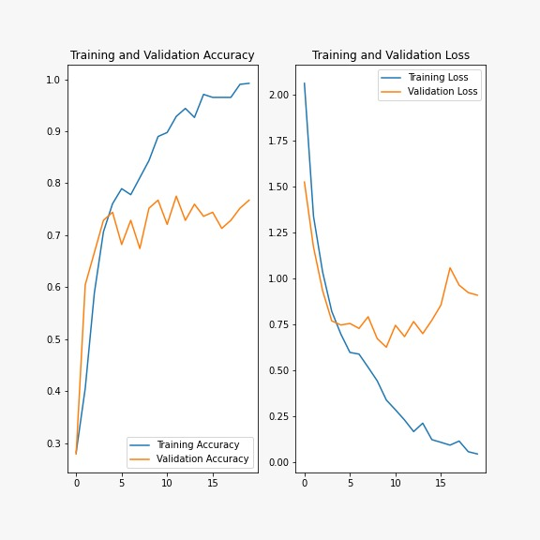
Training Results:

Slide 10
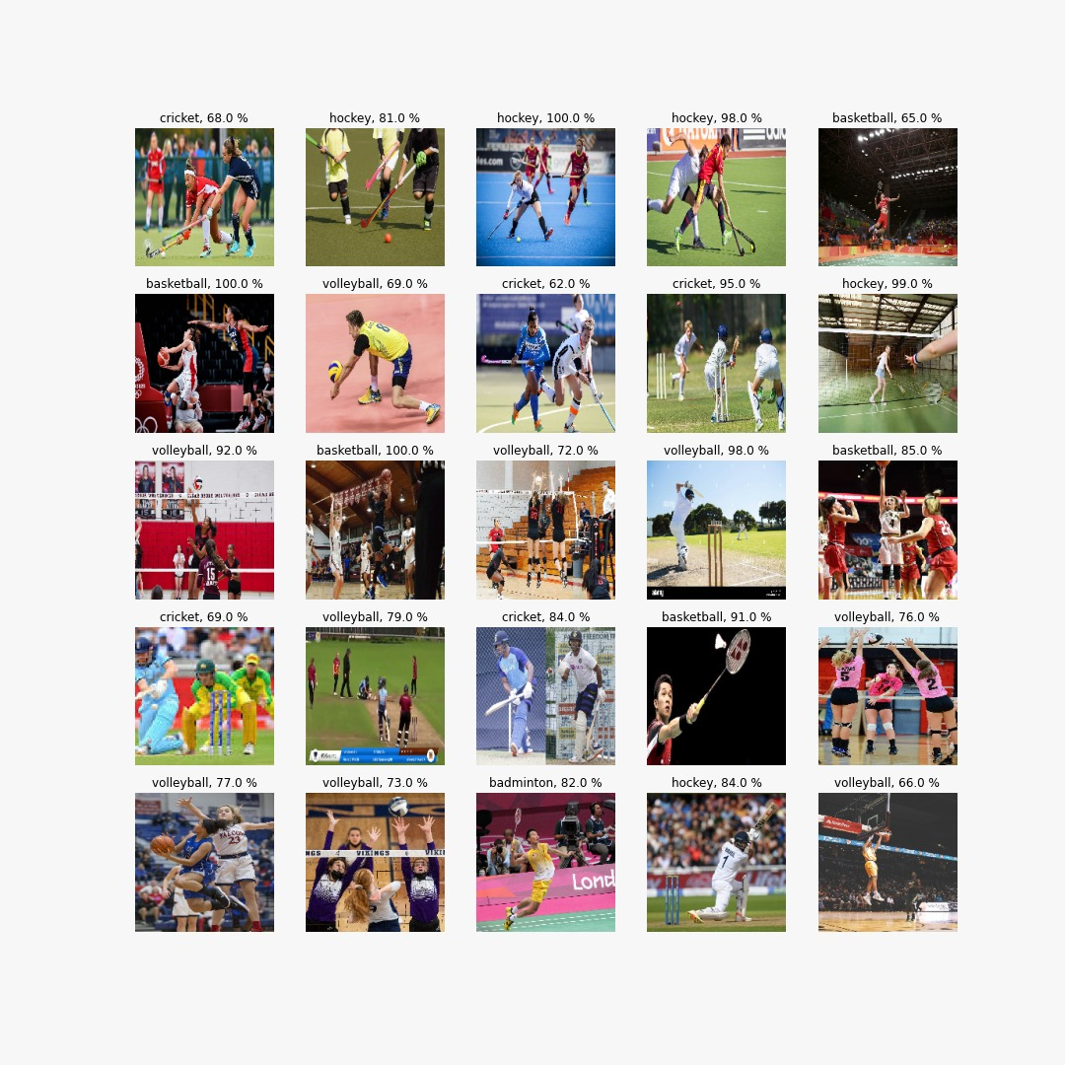
Prediction Results from our Sport Classification Model:-

Slide 11
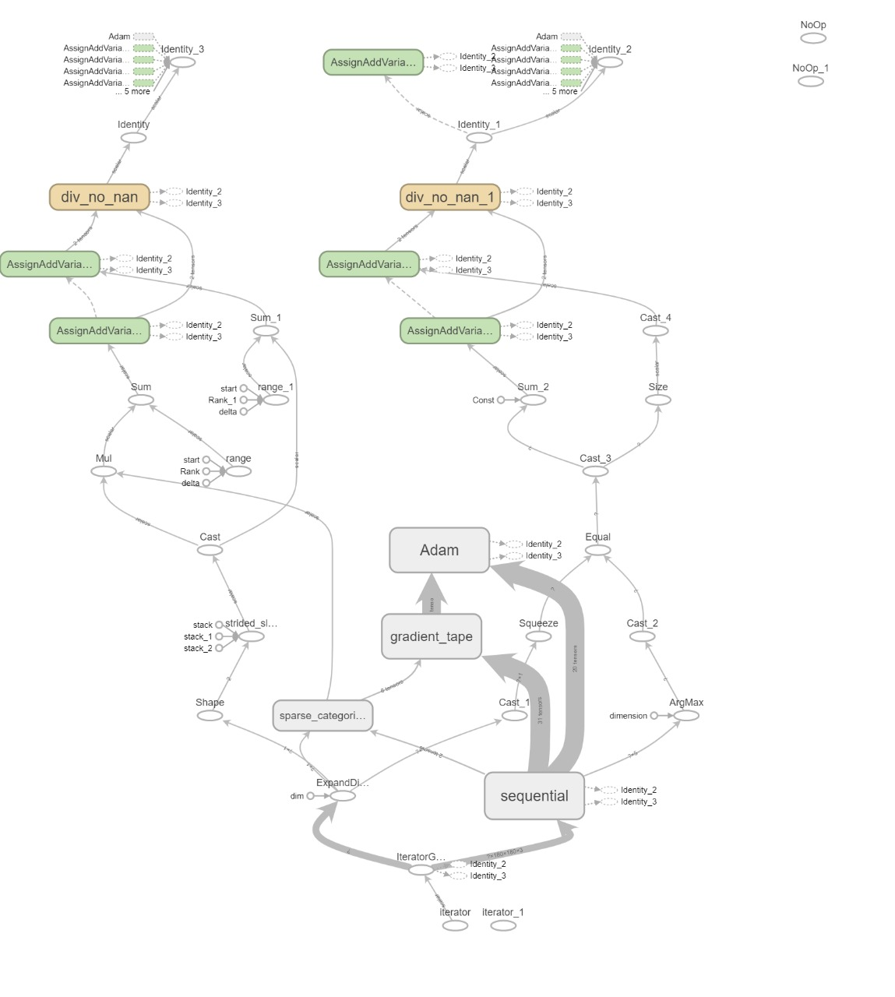
Model Architecture:-

Slide 12
Discussions:
Apart from using Yolov3 directly for our player detection, we also tried to implement Transfer Learning on it.
For that, we collected images of badminton matches and labelled them in YOLO format.
We then tried to train the YOLOv3 on our dataset but, for a long time we weren’t able to make it work.
Than finally we made it work but the training took a long time and we weren't able to finish the training on time for the submission.
We included our Training file also in the code folder, which is currently has about 3hrs of training left (it saves the trained weights regularly).

Slide 13
Conclusion
In conclusion, we have successfully trained a CNN model to classify different sports played in IISERB.
We were able to detect players on the court using a pre-trained model (YOLOv3 and OpenCV).
In future we would like to use transfer Learning to further improve the accuracy of our player detection model.
Thank You

