Slide 1


AdOptima

Slide 2
AdOptima
Machine Learning Project

Slide 3
AdOptima
Sadeen | maemonah |khadejah | layan

Slide 4
AdOptima
Nowadays, social media is one of the most popular ways for companies to market and promote their products. Choosing the right social media platform is an important part of a successful marketing campaign. Therefore, our project aims to build a Machine Learning model that predicts the expected sales of an influencer marketing campaign based on several factors, such as the platform used, before the campaign is implemented. This can help companies make better decisions and reduce financial losses.

Slide 5
Data overview

Slide 6
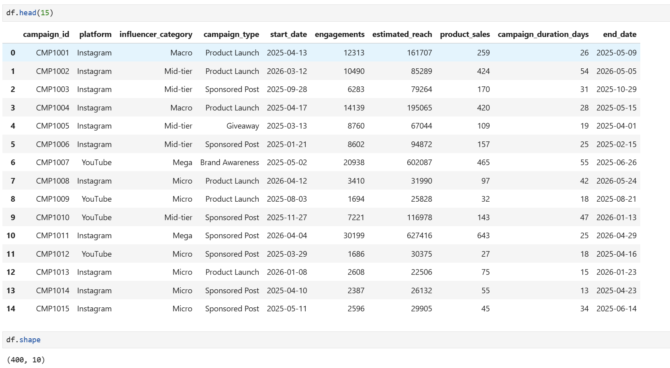
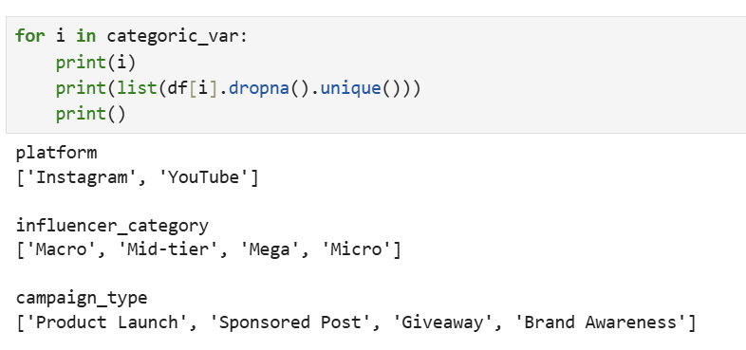

Slide 7
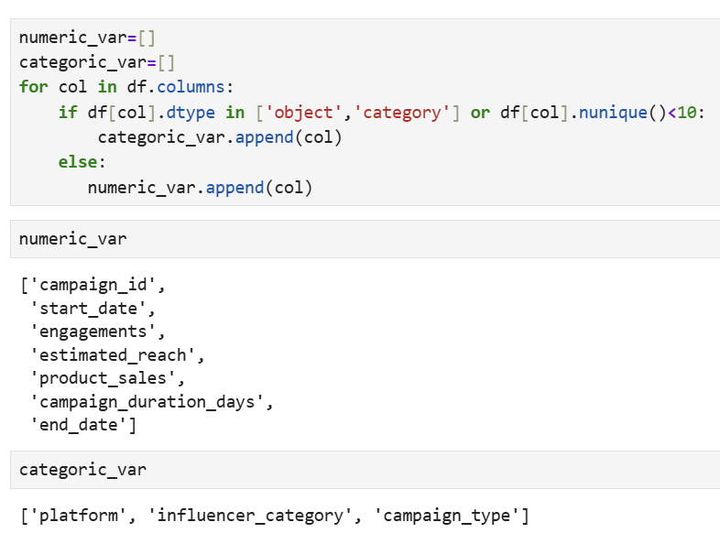
AdOptima
The dataset contains numerical and categorical variables that can be used to predict campaign performance.
The target variable is numeric : product_sales
making this a Regression problem.

Slide 8
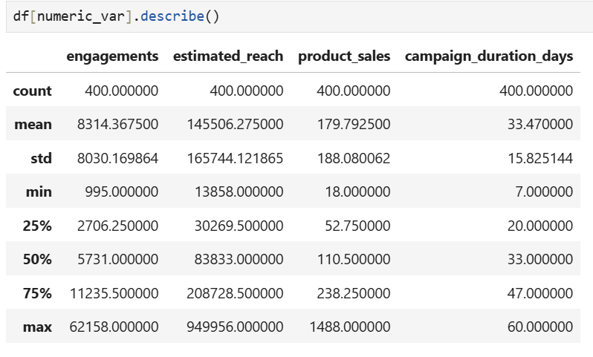
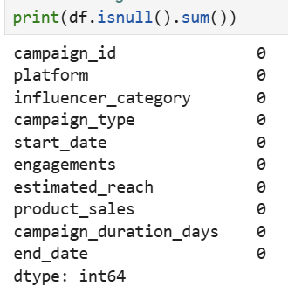


Slide 9
Mess with the data

Slide 10
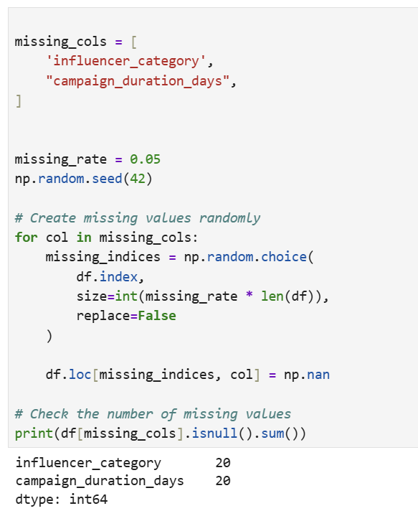
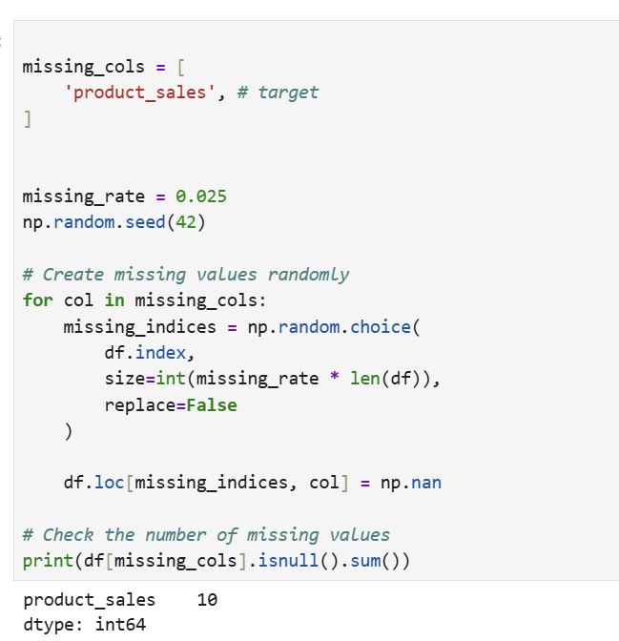

Slide 11
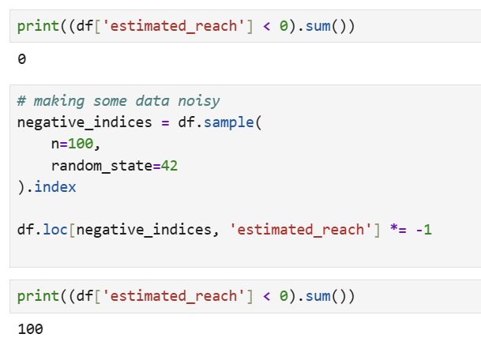
For nulls in campaign duration days We can compute campaign duration using end_date and start_date to fill missing campaign_duration_days
And for engagement, we take the absolute value

Slide 12
EDA

Slide 13
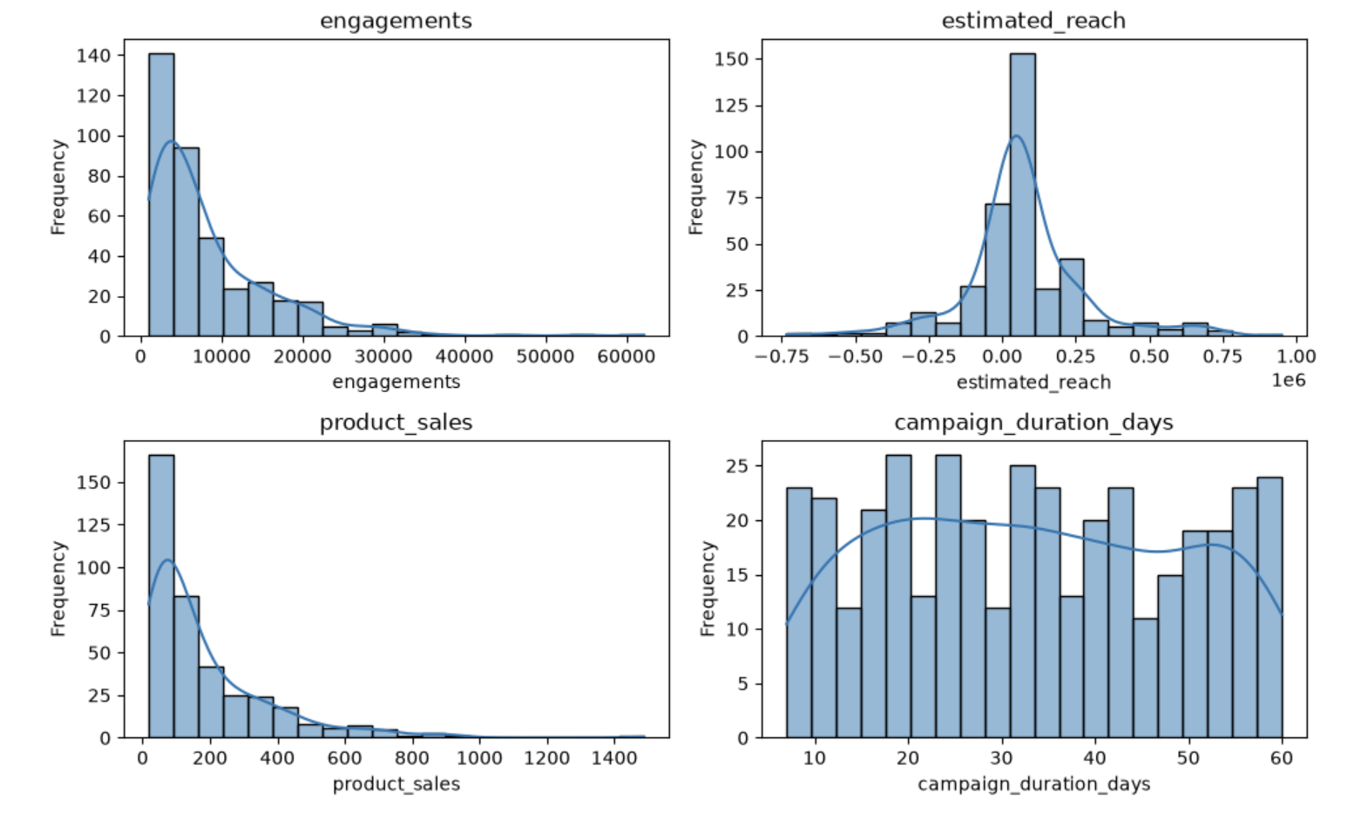

Slide 14
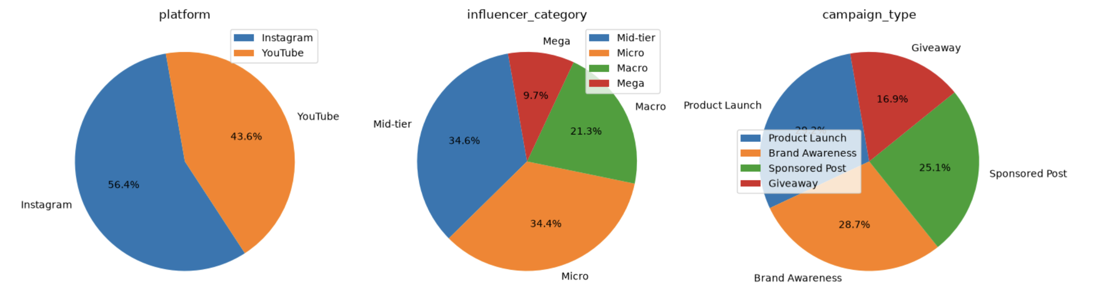

Slide 15
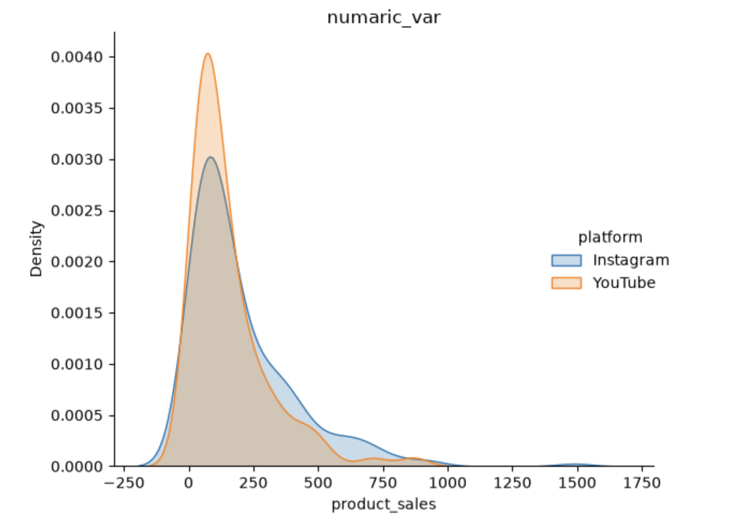

Slide 16
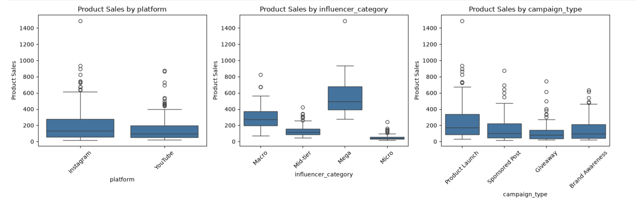

Slide 17
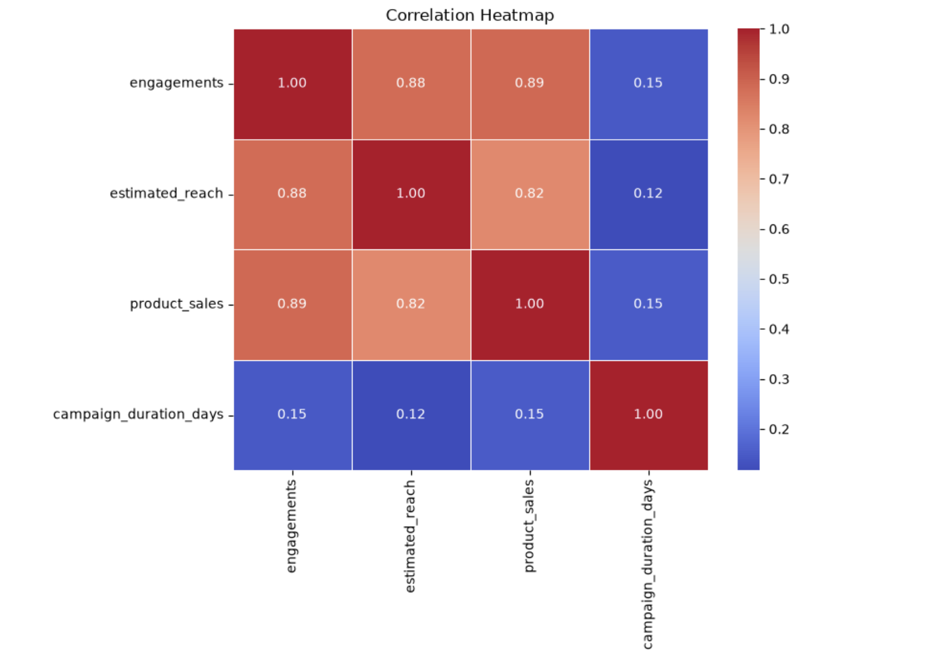

Slide 18
Bulid a module

Slide 19
Data Splitting & Validation Strategy
1. Train / Test Split
The dataset was divided into:
  80% Training Data
  20% Testing Data
random_state = 42 was used to ensure reproducibility.
The Test Set was not used during model training or cross-validation.

Slide 20
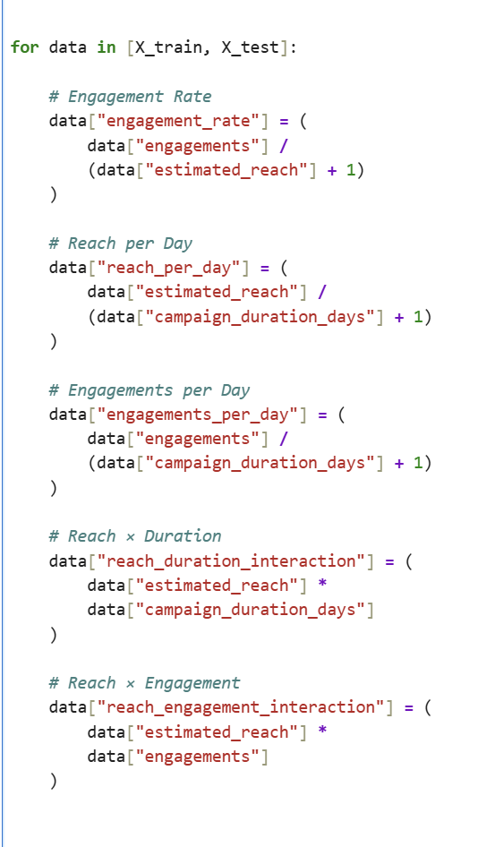
Feature Engineering

Slide 21
Catboost parameters
Parameter | Value | Note / Hint
iterations | 1800 | Number of boosting iterations / trees
learning_rate | 0.02 | Small step size → more stable learning
depth | 4 | Controls tree complexity
l2_leaf_reg | 8 | L2 regularization → reduces overfitting
loss_function | RMSE | Regression loss function
bootstrap_type | Bernoulli | Random row sampling for each tree
subsample | 0.85 | Uses 85% of samples per tree
random_strength | 1.0 | Adds randomness to split selection
min_data_in_leaf | 5 | Minimum samples allowed in a leaf
border_count | 128 | Number of bins for numerical features
thread_count | -1 | Uses all available CPU threads
random_seed | 42 | Ensures reproducible results
verbose | False | Hides training output

Slide 22
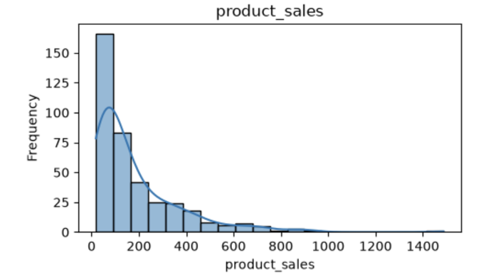
Target Transformation
product_sales was transformed using Log Transformation on the training data.
Reduce the skewness of the target distribution.
Fold Stratified Cross-Validation
A 10-Fold Stratified Cross-Validation strategy was applied to the training data For each fold Training Data (80%):
90% of the training data was used to train CatBoost.
10% was used for validation.
The process was repeated 10 times, allowing every training sample to be used for validation once.

Slide 23
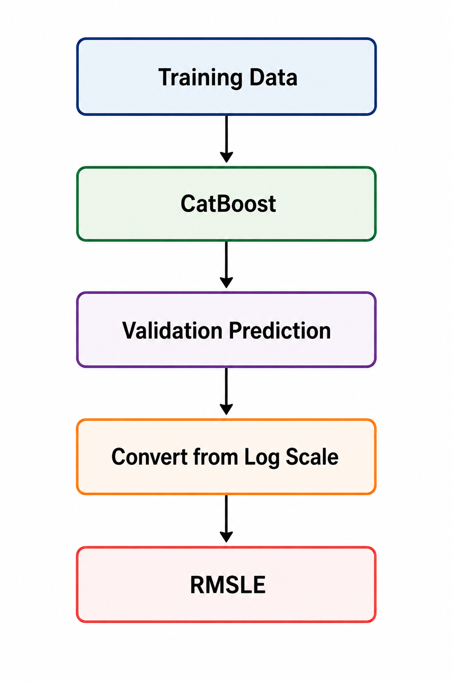
Model Evaluation

Slide 24
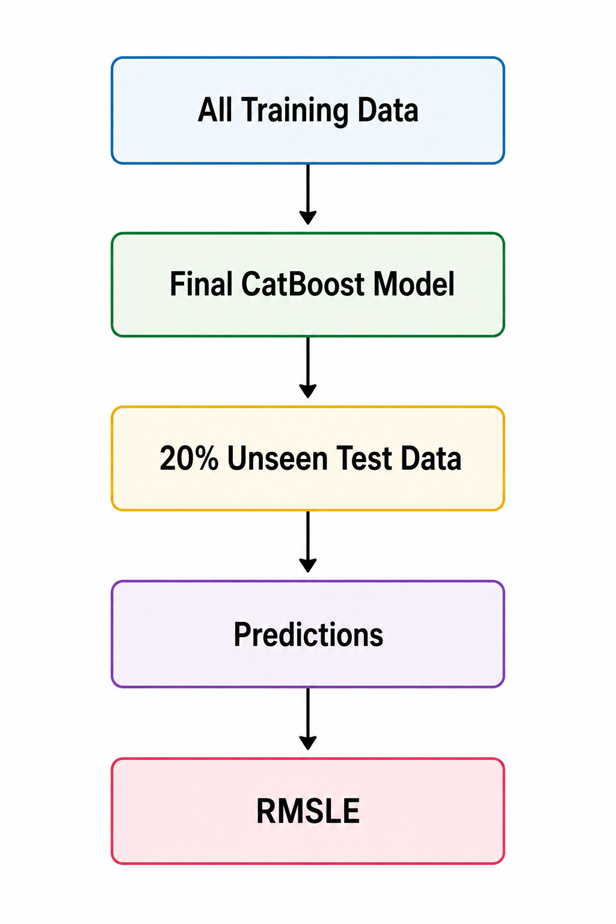
Final Model & Test Evaluation

Slide 25
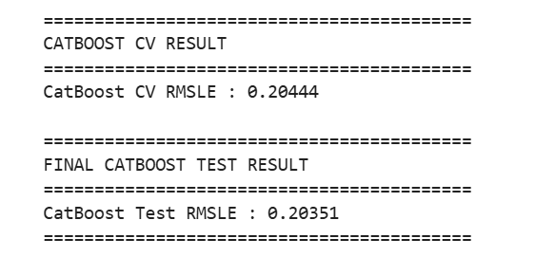
The Resultes

Slide 26
The end

