Slide 1

SMS Spam Detection
A Naive Bayes Approach with TF-IDF Vectorization
PREPARED BY
SUPERVISED BY
khadijah hzayen
Dr. Samar

Slide 2

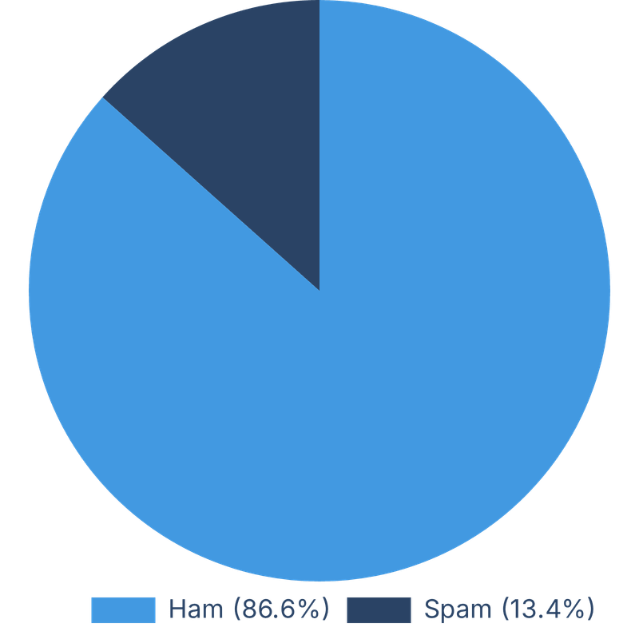
Dataset Overview
Source & Size
Source: Downloaded from Kaggle (SMS Spam Collection).
Total Size: Contains 5,574 real-world text messages.
Target Classes
Messages are classified into Ham (Normal messages ) and Spam (Unwanted).
imbalanced dataset :
Ham: ~86.6% (4,825 messages)
Spam: ~13.4% (747 messages)
accurately reflecting real-world scenarios.

Slide 3




Data Preprocessing: Text Cleaning
Handling Encoding
Lowercasing
Punctuation Removal
Used encoding='latin-1' to correctly process special symbols (£) and avoid system crashes.
Converted all text to lowercase to ensure consistency (e.g., "Free" vs "free").
Stripped out unnecessary punctuation and symbols to isolate core semantic tokens.

Slide 4





Data Preprocessing: Feature Extraction
Linguistic Refinement
TF-IDF Vectorization
Tokenization: Splitting messages into individual words or tokens.
Converting text into numeric weights based on word importance across the corpus.
Stop Words Removal: Filtering out common words (e.g., "the", "is") that lack predictive value.
Feature Selection: Extracted the top 5,000 features using max_features=5000.
Lemmatization: Reducing words to their dictionary base form (Lemma).
Weighting: Assigns higher importance to words that are frequent in a document but rare in the dataset.

Slide 5
Model Selection & Training
Training Process
Why Naive Bayes?
Data Splitting
Divided dataset into 80% Training and 20% Testing sets using random_state=42.
Extremely fast and lightweight, making it suitable for real-time SMS filtering.
Algorithm
Works effectively based on word frequencies and probability calculations.
Implemented Multinomial Naive Bayes (MultinomialNB), a probabilistic learning method ideal for discrete features like word counts.

Slide 6

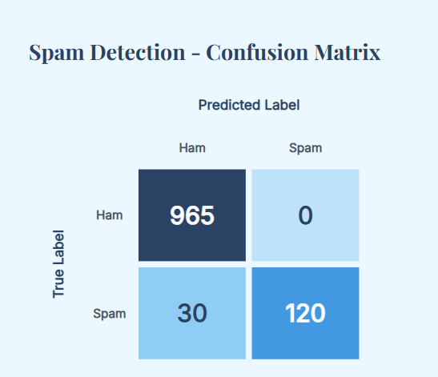
Model Performance & Results
Overall Accuracy: 97% - 98%
Exceptional performance in distinguishing between ham messages and spam.
Macro vs. Weighted Average
Macro Avg treats classes equally (critical for spam), while Weighted Avg Reflects the performance adjusted by the actual size of each class.
Ham Class Metrics: Achieved ~98% Precision and ~99% Recall, ensuring legitimate messages are perfectly safe.
Spam Class Metrics: Achieved ~96% Precision and ~95% Recall, showing excellent capability in catching spam without missing important texts.
Confusion Matrix Analysis
Heatmap visualization confirmed minimal false positives and false negatives.

Slide 7




Challenges Faced
Data Imbalance
The majority of data was ham, making it a challenge to train the model to catch spam accurately without bias.
Encoding Issues
Faced initial crashes due to unique symbols in SMS text, resolved by shifting to latin-1 encoding.
Text Noise
People write SMS messages using informal words and shortcuts and spelling mistakes, making the text very noisy and harder for the model to understand

Slide 8
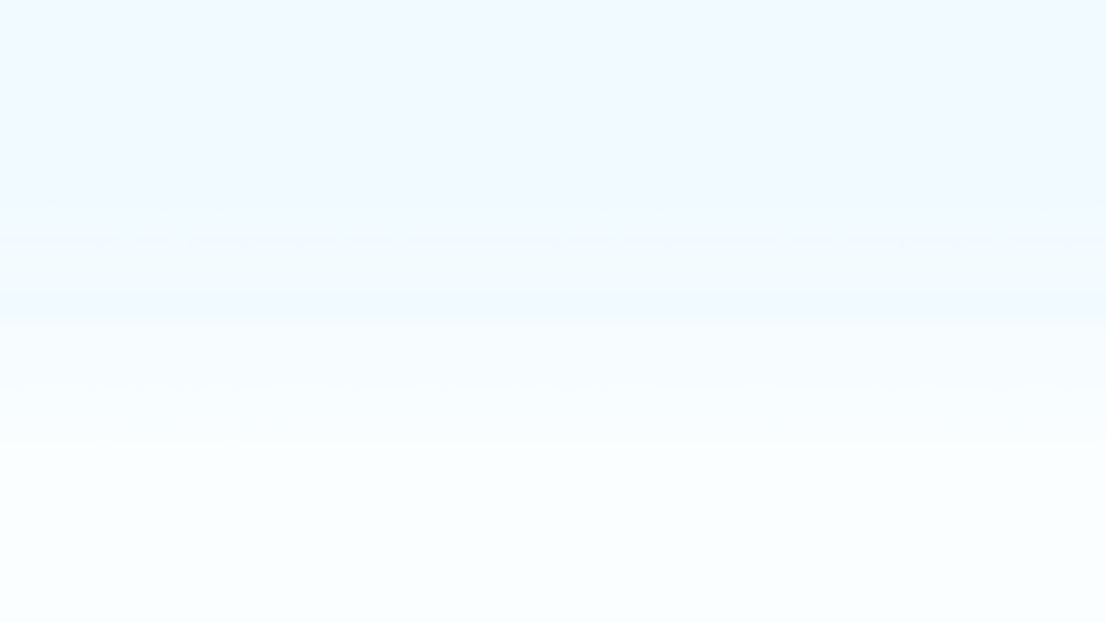
Conclusion
Combining TF-IDF features with Naive Bayes provides a robust, fast, and highly efficient solution for real-time spam filtering, achieving near-perfect accuracy on the SMS dataset.
Thank You!
Any Questions?

