Slide 1
KTP ASSOCIATE RECRUITMENT PROJECT
3,150
Telecom Customer
Churn Prediction
Subscribers
15.7%
AI & Analytics to Reduce Subscriber Churn By Khadija Ahmad
Churn Rate
0.984
Model AUC
Haldane Group Limited × Queen's University Belfast · Ref: 26/113195 · Deadline: 10 April 2026

Slide 2



Project Overview
SLIDE 2 / 9
Analyse
Predict
Automate
Explore 3,150 subscriber records across 13 features to identify the key drivers of 15.7% churn rate
Train and test a Random Forest ML model to predict which subscribers will churn — achieving ROC-AUC 0.984
Use Generative AI to turn model outputs into plain-English risk reports, emails and action plans
Brief alignment:
Telecom scenario · Python ML pipeline · GenAI integration (Claude) · 5 visualisations · Haldane AI strategy

Slide 3
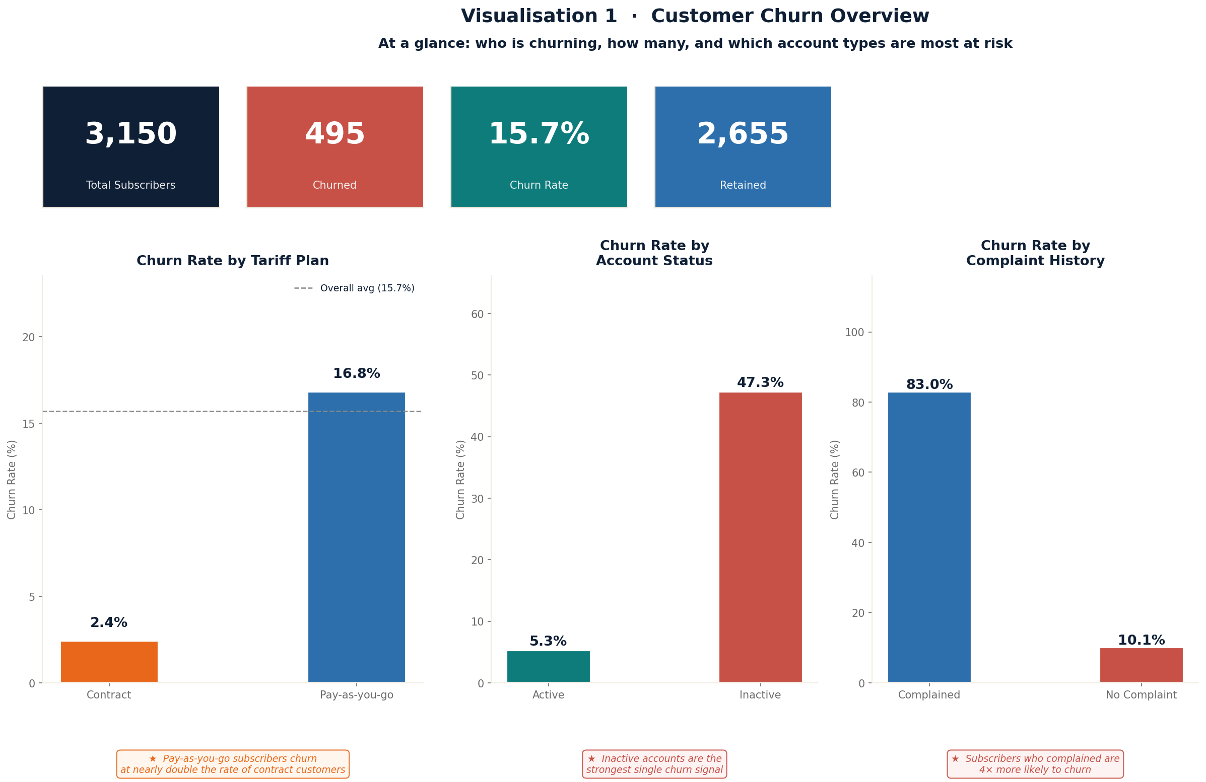
Visualisation 1 · The Business Problem
SLIDE 3 / 9
15.7%
Overall churn rate
83%
Churn if complained
47%
Churn if account inactive
2.4%
Churn on contract plan

Slide 4
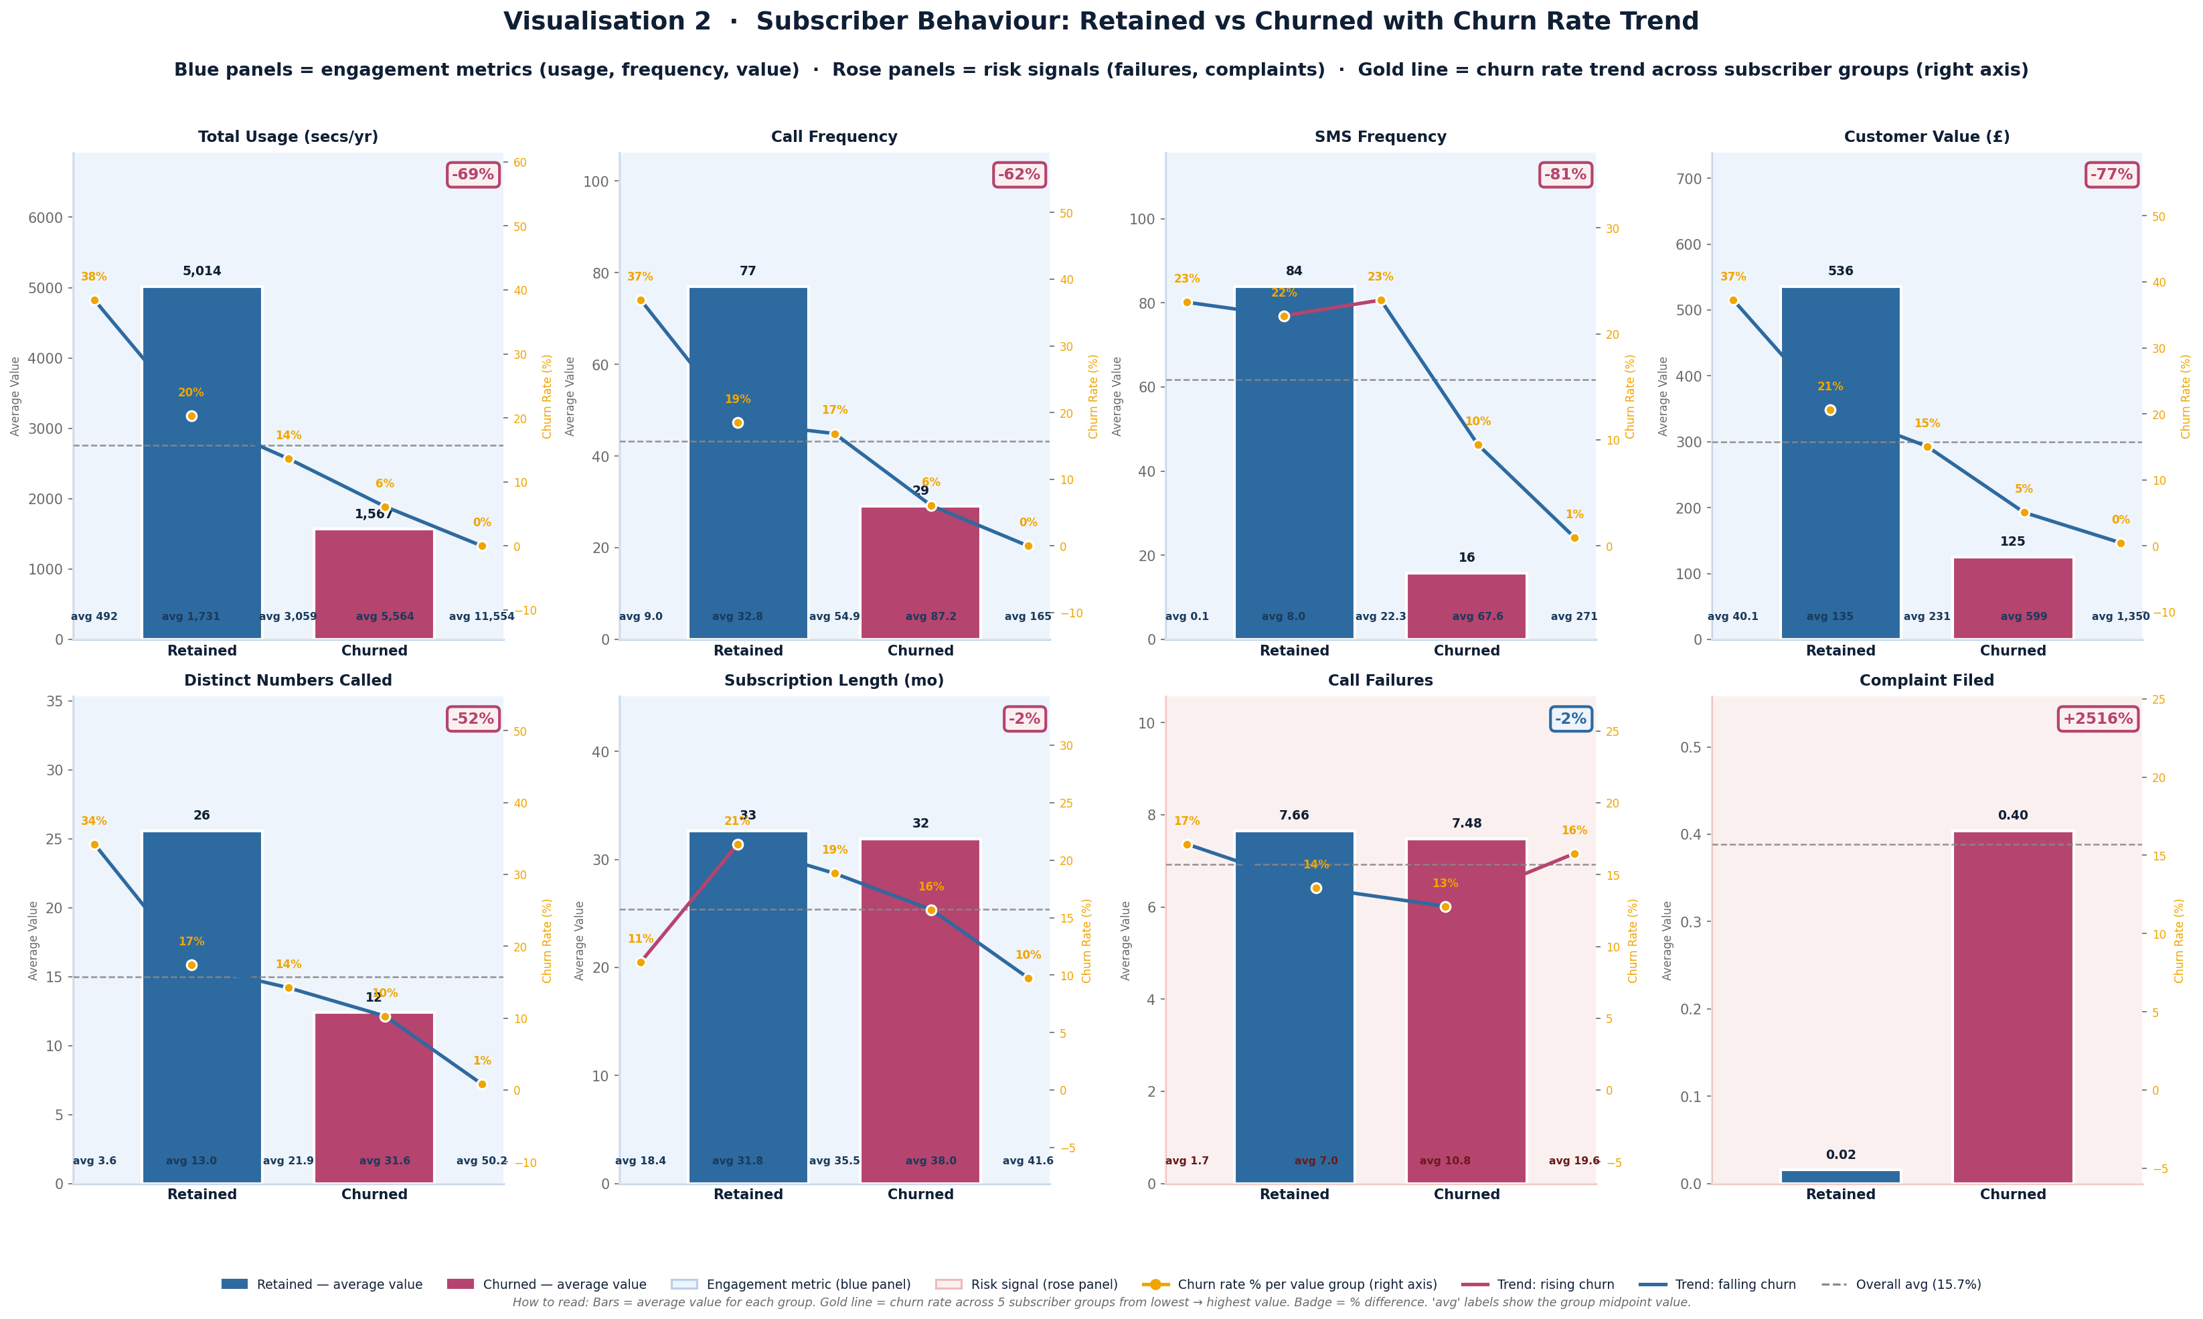
Visualisation 2 · Subscriber Behaviour: Retained vs Churned
SLIDE 4 / 9
Usage -69%
Churners use the service 69% less — disengagement is visible months before they leave
Calls -62%
Call frequency drops sharply. Low usage is a reliable early warning signal
+2,516%
Complaint rate is 25× higher in churners — the single strongest risk signal

Slide 5
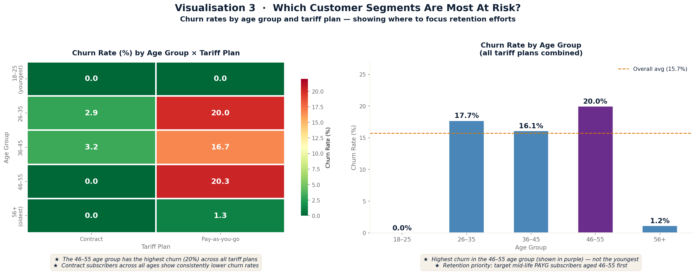
Visualisation 3 · Which Segments Are Most At Risk?
SLIDE 5 / 9
Key Findings
20.0%
46–55 age group — highest churn across ALL tariff plans
0%
18–25 age group — surprisingly zero churn
2.4%
Contract subscribers — consistently low across all ages
16.8%
Pay-as-you-go — nearly 7× higher than contract rate

Slide 6
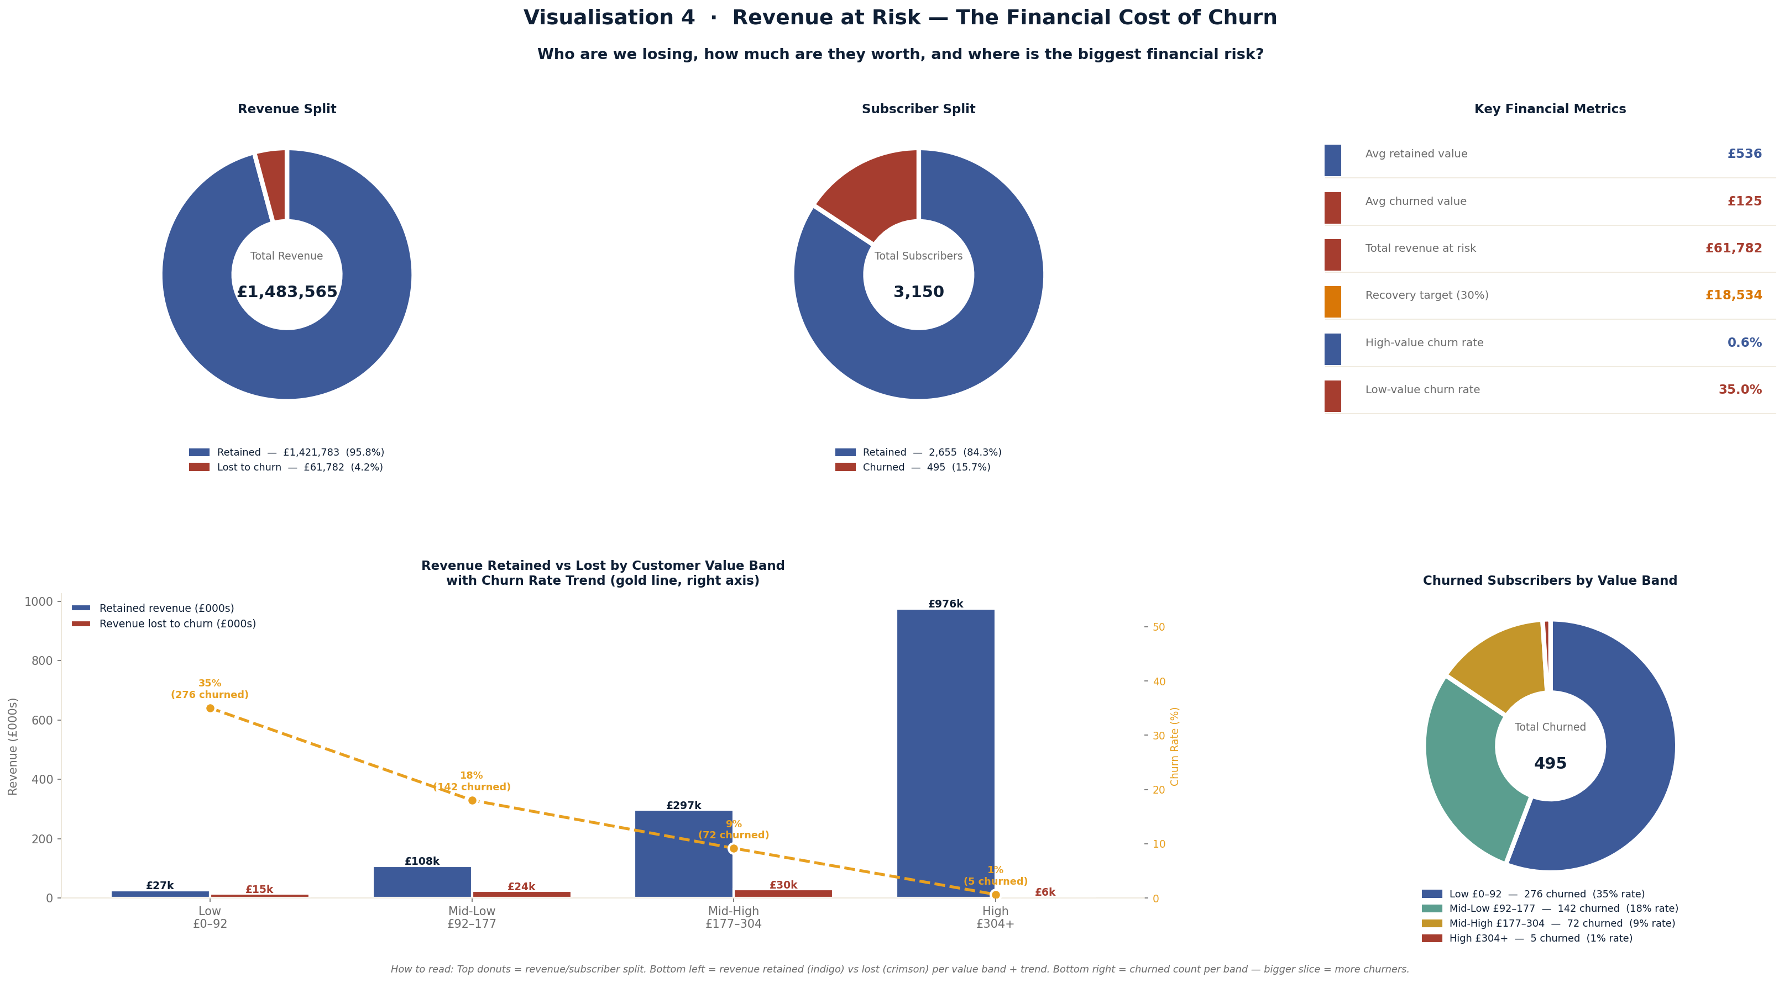
Visualisation 4 · Revenue at Risk
SLIDE 6 / 9
£535
Avg retained
subscriber value
4.2%
15.7%
£125
Avg churned
subscriber value
3.3%
Revenue lost
despite 15.7% churn
0.6%
High-value band
churn rate
35.0%
Low-value band
churn rate

Slide 7
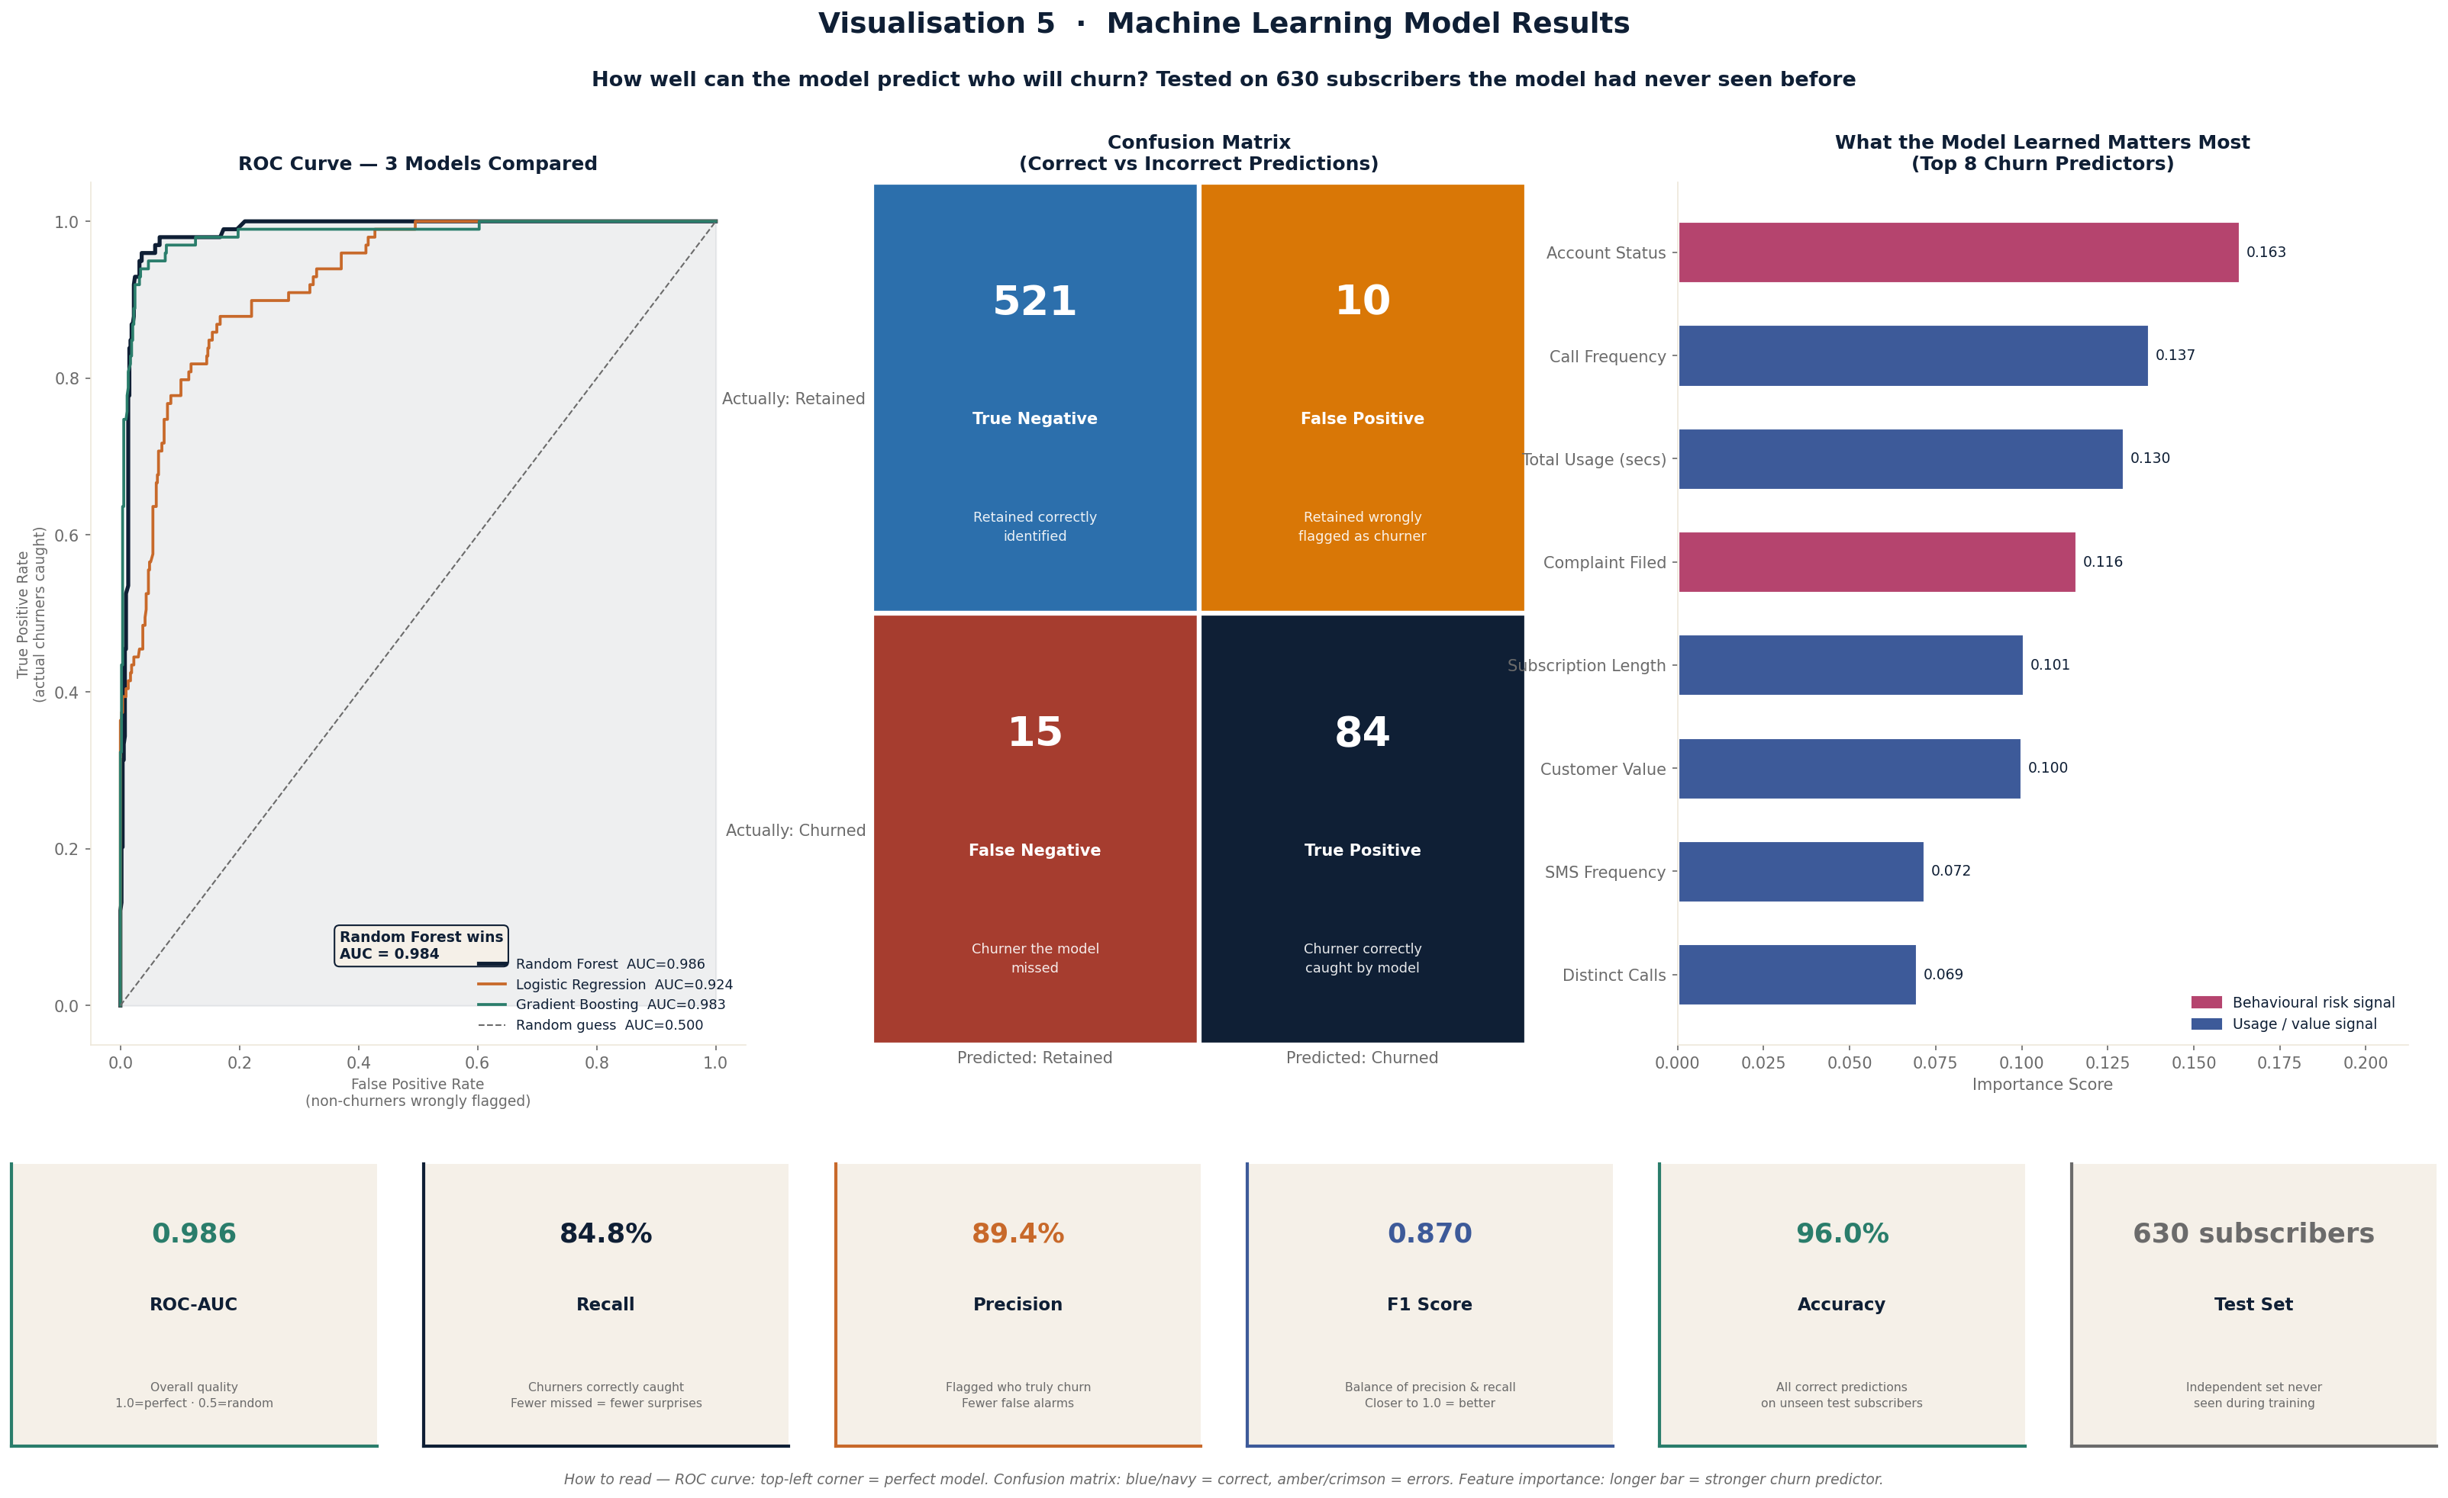
Visualisation 5 · Machine Learning Model Results
SLIDE 7 / 9
Model Scorecard
ROC-AUC
0.984
Close to perfect (1.0)
CV AUC
0.983
±0.003 — stable & generalises
Recall
84.8%
Churners caught before leaving
Precision
89.4%
Low false alarm rate
F1 Score
0.871
Balanced accuracy
Accuracy
96.0%
On 630 unseen subscribers

Slide 8





Generative AI Integration
SLIDE 8 / 9
ML Model
Scores Subscribers
Top N At-Risk
Subscribers
API
Call per Profile
Plain-English
Risk Report
Weekly batch
ROC-AUC 0.984
Ranked by churn
probability × value
System prompt +
subscriber data
Actions for
retention agents
AI Retention Hub — 5 Automated Modules
Risk Scanner
Offer Builder
Enter subscriber profile → instant churn risk score + recommended actions
Designs targeted retention offer by subscriber segment and churn reason
AI Analyst
Action Plan
Chat interface with full dataset context baked into the system prompt
Structured 30/90-day retention plan with KPIs and CRM integration steps
Retention Email
Auto-generates personalised outreach email from account manager

Slide 9
AI Strategy · Where Haldane Group Could Apply This
SLIDE 9 / 9
0–6 Months
6–18 Months
18+ Months
Quick wins
Tactical
Strategic
Weekly at-risk customer list from K8 ERP transaction data
Customer lifetime value scoring for proactive outreach
Full K8 ERP integration — churn flags in daily workflow
AI-generated account manager outreach via Phocas BI
Predictive stock ordering using purchase history
Automated pricing intelligence vs competitor offers
Complaint triage automation using NLP on service records
AI assistant for trade counter product recommendations
Segment-specific AI retention campaigns
Churn early-warning dashboard embedded in Phocas
Price sensitivity modelling for contract renewal offers
Generative AI for personalised trade account proposals
This project architecture — ML prediction + GenAI automation — maps directly onto Haldane's K8 ERP + Phocas BI stack

Slide 10




Summary
GitHub
All code, charts
and AI Hub
5 Visualisations
Churn overview · Behaviour comparison · Segment heatmap · Revenue impact · ML results
Tech Stack
Random Forest Model — ROC-AUC 0.984
Python
scikit-learn
Catches 84.8% of churners · Stable across 5-fold CV · Class imbalance handled
matplotlib
Claude API
Generative AI (Claude)
3 documented uses: code structuring · risk report generation · retention automation hub
HTML / JS
Flask
Key Findings
Inactive accounts · Complaints · PAYG tariff are top 3 churn drivers · 46–55 age group highest risk
Haldane AI Strategy
Thank you
Embed in K8 + Phocas · Weekly at-risk list · Account manager outreach automation

