Slide 1
Data warehousing and Business Intelligence Dr Panagiotis(Panos) Chountas

Slide 2
Organizations are drowning in data…
… but lacking in information / knowledge
Our ability to collect and store data seems to have surpassed our ability to make sense of it!
Important trends:
Storage capacity continues to rise rapidly
Cost of storage continues to drop
Credit Histories
Web Click Streams
Activity Records
Purchase Data
ERP Transactions
Customer Profiles
Location Tracking (GPS)

Slide 3
What is Business Intelligence?
A Simple Definition: The applications and technologies transforming Business Data into Action-Proactive Management
Fact-based decision making typically involves a subset of the following skills/tools…
Data querying / SQL
Database design / data warehousing
Data mining
Decision support systems / simulations
Data visualization / Dashboards

Slide 4
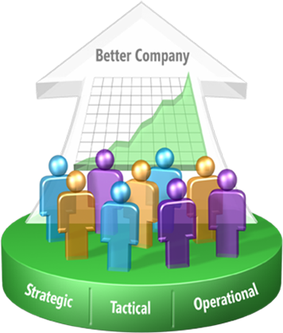

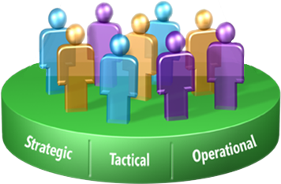
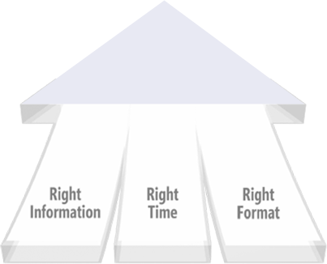
The BI goal
BI is about using data to help enterprise users make better business decisions

Slide 5
Data Warehouse System
Reporting
Oper-
ational
DB
Data Mining
Data
Ware-
house
External
DB
KM
Other
DB
Expert

Slide 6
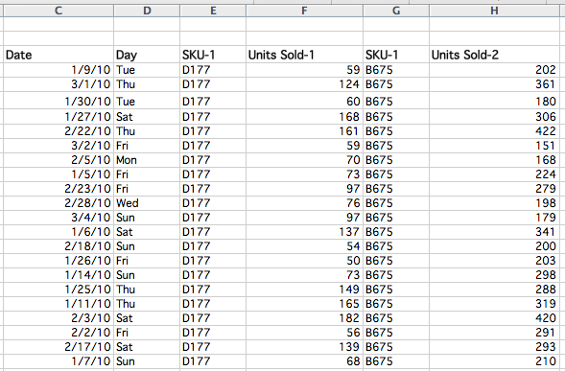
Famous “Beer and Diapers” BI example
Consider the follow convenience-store transactional data (register sales receipts)

Slide 7
Famous “Beer and Diapers” BI example
What did managers learn? That beer & diapers are often bought by men on Thursday and Saturdays. Why?
Data → Information → Knowledge (Insight)

Slide 8
Goal: Convert Data to (Actionable) Knowledge
Knowledge
Info
Increasing
Value
Data
Hard to do in practice – requires commitment/effort.

Slide 9
Data / information / knowledge
Data – a collection of raw value elements or facts used for calculating, reasoning, or measuring.
Information – the result of collecting and organizing data in a way that establishes relationship between data items, which thereby provides context and meaning
Knowledge – the concept of understanding information based on recognized patterns in a way that provides insight to information.

Slide 10
What is stored in a Data Warehouse
Business Processes Instances (facts)
record details about particular events that occur in the business. The events that decision makers want to understand and analyse
event that happens at a point of time.
It contains measurements or quantities that may be summarized.
an insurance claim records a particular business event and the amount claimed.
A sale records an event that relates a product sold in an order and the sum of amount and the number of units sold.

Slide 11
What is a business process?
Laudon & Laudon definition:
”The unique ways in which organisations coordinate and organize work activities, information, and knowledge to produce a valuable product or service”
[Laudon&Laudon, 2000]

Slide 12
What is stored in a Data Warehouse
Dimension Instances
ARE directly related to a BUSINESS INSTANCES via a one-to-many relationship. They define the details or “components” of each business instance.
answer the “who”, “what”, “when”, “how” and “why” of a business event.
EX: a sales instance may be defined by a number of components:
Customer: who made the purchase.
Product: what was sold.
Location: where it was sold.
Period: when it was sold.

Slide 13
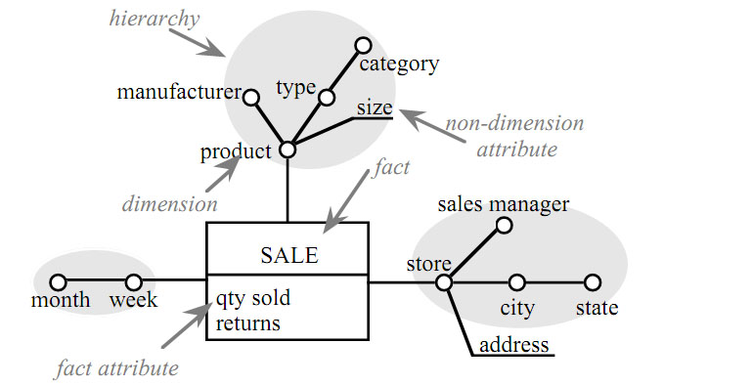
A simple fact scheme for the Business Process Sale,

Slide 14
Step 1: Choosing the process
The process (function) refers to the subject matter of a particular data mart.
E.g. Lease, PropertySale, …
First data mart built should be the one that is most likely to be delivered on time, within budget, and to answer the most commercially important business questions.

Slide 15
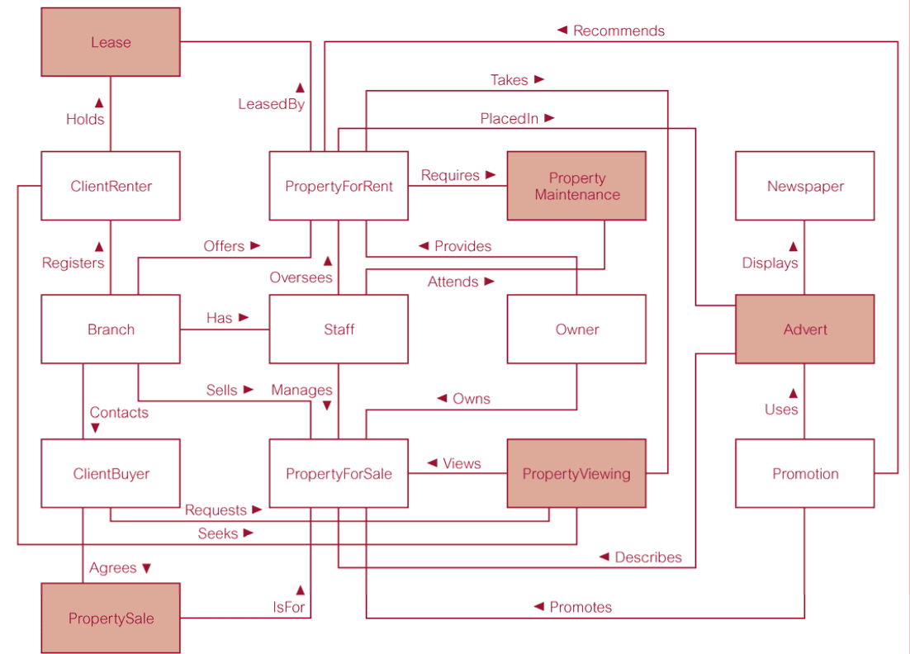
UML Class model
version of DreamHome

Slide 16
Step 2: Identifying and conforming the dimensions
Dimensions set the context for asking questions about the facts in the fact table.
If any dimension occurs in two data marts, they must be exactly the same dimension, or one must be a mathematical subset of the other.
A dimension used in more than one data mart is referred to as being conformed.

Slide 17
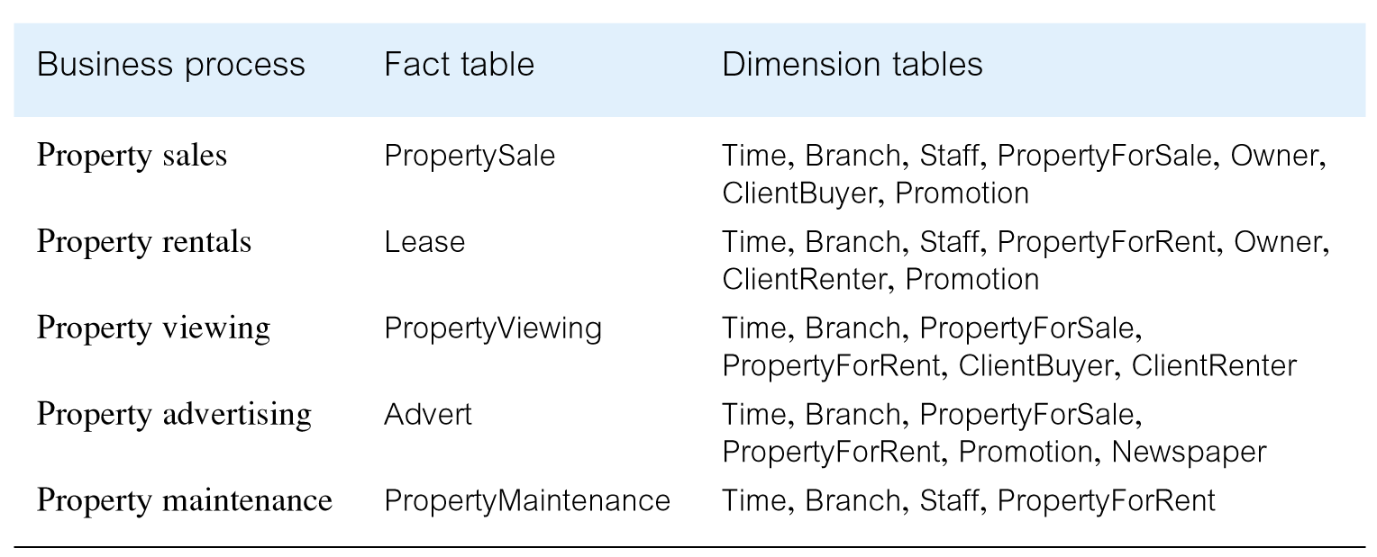
Fact and
dimension
tables for
of
each business
DreamHome
process
© Pearson Education Limited 1995, 2018

Slide 18
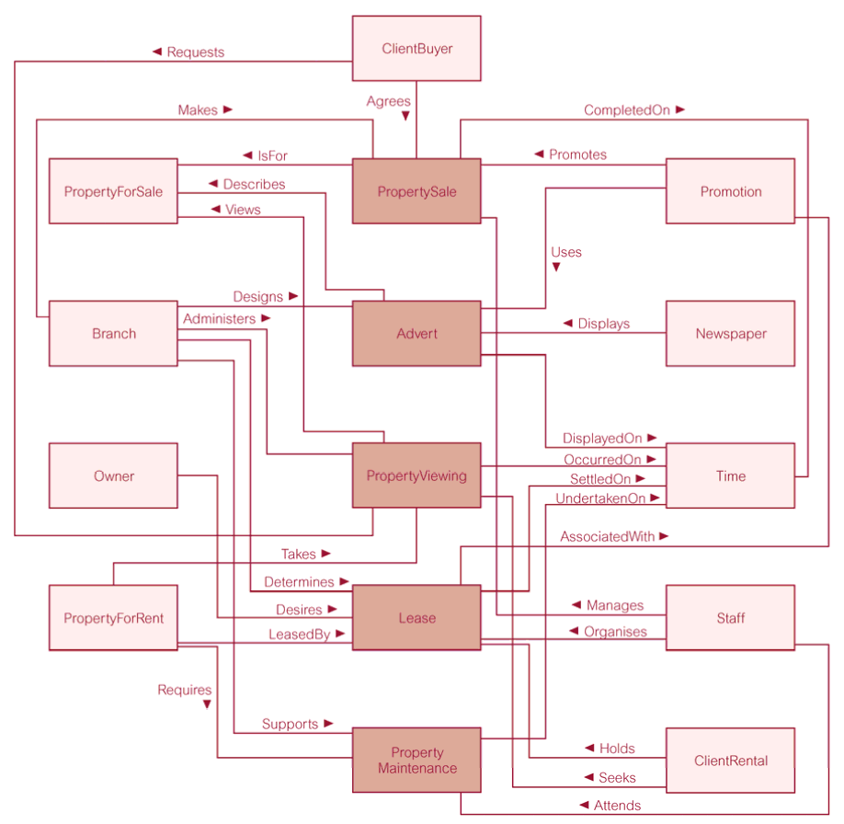
Dimensional model (fact constellation)
for the DreamHome data warehouse

Slide 19
Dependent vs. Independent data marts-Business Process Data
Independent Data marts
Data warehouse
Dependent Data marts
Data warehouse

Slide 20
Typical OLAP/OLAM queries
Which customer groups are most profitable?
How much is the total sale by month for each sales office?
Are some sales offices failing to sell some otherwise popular products?
Is there a correlation between promotion campaigns and sales growth?
Do we have adequate production capacity and stocks to meet anticipated demand?

Slide 21
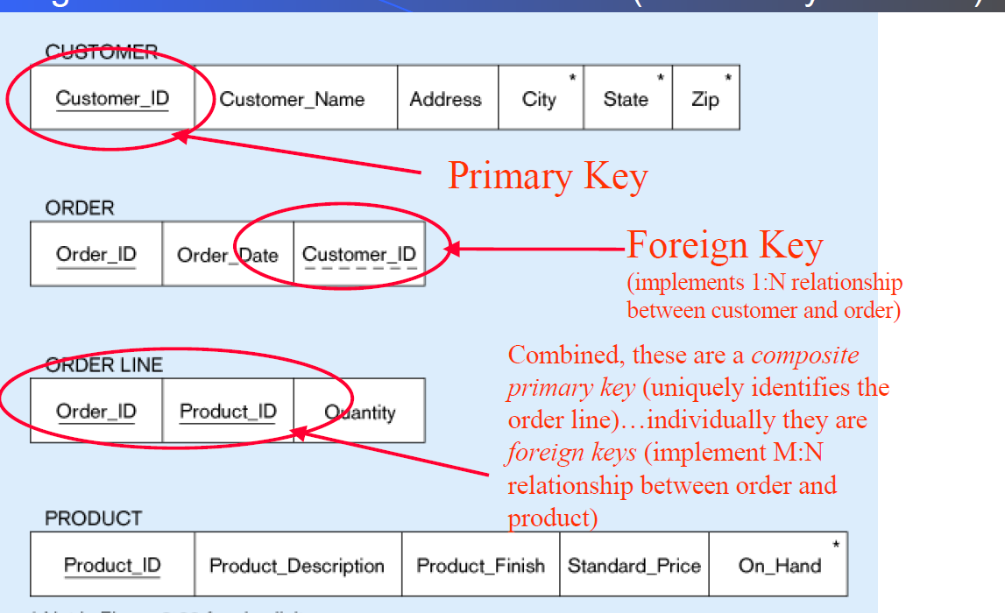
Review- Data Modelling

Slide 22
Review-Data Modelling
Every Primary Key denotes a Functional Dependency (X→Y), for example
Order_Id→ Order_Date, Customer_Id
Order_Id, Product_Id→Quantity
Customer_Id→ Customer_Name, Address, City, State, Zip
Product_Id→ Product_Description, Product_Finish, Standard_Price, On_Hand
All attributes of a Table are funtionally dependent on the Primary Key.
Every Foreign Key points to a transitive functional dependency: X→Y Y→Z => X→Z
Order_Id→ Order_Date, Customer_Id
Customer_Id→ Customer_Name, Address, City, State, Zip

Slide 23
From Tables to UML Class Models
Order_Id→ Order_Date, Customer_Id
Customer_Id→ Customer_Name, Address, City, State, Zip
Product_Id→ Product_Description, Product_Finish, Standard_Price, On_Hand
Order_Id, Product_Id→Quantity

Slide 24
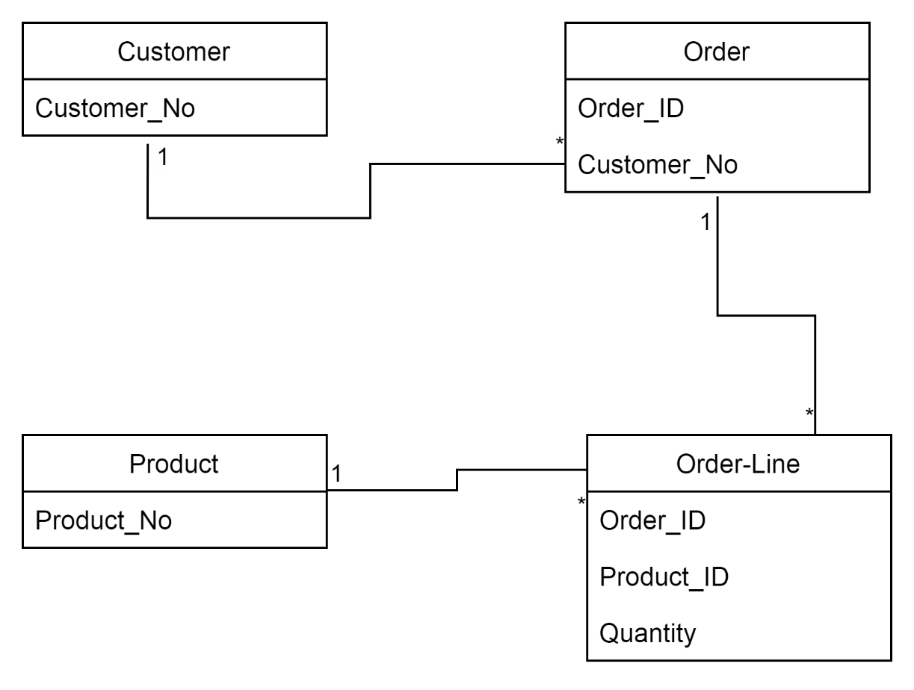
From Tables to UML Class Models

Slide 25
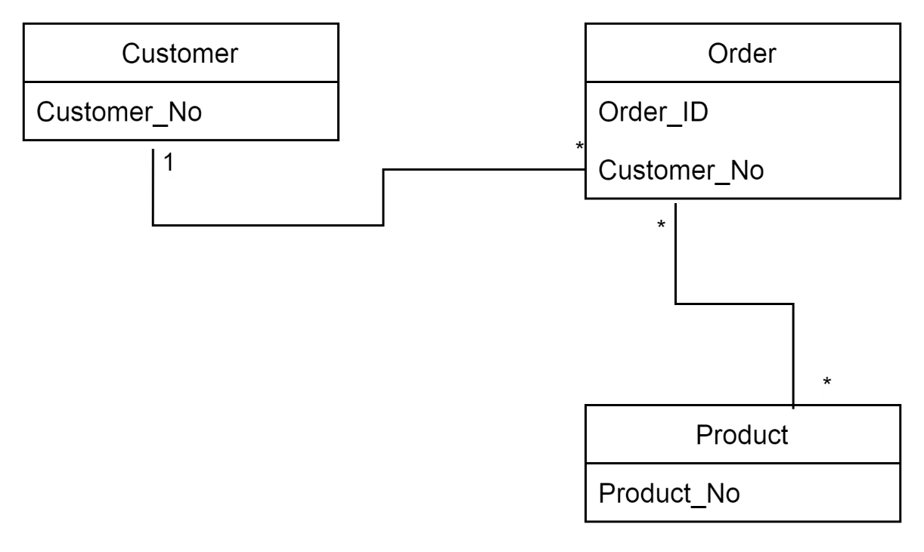
From Tables to UML Class Models

