Slide 1
APPLIED PROJECT
Tree-Based Models
Through a Churn Project
Clean
Train
Predict
Evaluate
Act
A beginner-friendly walkthrough: terms, code steps, example outputs, and real-life business meaning.
Project story
Predict which customers may leave, then use model output to plan retention actions.
7,032
Churn
Recall
Rows after cleaning
Target
Key metric
example dataset
Yes / No
catch churners

Slide 2
1. Business Problem: Customer Churn
Before choosing a model, define the real decision we want to support.
Business question
Real-life implication
Can we predict which customers are likely to leave the company?
High churn risk
Send retention offer or call
Machine learning type
Low churn risk
No action or normal marketing
• Supervised learning: the target is known
• Classification: predict a category
• Binary classification: Churn = 0 or 1
Unclear case
Ask for more data / monitor
Say this: The model is useful only if its prediction leads to a better business decision.

Slide 3
2. Dataset: Rows, Features, and Target
Start by explaining what each part of the table represents.
7,032
Churn
20+
0 / 1
Binary
Rows
Target
Features
Classes
Problem
customers after cleaning
what we predict
customer information
No Churn / Churn
classification
tenure
MonthlyCharges
Contract
TechSupport
Churn
Meaning
1
29.85
Month-to-month
No
Yes
• One row = one customer
• Features describe the customer
• Target is the answer the model learns to predict
34
56.95
One year
Yes
No
2
53.85
Month-to-month
No
Yes
Junior focus: Always identify X and y before building any model.

Slide 4
3. Split the Table into X and y
This is where data leakage can happen if we are careless.
y = df["Churn"].map({"No": 0, "Yes": 1})
X = df.drop(columns=["Churn", "customerID"])
Data leakage warning
If Churn stays inside X, the model sees the answer during training. Results may look very high but are fake.
Terms
• y = target label: what we predict
• X = features: what the model uses
• customerID = identifier, not behavior
Business meaning: leakage creates a model that cannot work in the real world.

Slide 5
4. Clean Numeric Columns: TotalCharges
Some columns look numeric but are stored as text.
df["TotalCharges"] = pd.to_numeric(
df["TotalCharges"],
errors="coerce"
)
missing = df["TotalCharges"].isnull().sum()
df = df.dropna(subset=["TotalCharges"])
Term: errors="coerce"
• Invalid values become NaN instead of crashing the code
• Example: " " → NaN
• Then we decide how to handle missing values
Example result
• Missing TotalCharges: 11 rows
• Rows after cleaning: 7,032
• Small missing percentage → dropping rows is acceptable
Practical meaning: clean inputs prevent wrong training and make results trustworthy.

Slide 6
5. Encode Categorical Features
Trees still need numeric input when using scikit-learn.
X = pd.get_dummies(X, drop_first=True)
Meaning of drop_first=True
• One category is removed to avoid redundant columns
• If both remaining columns are 0, it means the removed category
• We keep information without extra duplicated columns
Before encoding
After get_dummies()
Contract
Contract_One year
Contract_Two year
Month-to-month
0
0
One year
1
0
Two year
0
1
Practical meaning: keep useful business categories instead of deleting them.

Slide 7
6. Train/Test Split
We need a fair test on customers the model has not seen.
X_train, X_test, y_train, y_test = train_test_split(
X, y,
test_size=0.2,
random_state=42,
stratify=y
)
Original target distribution
No Churn ~73%
Churn ~27%
Train set keeps similar class ratio
Test set keeps similar class ratio
Set
No Churn
Churn
Meaning
Why stratify=y?
Full data
73.4%
26.6%
Original ratio
Keeps the same Churn / No Churn ratio in train and test
Prevents an unfair test set
Train
73.4%
26.6%
Learning data
Important when classes are imbalanced
Test
73.4%
26.6%
Unseen evaluation

Slide 8
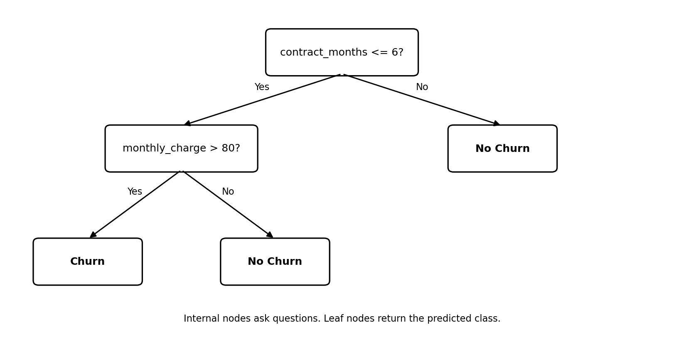
7. Baseline Decision Tree
First build a simple model so later improvements have a reference point.
tree_model = DecisionTreeClassifier(
criterion="gini",
random_state=42
)
tree_model.fit(X_train, y_train)
y_pred = tree_model.predict(X_test)
Terms in this step
• Decision Tree: asks yes/no questions
• Gini impurity: measures how mixed a node is
• fit(): learn from training data
• predict(): generate class labels for test data
Baseline is not the final model. It shows what happens before pruning and ensembles.

Slide 9
8. Evaluate: Accuracy, Precision, Recall, F1
For churn, accuracy alone can hide weak performance on the minority class.
print(classification_report(y_test, y_pred))
How to explain class 1
• Precision: when the model says Churn, how often is it right?
• Recall: out of all real churners, how many did we catch?
• F1: balance between precision and recall
Class
Precision
Recall
F1
Support
0 No Churn
0.82
0.79
0.80
1035
1 Churn
0.47
0.53
0.50
374

Slide 10
9. Check Overfitting with Train vs Test Accuracy
A model can look perfect on training data and still fail on new customers.
train_acc = tree_model.score(X_train, y_train)
test_acc = tree_model.score(X_test, y_test)
gap = abs(train_acc - test_acc)
Example baseline result
1.00
0.73
Interpretation
• Train = 1.00 means the tree memorized training data
• Test = 0.73 is much lower
• Large gap = overfitting warning
Train
Test
Goal: not perfect training accuracy. Goal: good performance on unseen customers.

Slide 11
10. Pre-Pruning: Stop the Tree Early
Control complexity while the decision tree is being built.
param_grid = {
"criterion": ["gini", "entropy"],
"max_depth": range(2, 5),
"min_samples_leaf": range(2, 5),
"min_samples_split": range(2, 5)
}
grid = GridSearchCV(tree_model, param_grid, cv=5)
grid.fit(X_train, y_train)
best_tree = grid.best_estimator_
Terms
• max_depth: maximum tree levels
• min_samples_leaf: minimum samples at a final leaf
• min_samples_split: minimum samples before splitting
• GridSearchCV: tries combinations using cross-validation
Example result: Train accuracy may drop from 1.00 to 0.84, while test accuracy can improve from 0.73 to 0.80.

Slide 12
11. Post-Pruning: ccp_alpha
Grow a tree, then remove branches that are not worth the complexity.
path = tree_model.cost_complexity_pruning_path(X_train, y_train)
ccp_alphas = path.ccp_alphas
for alpha in ccp_alphas:
model = DecisionTreeClassifier(ccp_alpha=alpha, random_state=42)
model.fit(X_train, y_train)
train_scores.append(model.score(X_train, y_train))
test_scores.append(model.score(X_test, y_test))
Example pattern
alpha
train
test
0.000
1.00
0.73
0.003
0.88
0.79
0.007
0.82
0.80
0.021
0.74
0.73
Best trade-off: strong test score with smaller gap
Interpretation: choose the alpha with strong test score and reasonable train-test gap.

Slide 13
12. Compare the Three Decision Trees
Now we can explain which tree generalized better and why.
Model
Train Acc
Test Acc
Gap
Meaning
Baseline
1.00
0.73
0.27
Overfitting
Pre-Pruned
0.84
0.80
0.04
Better generalization
Post-Pruned
0.82
0.79
0.03
Simpler model
Decision
How to say it
• Baseline is too complex
• Pre-pruning improves test accuracy
• Post-pruning produces a simpler tree
• Choose based on test score + gap + business metric
The pruned tree is less perfect on training data, but more useful for real customers because it generalizes better.

Slide 14
13. Random Forest: Bagging + Feature Importance
Several trees vote together, reducing dependence on one unstable tree.
rf_model = RandomForestClassifier(
n_estimators=100,
random_state=42
)
rf_model.fit(X_train, y_train)
rf_predictions = rf_model.predict(X_test)
importances = rf_model.feature_importances_
Tree 1
Tree 2
Tree 3
Vote
Tree 4
Tree 5
Feature importance example
• tenure: 0.18
• TotalCharges: 0.15
• MonthlyCharges: 0.14
• Contract_Month-to-month: 0.12
Business meaning: important features help managers understand what factors are connected to churn risk. Importance is not proof of causation.

Slide 15
14. Boosting Models
Boosting builds models sequentially: each new model focuses on previous errors.
Model 1
Errors
Model 2
Errors
Model 3
Final prediction
AdaBoost
Gradient Boosting
increases weight of misclassified samples
learns remaining errors
XGBoost
LightGBM
optimized gradient boosting with regularization
fast gradient boosting for large datasets
Practical meaning: boosting can improve performance, but it may overfit if we do not check train-test gap.

Slide 16
15. Final Model Comparison
Use one table to compare performance and explain the trade-offs.
Model
Train
Test
Gap
Churn Prec.
Churn Rec.
Churn F1
Baseline Tree
1.00
0.73
0.27
0.46
0.52
0.49
Pre-Pruned Tree
0.84
0.80
0.04
0.64
0.56
0.60
Post-Pruned Tree
0.82
0.79
0.03
0.61
0.58
0.59
Random Forest
0.90
0.82
0.08
0.66
0.59
0.62
AdaBoost
0.81
0.80
0.01
0.62
0.60
0.61
Gradient Boosting
0.83
0.81
0.02
0.65
0.61
0.63
XGBoost
0.89
0.83
0.06
0.67
0.63
0.65
LightGBM
0.88
0.82
0.06
0.66
0.62
0.64

Slide 17
16. Choosing a Final Model for Business Use
The best model depends on the cost of mistakes.
If retention action is cheap
Example final choice
• Goal: catch as many churners as possible
• Prioritize Churn Recall
• Accept some False Positives
XGBoost
Reason: strongest Churn F1 and high Churn Recall while keeping the train-test gap acceptable.
If retention offer is expensive
• Goal: avoid wasting money
• Balance Precision and Recall
• Use F1 and business cost
Do not choose the model only by accuracy; I chose it based on the business objective.
Junior skill: explain the trade-off, not just the highest number.

Slide 18
17. Confusion Matrix: What Mistakes Cost
Convert model predictions into business consequences.
Example confusion matrix
Business interpretation
Predicted 0
Predicted 1
• FP: customer would not leave, but we contact them unnecessarily
• FN: customer leaves, but we miss the chance to intervene
• In churn projects, FN is often the most painful error
Actual 0
TN
950
FP
85
Actual 1
FN
140
TP
234
Recall increases when we reduce False Negatives: Recall = TP / (TP + FN).

Slide 19
18. Turning Predictions into Retention Actions
The output becomes useful only when it supports a practical process.
Customer data
Model score
Segment
Action
Measure
CRM + billing + support
Probability of churn
High / medium / low risk
Call, discount, support
Did churn decrease?
Example action rule
What to monitor after deployment
• Risk > 70%: retention call within 48 hours
• Risk 40–70%: email offer or service check
• Risk < 40%: normal customer journey
• Churn rate before vs after campaign
• Cost of offers vs saved revenue
• Model drift: data patterns may change over time
Real-life value: the model is not the final product. The decision process around the model creates business value.

Slide 20
19. What to Say as a Junior Data Scientist
A clear explanation is more important than naming advanced models.
Strong explanation
Avoid saying only
• I started from the business problem
• I separated X and y and avoided leakage
• I cleaned and encoded the data
• I used train/test split with stratify=y
• I compared models using metrics that match the business goal
• The model accuracy is high
• XGBoost is best because it is advanced
• Feature importance proves causation
• Training accuracy is enough
Best final sentence: I selected the final model based on churn recall, F1-score, and generalization because the business goal is to catch customers before they leave.

Slide 21
20. Recap: The Full Project Flow
This is the story your classmates should remember.
Problem
Data
Clean
Encode
Split
Tree
Evaluate
Prune
Forest
Boost
Choose
Act
Main learning objective
Tree-based models are not just algorithms. In a real churn project, they help us move from customer data to retention decisions.

