Slide 1

WEB SCRAPING
From websites
to usable data
A beginner-friendly guide to the main scraping methods, their differences, and when to use each one.
Data Collection
Requests • BeautifulSoup • APIs • JSON-LD • Sessions • Selenium

Slide 2
The main ways to collect data from websites
METHOD MAP
The best method depends on how the website provides its data.
</>
Static HTML
{}
API / JSON
LD
JSON-LD
Requests downloads the page.
BeautifulSoup reads its tags and classes.
The website provides structured data directly through an endpoint.
Structured JSON is embedded inside the HTML for search engines.
🔐
Authenticated pages
▶
Browser automation
A Session preserves cookies while login data and CSRF tokens are sent.
Selenium runs a real browser for JavaScript, clicks, typing and scrolling.
The pattern behind every method
1. Inspect
HTML, API, JSON-LD, or JS?
2. Choose
Requests, API, Session, or Selenium?
3. Load
Fetch data or open a browser
4. Extract
Keys, selectors, text, attributes
5. Validate
Errors, duplicates, missing values
6. Return
Clean list of dictionaries

Slide 3
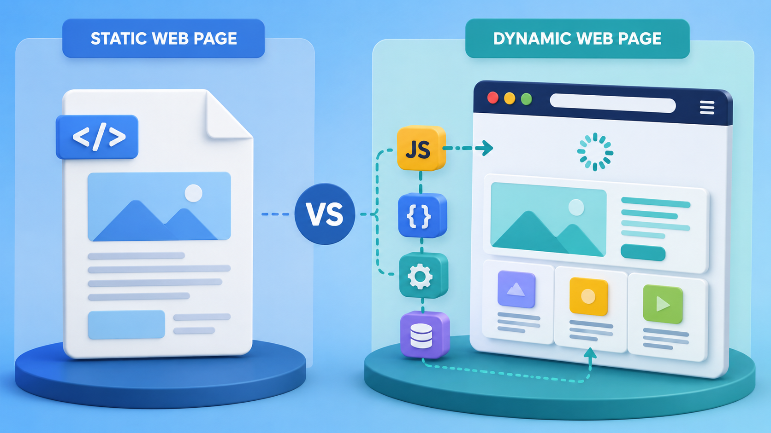
Static pages vs dynamic pages
CORE CONCEPT
This distinction usually decides whether Requests is enough or a browser is needed.
Static page
Data is already in the returned HTML
Usually faster and easier to scrape
Best tools: Requests + BeautifulSoup
Dynamic page
JavaScript loads or changes the content
May require clicking, waiting or scrolling
Best tool when no API exists: Selenium

Slide 4
CSS selectors — how we point to the data
SELECTORS
A selector describes the element we want to find in the HTML.
HTML
div
all <div> tags
<div class="product">
<a class="title" title="Laptop A">Laptop...</a>
<h4 class="price">$500</h4>
<div class="ratings">
<p class="ws-icon ws-icon-star"></p>
</div>
</div>
.product
any element with class="product"
div.product
a <div> with that class
.product .title
a title inside a product
p.ws-icon.ws-icon-star
one <p> with both classes

Slide 5
METHOD LOGIC
Method 1 — Requests + BeautifulSoup
Use this when the data already exists in the page source.
1. Check source
Can you find the data in HTML?
Use when page source already contains the data.
html = fetch_html(url)
soup = BeautifulSoup(html, "html.parser")
cards = soup.find_all("div", class_="quote")
for card in cards:
text = card.find("span", class_="text")
text = text.get_text(strip=True)
2. Fetch HTML
Request the page.
3. Parse HTML
Create BeautifulSoup object.
Avoid when JavaScript creates the final content.
4. Find blocks
Repeated cards or quotes.
5. Extract fields
.text or attributes.
Fast, simple, low resources.
Breaks if tags/classes change.
6. Return results
List of dictionaries.
2

Slide 6
METHOD LOGIC
Method 2 — API and JSON
Use this when the website exposes structured JSON data.
1. Find endpoint
Network tab or known API URL.
Think in keys, not HTML tags.
json_text = fetch_html(api_url)
data = json.loads(json_text)
items = data["quotes"]
for item in items:
text = item["text"]
author = item["author"]["name"]
2. Request JSON
Fetch the API URL.
3. Convert
json.loads(json_text).
Cleaner than visual-page scraping.
Usually more stable than CSS selectors.
Still handle pagination and errors.
4. Inspect keys
Print data.keys() or a sample.
5. Loop items
Extract values from dictionaries.
6. Handle pages
page += 1 or has_next.

Slide 7
METHOD LOGIC
Method 3 — JSON-LD inside HTML
Use this when structured JSON is embedded inside HTML.
1. Find JSON-LD scripts
script type=application/ld+json
2. Parse script text
json.loads(script.string)
3. Filter target type
example: @type == Quote
4. Extract + normalize
nested .get(), split keywords
JSON-LD is still inside HTML, but the useful data is JSON, not visible page text.
HTML
scripts = soup.find_all("script", type="application/ld+json")
data = json.loads(script.string)
if data.get("@type") == "Quote":
<script type="application/ld+json">
{
"@type": "Product",
"name": "Laptop A",
"author": {"name": "Example"},
"keywords": "tech, laptop"
}
</script>
author = data.get("author", {}).get("name")
keywords = data.get("keywords", "")

Slide 8
METHOD LOGIC
Method 4 — Login, Sessions, Cookies and CSRF
Use a Session when the website must recognize the same user across requests.
1. Create Session
session = requests.Session()
2. GET login page
receive form + cookies
3. Extract CSRF
hidden input value
6. GET protected page
same session, same cookies
5. Verify login
200 OK is not enough
4. POST payload
username + password + token
Session
CSRF token
Keeps cookies between requests, so the website sees the same visitor.
A hidden security value that must often be returned with the form data.

Slide 9
METHOD LOGIC
Method 5 — Selenium browser automation
Use this when JavaScript, clicking, typing, waiting, or scrolling is required.
1. Setup browser
headless, window size, no sandbox
driver = webdriver.Chrome(options=options)
try:
driver.get(url)
time.sleep(delay)
products = driver.find_elements(...)
finally: driver.quit()
2. Open page
driver.get(url)
3. Wait / interact
sleep, click, type, filters
4. Find elements
driver or product scope
5. Extract values
.text or get_attribute
6. Cleanup
driver.quit() in finally

Slide 10
METHOD LOGIC
Logic for loading more data + duplicates
Pagination follows links; infinite scroll watches page height. Both may require duplicate checks.
Pagination logic
Infinite scroll logic
Duplicate logic
1. Scrape current page
collect visible items
1. Measure height
document.body.scrollHeight
seen = set()
key = (title, price)
if key in seen:
continue
seen.add(key)
2. Find Next link
li.next a[href]
2. Scroll bottom
window.scrollTo(...)
3. Build full URL
urljoin(current, href)
3. Wait + measure
time.sleep(scroll_pause)
Store the unique key in a set, not the whole dictionary.
4. Stop when missing
if next is None: break
4. Stop unchanged
new_height == last_height

Slide 11
How to choose the right method
DECISION TREE
Start with the simplest route, then move to a browser only when necessary.
Is the required data in the returned HTML?
YES
NO
Requests + BeautifulSoup
Is there an API endpoint?
YES
NO
Check JSON-LD too
It may provide cleaner fields than the visible HTML.
Use the API / JSON
Use Selenium

Slide 12
Five sentences to remember
RECAP
A one-minute recap for the end of the presentation.
1
Static HTML
Use Requests + BeautifulSoup when the data is already in the HTML.
2
API first
Prefer JSON APIs when available because they are structured and stable.
3
Dynamic content
Use Selenium when JavaScript, clicks, typing or scrolling are required.
4
Inspect before coding
Tags, classes and attributes come from the real page structure.
5
Build responsibly
Handle waits, errors, duplicates, cleanup and request limits.
Questions?

