Slide 1
Document Search Tool
Khadim Hussain 2021-CS-204

Slide 2

Scope of the Project
Python tool that allows users to search documents by name.
Enable keyword search within a set of documents.
Provide results quickly, with a focus on accuracy and efficiency.
Utilize regular expressions for content cleaning and indexing.
Support storing documents in a specified directory.

Slide 3


Project Objectives & Outcomes
Objectives:
Streamline document management through easy search functionalities.
Implement a lightweight text indexing mechanism.
Outcomes:
Efficient document searching by name.
Quick keyword lookup across multiple documents.
Accurate search results, focusing on relevant content only.
User-friendly interface via a command-line application.

Slide 4
System Overview
Reads all .txt files in a specified directory.
Cleans content, removes punctuation, and indexes words.
Searches documents based on user input.

Slide 5
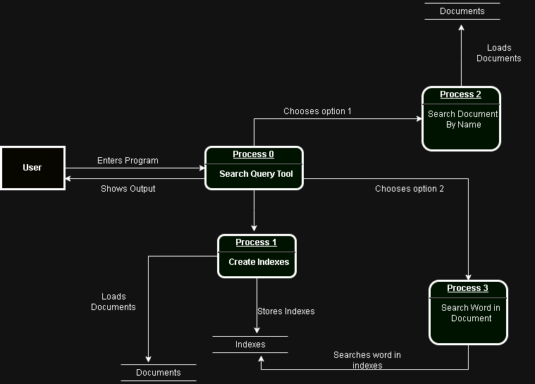
Data Flow Diagram (DFD)

Slide 6
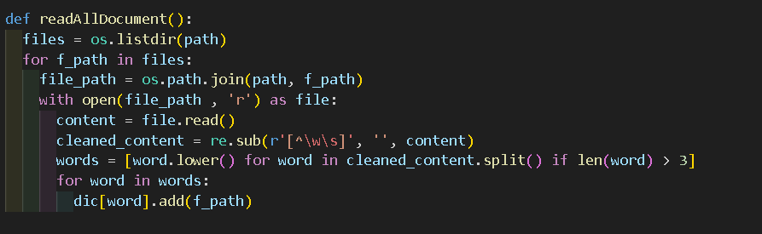
Code Snippet & Explanation
This code reads all documents, cleans it and creates indexes

Slide 7
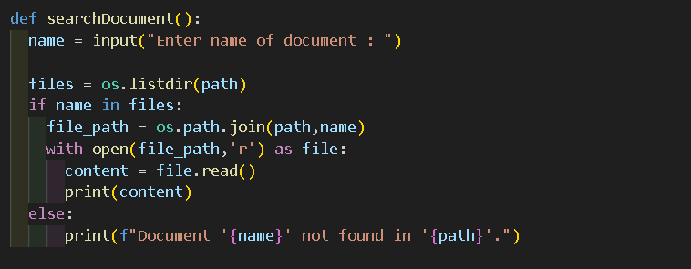
Cont..
This code takes document name from user and shows content of document if it exists.

Slide 8
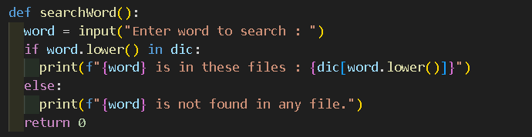
Cont..
This code takes word from user and show in which document it exists.

Slide 9
Key Features
Document search by file name.
Keyword search within documents.
Case-insensitive search.
Excludes words with fewer than 3 characters.
Utilizes defaultdict for efficient indexing.

Slide 10
Code Workflow
Load all documents from a directory.
Clean and index the text, storing results in a dictionary.
Accept user input for searches (by document name or keyword).
Display the relevant results.

Slide 11
Challenges & Solutions
Challenges:
Cleaning and normalizing document content.
Efficiently handling large numbers of documents.
Providing accurate search results.
Solutions:
Used regular expressions for cleaning text.
Implemented a dictionary-based indexing for quick look-up.
Filtered words based on length and case to improve relevance.

Slide 12
Future Enhancements
Add a graphical user interface (GUI) for better usability.
Implement fuzzy search to handle misspellings.
Allow the addition of more file types (e.g., PDFs, Word docs).
Integrate database storage for better scalability.

Slide 13
Any Questions?

