Slide 1

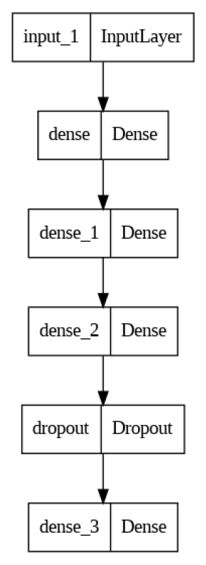
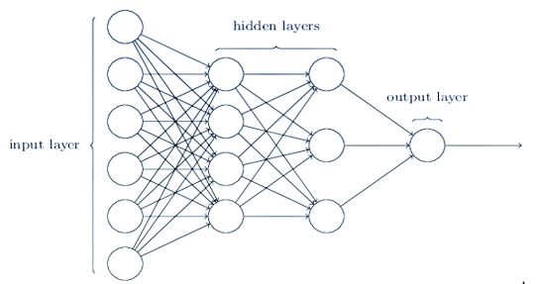
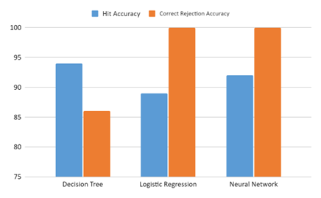
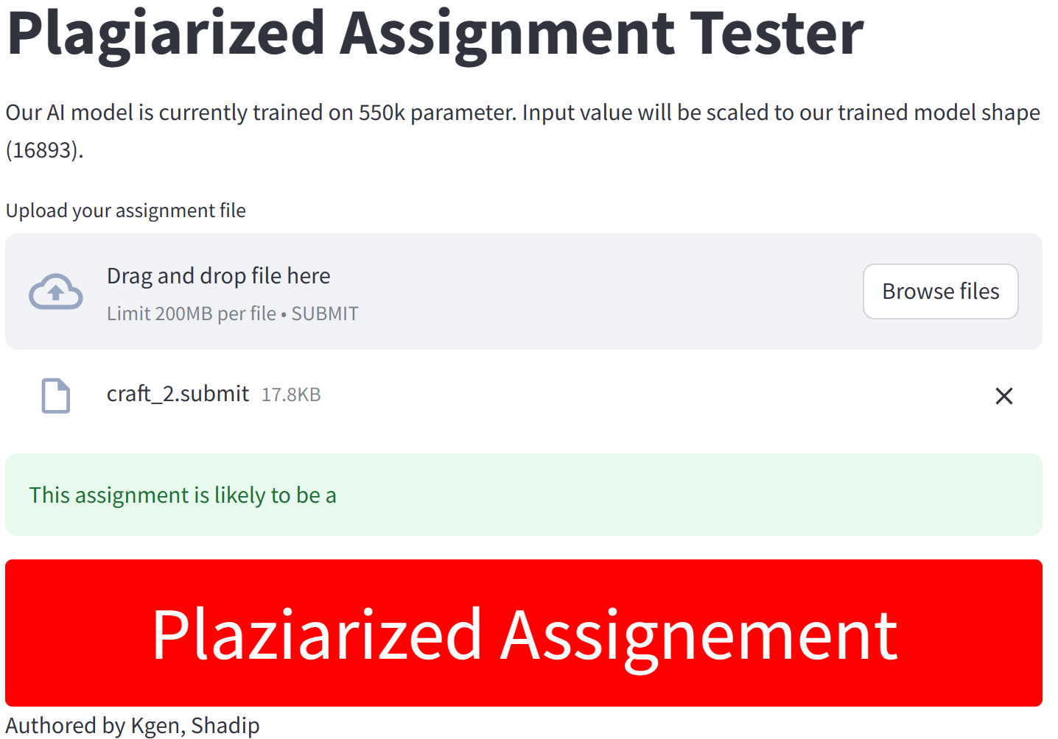
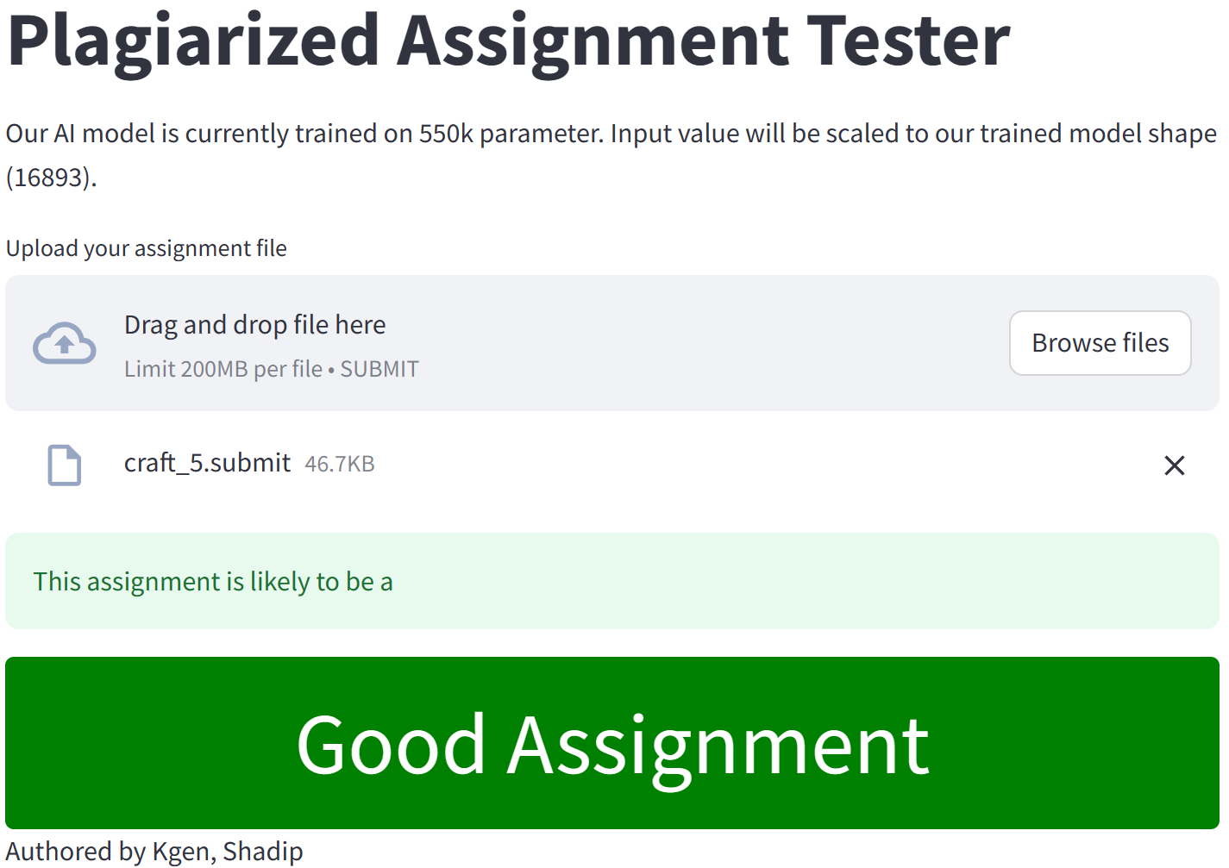
ML for Plagiarism Detection in Coding Assignment
Khagendra Khatri (kkhatri@caldwell.edu), Shadip Khadka (skhadka4@caldwell.edu), and Vladislav D. Veksler (vveksler@caldwell.edu)
Introduction
Recent advances in Artificial Intelligence (e.g., Chat-GPT) have
exacerbated plagiarism in student assignments. The goal of this
research is to evaluate the effectiveness of machine learning algorithms for automatically detecting plagiarism. Decision trees, logistic regression, and neural networks are selected to evaluate the effectiveness of these methods.
Methodology
The neural network model was trained for 20 epochs, comprised 3 hidden layers (each comprising 64 nodes with ‘relu’ activation), and was optimized using the ‘adam’ optimizer, with binary crossentropy as the loss function.
Conclusions
After rigorous testing of various methods, it was observed that a small neural network exhibited remarkable efficiency in identifying instances of plagiarized behavior within assignments. This suggests that neural networks hold significant promise as a tool for plagiarism detection in educational settings.
1
2
4
Future Works
Future work will involve gathering a larger training sample, checking minimum edit distance between assignments and completion time of the two closest assignments, using different machine learning algorithms (xgboost, CNNs, RNNs, transformers), and further research into what constraints might enhance detection of plagiarism in student assignments.
5
Results
Results indicate that the neural network outperforms other classifiers,
achieving 95.6% overall test accuracy. The neural net was able to
correctly identify non-plagiarized work 100% of the time, and correctly
identify plagiarized work 92% of the time on the test dataset.
3
Contact information
linkedin.com/in/khagendrakhatri
linkedin.com/in/shadip-khadka/
6
Notes:
‹#›

